Slide 1
5NPV-4
Reading scales with 2, 4, 5 or 10 intervals

Slide 2
5NPV-4
Divide 1 into 2, 4, 5 and 10 equal parts, and read scales/number lines marked in units of 1 with 2, 4, 5 and 10 equal parts.
The materials in this pack have been collated and written to support the teaching of 5NPV-4. Before planning and teaching the content, read the teaching guidance and example assessment questions in the non-statutory guidance itself, which can be found here.
A video summarising all of the ready-to-progress criteria for Year 5 can be found here.

Slide 3
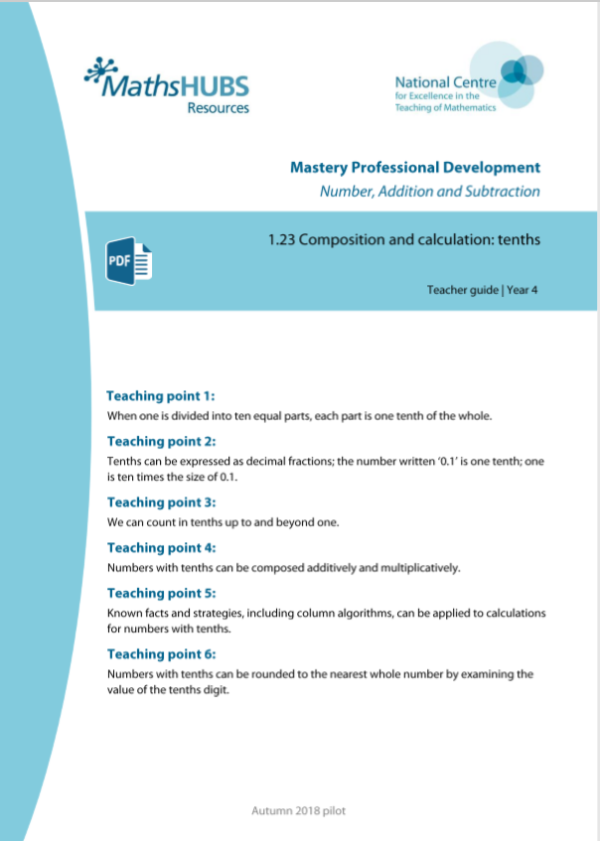
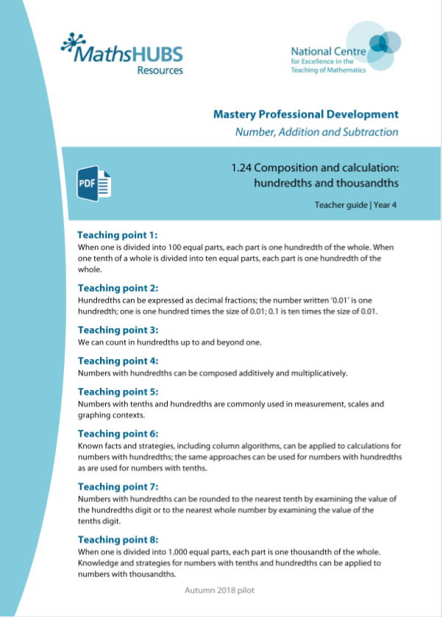
5NPV-4: Linked mastery PD materials
Additional pedagogical subject knowledge support can be found in the following Mastery Professional Development materials:
  1.23 Composition and calculation: tenths
  1.24 Composition and calculation: hundredths and thousandths
Several of the activity slides have been taken from these materials.

Slide 4
5NPV-4
Reading scales with 2, 4, 5 or 10 intervals

Slide 5
The following slides contain activities that can be used within the context of pre-teaching, intervention, or as supplementary material integrated into teaching. They do not represent complete lessons and should not be used as such. Also they should not be used all at once, but over the period of a teaching unit. It would be valuable to use many of the activities more than once to build fluency in understanding and application. Also many of them would benefit from the use of manipulatives to support interaction with the ideas. Ensure you engage in rich discussion with the children, asking them to reason and explain the ideas presented. Note that when working with a small group, pupils should also have access to the main teaching delivered by the class teacher and the focus should be directly linked so that the learning is connected and fluency is built.

Slide 6
Guidance for working with a small pre-teaching or intervention group
Take time to build understanding of the key idea. We would recommend no more than four slides in any one session, and probably fewer.
In subsequent sessions, review and practise previous learning before moving on.
Play the animation/observe the image and ask pupils “What do you notice?”.
Encourage pupils to explain what they see, what is happening and why.
Where there is a highlighted sentence, draw out the meaning of this from the image and repeat together and individually.

Slide 7
Guidance for working with a small pre-teaching or intervention group
Engage in the suggested activities, using manipulatives where appropriate, to enhance the interaction and stimulate discussion. However, note that the ultimate aim is to develop fluency in the mathematical ideas such that resources are no longer needed.
Repeat questions, using other numbers/examples where relevant.
Repeat the highlighted language structures wherever relevant to build fluency with the key idea and connect the learning. For example:
10 hundreds are equivalent to 1,000.

Slide 8
5NPV-4 Reading scales with 2, 4, 5 or 10 intervals

Slide 9
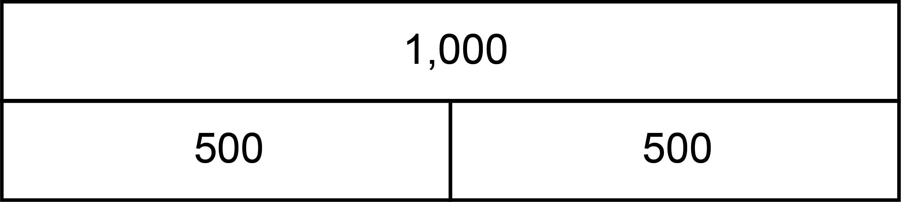
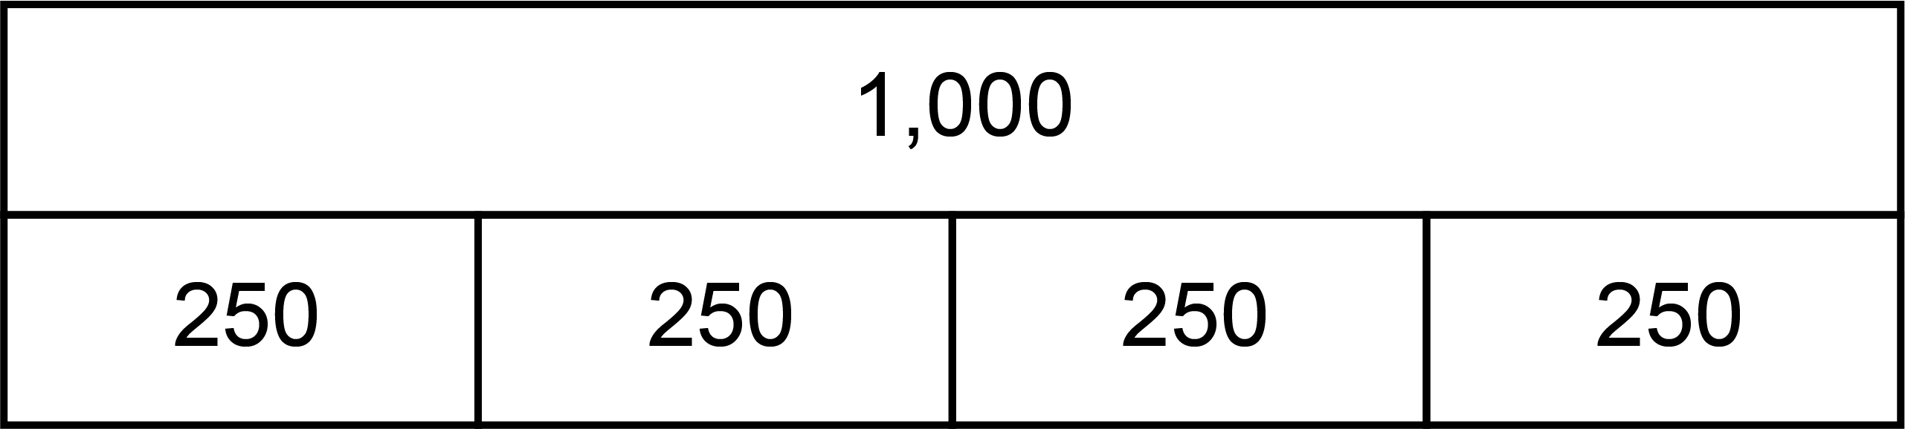
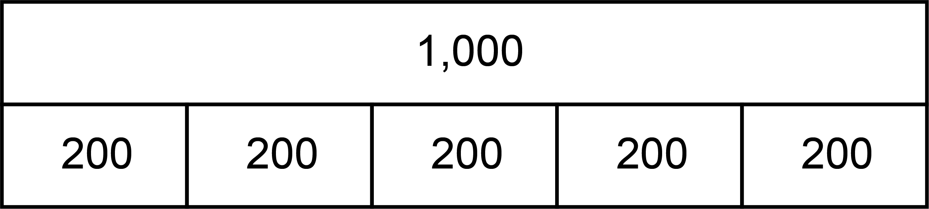
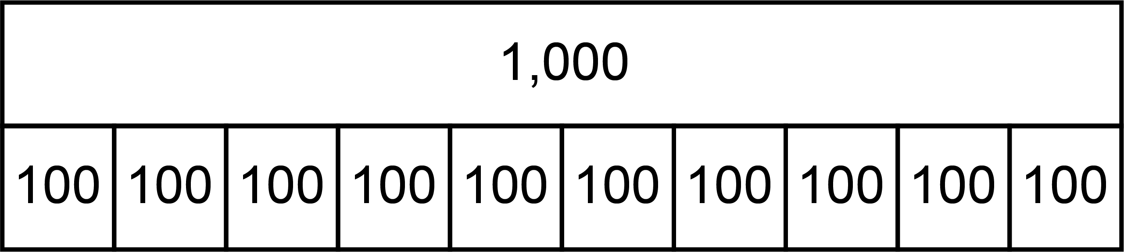
5NPV-4 Reading scales with 2, 4, 5 or 10 intervals
2, 4, 5 and 10 part composition of 1
If we divide one into 2 equal parts, what is the value of each part?
What if we divide one into 4 equal parts?
5 equal parts?
10 equal parts?
1
2 part
0.5
0.5
1
4 part
0.25
0.25
0.25
0.25
1
5 part
0.2
0.2
0.2
0.2
0.2
1
10 part
v
v
v
v
v
v
v
v
v
v
0.1
v
0.1
v
0.1
v
0.1
v
0.1
v
0.1
v
0.1
v
0.1
v
0.1
v
0.1
v

Slide 10
5NPV-4 Reading scales with 2, 4, 5 or 10 intervals
How many parts has the whole been split into? What do you think we need to count in? How do you know?
Let’s count…
Why don’t we say 0.50?
Why do we say 1 and not 0.100?
Reveal next bar model. What do we need to count in this time? How can you tell?
1
1
1
1
v
v
v
v
v
v
v
v
v
v
0.25, 0.5, 0.75, 1
v
v
v
v
v
v
v
v
v
v
0.1
0.1
0.1
0.1
0.1
0.1
0.1
0.1
0.1
0.1
0.25
0.5
0.25
0.25
0.5
0.25
0.2
0.2
0.2
0.2
0.2
Notes:
Pupils need to be able to decompose the unit 100 into 2, 4, 5, and 10 parts. 2 parts. 4 parts. 5 parts and 10 parts. This supports future fractions and measures work. Starting to link 4 parts and 25 prepares children for understanding why ¼ is equivalent to 0.25 when they meet decimals in year 5.

Slide 11
5NPV-4 Reading scales with 2, 4, 5 or 10 intervals
1
1
1
1
Let’s count in steps of 0.5 from zero to one.
Now let’s count in steps of 0.25, 0.2 and 0.1. Can you count backwards from each of these?
If I count in steps of 0.2, what comes after 0.4? Before 1?
If I count in steps of 0.1, what comes between 0.4 and 0.6?
0.9
0.8
0.8
Zero, 0.5, one.
0.75
0.7
0.6
0.6
0.5
0.5
0.5
0.4
0.4
0.3
0.25
0.2
0.2
0.1
0
0
0
0

Slide 12
5NPV-4 Reading scales with 2, 4, 5 or 10 intervals
4
10
7
2
Is the number before or after 3? How do you know?
Repeat with the other arrows.
How many intervals are there on each number line? How can we use this to decide what we are counting in?
Let’s check by counting from the lower multiple of one.
1.9
The number is between __ and __ but comes after __.
6.8
1.8
9.75
1.7
6.6
1.6
3.5
9.5
1.5
6.4
1.4
1.3
9.25
6.2
1.2
1.1
3
9
6
1

Slide 13
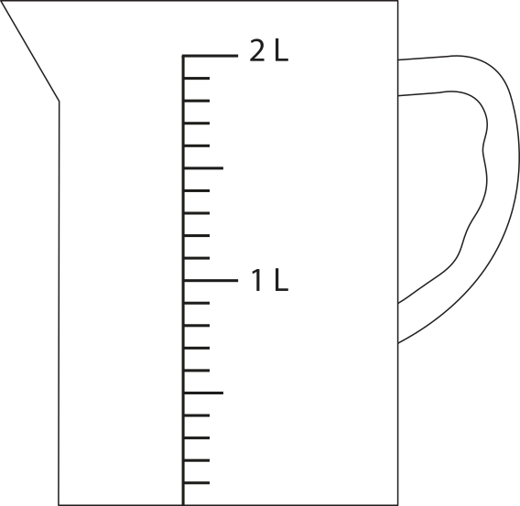
5NPV-4 Reading scales with 2, 4, 5 or 10 intervals
What is shown in the image? What would you use this for?
What do you notice about the scale? How many intervals are there between the two given values?
Why is zero not written on the scale? Where would this be recorded?
1.6 litres of water is to be poured into the measuring container. What interval on the scale would the water reach?
Repeat for other volumes of water.
1.6 litres

Slide 14
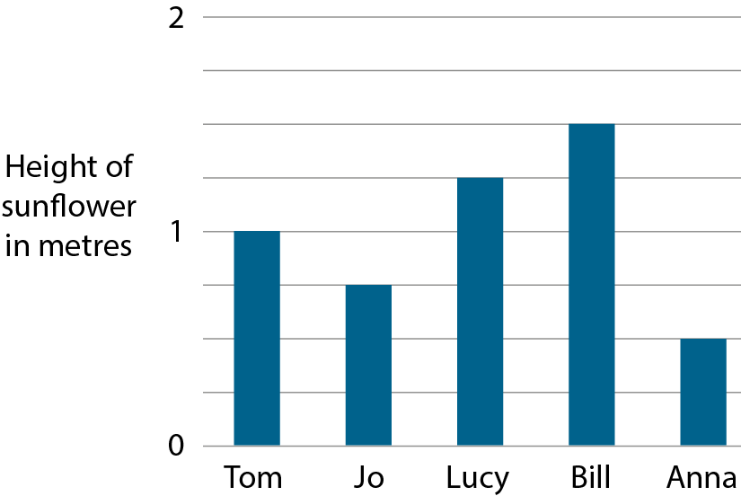
5NPV-4 Reading scales with 2, 4, 5 or 10 intervals
Where have you seen this kind of representation? What is different this time?
Could each interval be worth 0.1m? Why not?
What is the correct value of each interval?
What is the value of each bar?
What is the difference in height of Jo and Bill’s sunflowers? Can you do this without having to subtract? Explain how.
1.5 m
1.25 m
1 m
0.75 m
0.5 m

Slide 15
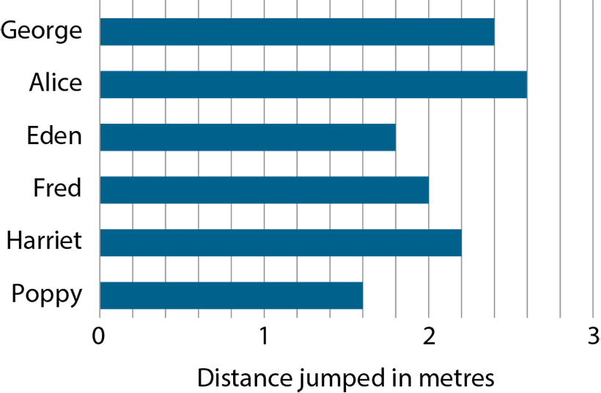
5NPV-4 Reading scales with 2, 4, 5 or 10 intervals
What do you notice this time? What is the same and what is different?
Is each interval still 0.25m? How do you know?
What is the correct value of each interval?
What is the value of each bar?
How far did the winning child jump?
What is the difference between the distance that Poppy and Alice jumped? How many different ways can this be calculated?
2.4 m
2.6 m
1.8 m
2 m
2.2 m
1.6 m
Notes:
How far did the winning girl jump?
What was the difference between the two longest jumps?

Slide 16
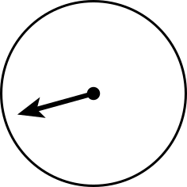
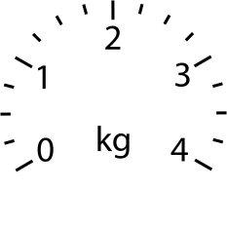
5NPV-4 Reading scales with 2, 4, 5 or 10 intervals
1.75 kg
3.5 kg
0.25 kg
Are all of the scales the same? What is the value of each interval?
Click to reveal the final location of each arrow. What value is it pointing at? How do you know?
Each kilogram has been split into four equal parts. Each interval is worth 0.25kg.
The first arrow has moved one interval, it is pointing at 0.25kg.
The second arrow is one interval before 2kg, it is pointing at 1.75kg.
The third arrow is half-way between 3kg and 4kg, it is pointing at 3.5kg.

Slide 17
5NPV-4 Reading scales with 2, 4, 5 or 10 intervals
The Deca Tree
https://nrich.maths.org/2006

