Slide 1
5NF-1
Secure fluency in multiplication and division facts

Slide 2
5NF-1
Secure fluency in multiplication table facts, and corresponding division facts, through continued practice.
The materials in this pack have been collated and written to support the teaching of 5NF-1. Before planning and teaching the content, read the teaching guidance and example assessment questions in the non-statutory guidance itself, which can be found here.
A video summarising all of the ready-to-progress criteria for Year 5 can be found here.

Slide 3
5NF-1
Secure fluency in multiplication and division facts

Slide 4
The following slides contain activities that can be used within the context of pre-teaching, intervention, or as supplementary material integrated into teaching. They do not represent complete lessons and should not be used as such. Also they should not be used all at once, but over the period of a teaching unit. It would be valuable to use many of the activities more than once to build fluency in understanding and application. Also many of them would benefit from the use of manipulatives to support interaction with the ideas. Ensure you engage in rich discussion with the children, asking them to reason and explain the ideas presented. Note that when working with a small group, pupils should also have access to the main teaching delivered by the class teacher and the focus should be directly linked so that the learning is connected and fluency is built.

Slide 5
Guidance for working with a small pre-teaching or intervention group
These slides are designed to build fluency in key facts. Use the ideas at the start to ensure understanding is secure.
Use the retrieval slides once children have built some recall, to provide regular practice to build fluency.

Slide 6
5NF-1 Secure fluency in multiplication and division facts

Slide 7
5NF-1 Secure fluency in multiplication and division facts
1 × 1 | 1 × 2 | 1 × 3 | 1 × 4 | 1 × 5 | 1 × 6 | 1 × 7 | 1 × 8 | 1 × 9 | 1 × 10 | 1 × 11 | 1 × 12
2 × 1 | 2 × 2 | 2 × 3 | 2 × 4 | 2 × 5 | 2 × 6 | 2 × 7 | 2 × 8 | 2 × 9 | 2 × 10 | 2 × 11 | 2 × 12
3 × 1 | 3 × 2 | 3 × 3 | 3 × 4 | 3 × 5 | 3 × 6 | 3 × 7 | 3 × 8 | 3 × 9 | 3 × 10 | 3 × 11 | 3 × 12
4 × 1 | 4 × 2 | 4 × 3 | 4 × 4 | 4 × 5 | 4 × 6 | 4 × 7 | 4 × 8 | 4 × 9 | 4 × 10 | 4 × 11 | 4 × 12
5 × 1 | 5 × 2 | 5 × 3 | 5 × 4 | 5 × 5 | 5 × 6 | 5 × 7 | 5 × 8 | 5 × 9 | 5 × 10 | 5 × 11 | 5 × 12
6 × 1 | 6 × 2 | 6 × 3 | 6 × 4 | 6 × 5 | 6 × 6 | 6 × 7 | 6 × 8 | 6 × 9 | 6 × 10 | 6 × 11 | 6 × 12
7 × 1 | 7 × 2 | 7 × 3 | 7 × 4 | 7 × 5 | 7 × 6 | 7 × 7 | 7 × 8 | 7 × 9 | 7 × 10 | 7 × 11 | 7 × 12
8 × 1 | 8 × 2 | 8 × 3 | 8 × 4 | 8 × 5 | 8 × 6 | 8 × 7 | 8 × 8 | 8 × 9 | 8 × 10 | 8 × 11 | 8 × 12
9 × 1 | 9 × 2 | 9 × 3 | 9 × 4 | 9 × 5 | 9 × 6 | 9 × 7 | 9 × 8 | 9 × 9 | 9 × 10 | 9 × 11 | 9 × 12
10 × 1 | 10 × 2 | 10 × 3 | 10 × 4 | 10 × 5 | 10 × 6 | 10 × 7 | 10 × 8 | 10 × 9 | 10 × 10 | 10 × 11 | 10 × 12
11 × 1 | 11 × 2 | 11 × 3 | 11 × 4 | 11 × 5 | 11 × 6 | 11 × 7 | 11 × 8 | 11 × 9 | 11 × 10 | 11 × 11 | 11 × 12
12 × 1 | 12 × 2 | 12 × 3 | 12 × 4 | 12 × 5 | 12 × 6 | 12 × 7 | 12 × 8 | 12 × 9 | 12 × 10 | 12 × 11 | 12 × 12
This grid shows the 144 multiplication facts which occur in the Year 4 multiplication check.
What do you notice about each row? Each column?
What happens to the product when we go down a row? Across a column?
Can you spot any rows/columns the same?
Which row/column do you find easiest?

Slide 8
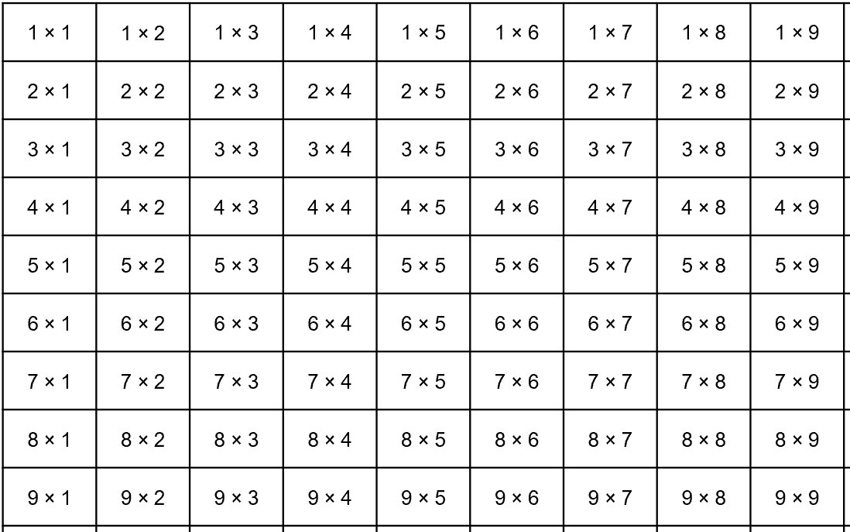
5NF-1 Secure fluency in multiplication and division facts
This grid shows the 81 facts that can occur within column calculations in short multiplication or short division.
What has changed?
Can you find two pairs of factors with the same product? And two more pairs?
Each product is repeated due to the commutative law and so if for example we know 5 x 3 = 15, we also know 3 x 5 = 15.

Slide 9
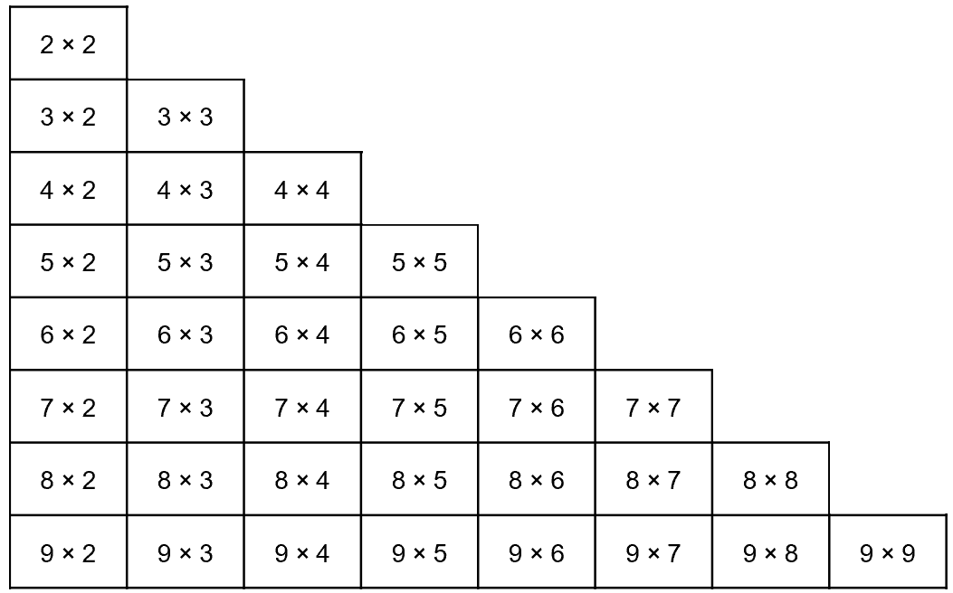
5NF-1 Secure fluency in multiplication and division facts
We can discount the 1 times table facts, because generally children know these.
Because each product is repeated we can halve the number of facts we need to learn. We now have 36 as shown in this grid
Once children can recall these, and apply them to commutative calculations, for example recognise that 5 x 7 has the same product as 7 x 5, they have learnt the essential facts for written multiplication and division.
Children who have not learnt all times table facts before the MTC should prioritise these in year 5.

Slide 10
5NF-1 Secure fluency in multiplication and division facts
18
18
6
6
6
3
3
3
3
3
3
What do you see? We have a row of 6, another row of 6 and another row of 6. We have three rows of 6. We have three 6s which makes 18.
Now let’s look at it a different way. We have a column of 3, another column of three… we have six columns of 3. We have six 3s which makes 18.
3 x 6 = 6 x 3 = 18

Slide 11
5NF-1 Secure fluency in multiplication and division facts
18
18
6
6
6
3
3
3
3
3
3
6 × 3 = 18
18 ÷ 6 = 3
of 18 = 3
3 × 6 = 18
18 ÷ 3 = 6
of 18 = 6
What other related facts can you write using division?
Can you write any facts using fractions of amounts?

Slide 12
5NF-1 Secure fluency in multiplication and division facts
The following slides provide recall practice of the 36 multiplication facts, and corresponding division facts, which are essential for progression in Year 5 as they are needed for formal written multiplication and division.
Pupils should continue to practise these in Year 5 to secure and maintain fluency.
Pupils should verbalise the facts regularly and be provided with retrieval practice.
Pupils can also have a their own set of the 36 priority fact cards, broken down into smaller sets for practice. When practising recall, stop every so often and check that children can:
  draw a bar model and array images to show that they can link a fact to associated structures (as per slide 10);
  write other facts that they know from the fact they have recalled, including division and fractional amounts (as per slide 11).

Slide 13
5NF-1 Secure fluency in multiplication and division facts
3 × 2 =
6

Slide 14
5NF-1 Secure fluency in multiplication and division facts
3 × 3 =
9

Slide 15
5NF-1 Secure fluency in multiplication and division facts
9 × 2 =
18

Slide 16
5NF-1 Secure fluency in multiplication and division facts
5 × 3 =
15

Slide 17
5NF-1 Secure fluency in multiplication and division facts
7 × 3 =
21

Slide 18
5NF-1 Secure fluency in multiplication and division facts
2 × 2 =
4

Slide 19
5NF-1 Secure fluency in multiplication and division facts
8 × 3 =
24

Slide 20
5NF-1 Secure fluency in multiplication and division facts
9 × 3 =
27

Slide 21
5NF-1 Secure fluency in multiplication and division facts
5 × 4 =
20

Slide 22
5NF-1 Secure fluency in multiplication and division facts
9 × 8 =
72

Slide 23
5NF-1 Secure fluency in multiplication and division facts
4 × 2 =
8

Slide 24
5NF-1 Secure fluency in multiplication and division facts
7 × 4 =
28

Slide 25
5NF-1 Secure fluency in multiplication and division facts
8 × 2 =
16

Slide 26
5NF-1 Secure fluency in multiplication and division facts
9 × 4 =
36

Slide 27
5NF-1 Secure fluency in multiplication and division facts
9 × 6 =
54

Slide 28
5NF-1 Secure fluency in multiplication and division facts
4 × 3 =
12

Slide 29
5NF-1 Secure fluency in multiplication and division facts
7 × 2 =
14

Slide 30
5NF-1 Secure fluency in multiplication and division facts
7 × 7 =
49

Slide 31
5NF-1 Secure fluency in multiplication and division facts
5 × 2 =
10

Slide 32
5NF-1 Secure fluency in multiplication and division facts
6 × 5 =
30

Slide 33
5NF-1 Secure fluency in multiplication and division facts
6 × 3 =
18

Slide 34
5NF-1 Secure fluency in multiplication and division facts
7 × 5 =
35

Slide 35
5NF-1 Secure fluency in multiplication and division facts
8 × 5 =
40

Slide 36
5NF-1 Secure fluency in multiplication and division facts
6 × 4 =
24

Slide 37
5NF-1 Secure fluency in multiplication and division facts
6 × 6 =
36

Slide 38
5NF-1 Secure fluency in multiplication and division facts
7 × 6 =
42

Slide 39
5NF-1 Secure fluency in multiplication and division facts
8 × 6 =
48

Slide 40
5NF-1 Secure fluency in multiplication and division facts
8 × 7 =
56

Slide 41
5NF-1 Secure fluency in multiplication and division facts
9 × 9 =
81

Slide 42
5NF-1 Secure fluency in multiplication and division facts
4 × 4 =
16

Slide 43
5NF-1 Secure fluency in multiplication and division facts
9 × 7 =
63

Slide 44
5NF-1 Secure fluency in multiplication and division facts
5 × 5 =
25

Slide 45
5NF-1 Secure fluency in multiplication and division facts
8 × 8 =
64

Slide 46
5NF-1 Secure fluency in multiplication and division facts
8 × 4 =
32

Slide 47
5NF-1 Secure fluency in multiplication and division facts
6 × 2 =
12

Slide 48
5NF-1 Secure fluency in multiplication and division facts
9 × 5 =
45

Slide 49
5NF-1 Secure fluency in multiplication and division facts
8 ÷ 2 =
4

Slide 50
5NF-1 Secure fluency in multiplication and division facts
10 ÷ 5 =
2

Slide 51
5NF-1 Secure fluency in multiplication and division facts
4 ÷ 2 =
2

Slide 52
5NF-1 Secure fluency in multiplication and division facts
14 ÷ 7 =
2

Slide 53
5NF-1 Secure fluency in multiplication and division facts
16 ÷ 2 =
8

Slide 54
5NF-1 Secure fluency in multiplication and division facts
18 ÷ 9 =
2

Slide 55
5NF-1 Secure fluency in multiplication and division facts
9 ÷ 3 =
3

Slide 56
5NF-1 Secure fluency in multiplication and division facts
12 ÷ 4 =
3

Slide 57
5NF-1 Secure fluency in multiplication and division facts
15 ÷ 3 =
5

Slide 58
5NF-1 Secure fluency in multiplication and division facts
12 ÷ 2 =
6

Slide 59
5NF-1 Secure fluency in multiplication and division facts
18 ÷ 6 =
3

Slide 60
5NF-1 Secure fluency in multiplication and division facts
21 ÷ 3 =
7

Slide 61
5NF-1 Secure fluency in multiplication and division facts
30 ÷ 6 =
5

Slide 62
5NF-1 Secure fluency in multiplication and division facts
24 ÷ 8 =
3

Slide 63
5NF-1 Secure fluency in multiplication and division facts
27 ÷ 3 =
9

Slide 64
5NF-1 Secure fluency in multiplication and division facts
16 ÷ 4 =
4

Slide 65
5NF-1 Secure fluency in multiplication and division facts
20 ÷ 5 =
4

Slide 66
5NF-1 Secure fluency in multiplication and division facts
24 ÷ 4 =
6

Slide 67
5NF-1 Secure fluency in multiplication and division facts
6 ÷ 3 =
2

Slide 68
5NF-1 Secure fluency in multiplication and division facts
32 ÷ 4 =
8

Slide 69
5NF-1 Secure fluency in multiplication and division facts
63 ÷ 7 =
9

Slide 70
5NF-1 Secure fluency in multiplication and division facts
36 ÷ 9 =
4

Slide 71
5NF-1 Secure fluency in multiplication and division facts
49 ÷ 7 =
7

Slide 72
5NF-1 Secure fluency in multiplication and division facts
35 ÷ 5 =
7

Slide 73
5NF-1 Secure fluency in multiplication and division facts
25 ÷ 5 =
5

Slide 74
5NF-1 Secure fluency in multiplication and division facts
40 ÷ 8 =
5

Slide 75
5NF-1 Secure fluency in multiplication and division facts
36 ÷ 6 =
6

Slide 76
5NF-1 Secure fluency in multiplication and division facts
72 ÷ 9 =
8

Slide 77
5NF-1 Secure fluency in multiplication and division facts
28 ÷ 7 =
4

Slide 78
5NF-1 Secure fluency in multiplication and division facts
42 ÷ 6 =
7

Slide 79
5NF-1 Secure fluency in multiplication and division facts
48 ÷ 8 =
6

Slide 80
5NF-1 Secure fluency in multiplication and division facts
81 ÷ 9 =
9

Slide 81
5NF-1 Secure fluency in multiplication and division facts
45 ÷ 5 =
9

Slide 82
5NF-1 Secure fluency in multiplication and division facts
64 ÷ 8 =
8

Slide 83
5NF-1 Secure fluency in multiplication and division facts
54 ÷ 6 =
9

Slide 84
5NF-1 Secure fluency in multiplication and division facts
56 ÷ 8 =
7

Slide 85
5NF-1 Secure fluency in multiplication and division facts
Times Tables Shifts
https://nrich.maths.org/6863
Satisfying Four Statements
https://nrich.maths.org/13377

