Slide 1
5MD-4
Divide using a formal written method

Slide 2
5MD-4
Divide a number with up to 4 digits by a one-digit number using a formal written method, and interpret remainders appropriately for the context.
The materials in this pack have been collated and written to support the teaching of 5MD-4. Before planning and teaching the content, read the teaching guidance and example assessment questions in the non-statutory guidance itself, which can be found here.
A video summarising all of the ready-to-progress criteria for Year 5 can be found here.

Slide 3
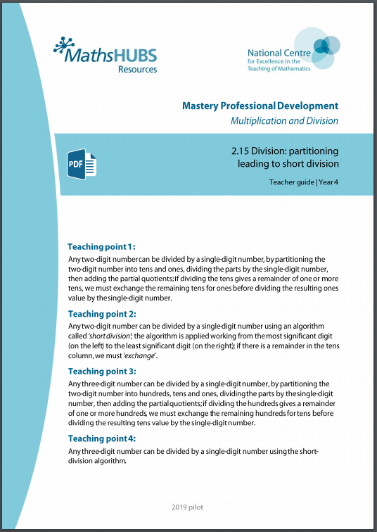
5MD-4: Linked mastery PD materials
Additional pedagogical subject knowledge support can be found in the Mastery Professional Development Materials:
2.15 Division: partitioning leading to short division
Several of the activity slides have been taken from these materials.

Slide 4
5MD-4
Divide using a formal written method

Slide 5
The following slides contain activities that can be used within the context of pre-teaching, intervention, or as supplementary material integrated into teaching. They do not represent complete lessons and should not be used as such. Also they should not be used all at once, but over the period of a teaching unit. It would be valuable to use many of the activities more than once to build fluency in understanding and application. Also many of them would benefit from the use of manipulatives to support interaction with the ideas. Ensure you engage in rich discussion with the children, asking them to reason and explain the ideas presented. Note that when working with a small group, pupils should also have access to the main teaching delivered by the class teacher and the focus should be directly linked so that the learning is connected and fluency is built.

Slide 6
Guidance for working with a small pre-teaching or intervention group
Take time to build understanding of the key idea. We would recommend no more than four slides in any one session, and probably fewer.
In subsequent sessions, review and practise previous learning before moving on.
Play the animation/observe the image and ask pupils “What do you notice?”.
Encourage pupils to explain what they see, what is happening and why.
Where there is a highlighted sentence, draw out the meaning of this from the image and repeat together and individually.

Slide 7
Guidance for working with a small pre-teaching or intervention group
Engage in the suggested activities, using manipulatives where appropriate, to enhance the interaction and stimulate discussion. However, note that the ultimate aim is to develop fluency in the mathematical ideas such that resources are no longer needed.
Repeat questions, using other numbers/examples where relevant.
Repeat the highlighted language structures wherever relevant to build fluency with the key idea and connect the learning. For example:
10 hundreds are equivalent to 1,000.

Slide 8
5MD-4 Divide using a formal written method

Slide 9
5MD-4 Divide using a formal written method
This guidance is for all of the following slides.
Children should engage in the calculation with the animation and be given the opportunity to first use real-life objects, progressing to place value counters to experience the stages of the calculations and increase understanding. They should repeat each animation with similar examples. Children may require place value headings while they learn to use the formal written method.
Initial calculations do not require exchange and children should understand these and additional similar calculations before moving on. Children should narrate the stages of the calculations shown and their own examples, using appropriate technical language.
Once pupils have mastered the basic principles of short division without exchange, they must learn to use the algorithm where exchange is required. Initially, children may use unitising language to support and explain their understanding.
The resources are to secure understanding of underlying structures and not as an aid to calculation. Once confident, children should build fluency in calculating without the aid of resources.
8 tens divided by 4 is equal to 2 tens: write 2 in the tens column.

Slide 10



5MD-4 Divide using a formal written method
84 sticks shared equally between 4 children. How many sticks each?
84 ÷ 4 =
Step 1 – write the divisor and dividend:
10s
1s
84 divided by 4.

Slide 11
5MD-4 Divide using a formal written method
84 sticks shared equally between 4 children. How many sticks each?
84 ÷ 4 =
Step 1 – write the divisor and dividend:
Step 2 – share the 10s:
10s
1s
8 tens ÷ 4 = 2 tens
8 tens divided by 4 is equal to 2 tens.
84 divided by 4.

Slide 12
5MD-4 Divide using a formal written method
84 sticks shared equally between 4 children. How many sticks each?
84 ÷ 4 =
Step 2 – share the 10s:
Step 3 – share the 1s:
10s
1s
8 tens ÷ 4 = 2 tens
4 ones ÷ 4 = 1 one
4 ones divided by 4 is equal to 1 one.
8 tens divided by 4 is equal to 2 tens.

Slide 13
5MD-4 Divide using a formal written method
84 sticks shared equally between 4 children. How many sticks each?
84 ÷ 4 =
Step 3 – share the 1s:
Summary
10s
1s
8 tens ÷ 4 = 2 tens
4 ones ÷ 4 = 1 one
4 ones divided by 4 is equal to 1 one.
Each child gets 21 sticks.

Slide 14

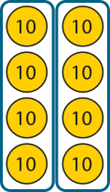

5MD-4 Divide using a formal written method
84 sticks shared equally between 4 children. How many sticks each?
84 ÷ 4 =
21
Summary
10s
1s
2
2
1
1
4
8
8
4
4
8 tens ÷ 4 = 2 tens
4 ones ÷ 4 = 1 one
Each child gets 21 sticks.

Slide 15
5MD-4 Divide using a formal written method
84 | ÷ | 4 | = | 21
dividend | ÷ | divisor | = | quotient

Slide 16
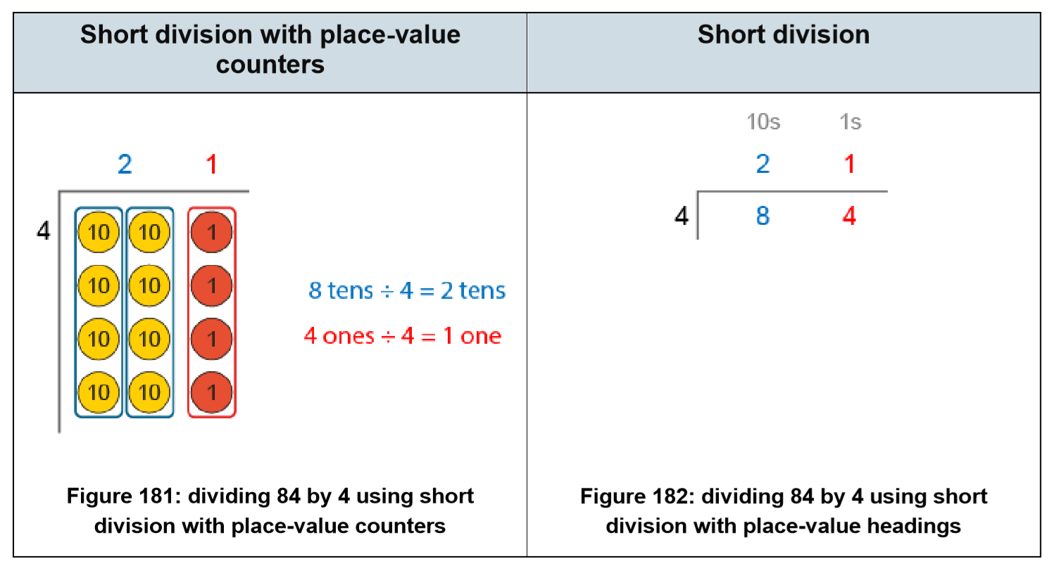
5MD-4 Divide using a formal written method

Slide 17



5MD-4 Divide using a formal written method
72 sticks shared equally between 3 children. How many sticks each?
72 ÷ 3 =
Step 1 – write the divisor and the dividend:
3

Slide 18

5MD-4 Divide using a formal written method
72 sticks shared equally between 3 children. How many sticks each?
72 ÷ 3 =
Step 1 – write the divisor and the dividend:
Step 2 – share the 10s:
2
3
7 tens ÷ 3 = 2 tens r 1 ten

Slide 19
5MD-4 Divide using a formal written method
72 sticks shared equally between 3 children. How many sticks each?
72 ÷ 3 =
Step 2 – share the 10s:
Step 3 – exchange:
2
3
7 tens ÷ 3 = 2 tens r 1 ten

Slide 20

5MD-4 Divide using a formal written method
72 sticks shared equally between 3 children. How many sticks each?
72 ÷ 3 =
24
Step 4 – share the 1s:
Step 3 – exchange:
2
4
3
7 tens ÷ 3 = 2 tens r 1 ten
12 ones ÷ 3 = 4 ones

Slide 21

5MD-4 Divide using a formal written method
73 sticks shared equally between 3 children. How many sticks each?
73 ÷ 3 =
Step 1 – write the divisor and the dividend:
3

Slide 22
5MD-4 Divide using a formal written method
73 sticks shared equally between 3 children. How many sticks each?
73 ÷ 3 =
Step 1 – write the divisor and the dividend:
Step 2 – share the 10s:
2
3
7 tens ÷ 3 = 2 tens r 1 ten

Slide 23
5MD-4 Divide using a formal written method
73 sticks shared equally between 3 children. How many sticks each?
73 ÷ 3 =
Step 2 – share the 10s:
Step 3 – exchange:
2
3
7 tens ÷ 3 = 2 tens r 1 ten

Slide 24
5MD-4 Divide using a formal written method
73 sticks shared equally between 3 children. How many sticks each?
73 ÷ 3 =
24 r 1
Step 4 – share the 1s:
Step 3 – exchange:
2
4
r 1
3
7 tens ÷ 3 = 2 tens r 1 ten
13 ones ÷ 3 = 4 ones r 1 one

Slide 25




5MD-4 Divide using a formal written method
612 ÷ 4 =
Step 1 – writing the divisor and the dividend:
4

Slide 26

5MD-4 Divide using a formal written method
612 ÷ 4 =
Step 1 – writing the divisor and the dividend:
Step 2 – sharing the 100s:
1
4
6 hundreds ÷ 4 = 1 hundred r 2 hundreds

Slide 27
5MD-4 Divide using a formal written method
612 ÷ 4 =
Step 2 – sharing the 100s:
Step 3 – exchanging:
1
4
6 hundreds ÷ 4 = 1 hundred r 2 hundreds
2 hundreds = 20 tens

Slide 28

5MD-4 Divide using a formal written method
612 ÷ 4 =
Step 4 – sharing the 10s:
Step 3 – exchanging:
1
5
4
6 hundreds ÷ 4 = 1 hundred r 2 hundreds
2 hundreds = 20 tens
21 tens ÷ 4 = 5 tens r 1 ten

Slide 29
5MD-4 Divide using a formal written method
612 ÷ 4 =
Step 4 – sharing the 10s:
Step 5 – exchanging:
1
5
4
6 hundreds ÷ 4 = 1 hundred r 2 hundreds
2 hundreds = 20 tens
21 tens ÷ 4 = 5 tens r 1 ten
1 ten = 10 ones

Slide 30
5MD-4 Divide using a formal written method
612 ÷ 4 =
153
Step 6 – sharing the 1s:
Step 5 – exchanging:
1
5
3
4
6 hundreds ÷ 4 = 1 hundred r 2 hundreds
2 hundreds = 20 tens
21 tens ÷ 4 = 5 tens r 1 ten
1 ten = 10 ones
12 ones ÷ 4 = 3 ones

Slide 31
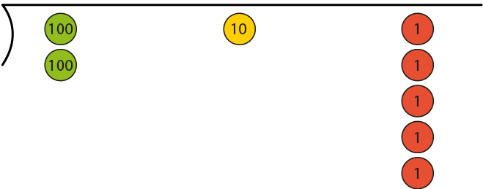
5MD-4 Divide using a formal written method
215 ÷ 5 =
Step 1 – writing the dividend and divisor:
5

Slide 32
5MD-4 Divide using a formal written method
215 ÷ 5 =
Step 1 – writing the dividend and divisor:
Step 2 – sharing the 100s:
0
5
2 hundreds ÷ 5 = 0 hundreds r 2 hundreds

Slide 33
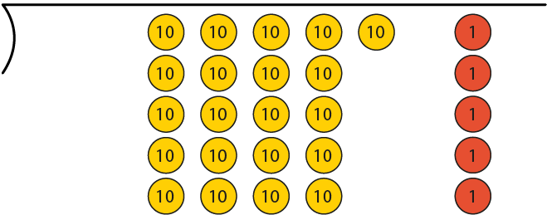
5MD-4 Divide using a formal written method
215 ÷ 5 =
Step 2 – sharing the 100s:
Step 3 – exchanging:
0
5
2 hundreds ÷ 5 = 0 hundreds r 2 hundreds
2 hundreds = 20 tens

Slide 34
5MD-4 Divide using a formal written method
215 ÷ 5 =
Step 4 – sharing the 10s:
Step 3 – exchanging:
0
4
5
2 hundreds ÷ 5 = 0 hundreds r 2 hundreds
2 hundreds = 20 tens
21 tens ÷ 5 = 4 tens r 1 ten

Slide 35
5MD-4 Divide using a formal written method
215 ÷ 5 =
Step 4 – sharing the 10s:
Step 5 – exchanging:
0
4
5
2 hundreds ÷ 5 = 0 hundreds r 2 hundreds
2 hundreds = 20 tens
21 tens ÷ 5 = 4 tens r 1 ten
1 ten = 10 ones

Slide 36
5MD-4 Divide using a formal written method
215 ÷ 5 =
43
Step 6 – sharing the 1s:
Step 5 – exchanging:
0
4
3
5
2 hundreds ÷ 5 = 0 hundreds r 2 hundreds
2 hundreds = 20 tens
21 tens ÷ 5 = 4 tens r 1 ten
1 ten = 10 ones
15 ones ÷ 5 = 3 ones

Slide 37
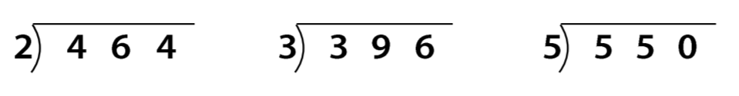
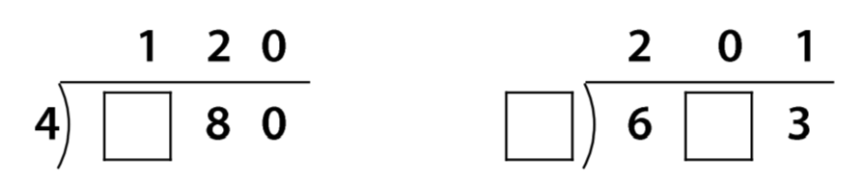
5MD-4 Divide using a formal written method
It is now really important to practise with other examples without resources to build fluency.
Complete these calculations.

Slide 38
5MD-4 Divide using a formal written method
Division Rules
https://nrich.maths.org/10490

