Slide 1
5MD-1
Multiplying and dividing by 10 and 100

Slide 2
5MD-1
Multiply and divide numbers by 10 and 100; understand this as equivalent to making a number 10 or 100 times the size, or 1 tenth or 1 hundredth times the size.
The materials in this pack have been collated and written to support the teaching of 5MD-1. Before planning and teaching the content, read the teaching guidance and example assessment questions in the non-statutory guidance itself, which can be found here.
A video summarising all of the ready-to-progress criteria for Year 5 can be found here.

Slide 3
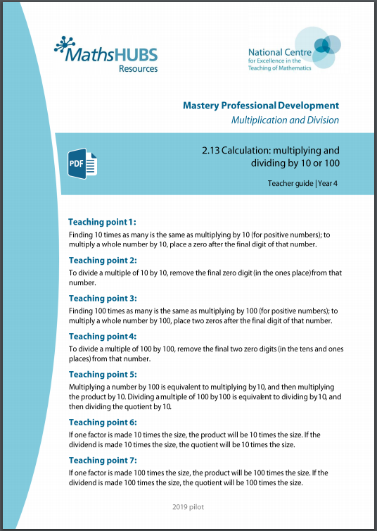
5MD-1: Linked mastery PD materials
Additional pedagogical subject knowledge support can be found in the Mastery Professional Development Materials:
2.13 Calculation: multiplying and dividing by 10 or 100
Several of the activity slides have been taken from these materials.

Slide 4
5MD-1
Multiplying and dividing by 10 and 100

Slide 5
The following slides contain activities that can be used within the context of pre-teaching, intervention, or as supplementary material integrated into teaching. They do not represent complete lessons and should not be used as such. Also they should not be used all at once, but over the period of a teaching unit. It would be valuable to use many of the activities more than once to build fluency in understanding and application. Also many of them would benefit from the use of manipulatives to support interaction with the ideas. Ensure you engage in rich discussion with the children, asking them to reason and explain the ideas presented. Note that when working with a small group, pupils should also have access to the main teaching delivered by the class teacher and the focus should be directly linked so that the learning is connected and fluency is built.

Slide 6
Guidance for working with a small pre-teaching or intervention group
Take time to build understanding of the key idea. We would recommend no more than four slides in any one session, and probably fewer.
In subsequent sessions, review and practise previous learning before moving on.
Play the animation/observe the image and ask pupils “What do you notice?”.
Encourage pupils to explain what they see, what is happening and why.
Where there is a highlighted sentence, draw out the meaning of this from the image and repeat together and individually.

Slide 7
Guidance for working with a small pre-teaching or intervention group
Engage in the suggested activities, using manipulatives where appropriate, to enhance the interaction and stimulate discussion. However, note that the ultimate aim is to develop fluency in the mathematical ideas such that resources are no longer needed.
Repeat questions, using other numbers/examples where relevant.
Repeat the highlighted language structures wherever relevant to build fluency with the key idea and connect the learning. For example:
10 hundreds are equivalent to 1,000.

Slide 8
5MD-1 Multiplying and dividing by 10 and 100

Slide 9
5MD-1 Multiplying and dividing by 10 and 100
This guidance is for the following two slides.
Place a counter or your finger on the number that is highlighted on the Gattegno chart.
Move the counter or your finger as shown by the animation and write a division or multiplication equation to describe the movement.
Children should also describe what has been shown by the movement of the counter or their finger and the equations.
Repeat each set of calculations with other single-digit numbers.
8, made one-tenth the size is 0.8.
8 divided by 10 is equal to 0.8.
First we had 8 ones, now we have 8 tenths.
0.8, made 10 times the size is 8.
0.8 multiplied by 10 is equal to 8.
First we had 8 tenths, now we have 8 ones.

Slide 10

5MD-1 Multiplying and dividing by 10 and 100
8 ÷ 10 = 0.8
0.8 ÷ 10 = 0.08
1,000
2,000
3,000
4,000
5,000
6,000
7,000
8,000
9,000
100
200
300
400
500
600
700
800
900
10
20
30
40
50
60
70
80
90
1
2
3
4
5
6
7
8
9
÷ 10
0.1
0.2
0.3
0.4
0.5
0.6
0.7
0.8
0.9
one-tenth the size
÷ 10
0.01
0.02
0.03
0.04
0.05
0.06
0.07
0.08
0.09
one-tenth the size

Slide 11
5MD-1 Multiplying and dividing by 10 and 100
0.08 x 10 = 0.8
0.8 x 10 = 8
1,000
2,000
3,000
4,000
5,000
6,000
7,000
8,000
9,000
100
200
300
400
500
600
700
800
900
10
20
30
40
50
60
70
80
90
1
2
3
4
5
6
7
8
9
× 10
0.1
0.2
0.3
0.4
0.5
0.6
0.7
0.8
0.9
ten times the size
× 10
0.01
0.02
0.03
0.04
0.05
0.06
0.07
0.08
0.09
ten times the size

Slide 12
5MD-1 Multiplying and dividing by 10 and 100
0.8 x 10 = 8
If each of my ones become tenths, what has happened? If each of my tenths become ones, what has happened?
Start with 8 ones, now exchange each for a tenths counter. Can you explain what you have done? Start with 8 tenths counters, then exchange each for a ones counter. Explain what you have done.
8 ÷ 10 = 0.8
0.1
0.1
1
1
0.1
0.1
1
1
0.1
0.1
1
1
0.1
0.1
8, made one-tenth the size is 0.8.
8 divided by 10 is 0.8.
First we had 8 ones, now we have 8 tenths.
1
1
one-tenth of the size
ten times the size

Slide 13
5MD-1 Multiplying and dividing by 10 and 100
0.08 x 100 = 8
If each of my ones become hundredths what has happened? If each of my hundredths become ones, what has happened?
Start with 8 ones, now exchange each for a hundredths counter. Can you explain what you have done? Start with 8 hundredths counters, then exchange each for a ones counter. Explain what you have done.
8 ÷ 100 = 0.08
0.01
0.01
1
1
0.01
0.01
1
1
0.01
0.01
1
1
0.01
0.01
8, made 100 times smaller is 0.08.
8 divided by 100 is 0.08.
First we had 8 ones, now we have 8 hundredths
1
1
one hundred times the size
one-hundredth of the size

Slide 14
5MD-1 Multiplying and dividing by 10 and 100
0.08 x 10 = 0.8
If each of my tenths become hundredths what has happened? If each of my hundredths become tenths, what has happened?
Start with 8 tenths, now exchange each for a hundredths counter. Can you explain what you have done? Start with 8 hundredths counters, then exchange each for a tenths counter. Explain what you have done.
0.8 ÷ 10 = 0.08
0.01
0.01
0.1
0.1
0.01
0.01
0.1
0.1
0.01
0.01
0.1
0.1
0.01
0.01
0.8, made one-tenth of the size is 0.08.
0.8 divided by 10 is 0.08.
First we had 8 tenths, now we have 8 hundredths.
0.1
0.1
one-tenth of the size
ten times the size

Slide 15

5MD-1 Multiplying and dividing by 10 and 100
1,000
2,000
3,000
4,000
5,000
6,000
7,000
8,000
9,000
100
200
300
400
500
600
700
800
900
3.6 × 10 = 36
10
20
30
40
50
60
70
80
90
1
2
3
4
5
6
7
8
9
÷ 10
36 ÷ 10 = 3.6
× 10
0.1
0.2
0.3
0.4
0.5
0.6
0.7
0.8
0.9
one-tenth of the size
ten times the size
0.01
0.02
0.03
0.04
0.05
0.06
0.07
0.08
0.09
What 2-digit number can you see on the chart? If we multiply by ten and make the number tens times the size, what happens?
If we start with 36 and move each part down a row, what have we done?
When we multiply a decimal number by 10, do we still add a zero? Can we try some other numbers?

Slide 16
5MD-1 Multiplying and dividing by 10 and 100
1.8 × 10 = 18
18 ÷ 10 = 1.8
If each part is one-tenth the value, show me the counters you will now have. Write a calculation and explain what you have done.
If I then make each counter ten times the value, describe what happens.
Provide children with 2-digit numbers to divide by ten and numbers with ones and tenths to multiply by ten, using counters to show their understanding. Ask them to explain their reasoning.
1
0.1
0.1
10
1
1
0.1
0.1
1
1
0.1
0.1
1
1
0.1
0.1
1
1
one-tenth of the size
ten times the size
1.8 is one-tenth the size of 18
18 divided by 10 is 1.8

Slide 17

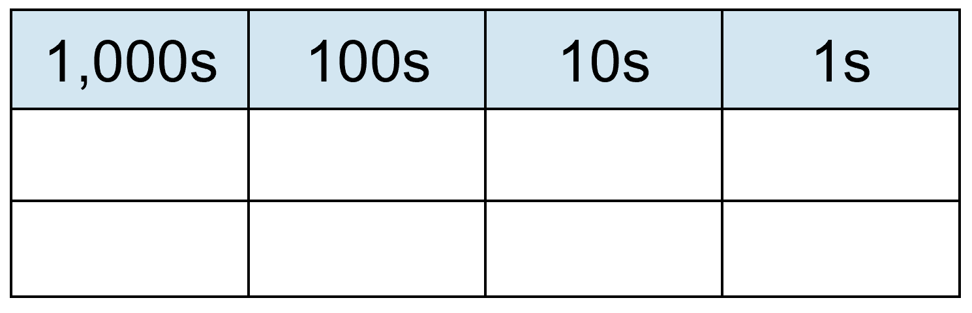
5MD-1 Multiplying and dividing by 10 and 100
1.8 × 10 = 180
18 ÷ 10 = 1.8
If we start with 1.8 and make this ten times the value, what has happened to the ones digit? The tenths digit?
What was the value of the 1 before? And now? What was the value of the 8 before? And now?
ten times the size
x10
x10
100s
10s
1s
0.1s
1
8
To multiply by 10, move each digit one place to the left.
To divide by 10, move each digit one place to the right.
1
8
1
8
0
÷10
÷10
one-tenth of the size

Slide 18
5MD-1 Multiplying and dividing by 10 and 100
1,000
2,000
3,000
4,000
5,000
6,000
7,000
8,000
9,000
100
200
300
400
500
600
700
800
900
0.27 × 10 = 2.7
10
20
30
40
50
60
70
80
90
2.7 ÷ 10 = 0.27
1
2
3
4
5
6
7
8
9
0.1
0.2
0.3
0.4
0.5
0.6
0.7
0.8
0.9
÷ 10
× 10
0.01
0.02
0.03
0.04
0.05
0.06
0.07
0.08
0.09
one-tenth of the size
ten times the size
What happens to 0.27 when we multiply by 10? What happens when we then divide by 10?
Can you start with 0.36 on your chart and make it 10 times the size? Now make the solution one-tenth of the size. What do you notice?
Think of 8.7 and make it one-tenth of the size. Now make it ten times the size.
Repeat with other numbers using either the Gattegno chart or visualization.

Slide 19
5MD-1 Multiplying and dividing by 10 and 100
4.4 ÷ 10 = 0.44
0.44 × 10 = 4.4
Make 4.4 with your counters. Now make each counter one-tenth of the value. Show me the counters you now have.
Start with 0.44 and make each counter ten times the value. Show me the counters you now have. Write a calculation.
Repeat for other similar numbers.
1
0.01
0.1
0.1
1
0.01
0.1
0.1
1
0.1
0.1
0.01
1
0.01
__ divided by 10 is equal to__.
__ is one-tenth the size of __.
__ multiplied by 10 is equal to__.
__ is 10 times the size of __.
0.1
0.1
one-tenth of the size
ten times of the size

Slide 20
5MD-1 Multiplying and dividing by 10 and 100
4.4 ÷ 10 = 0.44
0.44 × 10 = 4.4
What is the value of the 4 tenths after we multiply by 10? And the 4 hundredths?
What happens to each digit when we divide by 10?
Why is there a zero in the ones place to start with?
What happens to the zero in the ones when we multiply by 10?
ten times the size
x10
x10
x10
10s
1s
0.1s
0.01s
0
0
4
4
4
4
To multiply by 10, move each digit one place to the left.
To divide by 10, move each digit one place to the right.
4
4
÷10
÷10
÷10
one-tenth of the size

Slide 21
5MD-1 Multiplying and dividing by 10 and 100
1,000
2,000
3,000
4,000
5,000
6,000
7,000
8,000
9,000
100
200
300
400
500
600
700
800
900
0.95 × 100 = 95
10
20
30
40
50
60
70
80
90
1
2
3
4
5
6
7
8
9
÷ 100
95 ÷ 100 = 0.95
× 100
one-hundredth of the size
0.1
0.2
0.3
0.4
0.5
0.6
0.7
0.8
0.9
one hundred times the size
0.01
0.02
0.03
0.04
0.05
0.06
0.07
0.08
0.09
When we multiply 0.95 by 100, what is the new value of the 9 digit? The 5 digit?
What happens when we then divide by 100? What is the new value of each digit?
Provide further opportunities to multiply different number of hundredths by 100 and divide different two-digit numbers by 100.

Slide 22
5MD-1 Multiplying and dividing by 10 and 100
4.4 ÷ 10 = 0.44
0.44 × 10 = 4.4
Make 4.4 with your counters. Now make each counter one-tenth of the value. Show me the counters you now have.
Start with 0.44 and make each counter ten times the value. Show me the counters you now have. Write a calculation.
Repeat for other similar numbers.
1
0.01
0.1
0.1
1
0.01
0.1
0.1
1
0.1
0.1
0.01
1
0.01
0.1
0.1
__ divided by 10 is equal to__.
__ is one-tenth the size of __.
__ multiplied by 10 is equal to__.
__ is 10 times the size of __.
one-tenth of the size
ten times of the size

Slide 23
5MD-1 Multiplying and dividing by 10 and 100
4.4 ÷ 10 = 0.44
0.44 × 10 = 4.4
What is the value of the 4 tenths after we multiply by 10? And the 4 hundredths?
What happens to each digit when we divide by 10?
Why is there a zero in the ones place to start with?
What happens to the zero in the ones when we multiply by 10?
ten times the size
x10
x10
x10
10s
1s
0.1s
0.01s
0
0
4
4
4
4
To multiply by 10, move each digit one place to the left.
To divide by 10, move each digit one place to the right.
4
4
÷10
÷10
÷10
one-tenth of the size

Slide 24
5MD-1 Multiplying and dividing by 10 and 100
Complete the calculations using your understanding of place value. Click for each new calculation.
If required, use place value counters or a Gattegno chart to check or correct each solution before clicking for each answer.
0.72 × 10 = 7.2
4.82 × 10 = 48.2
0.91 × 100 = 91

Slide 25
5MD-1 Multiplying and dividing by 10 and 100
Complete the calculations using your understanding of place value. Click for each new calculation.
If required, use place value counters or a Gattegno chart to check or correct each solution before clicking for each answer.
57 ÷ 10 = 5.7
61.2 ÷ 10 = 6.12
75 ÷ 100 = 0.75

