Slide 1
5MD-2
Find factors and multiples

Slide 2
5MD-2
Find factors and multiples of positive whole numbers, including common factors and common multiples, and express a given number as a product of 2 or 3 factors.
The materials in this pack have been collated and written to support the teaching of 5MD-2. Before planning and teaching the content, read the teaching guidance and example assessment questions in the non-statutory guidance itself, which can be found here.
A video summarising all of the ready-to-progress criteria for Year 5 can be found here.

Slide 3
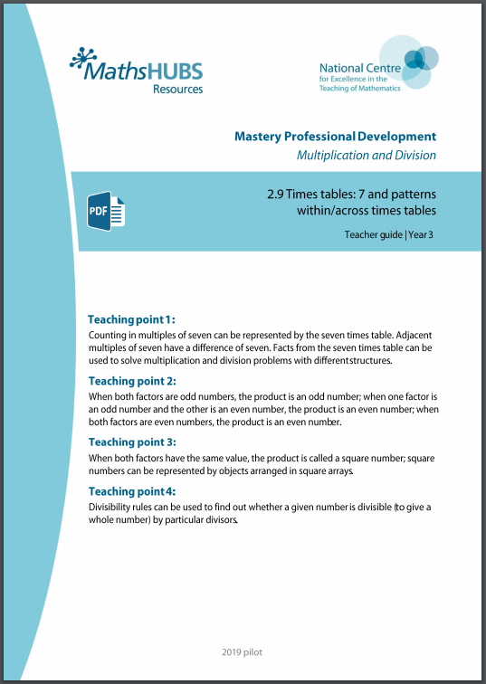
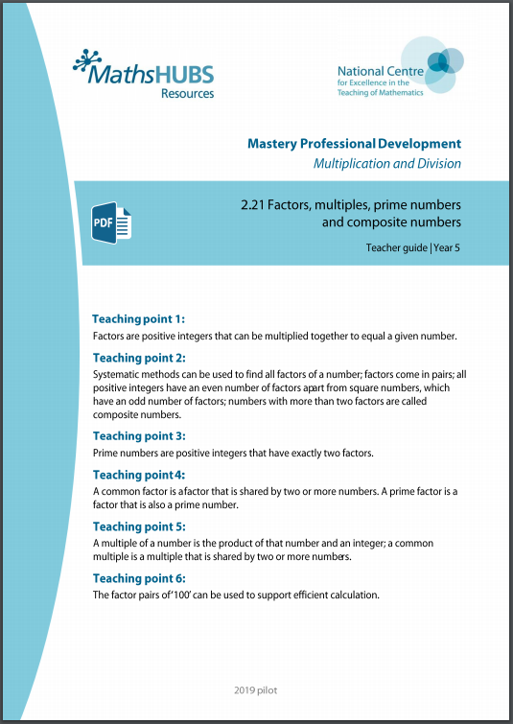
5MD-2: Linked mastery PD materials
Additional pedagogical subject knowledge support can be found in the following Mastery Professional Development materials:
  2.9 Times tables:7 and patterns within/across times tables
  2.21 Factors, multiples, prime numbers and composite numbers
Several of the activity slides have been taken from these materials.

Slide 4
5MD-2
Find factors and multiples

Slide 5
The following slides contain activities that can be used within the context of pre-teaching, intervention, or as supplementary material integrated into teaching. They do not represent complete lessons and should not be used as such. Also they should not be used all at once, but over the period of a teaching unit. It would be valuable to use many of the activities more than once to build fluency in understanding and application. Also many of them would benefit from the use of manipulatives to support interaction with the ideas. Ensure you engage in rich discussion with the children, asking them to reason and explain the ideas presented. Note that when working with a small group, pupils should also have access to the main teaching delivered by the class teacher and the focus should be directly linked so that the learning is connected and fluency is built.

Slide 6
Guidance for working with a small pre-teaching or intervention group
Take time to build understanding of the key idea. We would recommend no more than four slides in any one session, and probably fewer.
In subsequent sessions, review and practise previous learning before moving on.
Play the animation/observe the image and ask pupils “What do you notice?”.
Encourage pupils to explain what they see, what is happening and why.
Where there is a highlighted sentence, draw out the meaning of this from the image and repeat together and individually.

Slide 7
Guidance for working with a small pre-teaching or intervention group
Engage in the suggested activities, using manipulatives where appropriate, to enhance the interaction and stimulate discussion. However, note that the ultimate aim is to develop fluency in the mathematical ideas such that resources are no longer needed.
Repeat questions, using other numbers/examples where relevant.
Repeat the highlighted language structures wherever relevant to build fluency with the key idea and connect the learning. For example:
10 hundreds are equivalent to 1,000.

Slide 8
5MD-2 Find factors and multiples

Slide 9

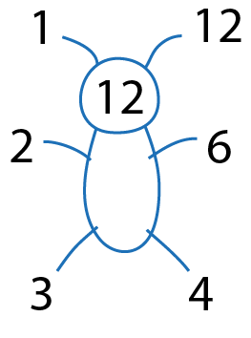
5MD-2 Find factors and multiples
3
6
12
24
1
2
4
Record the multiplication equations shown by the array after each animation.
Why were the 24 cubes not shown in five rows?
Identify all the factors of 24 from the factors within the multiplication equations.
Repeat with other numbers, using cubes to create 3-D arrays at each stage.
1
24
8 x 3 = 24
8
24
4 x 6 = 24
2
12
2 x 12 = 24
4
6
1 x 24 = 24
8
3

Slide 10

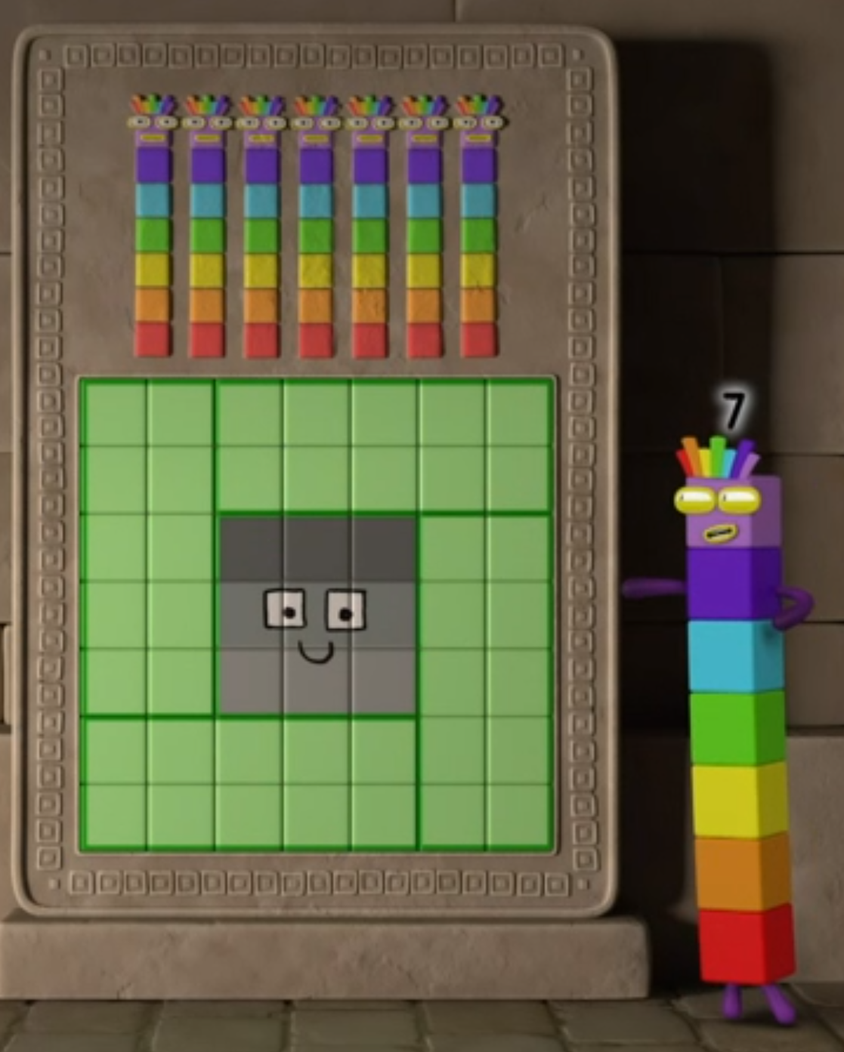
5MD-2 Find factors and multiples
Create a square array using nine cubes.
What factor does the square array show?
Does nine have an odd or even number of factors? Why?
Will other square numbers have an odd or even number of factors? Why?
Explore the factors of the other square numbers, using cubes if required.
Images © 2017 Alphablocks Ltd. All Rights Reserved.

Slide 11
5MD-2 Find factors and multiples
× | 0 | 1 | 2 | 3 | 4 | 5 | 6 | 7 | 8 | 9 | 10 | 11 | 12
0 | 0 | 0 | 0 | 0 | 0 | 0 | 0 | 0 | 0 | 0 | 0 | 0 | 0
1 | 0 | 1 | 2 | 3 | 4 | 5 | 6 | 7 | 8 | 9 | 10 | 11 | 12
2 | 0 | 2 | 4 | 6 | 8 | 10 | 12 | 14 | 16 | 18 | 20 | 22 | 24
3 | 0 | 3 | 6 | 9 | 12 | 15 | 18 | 21 | 24 | 27 | 30 | 33 | 36
4 | 0 | 4 | 8 | 12 | 16 | 20 | 24 | 28 | 32 | 36 | 40 | 44 | 48
5 | 0 | 5 | 10 | 15 | 20 | 25 | 30 | 35 | 40 | 45 | 50 | 55 | 60
6 | 0 | 6 | 12 | 18 | 24 | 30 | 36 | 42 | 48 | 54 | 60 | 66 | 72
7 | 0 | 7 | 14 | 21 | 28 | 35 | 42 | 49 | 56 | 63 | 70 | 77 | 84
8 | 0 | 8 | 16 | 24 | 32 | 40 | 48 | 56 | 64 | 72 | 80 | 88 | 96
9 | 0 | 9 | 18 | 27 | 36 | 45 | 54 | 63 | 72 | 81 | 90 | 99 | 108
10 | 0 | 10 | 20 | 30 | 40 | 50 | 60 | 70 | 80 | 90 | 100 | 110 | 120
11 | 0 | 11 | 22 | 33 | 44 | 55 | 66 | 77 | 88 | 99 | 110 | 121 | 132
12 | 0 | 12 | 24 | 36 | 48 | 60 | 72 | 84 | 96 | 108 | 120 | 132 | 144
What do you notice about the numbers highlighted in blue?
What is special about these numbers?
Would it be possible to create a square shaped array of each of these numbers? Why/why not?

Slide 12
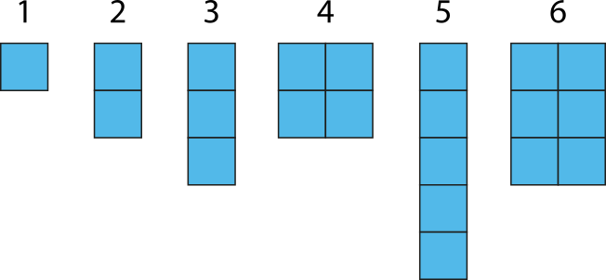
5MD-2 Find factors and multiples
What do you notice about the arrays that have been created for the first six counting numbers?
Could any of the arrays have been created in different ways? What do those arrays tell you about the number of factors that number has?
What does each array tell you about the number? Which are prime? Which are not prime? Which are square?
Repeat for other small numbers to investigate further.

Slide 13
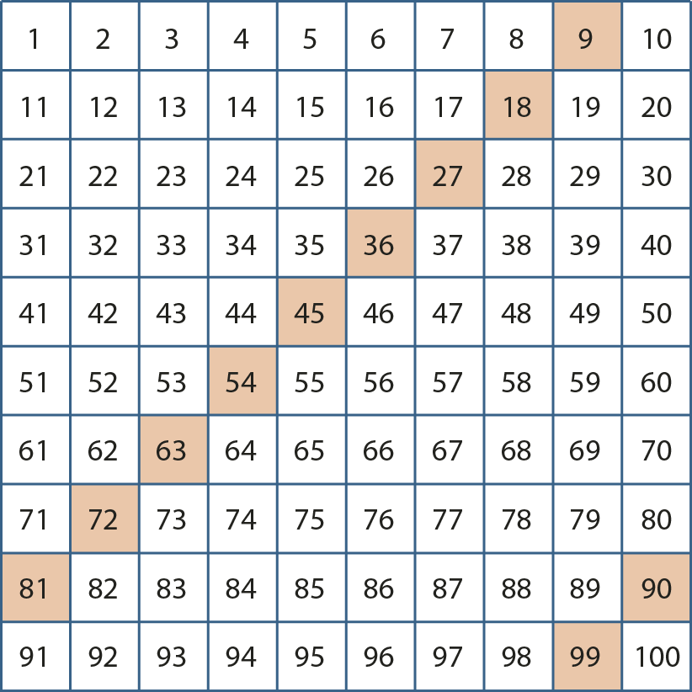
5MD-2 Find factors and multiples
What do you notice about the highlighted numbers?
Which number is a factor of all of these multiples?
Is there more than one number that is a factor of all of these multiples?
Nine is a factor of all of these numbers.
Three is a factor of nine which means it is also a factor of all of these numbers.

Slide 14
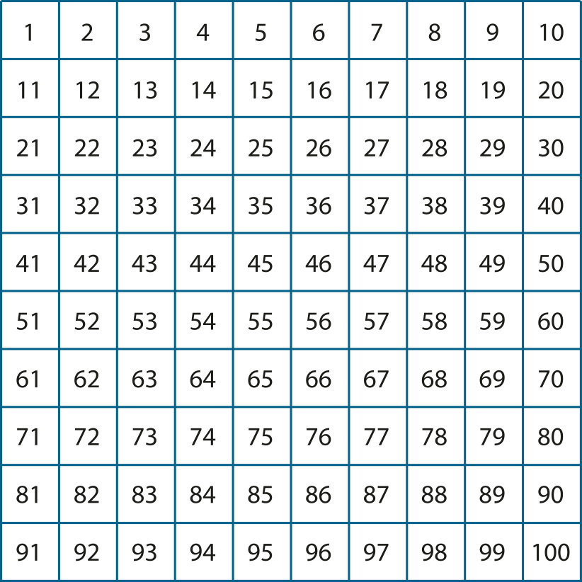


5MD-2 Find factors and multiples
Use an empty hundred square and shade the multiples of three and five different colours.
Use the shaded hundred square to identify common multiples of 3 and 5.
What do you notice about the common multiples?
What would the next common multiple be? How do you know?

Slide 15
5MD-2 Find factors and multiples
Identify where each of the digits in the multiplication equation are represented in the array.
From the array and multiplication equations, what statements about factors and multiples can be made?
7 represents the number of counters in each row.
3 represents the number of counters in each column.
21 represents the total number of counters.
7 × 3 = 21
7 and 3 are factors of 21.
21 is a multiple of 7 and 3.

Slide 16
5MD-2 Find factors and multiples
Identify where each of the digits in the multiplication equation are represented in the array.
From the array and multiplication equations, what statements about factors and multiples can be made?
10
10
10
10
10
10
10
10
10
10
10
10
10
10
7 represents the number of counters in each row.
30 represents the total value of the counters in each column.
210 represents the total value of the counters.
10
10
10
10
10
10
10
7 × 30 = 210
70 × 3 = 210
3, 7, 10, 21 and 70 are factors of 210.
210 is a multiple of 3, 7, 10, 21 and 70.
10 x 21 = 210

Slide 17
5MD-2 Find factors and multiples
Identify where each of the digits in the multiplication equation are represented in the array.
From the array and multiplication equations, what statements about factors and multiples can be made?
100
100
100
100
100
100
100
100
100
100
100
100
100
100
7 represents the number of counters in each row.
300 represents the total value of the counters in each column.
2100 represents the total value of the counters.
100
100
100
100
100
100
100
7 × 300 = 2,100
700 × 3 = 2,100
3, 7, 100, 21 and 700 are factors of 2100.
2100 is a multiple of 3, 7, 100, 21 and 700.
100 x 21 = 2,100

Slide 18
5MD-2 Find factors and multiples
What do you notice about the three equations?
The first equation shows 21 is a multiple of 3 and 7. What similar statement can be made from the other expressions?
How can the second expression help to determine if 2 is a factor of 210?
21 = 7 × 3
210 = 7 × 3 × 10
2,100 = 7 × 3 × 100
21 is a multiple of 3 and 7, so…
210 and 2,100 are multiples of 3 and 7.
2 is a factor of 10.
Because 10 is a factor of 210, this means 2 is also a factor of 210.

Slide 19
5MD-2 Find factors and multiples
Factors and Multiples Game
https://nrich.maths.org/factorsandmultiples

