Slide 1
5G-1
Compare, estimate, measure and draw angles

Slide 2
5G-1
Compare angles, estimate and measure angles in degrees (°) and draw angles of a given size.
The materials in this pack have been collated and written to support the teaching of 5G-1, with a particular focus on review, practice and consolidation. Before planning and teaching the content, read the teaching guidance and example assessment questions in the non-statutory guidance itself, which can be found here.
A video summarising all of the ready-to-progress criteria for the year group can be found here.

Slide 3
5G-1
Compare, estimate, measure and draw angles

Slide 4
The following slides contain activities that can be used within the context of pre-teaching, intervention, or as supplementary material integrated into teaching. They do not represent complete lessons and should not be used as such. Also they should not be used all at once, but over the period of a teaching unit. It would be valuable to use many of the activities more than once to build fluency in understanding and application. Also many of them would benefit from the use of manipulatives to support interaction with the ideas. Ensure you engage in rich discussion with the children, asking them to reason and explain the ideas presented. Note that when working with a small group, pupils should also have access to the main teaching delivered by the class teacher and the focus should be directly linked so that the learning is connected and fluency is built.

Slide 5
Guidance for working with a small pre-teaching or intervention group
Take time to build understanding of the key idea. We would recommend no more than four slides in any one session, and probably fewer.
In subsequent sessions, review and practise previous learning before moving on.
Play the animation/observe the image and ask pupils “What do you notice?”.
Encourage pupils to explain what they see, what is happening and why.
Where there is a highlighted sentence, draw out the meaning of this from the image and repeat together and individually.

Slide 6
Guidance for working with a small pre-teaching or intervention group
Engage in the suggested activities, using manipulatives where appropriate, to enhance the interaction and stimulate discussion. However, note that the ultimate aim is to develop fluency in the mathematical ideas such that resources are no longer needed.
Repeat questions, using other numbers/examples where relevant.
Repeat the highlighted language structures wherever relevant to build fluency with the key idea and connect the learning. For example:
10 hundreds are equivalent to 1,000.

Slide 7
5G-1 Compare, estimate, measure and draw angles

Slide 8
5G-1 Compare, estimate, measure and draw angles
These activities should be completed before children discuss the images on the next slide.
Give children the opportunity to investigate turn and link this to angles and degrees (º) as a measure of turn. This can be achieved by joining two geostrips, rulers or strips of paper held by a split pin and turning one of the objects to different amounts. A door could also be used: explore the angle that it is possible to turn it to. Alternatively children could turn their bodies and arms to experience and show different degrees of turn.
Children should know that there are 360° in a full turn, 90° in a quarter turn or right angle, and 180° in a half turn or on a straight line. Give children the opportunity to show these angles of turn with their own bodies and/or equipment, as well as recording what degree of turn they think has been completed during a demonstration.

Slide 9
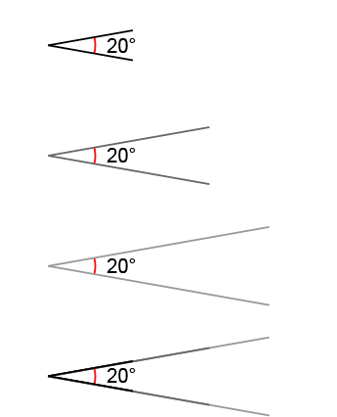
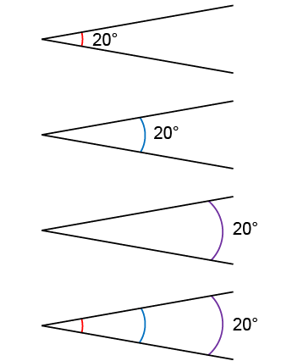
5G-1 Compare, estimate, measure and draw angles
Look at the images shown. What’s the same? What’s different?
Give children the opportunity to draw angles of different sizes between lines of different length to experience the different ways angles could be labelled.
The angle between each line is the same.
The length of each pair of lines is different.
The angle between each line is the same.
The position of the arc indicating the angle is drawn in different locations.

Slide 10
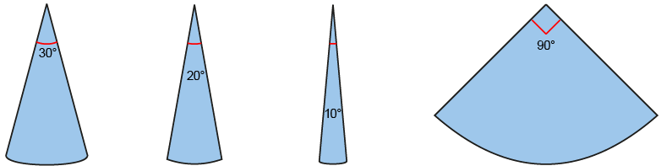
5G-1 Compare, estimate, measure and draw angles
Give children labelled pieces of card and paper as shown. Allow them to explore the classroom or plastic shapes and find angles that are similar to, or smaller/greater than their cut-out benchmark.
Provide children with drawn examples and ask them to estimate the size of the angles based on known values. This could include combining known angles together to calculate an angle size.
Interactive teaching tools can also be used where children shout stop when they think a line has turned a required angle, to develop their ability to visually estimate.

Slide 11
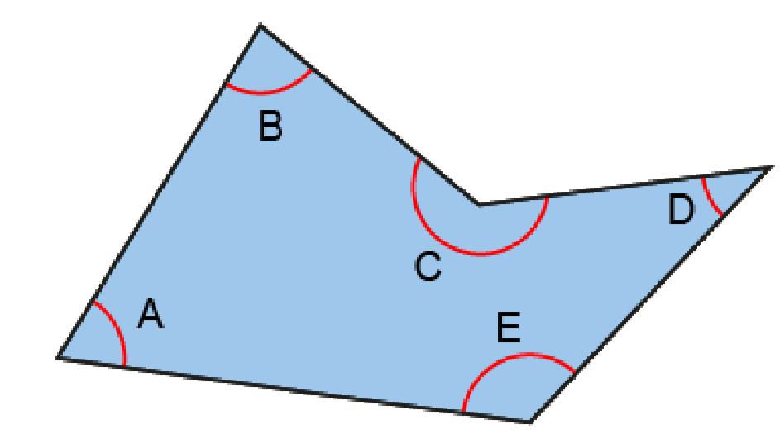
5G-1 Compare, estimate, measure and draw angles
The shape shown has been created by joining five crosses drawn on a piece of paper.
Can you see, just by looking, the largest and smallest angle in the shape? Are these angles acute, obtuse or reflex?
How would you classify the other internal angles of the shape?
D is the smallest angle. It is an acute angle.
C is the largest angle. It is a reflex angle.
An acute angle is less than 90º.
An obtuse angle is greater than 90º but less than 180º.
A reflex angle is greater than 180º.

Slide 12
5G-1 Compare, estimate, measure and draw angles
These activities can be completed after children have finished and discussed the tasks in the previous slide.
On a blank piece of paper mark five points with crosses. Accurately join these points.
Identify the largest and smallest angle in the shape that you have created. Are these angles acute, obtuse or reflex?
How could you arrange the points to make a shape with one very large angle when joined? A very small angle? Angles that are roughly the same size?
Repeat with other shapes made from 4, 5 and 6 points.

Slide 13
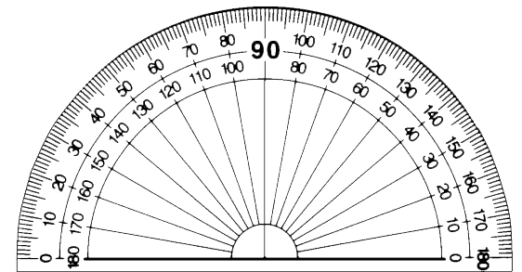
5G-1 Compare, estimate, measure and draw angles
What is your estimate for the size of angle A?
What are the key features of an angle measurer (protractor)?
What important parts of the protractor need to be positioned accurately?
What do you notice about the scales on the protractor? Which should be used? Why?
What is the size of angle A?
Repeat measuring other internal angles and those of other shapes given to or drawn by children.
Angle A is an acute angle. It is 66º.

Slide 14


5G-1 Compare, estimate, measure and draw angles
What steps should be taken to draw an angle of 102º
Narrate the steps shown by the animations describing the critical features of the protractor and important steps where mistakes could occur.
Allow children to work in pairs where one child follows the verbal instructions of their partner, drawing angles of different sizes.

Slide 15
5G-1 Compare, estimate, measure and draw angles
Estimating Angles
https://nrich.maths.org/1235

