Slide 1
5F-3
Recall decimal equivalents for common fractions

Slide 2

5F-3
Recall decimal fraction equivalents for , , and , and for multiples of these proper fractions.
The materials in this pack have been collated and written to support the teaching of 5F-3. Before planning and teaching the content, read the teaching guidance and example assessment questions in the non-statutory guidance itself, which can be found here.
A video summarising all of the ready-to-progress criteria for Year 5 can be found here.

Slide 3
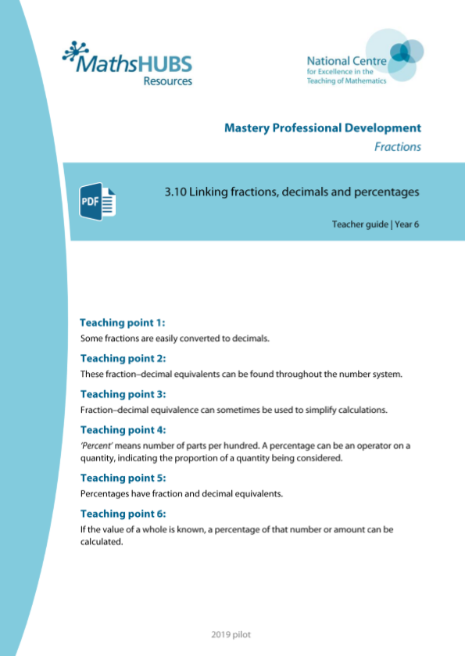
5F-3: Linked mastery PD materials
Additional pedagogical subject knowledge support can be found in the Mastery Professional Development Materials:
3.10 Linking fractions, decimals and percentages
Several of the activity slides have been taken from these materials.

Slide 4
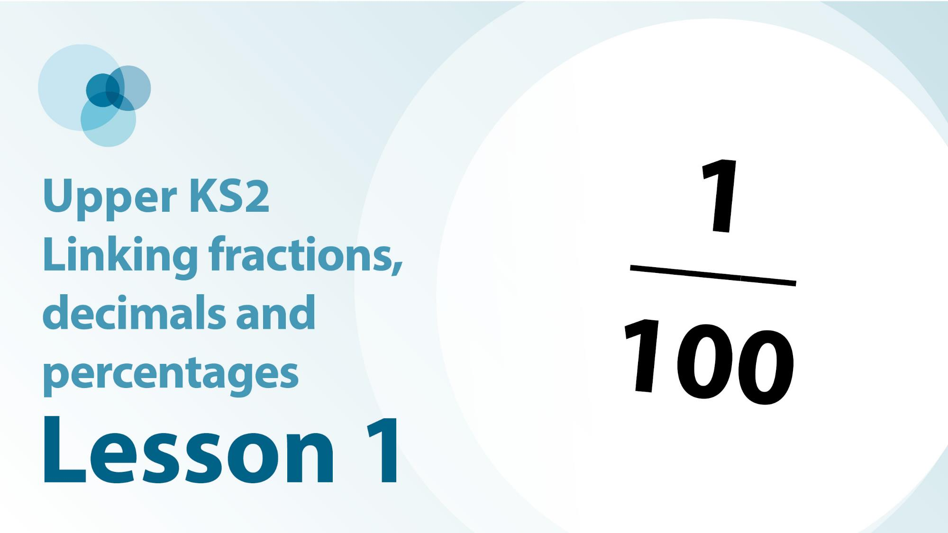
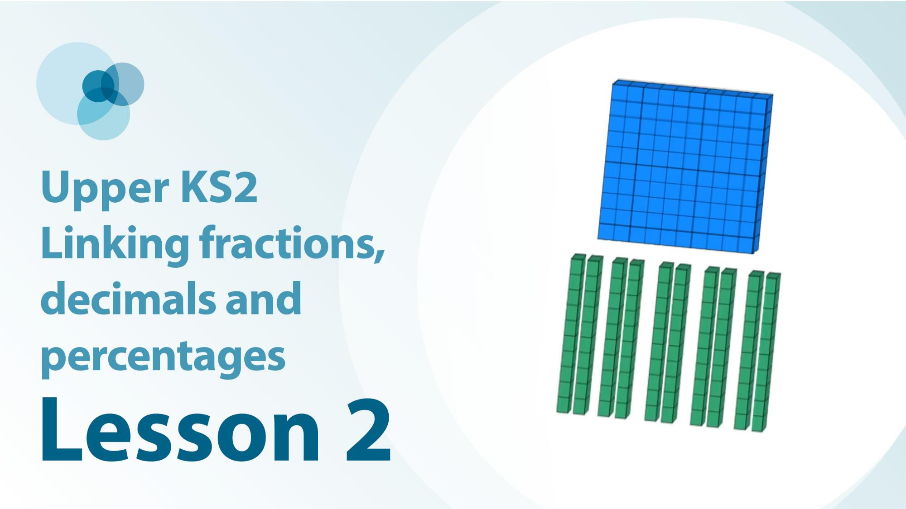
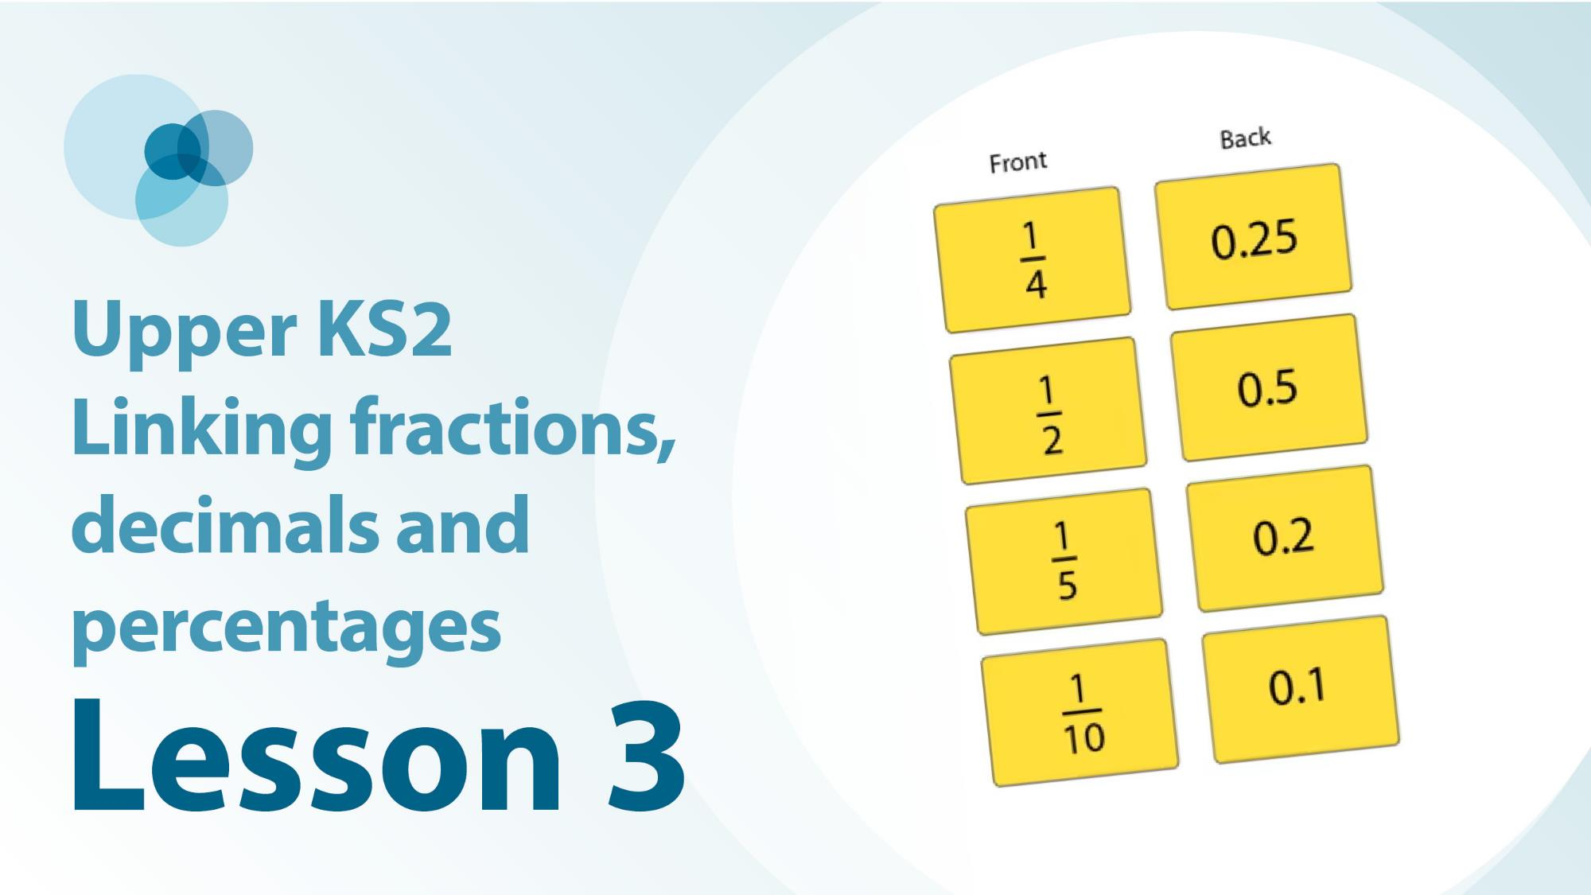
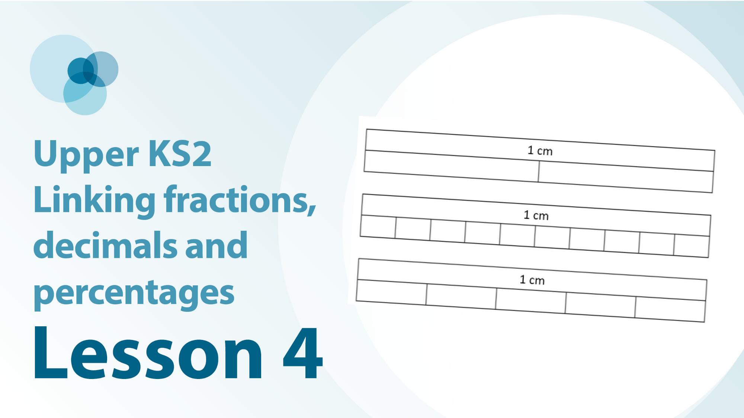
5F-3 Linked video lessons
Upper Key Stage 2 linking fractions, decimals and percentages
One tenth and one hundredth as fractions and decimals
Knowing some fraction and decimal equivalents that pop up again and again
Some non-unit fractions and their decimal equivalents using measures contexts
Patterns through the number system and comparison of fractions and decimals

Slide 5
5F-3
Recall decimal equivalents for common fractions

Slide 6
The following slides contain activities that can be used within the context of pre-teaching, intervention, or as supplementary material integrated into teaching. They do not represent complete lessons and should not be used as such. Also they should not be used all at once, but over the period of a teaching unit. It would be valuable to use many of the activities more than once to build fluency in understanding and application. Also many of them would benefit from the use of manipulatives to support interaction with the ideas. Ensure you engage in rich discussion with the children, asking them to reason and explain the ideas presented. Note that when working with a small group, pupils should also have access to the main teaching delivered by the class teacher and the focus should be directly linked so that the learning is connected and fluency is built.

Slide 7
Guidance for working with a small pre-teaching or intervention group
Take time to build understanding of the key idea. We would recommend no more than four slides in any one session, and probably fewer.
In subsequent sessions, review and practise previous learning before moving on.
Play the animation/observe the image and ask pupils “What do you notice?”.
Encourage pupils to explain what they see, what is happening and why.
Where there is a highlighted sentence, draw out the meaning of this from the image and repeat together and individually.

Slide 8
Guidance for working with a small pre-teaching or intervention group
Engage in the suggested activities, using manipulatives where appropriate, to enhance the interaction and stimulate discussion. However, note that the ultimate aim is to develop fluency in the mathematical ideas such that resources are no longer needed.
Repeat questions, using other numbers/examples where relevant.
Repeat the highlighted language structures wherever relevant to build fluency with the key idea and connect the learning. For example:
10 hundreds are equivalent to 1,000.

Slide 9
5F-3 Recall decimal equivalents for common fractions

Slide 10
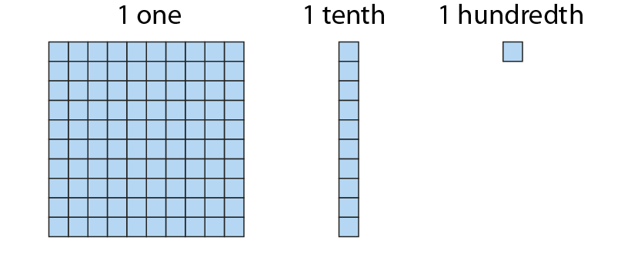
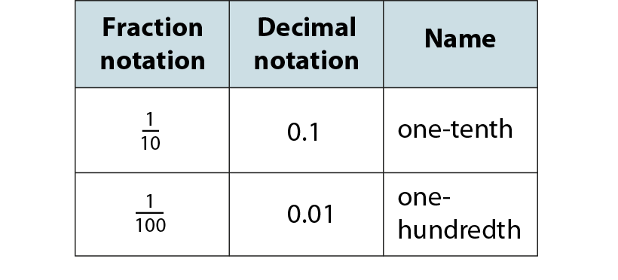
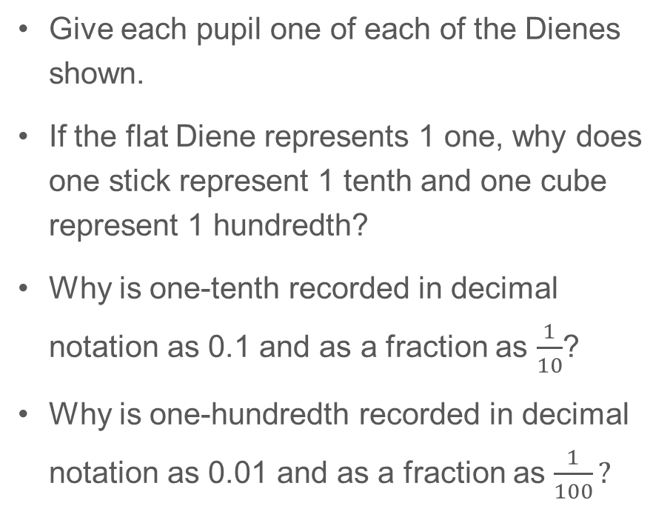
5F-3 Recall decimal equivalents for common fractions
Give each pupil one of each of the Dienes shown.
If the flat Diene represents 1 one, why does one stick represent 1 tenth and one cube represent 1 hundredth?
Why is one-tenth recorded in decimal notation as 0.1 and as a fraction as $\frac{1}{10}$?
Why is one-hundredth recorded in decimal notation as 0.01 and as a fraction as $\frac{1}{100}?$

Slide 11
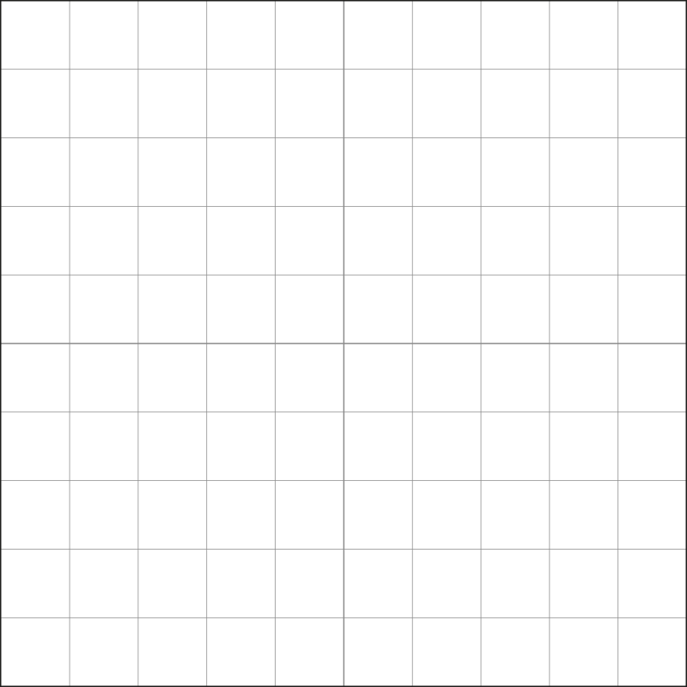
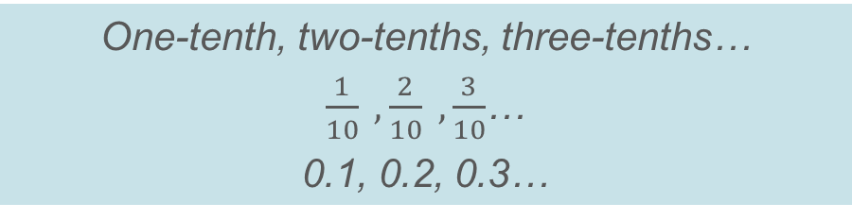
5F-3 Recall decimal equivalents for common fractions
Allow children to use Dienes to represent each image shown to identify the fraction of the hundred grid that is shaded.
Skip count in tenths as a new part is added each time using the fraction name, fractional notation and decimal notation.
One-tenth, two-tenths, three-tenths…
$\frac{1}{10} ,\frac{2}{10} ,\frac{3}{10}$…
0.1, 0.2, 0.3…

Slide 12
5F-3 Recall decimal equivalents for common fractions
Allow children to use Dienes to represent each image shown.
How many equal parts has the hundred grid been divided into?
What fraction of the whole does each part represent?
How many hundredths are found within each shaded part?
What decimal notation can be used to describe each shaded part?

Slide 13
5F-3 Recall decimal equivalents for common fractions
Allow children to use Dienes to represent each image shown.
How many equal parts has the hundred grid been divided into?
What fraction of the whole does each part represent?
How many hundredths are found within each shaded part?
What decimal notation can be used to describe each shaded part?

Slide 14
5F-3 Recall decimal equivalents for common fractions
Allow children to use Dienes to represent each image shown.
How many equal parts has the hundred grid been divided into?
What fraction of the whole does each part represent?
How many hundredths are found within each shaded part?
What decimal notation can be used to describe each shaded part?

Slide 15
5F-3 Recall decimal equivalents for common fractions
Unit fraction
Decimal fraction
True or false? 0.5, 0.2 and 0.1 could also be written as 0.50, 0.20 and 0.10
How do you know each unit and decimal fraction are equivalent to each other? The Dienes could be used to help children’s explanations.
1
0.5
2
1
0.25
4
1
0.2
5
1
I know __ and __ are equivalent because if the hundred grid is split into __ equal parts there would be __ hundredths in each part.
0.1
10

Slide 16
5F-3 Recall decimal equivalents for common fractions
10
2
4
5
5
10
2
1
1
1
4
1
1
1
10
1
1
2
4
5
5
10
2
4
Count up and back along each vertical number line in decimal and fractional notation.
Why are different fractions shown on the different number lines? What is the link between the denominator of each fraction and the number of intervals on each number line?
0.9
9
0.9
9
10
10
8
0.8
4
0.8
4
8
0.8
10
0.8
3
5
5
10
0.75
0.75
3
4
4
0.7
7
0.7
7
10
10
0, 0.5, 1 1, 0.5, 0
Zero, one-half, two-halves.
Two-halves, one-half, zero.
6
0.6
3
3
6
0.6
10
0.6
0.6
5
5
10
1
2
1
2
0.5
0.5
0.5
5
5
0.5
2
0.5
0.5
4
2
4
10
10
4
0.4
2
2
4
0.4
10
0.4
0.4
5
5
10
0.3
3
0.3
3
1
10
10
0.25
0.25
1
4
4
2
0.2
1
1
2
0.2
10
0.2
0.2
5
5
10
0.1
1
0.1
1
10
10
0
0
0
0
0
0
0
0
0
0
0
0
0
0
0
0

Slide 17
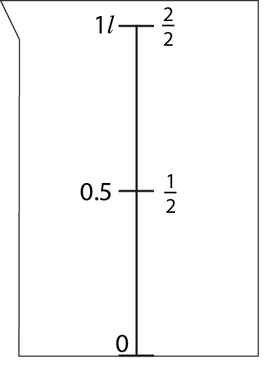
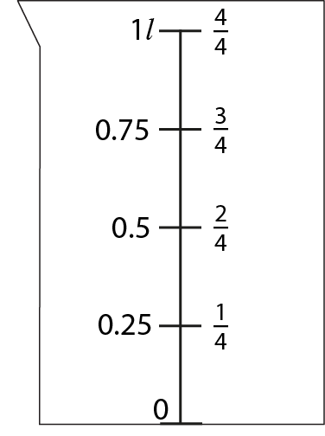
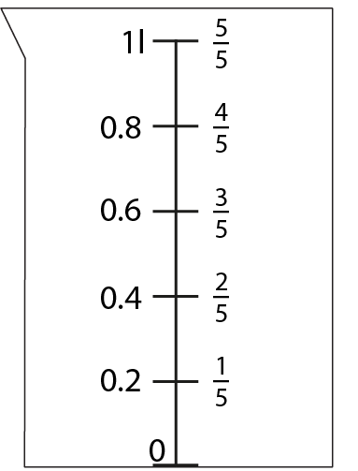
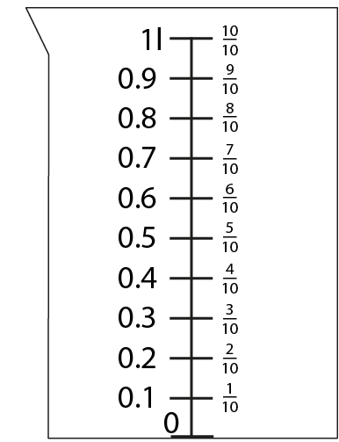
5F-3 Recall decimal equivalents for common fractions
How many parts has each container been split into between 0 and 1 litre?
Complete the missing fractional notations using the decimal notations to help you.
Complete the missing decimal notations using the fractional notations to help you.
Count forwards and backwards on each number line in fractional and decimal notations.

Slide 18
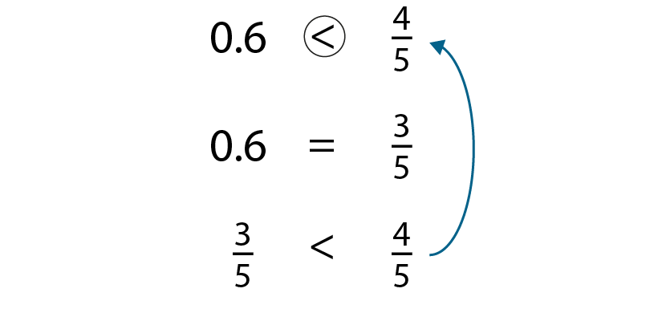
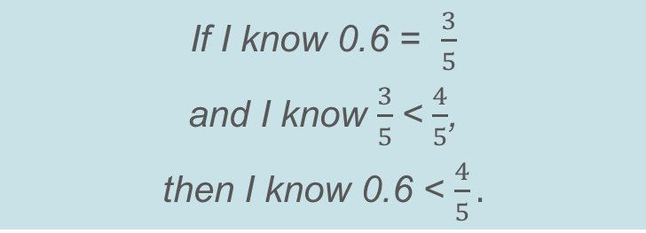
5F-3 Recall decimal equivalents for common fractions
Should the expression given be completed with <, > or =?
How does the given equality help us to complete the original expression?
If I know 0.6 = $\frac{3}{5}$
and I know $\frac{3}{5}$< $\frac{4}{5}$,
then I know 0.6 < $\frac{4}{5}.$

Slide 19
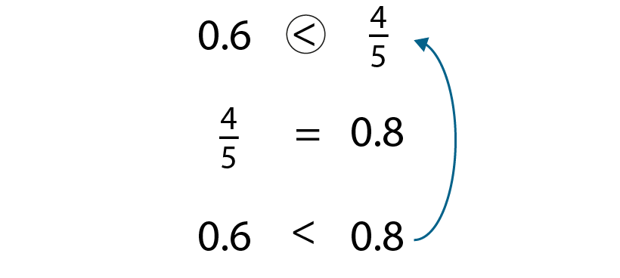
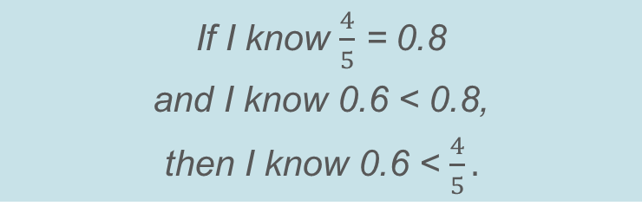
5F-3 Recall decimal equivalents for common fractions
Should the expression given be completed with <, > or =?
How does the given equality help us to complete the original expression?
If I know $\frac{4}{5}$ = 0.8
and I know 0.6 < 0.8,
then I know 0.6 < $\frac{4}{5}.$

Slide 20
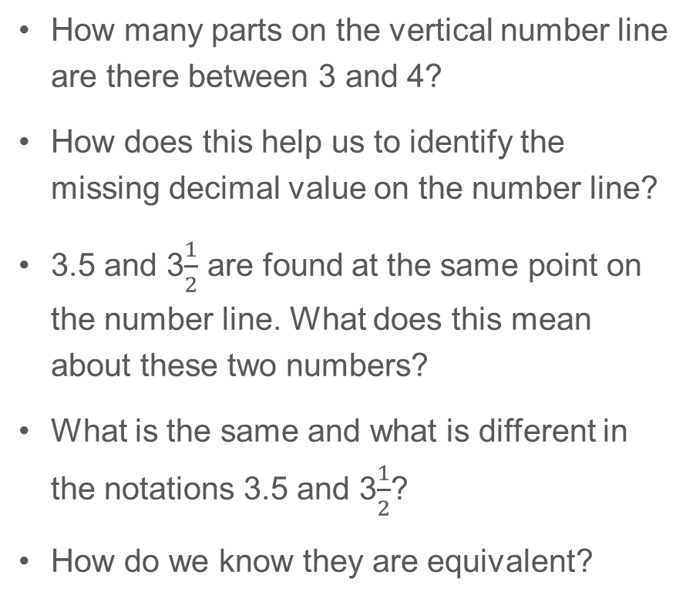
5F-3 Recall decimal equivalents for common fractions
4
4
How many parts on the vertical number line are there between 3 and 4?
How does this help us to identify the missing decimal value on the number line?
3.5 and 3$\frac{1}{2}$ are found at the same point on the number line. What does this mean about these two numbers?
What is the same and what is different in the notations 3.5 and 3$\frac{1}{2}$?
How do we know they are equivalent?
1
3.5
3
2
3

Slide 21
5F-3 Recall decimal equivalents for common fractions
10
10
How many parts on the vertical number line are there between 9 and 10?
How does this help us to identify the missing decimal values on the number line?
Identify the decimal and fractional notations that are equivalent to each other. How do you know these numbers are equivalent?
3
9.75
9
4
2
9.5
9
4
1
9.25
9
4
9
9

Slide 22
5F-3 Recall decimal equivalents for common fractions
7
7
How many parts in the vertical number line are there between 6 and 7?
How does this help us to identify the missing decimal values on the number line?
Identify the decimal and fractional notations that are equivalent to each other. How do you know these numbers are equivalent?
4
6.8
6
5
3
6.6
6
5
2
6.4
6
5
1
6.2
6
5
6
6

Slide 23
5F-3 Recall decimal equivalents for common fractions
2
2
How many parts in the vertical number line are there between 1 and 2?
How does this help us to identify the missing decimal values on the number line?
Identify the decimal and fractional notations that are equivalent to each other. How do you know these numbers are equivalent?
9
1.9
1
10
8
1.8
1
10
7
1.7
1
10
6
1.6
1
10
5
1.5
1
10
4
1.4
1
10
3
1.3
1
10
2
1.2
1
10
1.1
1
1
10
1
1

Slide 24
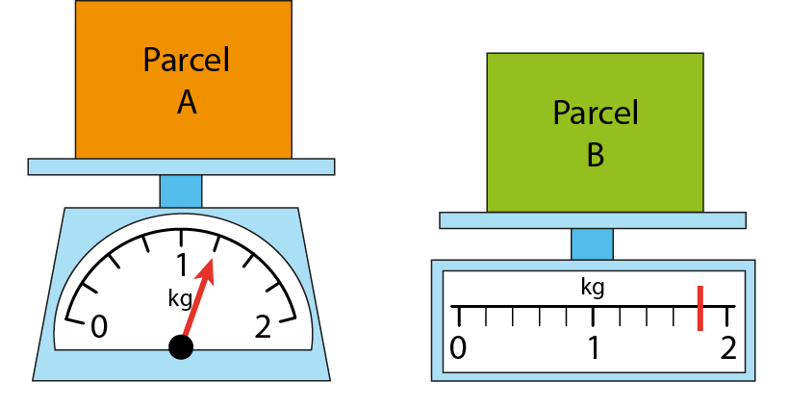
5F-3 Recall decimal equivalents for common fractions
What is different about the two scales shown?
How many intervals are there between zero and one for each scale? So, what interval do we need to count up in for each scale?
Do we need to start at zero on each scale when we count up? Why/why not?
What is the mass of Parcel A and Parcel B? Give your answers in fractional and decimal notations.
Which parcel is heavier? How do you know?

Slide 25
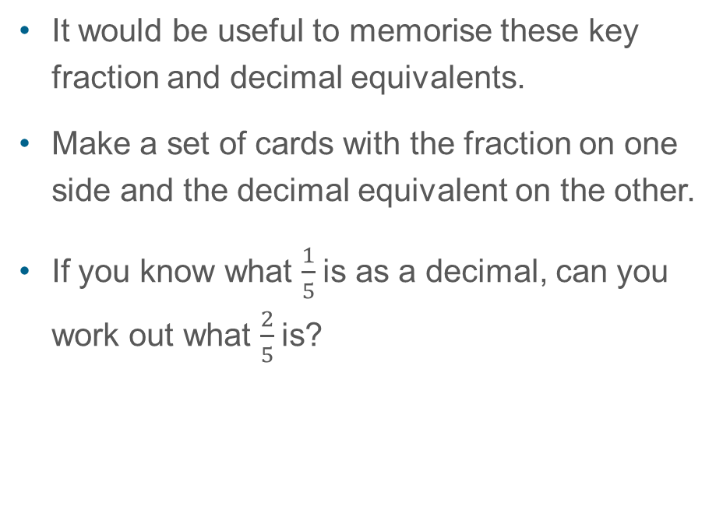
5F-3 Recall decimal equivalents for common fractions
Unit fraction
Decimal fraction
It would be useful to memorise these key fraction and decimal equivalents.
Make a set of cards with the fraction on one side and the decimal equivalent on the other.
If you know what $\frac{1}{5}$is as a decimal, can you work out what $\frac{2}{5}$is?
1
0.5
2
1
0.25
4
1
0.2
5
1
0.1
$\frac{1}{5 }$is equivalent to 0.2,so $\frac{2}{5}$ is equivalent to 0.4
10

