Slide 1
5F-2
Find equivalent fractions

Slide 2
5F-2
Find equivalent fractions and understand that they have the same value and the same position in the linear number system.
The materials in this pack have been collated and written to support the teaching of 5F-2. Before planning and teaching the content, read the teaching guidance and example assessment questions in the non-statutory guidance itself, which can be found here.
A video summarising all of the ready-to-progress criteria for Year 5 can be found here.

Slide 3
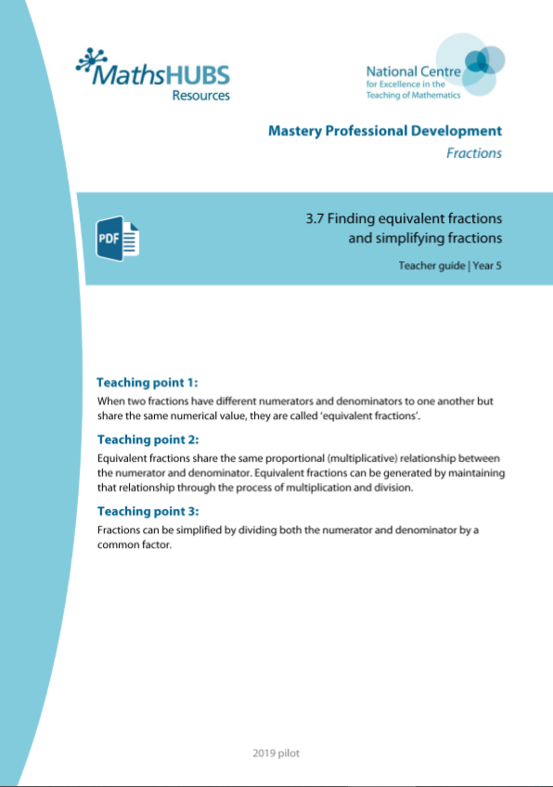
5F-2: Linked mastery PD materials
Additional pedagogical subject knowledge support can be found in the Mastery Professional Development Materials:
3.7 Finding equivalent fractions and simplifying fractions
Several of the activity slides have been taken from these materials.

Slide 4
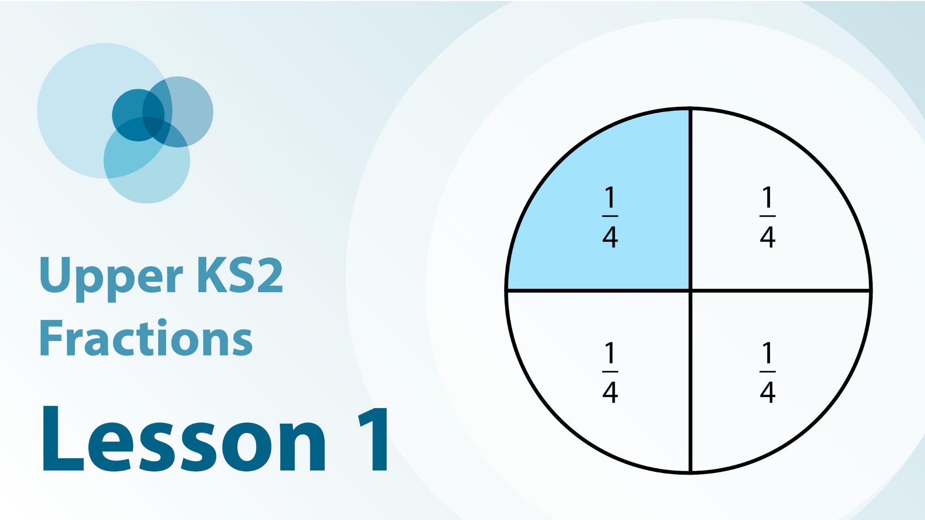

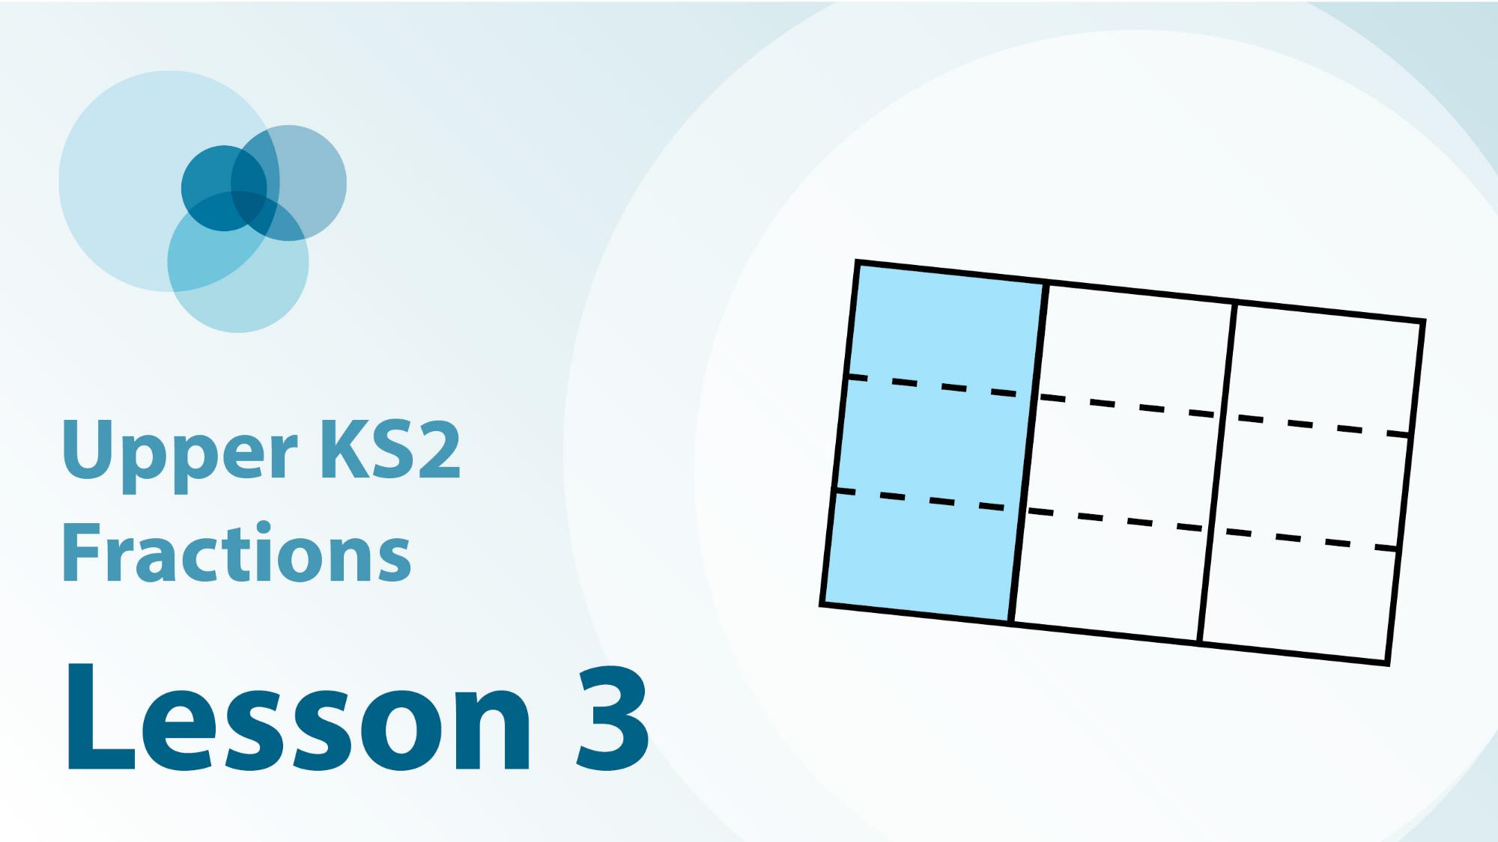
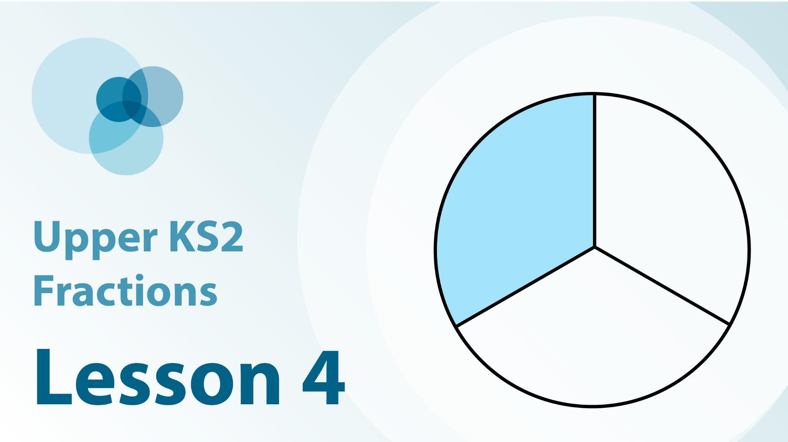
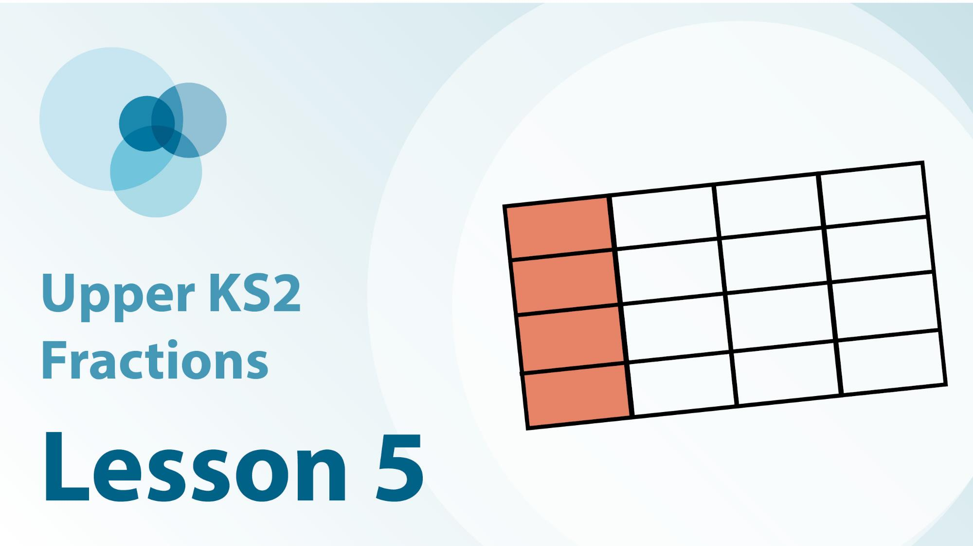
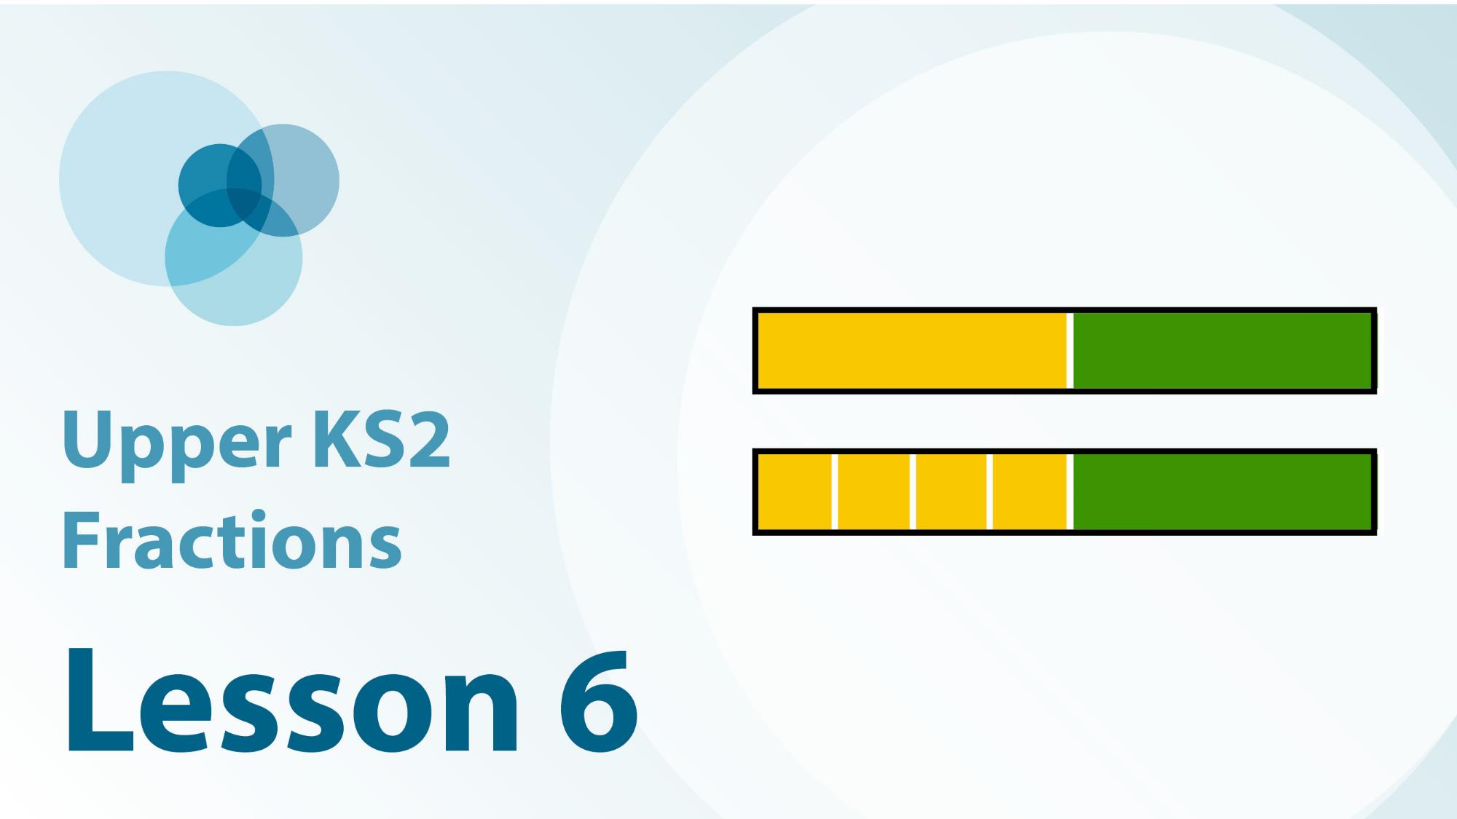
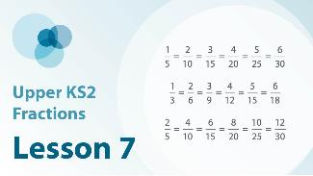
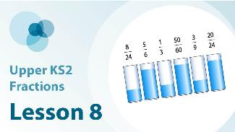
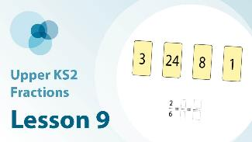
5F-2 Linked video lessons
Upper Key Stage 2 fractions
Develop understanding of equivalent fractions through quantity, area and number line models
Develop understanding of equivalent fractions through measuring and pouring context
Use the relationship between the numerator and denominator to identify equivalent fractions
Scale the numerator and denominator by the same factor to produce equivalent fractions
Practise seeing both vertical and horizontal relationships in the context of equivalent fractions
Introduction to equivalent fractions for non-unit fractions
Explore the relationship between numerators and denominators including non-unit fractions
Practise using both vertical and horizontal relationships in fractions to find missing numbers
Further practice using examples for children to deepen and consolidate learning

Slide 5
5F-2
Find equivalent fractions

Slide 6
The following slides contain activities that can be used within the context of pre-teaching, intervention, or as supplementary material integrated into teaching. They do not represent complete lessons and should not be used as such. Also they should not be used all at once, but over the period of a teaching unit. It would be valuable to use many of the activities more than once to build fluency in understanding and application. Also many of them would benefit from the use of manipulatives to support interaction with the ideas. Ensure you engage in rich discussion with the children, asking them to reason and explain the ideas presented. Note that when working with a small group, pupils should also have access to the main teaching delivered by the class teacher and the focus should be directly linked so that the learning is connected and fluency is built.

Slide 7
Guidance for working with a small pre-teaching or intervention group
Take time to build understanding of the key idea. We would recommend no more than four slides in any one session, and probably fewer.
In subsequent sessions, review and practise previous learning before moving on.
Play the animation/observe the image and ask pupils “What do you notice?”.
Encourage pupils to explain what they see, what is happening and why.
Where there is a highlighted sentence, draw out the meaning of this from the image and repeat together and individually.

Slide 8
Guidance for working with a small pre-teaching or intervention group
Engage in the suggested activities, using manipulatives where appropriate, to enhance the interaction and stimulate discussion. However, note that the ultimate aim is to develop fluency in the mathematical ideas such that resources are no longer needed.
Repeat questions, using other numbers/examples where relevant.
Repeat the highlighted language structures wherever relevant to build fluency with the key idea and connect the learning. For example:
10 hundreds are equivalent to 1,000.

Slide 9
5F-2 Find equivalent fractions

Slide 10
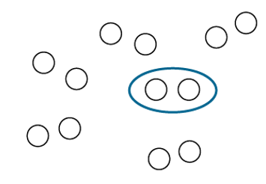
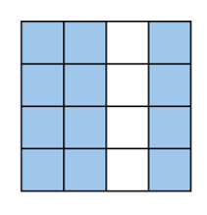
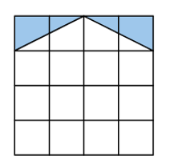
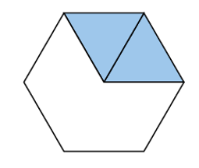
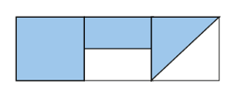

5F-2 Find equivalent fractions
Equivalent fractions can be written for each of the representations.
Can you see each of the pairs of equivalent fractions by looking at the whole in different ways?
Explain why they are equivalent fractions – why they represent the same value?

Slide 11
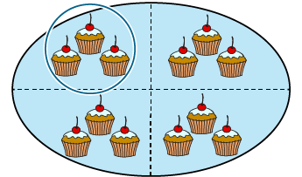
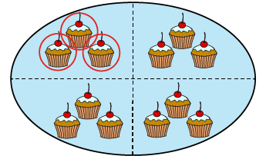
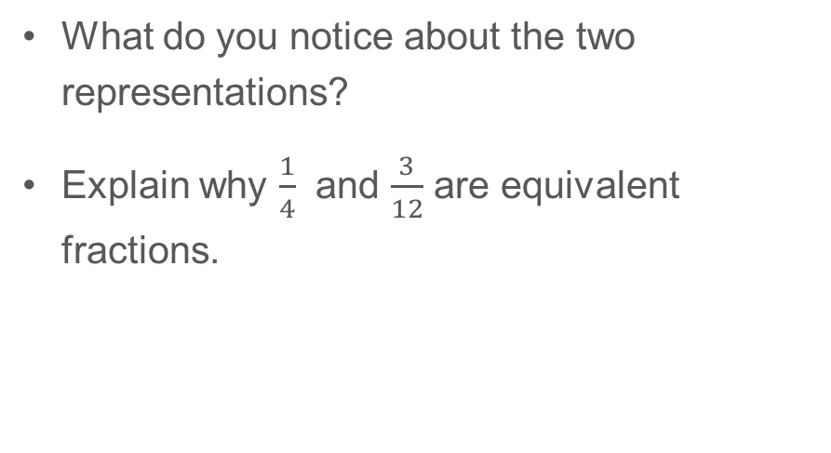
5F-2 Find equivalent fractions
What do you notice about the two representations?
Explain why $\frac{1}{4}$ and $\frac{3}{12}$ are equivalent fractions.
The whole is divided into 4 equal parts and 1 of those parts is circled.
The whole is divided into 12 equal parts and 3 of those parts are circled.
1
3
4
12

Slide 12
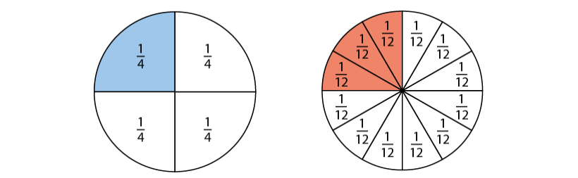
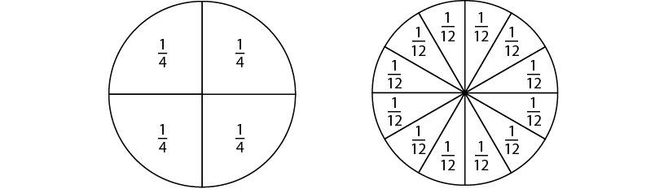

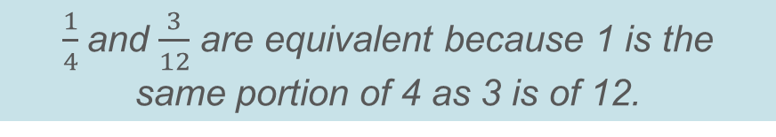
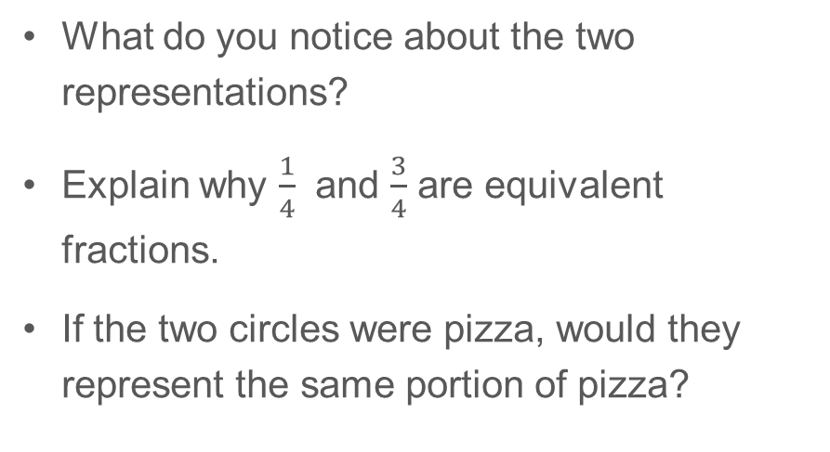
5F-2 Find equivalent fractions
What do you notice about the two representations?
Explain why $\frac{1}{4}$ and $\frac{3}{4}$ are equivalent fractions.
If the two circles were pizza, would they represent the same portion of pizza?
The whole is divided into 4 equal parts and 1 of those parts is shaded.
The whole is divided into 12 equal parts and 3 of those parts are shaded.
$\frac{1}{4}$and $\frac{3}{12}$ are equivalent because 1 is the same portion of 4 as 3 is of 12.

Slide 13
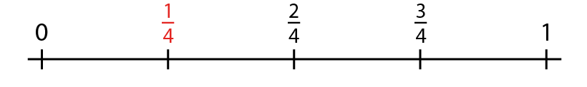
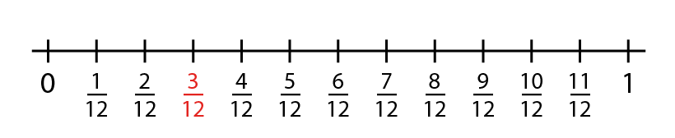

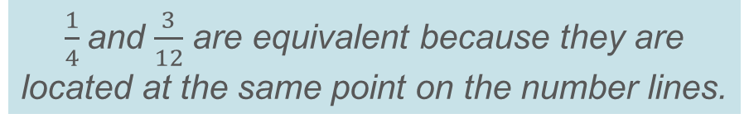
5F-2 Find equivalent fractions
What do you notice about where 0 and 1 are located on both number lines?
What is the same about both fractions shown in red on the number lines?
Why are the two fractions located at the same point on the number lines?
Identify other equivalent fractions on the number lines. Explain how you know that they are equivalent.
$\frac{1}{4}$and $\frac{3}{12}$ are equivalent because they are located at the same point on the number lines.

Slide 14

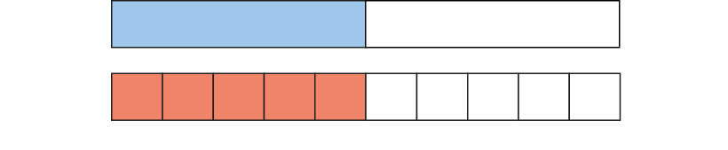
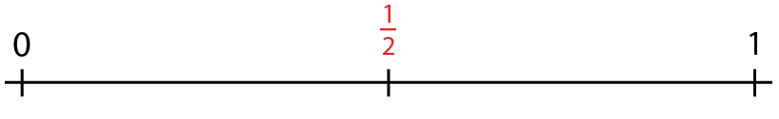
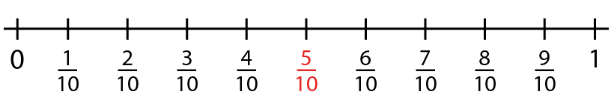
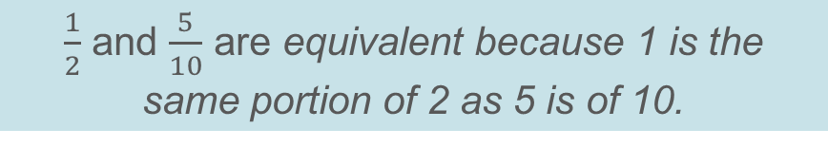
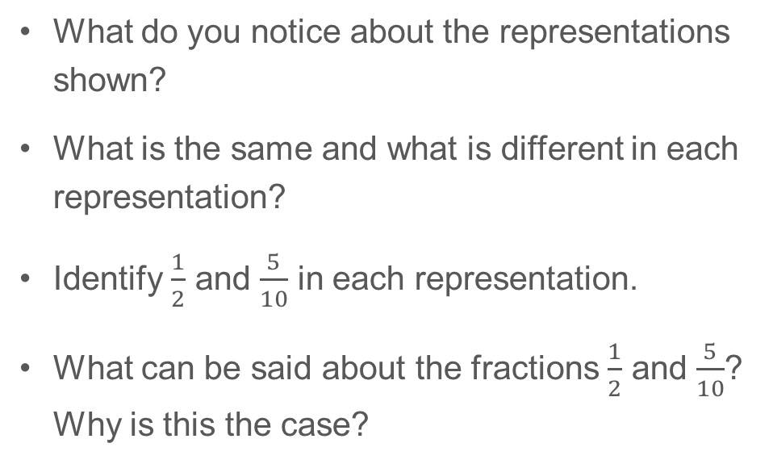
5F-2 Find equivalent fractions
What do you notice about the representations shown?
What is the same and what is different in each representation?
Identify $\frac{1}{2}$ and $\frac{5}{10}$ in each representation.
What can be said about the fractions $\frac{1}{2}$ and $\frac{5}{10}$? Why is this the case?
$\frac{1}{2}$ and $\frac{5}{10}$ are equivalent because 1 is the same portion of 2 as 5 is of 10.

Slide 15
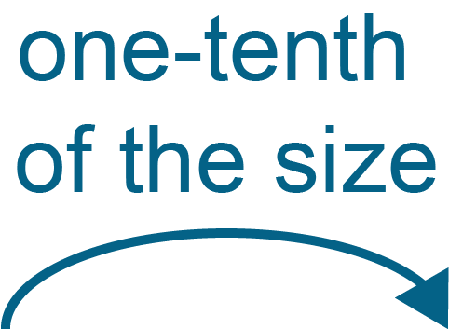
5F-2 Find equivalent fractions
× 3
× 5
What do you notice about the vertical relationship between the numerator and denominator of each fraction?
What do you notice about the horizontal relationship between the numerators and denominators of both fractions?
1
1
3
5
=
× 4
=
× 2
× 4
× 2
4
2
12
10
× 3
× 5

Slide 16
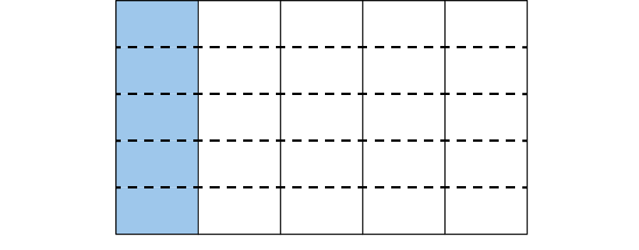
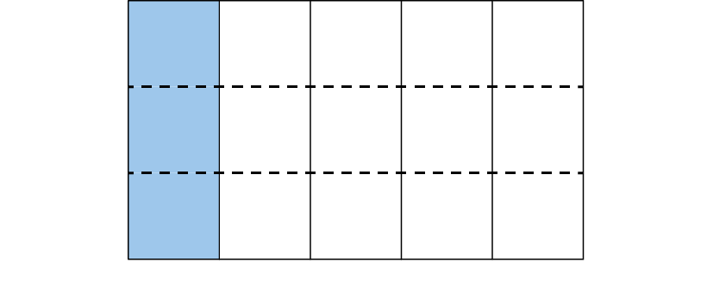

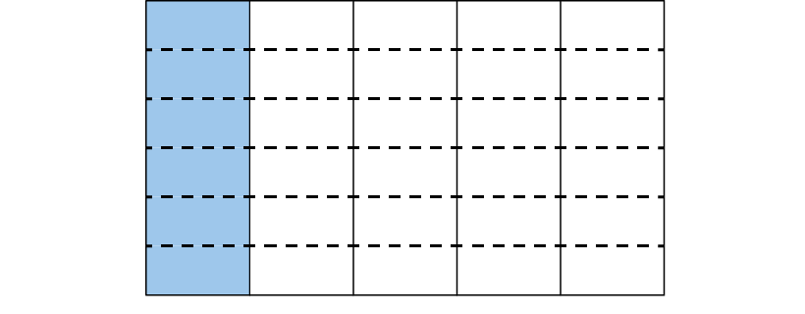
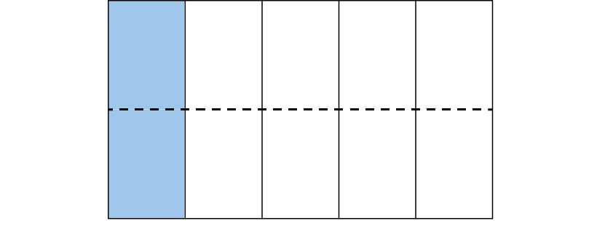
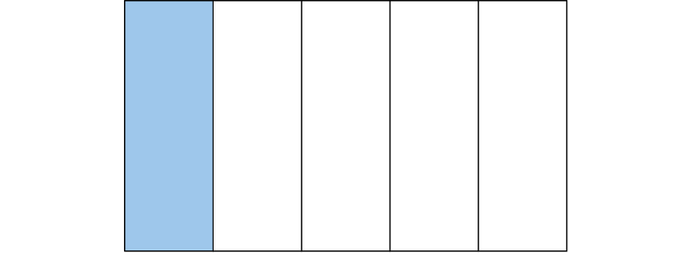

5F-2 Find equivalent fractions
How many equal parts make the whole? How many of these parts are blue? What fraction of the whole is shaded?
How can we describe the fraction of the whole that is shaded if we change the number of parts that are found in the same- sized whole?
Keep your attention on the blue part ($\frac{1}{5}).$For each change in the number of parts can you still see $\frac{1}{5}$?
What can be said about all of the fractions that have been identified?

Slide 17
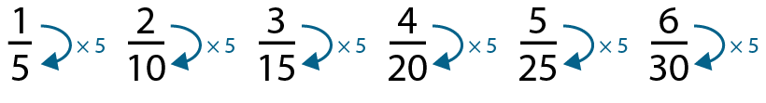
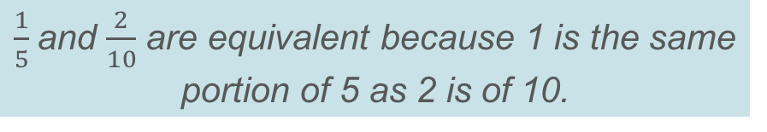
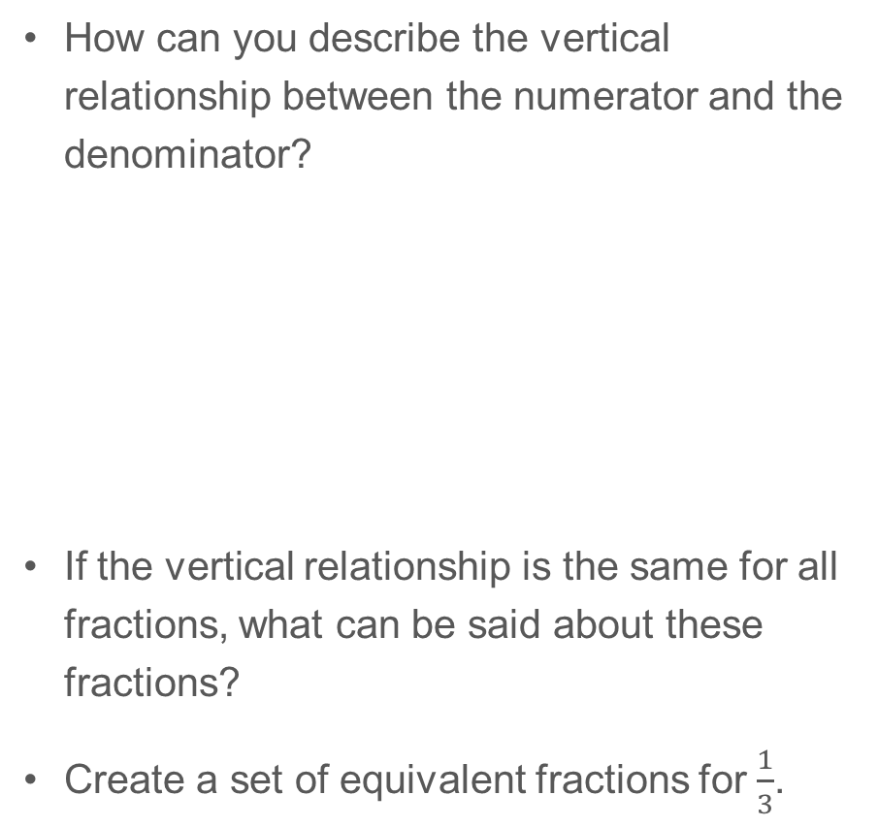

5F-2 Find equivalent fractions
How can you describe the vertical relationship between the numerator and the denominator?
If the vertical relationship is the same for all fractions, what can be said about these fractions?
Create a set of equivalent fractions for $\frac{1}{3}$.
The denominator is five times larger than the numerator.
$\frac{1}{5}$and $\frac{2}{10}$ are equivalent because 1 is the same portion of 5 as 2 is of 10.
1 is $\frac{1}{5}$of 5 and 2 is $\frac{1}{5}$of 10 so both represent $\frac{1}{5}$.

Slide 18
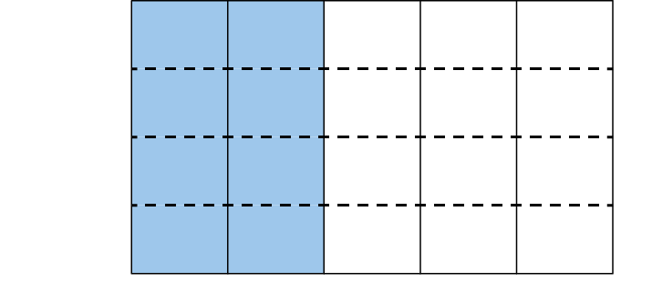
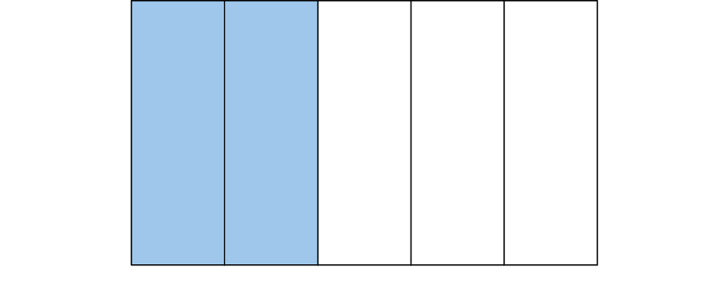
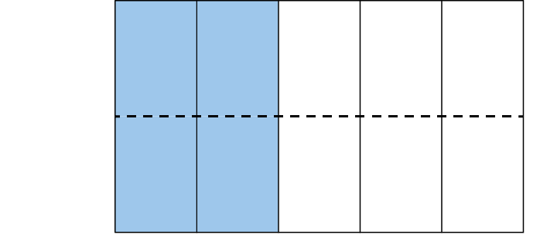
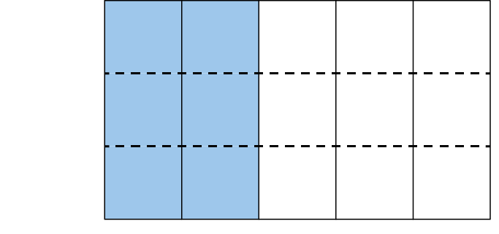
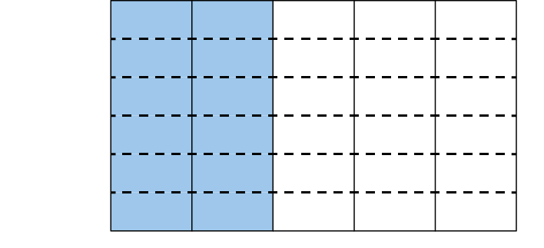
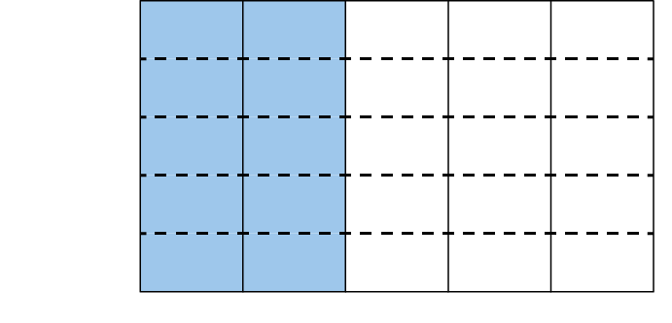
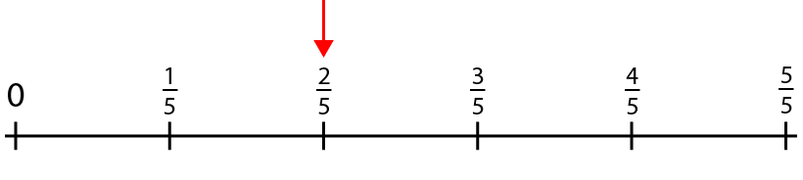

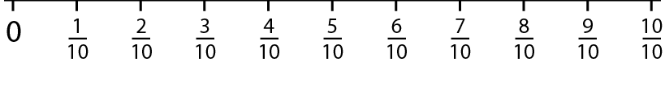

5F-2 Find equivalent fractions
What fraction of the whole is shaded?
Where would this fraction be located on a number line?
Identify the fraction and its location on the number line when the same-sized whole is split into a different number of parts.

Slide 19
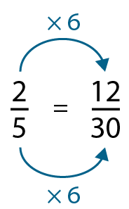
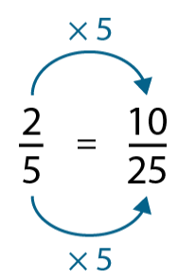
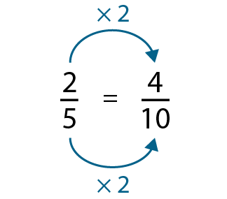



5F-2 Find equivalent fractions
Describe the horizontal relationship between the numerators and denominators to help explain how we know the following fractions are equivalent.
How do we know that these fractions are equivalent? Describe the vertical and horizontal relationships within your explanation.
Create a set of equivalent fractions for $\frac{2}{3}$.
The numerator and denominator of the second fraction are both __ times greater than the first fraction. This means that the fractions are equivalent.

Slide 20






5F-2 Find equivalent fractions
Which of these fractions are equivalent? How do you know?
Does each representation of water in the glass match each fraction? How do you know?
How does each representation help to show which fractions are equivalent to each other?

Slide 21













5F-2 Find equivalent fractions
Practise identifying equivalent fractions to build fluency.
$$\frac{1}{4}$$
$$\frac{1}{2}$$
$$\frac{50}{60}$$
$$\frac{1}{2}$$
$$\frac{1}{2}$$
$$\frac{2}{10}$$
$$\frac{4}{8}$$
$$\frac{25}{100}$$
$$\frac{9}{10}$$
$$\frac{5}{6}$$
$$\frac{5}{10}$$
$$\frac{4}{20}$$
✓
✓
✓
✓

