Slide 1
4NPV- 4
Reading scales with 2, 4, 5 or 10 intervals

Slide 2
4NPV-4
Divide 1,000 into 2, 4, 5 and 10 equal parts, and read scales/number lines marked in multiples of 1,000 with 2, 4, 5 and 10 equal parts.
The materials in this pack have been collated and written to support the teaching of 4NPV-4. Before planning and teaching the content in 4NPV-4, read the teaching guidance and example assessment questions in the non-statutory guidance itself, which can be found here.
A video summarising all of the ready-to-progress criteria for Year 4 can be found here.

Slide 3
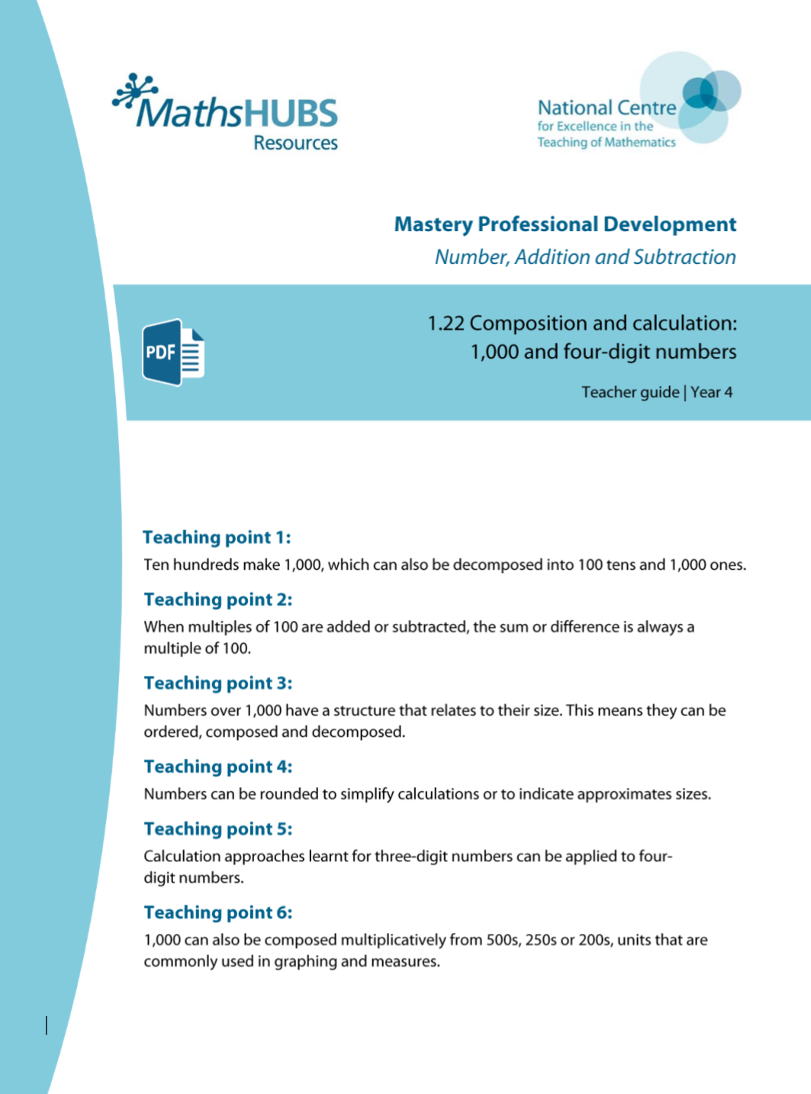
4NPV-4: Linked mastery PD materials
Additional pedagogical subject knowledge support can be found in the Mastery Professional Development Materials:
1.22 Composition and calculation: 1,000 and four-digit numbers
Several of the activity slides have been taken from these materials.

Slide 4
4NPV- 4
Reading scales with 2, 4, 5 or 10 intervals

Slide 5
The following slides contain activities that can be used within the context of pre-teaching, intervention, or as supplementary material integrated into teaching. They do not represent complete lessons and should not be used as such. Also they should not be used all at once, but over the period of a teaching unit. It would be valuable to use many of the activities more than once to build fluency in understanding and application. Also many of them would benefit from the use of manipulatives to support interaction with the ideas. Ensure you engage in rich discussion with the children, asking them to reason and explain the ideas presented. Note that when working with a small group, pupils should also have access to the main teaching delivered by the class teacher and the focus should be directly linked so that the learning is connected and fluency is built.

Slide 6
Guidance for working with a small pre-teaching or intervention group
Take time to build understanding of the key idea. We would recommend no more than four slides in any one session, and probably fewer.
In subsequent sessions, review and practise previous learning before moving on.
Play the animation/observe the image and ask pupils “What do you notice?”.
Encourage pupils to explain what they see, what is happening and why.
Where there is a highlighted sentence, draw out the meaning of this from the image and repeat together and individually.

Slide 7
Guidance for working with a small pre-teaching or intervention group
Engage in the suggested activities, using manipulatives where appropriate, to enhance the interaction and stimulate discussion. However, note that the ultimate aim is to develop fluency in the mathematical ideas such that resources are no longer needed.
Repeat questions, using other numbers/examples where relevant.
Repeat the highlighted language structures wherever relevant to build fluency with the key idea and connect the learning. For example:
10 hundreds are equivalent to 1,000.

Slide 8
4NPV-4 Reading scales with 2, 4, 5 or 10 intervals

Slide 9
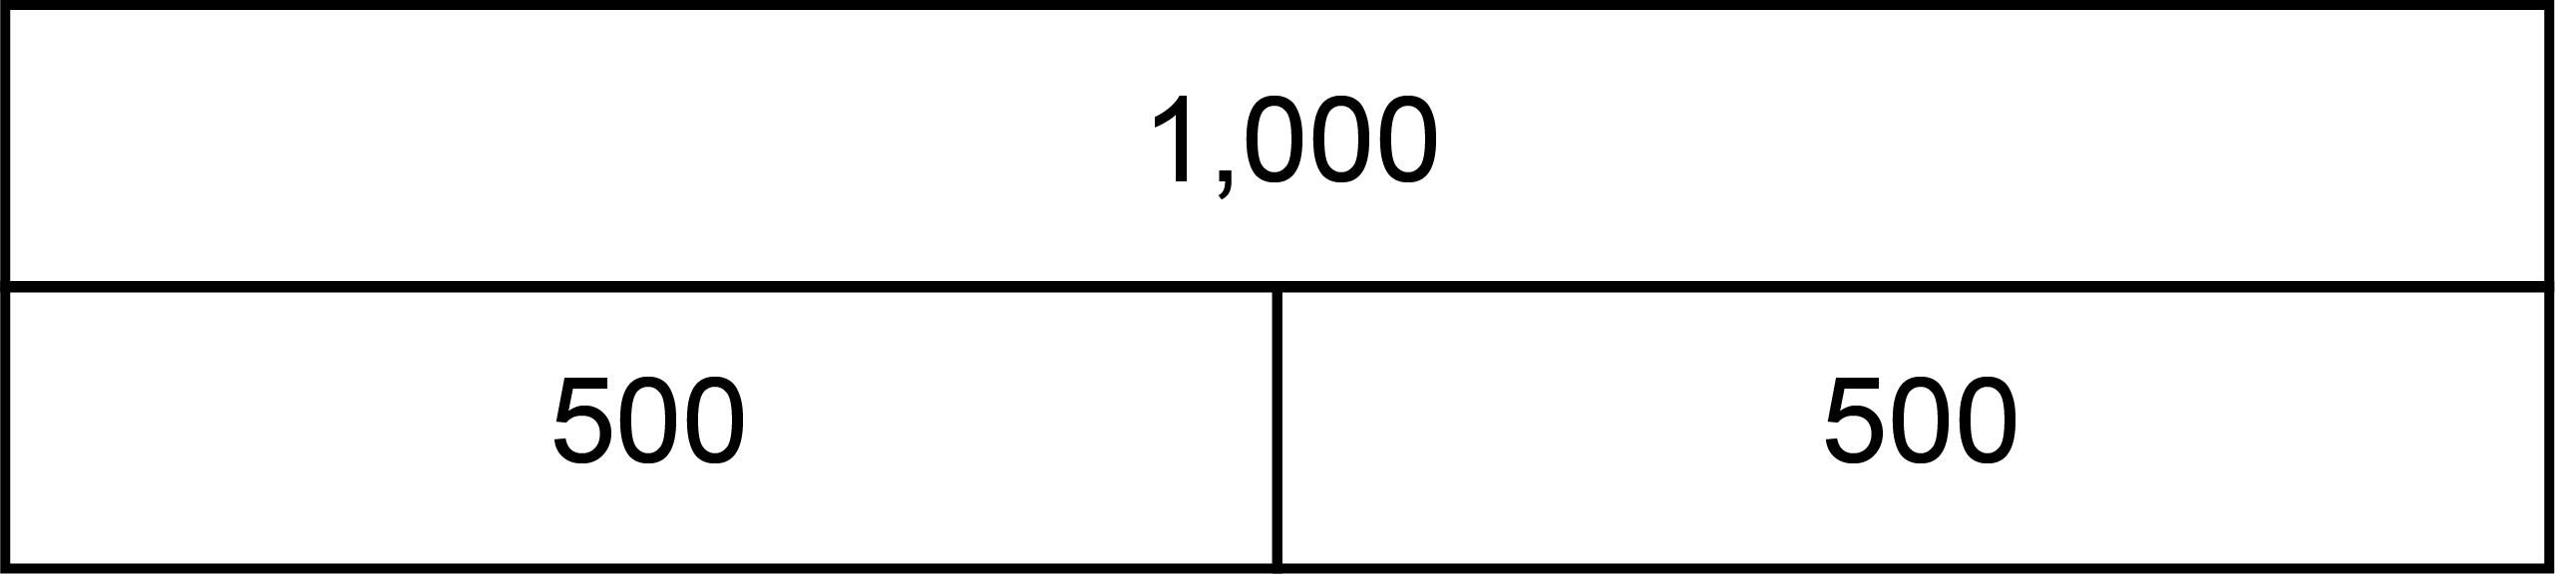
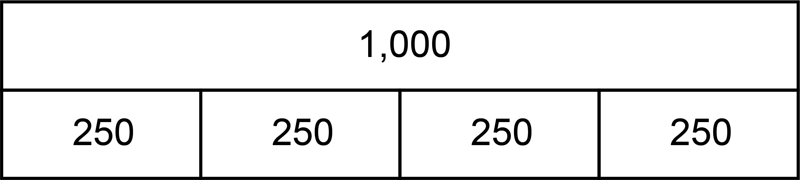
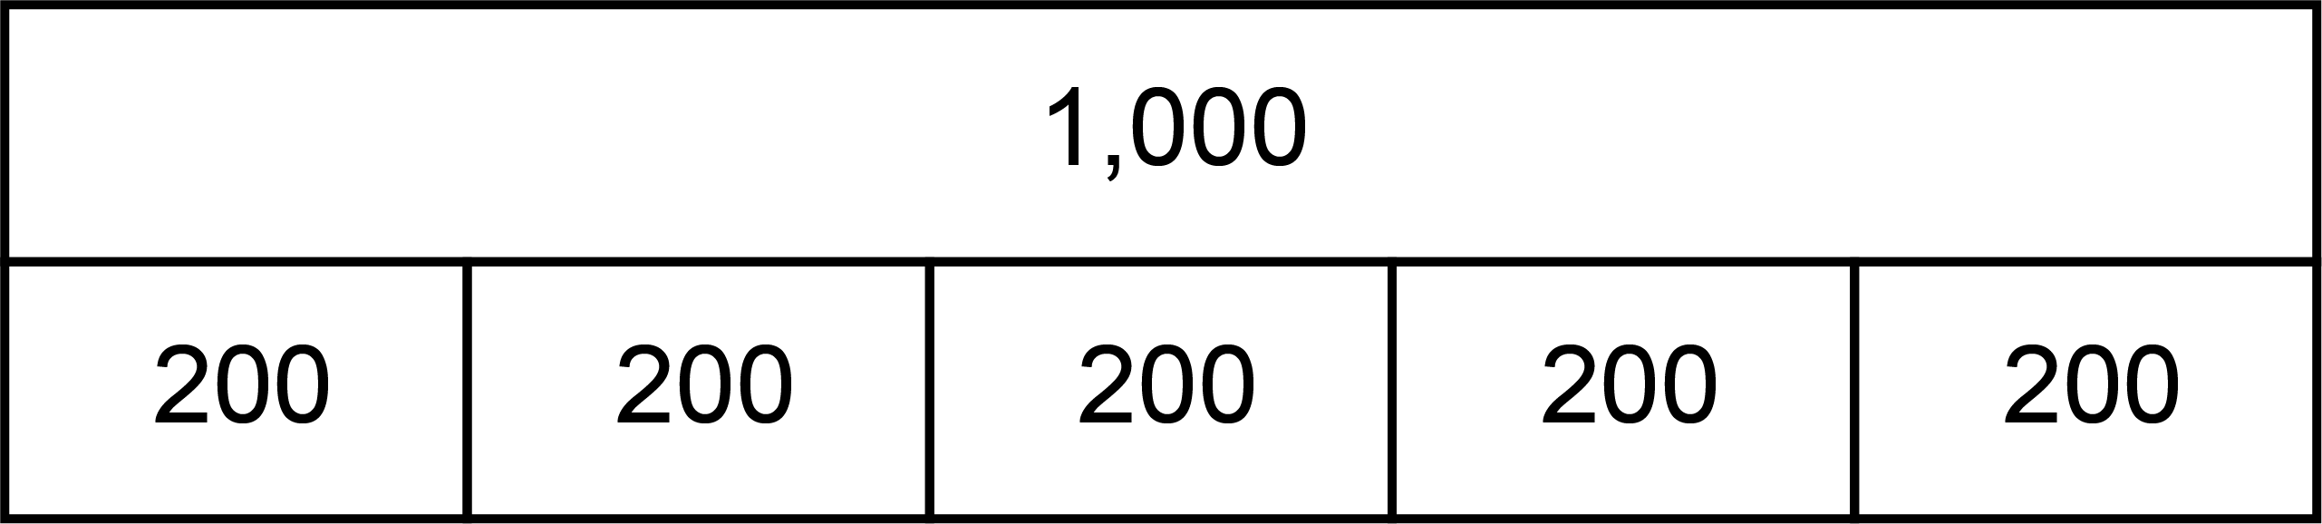
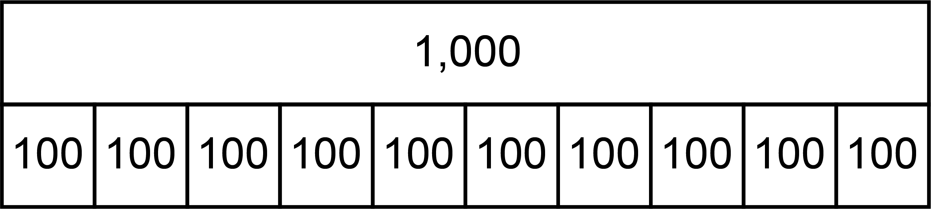
4NPV-4 Reading scales with 2, 4, 5 or 10 intervals
2, 4, 5 and 10 part composition of 1,000
If we divide the thousand into 2 equal parts, what is the value of each part?
What if we divide the thousand into 4 equal parts?
5 equal parts?
10 equal parts?
2 part
4 part
5 part
10 part
v
v
v
v
v
v
v
v
v
v

Slide 10
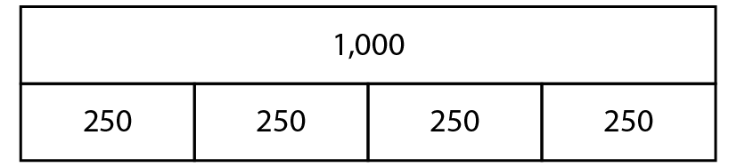
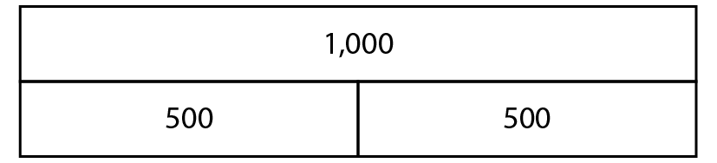
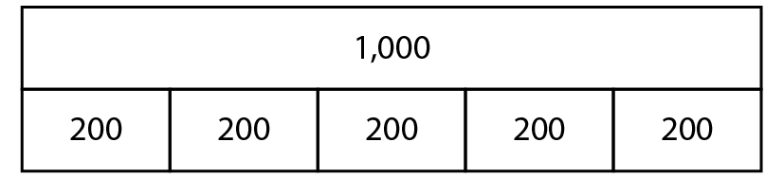
4NPV-4 Reading scales with 2, 4, 5 or 10 intervals
What kind of representation have we used this time? How many parts are there? What do you think we need to count in? How do you know?
Let’s count…
Why don’t we say ten hundred?
Reveal the next bar model. What do we need to count in this time? How can you tell?
v
v
v
v
v
v
v
v
v
v
100, 200, 300… one thousand.

Slide 11
4NPV-4 Reading scales with 2, 4, 5 or 10 intervals
1,000
1,000
1,000
1,000
Let’s count in five hundreds from zero to a thousand.
Now let’s count in steps of two hundred and fifty, two hundred, one hundred. Can you count backwards from each of these?
If I count in steps of two hundred, what comes after 400? Before 1,000?
If I count in one hundreds, what comes between 300 and 500?
900
800
800
Five hundred, one thousand.
750
700
600
600
500
500
500
400
400
300
250
200
200
100
0
0
0
0

Slide 12
4NPV-4 Reading scales with 2, 4, 5 or 10 intervals
In turn identify which number the arrow is pointing to on each number line by using the following clues.
First identify which 2 multiples of a thousand the arrow is between.
Then look at how many intervals are there on the number line and decide the size of each step.
Then count in steps from the lower number until you reach the arrow.
4,000
10,000
7,000
2,000
1,900
6,800
1,800
9,750
1,700
The arrow is between ___ thousand and ___ thousand.
6,600
1,600
3,500
9,500
1,500
6,400
1,400
1,300
9,250
6,200
1,200
1,100
3,000
9,000
6,000
1,000

Slide 13
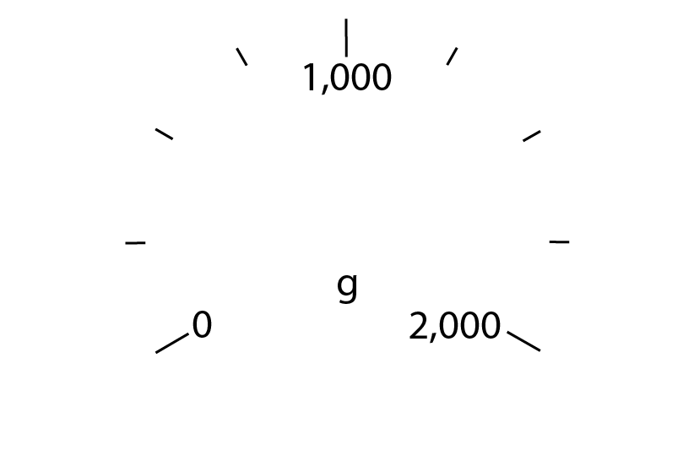

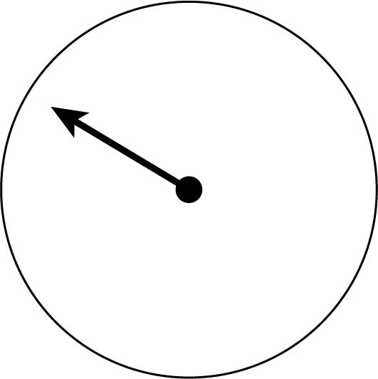
4NPV-4 Reading scales with 2, 4, 5 or 10 intervals
What is different about this representation? Where might you see this?
Where has the arrow stopped? Is it before or after 1,000? How do you know?
Could it be 300? Why not?
How many intervals are there between zero and 1,000? So, what interval do we need to count up in?
Did you get 750g? Count in steps of 250 from zero to check if you are correct.

Slide 14
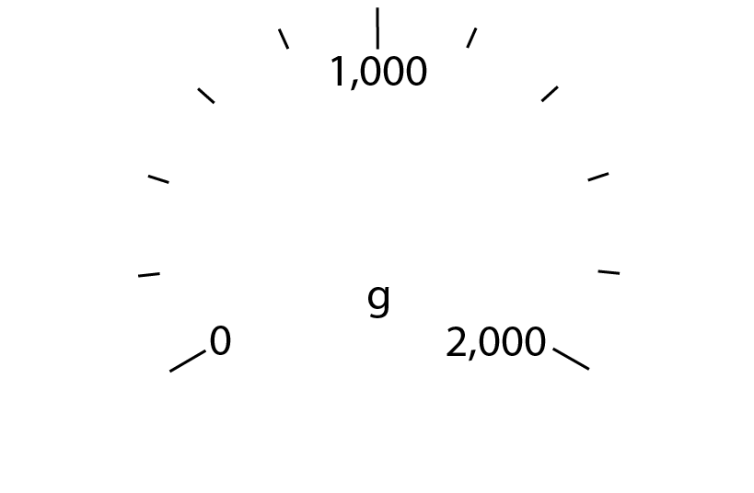

4NPV-4 Reading scales with 2, 4, 5 or 10 intervals
Where has the arrow stopped? Is it before or after 1,000? How do you know?
How many intervals are there between zero and 1,000? So what interval do we need to count in?
Could the arrow be pointing to 600? Why not?
If the answer is 1,400g, can you count in steps of 200 from zero to check if you are correct?

Slide 15
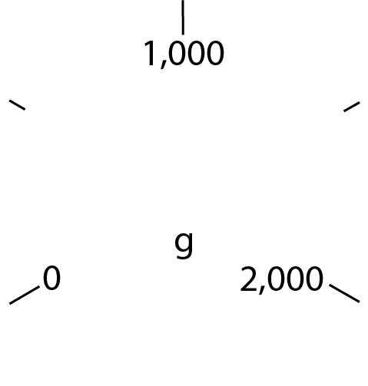

4NPV-4 Reading scales with 2, 4, 5 or 10 intervals
Where has the arrow stopped? Is it before or after 1,000? How do you know?
How many intervals are there between zero and 1,000? So what interval do we need to count in?
Could the arrow be pointing to 100? Why not?
If the answer is 500g how can you check if you are correct?

Slide 16
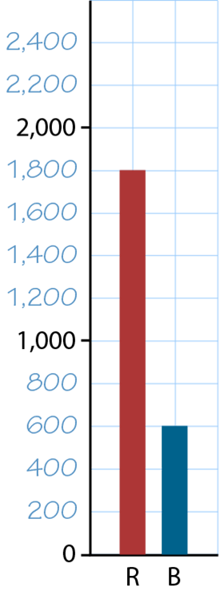
4NPV-4 Reading scales with 2, 4, 5 or 10 intervals
Where have you seen this kind of representation? What is different this time?
How do the squares help you? Could each square be worth 100? Why not?
What is the correct value of each square?
What is the value of the red bar? The blue bar?
What is the difference in value between the bars? Can you do this without having to subtract? Explain how.

Slide 17
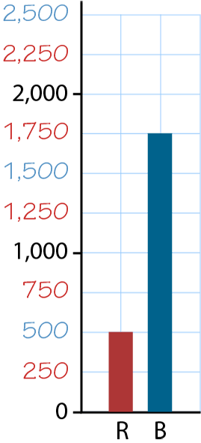
4NPV-4 Reading scales with 2, 4, 5 or 10 intervals
How do the squares help you? Could each square be worth 200? Why not?
What is the correct value of each square? How do you know?
What is the value of the red bar? The blue bar?
What is the difference in value between the bars? Can you do this without having to subtract? Explain how.

Slide 18
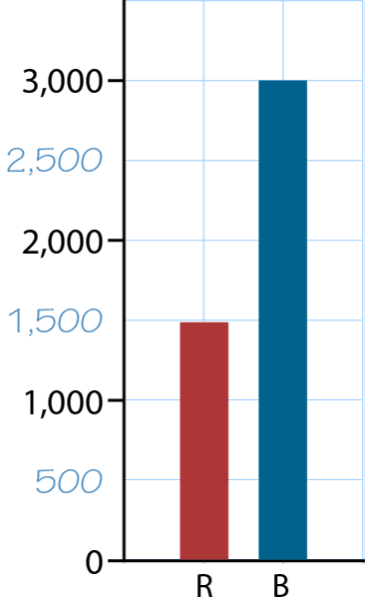

4NPV-4 Reading scales with 2, 4, 5 or 10 intervals
Could each square be worth 100? Why not?
What is the correct value of each square? How do you know?
What is the value of the red bar? The blue bar?
What is the difference in value between the bars? Explain how you know.

Slide 19
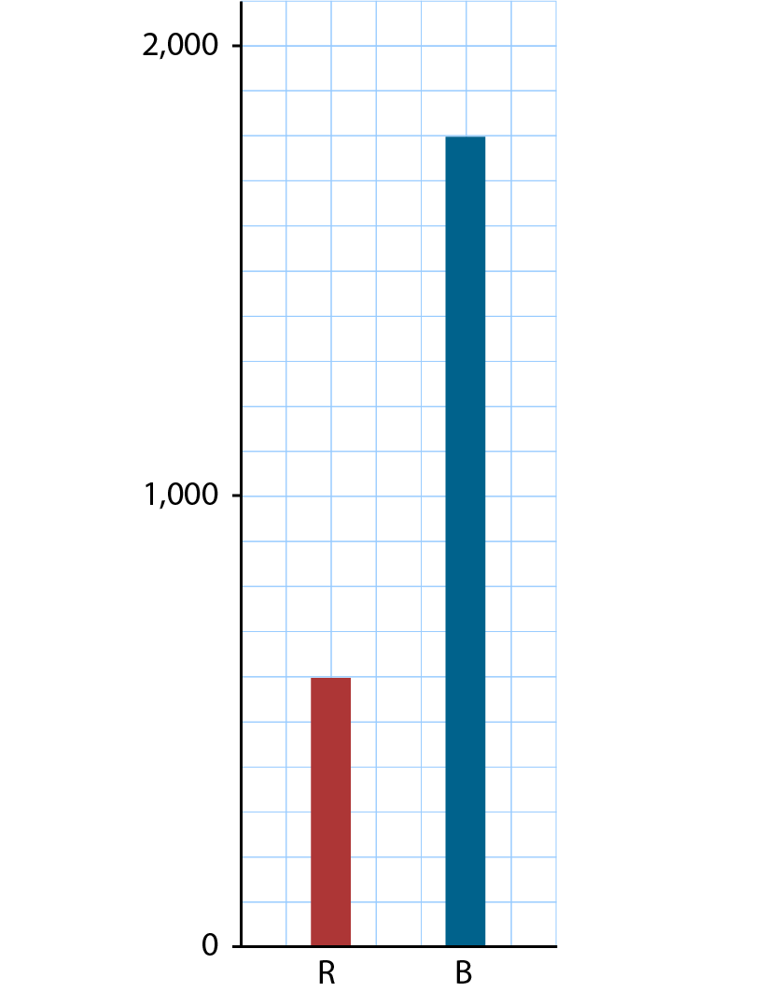
4NPV-4 Reading scales with 2, 4, 5 or 10 intervals
Could each square be worth 200? Why not?
What is the correct value of each square? How do you know?
What is the value of the red bar? The blue bar?
What is the difference in value between the bars? Explain how you know.
Can you think what this bar graph might show and write a title?

