Slide 1
4NPV-1
Equivalence of 10 hundreds and 1 thousand

Slide 2
4NPV-1
Know that 10 hundreds are equivalent to 1 thousand, and that 1,000 is 10 times the size of 100; apply this to identify and work out how many 100s there are in other four-digit multiples of 100.
The materials in this pack have been collated and written to support the teaching of 4NPV-1. Before planning and teaching the content in 4NPV-1, read the teaching guidance and example assessment questions in the non-statutory guidance itself, which can be found here.
A video summarising all of the ready-to-progress criteria for Year 4 can be found here.

Slide 3
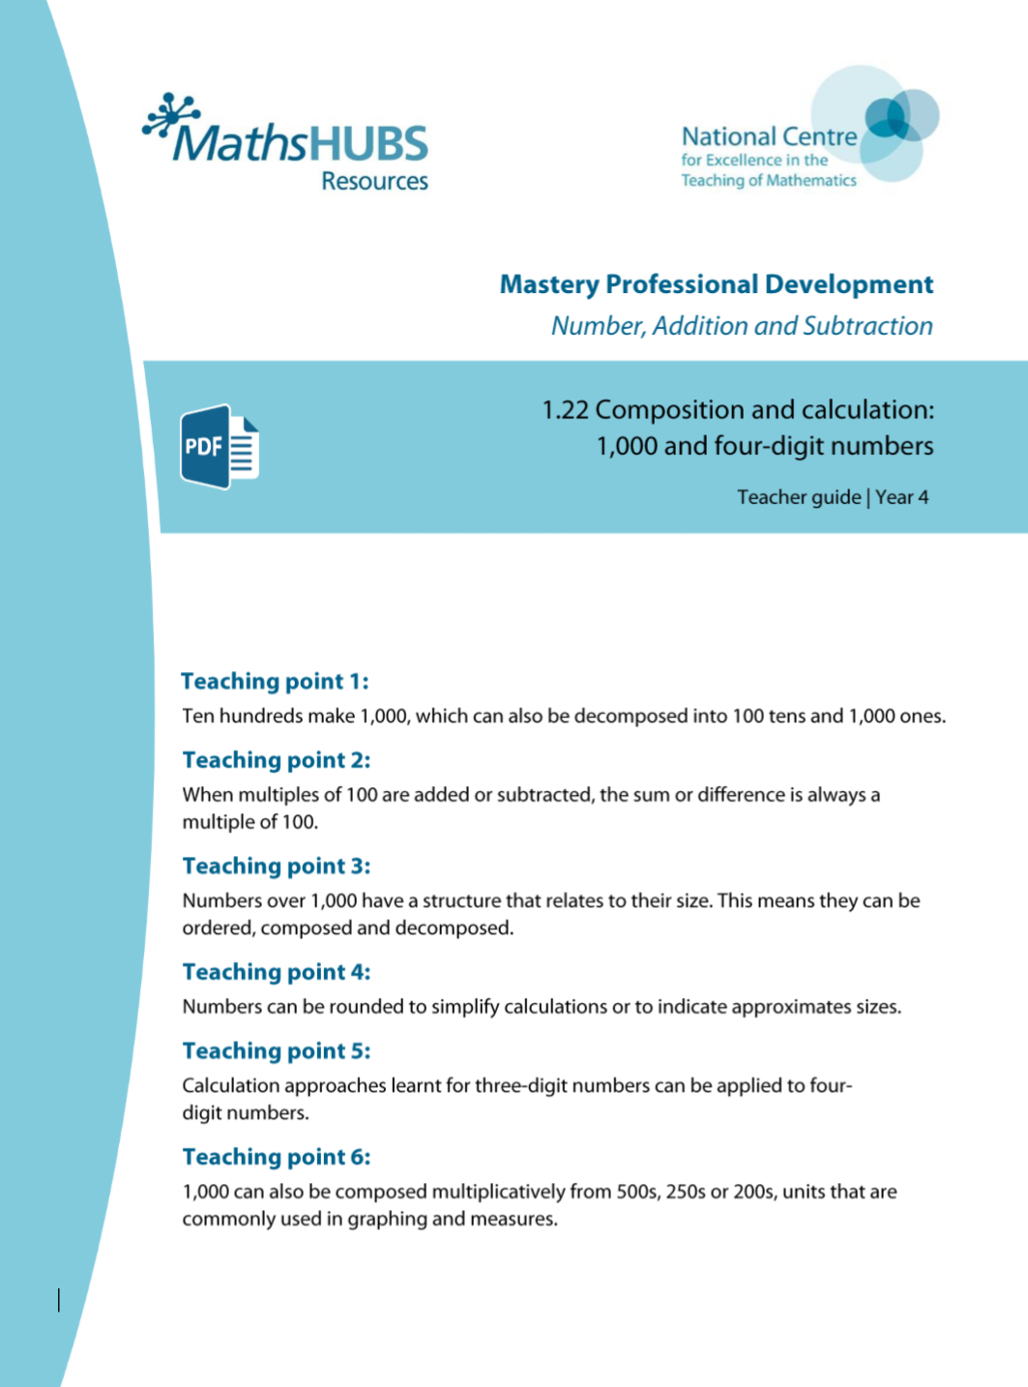
4NPV-1: Linked mastery PD materials
Additional pedagogical subject knowledge support can be found in the Mastery Professional Development Materials:
1.22 Composition and calculation: 1,000 and four-digit numbers
Several of the activity slides have been taken from these materials.

Slide 4
4NPV-1
Equivalence of 10 hundreds and 1 thousand

Slide 5
The following slides contain activities that can be used within the context of pre-teaching, intervention, or as supplementary material integrated into teaching. They do not represent complete lessons and should not be used as such. Also they should not be used all at once, but over the period of a teaching unit. It would be valuable to use many of the activities more than once to build fluency in understanding and application. Also many of them would benefit from the use of manipulatives to support interaction with the ideas. Ensure you engage in rich discussion with the children, asking them to reason and explain the ideas presented. Note that when working with a small group, pupils should also have access to the main teaching delivered by the class teacher and the focus should be directly linked so that the learning is connected and fluency is built.

Slide 6
Guidance for working with a small pre-teaching or intervention group
Take time to build understanding of the key idea. We would recommend no more than four slides in any one session, and probably fewer.
In subsequent sessions, review and practise previous learning before moving on.
Play the animation/observe the image and ask pupils “What do you notice?”.
Encourage pupils to explain what they see, what is happening and why.
Where there is a highlighted sentence, draw out the meaning of this from the image and repeat together and individually.

Slide 7
Guidance for working with a small pre-teaching or intervention group
Engage in the suggested activities, using manipulatives where appropriate, to enhance the interaction and stimulate discussion. However, note that the ultimate aim is to develop fluency in the mathematical ideas such that resources are no longer needed.
Repeat questions, using other numbers/examples where relevant.
Repeat the highlighted language structures wherever relevant to build fluency with the key idea and connect the learning. For example:
10 hundreds are equivalent to 1,000.

Slide 8
4NPV-1 Equivalence of 10 hundreds and 1 thousand

Slide 9
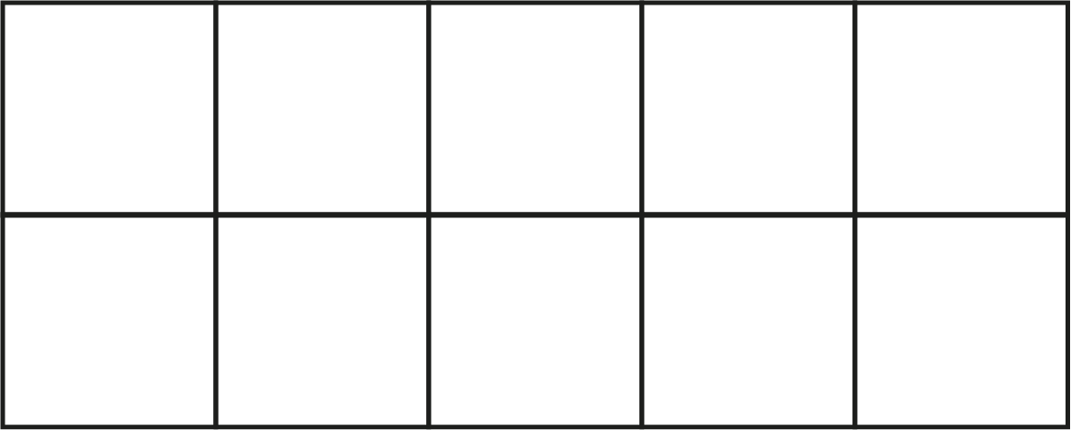

4NPV-1 Equivalence of 10 hundreds and 1 thousand
10 hundreds are equivalent to 1,000.
Count in steps of 100 to 1,000
How many steps did you count?
1,000

Slide 10
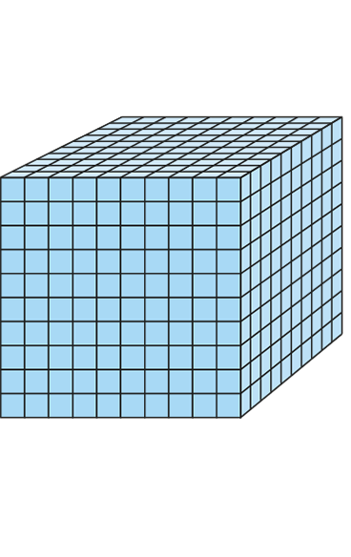
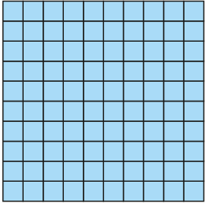
4NPV-1 Equivalence of 10 hundreds and 1 thousand
Use Dienes blocks to show that 10 hundreds are equivalent to 1,000.

Slide 11
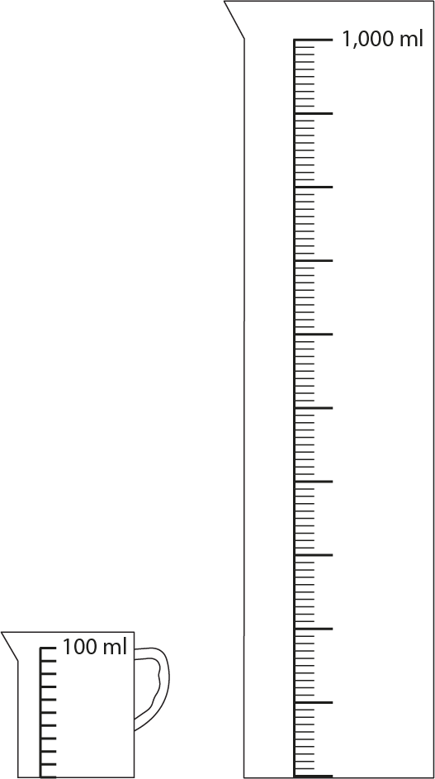
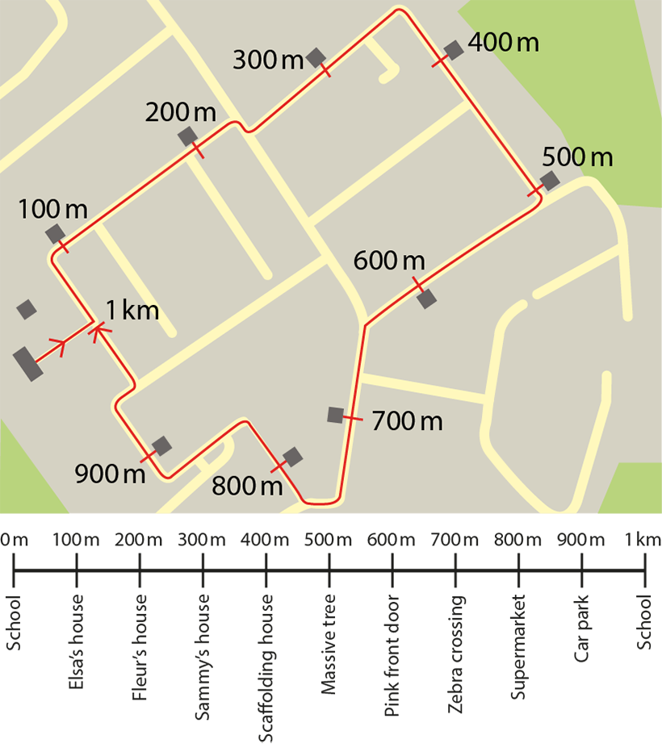
4NPV-1 Equivalence of 10 hundreds and 1 thousand
How many 100ml jugs of water does it take to fill the 1 litre measuring cylinder?
How many lots of 100m do I need to walk to walk 1km?
If we walked 100m from the school gate, where would we get to?
If we walked 1,000m from the school gate, where would we get to?

Slide 12
4NPV-1 Equivalence of 10 hundreds and 1 thousand
10 hundreds are equivalent to 1,000.
18 hundreds are equivalent to 1,800.
Take a handful of 100 counters and write the number you have. Say it two ways: the number of hundreds you have, and the way the number is normally read.
Repeat the activity.
1,800

Slide 13
4NPV-1 Equivalence of 10 hundreds and 1 thousand
Count up in 100s beyond 9 hundred, saying 10 hundred, 11 hundred, 12 hundred… Stop at a number of your choice and say the number in two ways, e.g. 16 hundreds and 1,600 (one thousand six hundred). Repeat, stopping at different numbers each time.

Slide 14
4NPV-1 Equivalence of 10 hundreds and 1 thousand
100
200
300
400
500
600
700
800
900
1,000
Count in multiples of 100. What do you notice when you get to the end of each row?
Choose a number and say how many hundreds it is made from.
1,100
1,200
1,300
1,400
1,500
1,600
1,700
1,800
1,900
2,000
2,100
2,200
2,300
2,400
2,500
2,600
2,700
2,800
2,900
3,000
3,100
3,200
3,300
3,400
3,500
3,600
3,700
3,800
3,900
4,000
4,100
4,200
4,300
4,400
4,500
4,600
4,700
4,800
4,900
5,000
5,100
5,200
5,300
5,400
5,500
5,600
5,700
5,800
5,900
6,000
6,100
6,200
6,300
6,400
6,500
6,600
6,700
6,800
6,900
7,000
7,100
7,200
7,300
7,400
7,500
7,600
7,700
7,800
7,900
8,000
8,100
8,200
8,300
8,400
8,500
8,600
8,700
8,800
8,900
9,000
9,100
9,200
9,300
9,400
9,500
9,600
9,700
9,800
9,900
10,000

Slide 15
4NPV-1 Equivalence of 10 hundreds and 1 thousand
100
100
100
100
100
100
100
100
100
100
What do you notice about the value of the each row? And of the whole grid?
Click in the grid to reveal a number of hundreds.
How many hundreds are there? What is the total value of those hundreds?
Highlight some of the hundreds in a grid yourself. How many hundreds are there? What is the number you have made?
100
100
100
100
100
100
100
100
100
100
100
100
100
100
100
100
100
100
100
100
100
100
100
100
100
100
100
100
100
100
100
100
100
100
100
100
100
100
100
100
100
100
100
100
100
100
100
100
100
100
100
100
100
100
100
100
100
100
100
100
100
100
100
100
100
100
100
100
100
100
100
100
100
100
100
100
100
100
100
100
100
100
100
100
100
100
100
100
100
100

Slide 16
4NPV-1 Equivalence of 10 hundreds and 1 thousand
1,000 | 2,000 | 3,000 | 4,000 | 5,000 | 6,000 | 7,000 | 8,000 | 9,000
100 | 200 | 300 | 400 | 500 | 600 | 700 | 800 | 900
10 | 20 | 30 | 40 | 50 | 60 | 70 | 80 | 90
1 | 2 | 3 | 4 | 5 | 6 | 7 | 8 | 9
Click to reveal a number.
Use this slide to practise saying other numbers made of thousands and hundreds, or place counters onto Gattegno charts to identify and say other numbers.
How many hundreds are there in each number you say?

Slide 17

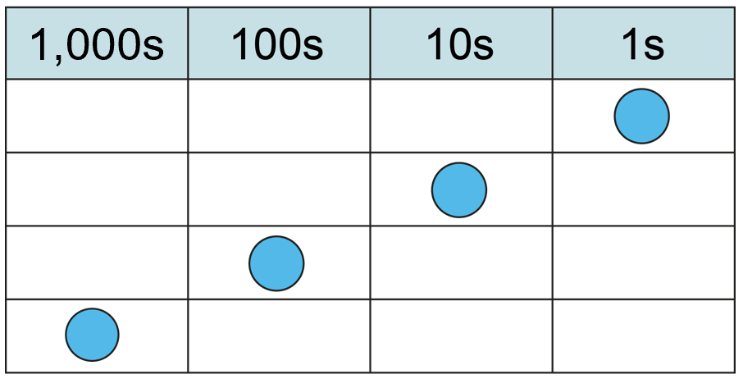
4NPV-1 Equivalence of 10 hundreds and 1 thousand
one-tenth of the size
one-tenth of the size
one-tenth of the size
If the blue counter has a value of 1, what happens to its value when it moves from the ones column to the tens column? And from the tens column to the hundreds column? And from the hundreds column to the thousands column?
What happens to the counter’s value when you move it the other way?
ten times the size
ten times the size
ten times the size

Slide 18
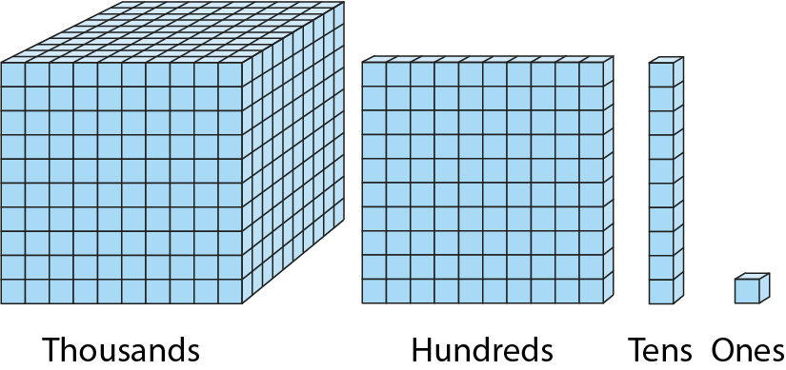
4NPV-1 Equivalence of 10 hundreds and 1 thousand
Compare the value of the units. What do you notice?

Slide 19
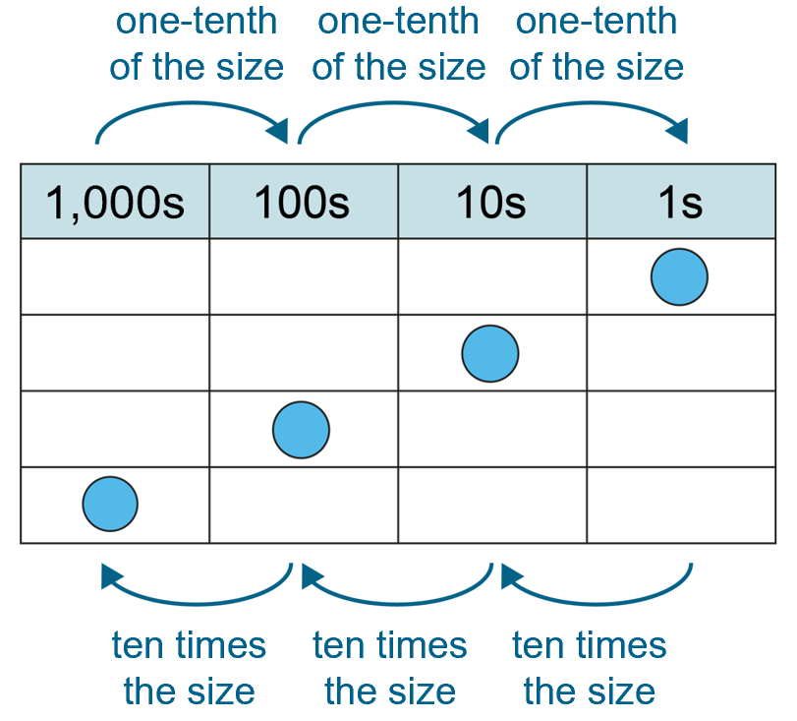
4NPV-1 Equivalence of 10 hundreds and 1 thousand
Grouping and exchange model
Scaling model
10 hundreds are equivalent to
1 thousand.
1,000 is ten times the size of 100.
100 is one-tenth of the size of 1,000.
Practise describing the relationship between 100 and 1,000 in these two different ways.

Slide 20
4NPV-1 Equivalence of 10 hundreds and 1 thousand
The Deca Tree
https://nrich.maths.org/2006

