Slide 1
4MD-2
Manipulating the multiplicative relationship

Slide 2
4MD-2
Manipulate multiplication and division equations, and understand and apply the commutative property of multiplication.
The materials in this pack have been collated and written to support the teaching of 4MD-2. Before planning and teaching the content, read the teaching guidance and example assessment questions in the non-statutory guidance itself, which can be found here.
A video summarising all of the ready-to-progress criteria for Year 4 can be found here.

Slide 3
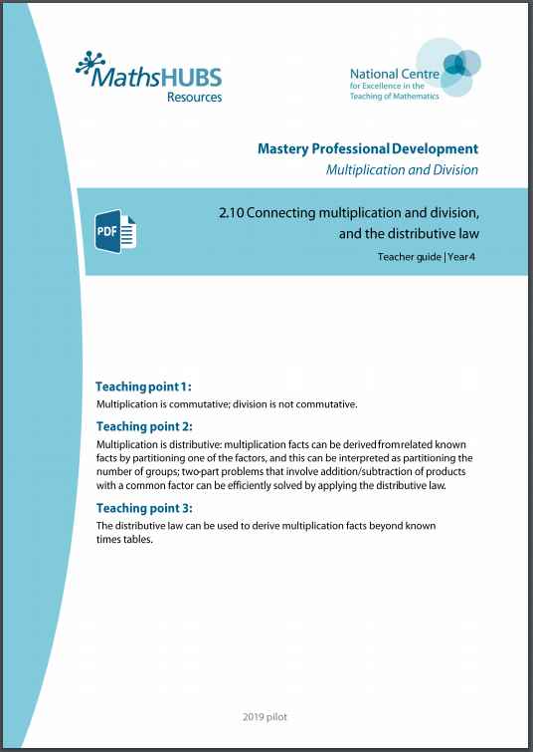
4MD-2: Linked mastery PD materials
Additional pedagogical subject knowledge support can be found in the Mastery Professional Development Materials:
2.10 Connecting multiplication and division, and the distributive law
Several of the activity slides have been taken from these materials.

Slide 4
4MD-2
Manipulating the multiplicative relationship

Slide 5
The following slides contain activities that can be used within the context of pre-teaching, intervention, or as supplementary material integrated into teaching. They do not represent complete lessons and should not be used as such. Also they should not be used all at once, but over the period of a teaching unit. It would be valuable to use many of the activities more than once to build fluency in understanding and application. Also many of them would benefit from the use of manipulatives to support interaction with the ideas. Ensure you engage in rich discussion with the children, asking them to reason and explain the ideas presented. Note that when working with a small group, pupils should also have access to the main teaching delivered by the class teacher and the focus should be directly linked so that the learning is connected and fluency is built.

Slide 6
Guidance for working with a small pre-teaching or intervention group
Take time to build understanding of the key idea. We would recommend no more than four slides in any one session, and probably fewer.
In subsequent sessions, review and practise previous learning before moving on.
Play the animation/observe the image and ask pupils “What do you notice?”.
Encourage pupils to explain what they see, what is happening and why.
Where there is a highlighted sentence, draw out the meaning of this from the image and repeat together and individually.

Slide 7
Guidance for working with a small pre-teaching or intervention group
Engage in the suggested activities, using manipulatives where appropriate, to enhance the interaction and stimulate discussion. However, note that the ultimate aim is to develop fluency in the mathematical ideas such that resources are no longer needed.
Repeat questions, using other numbers/examples where relevant.
Repeat the highlighted language structures wherever relevant to build fluency with the key idea and connect the learning. For example:
10 hundreds are equivalent to 1,000.

Slide 8
4MD-2 Manipulating the multiplicative relationship

Slide 9

4MD-2 Manipulating the multiplicative relationship
What do you see? Can you see 2 groups of 7? What do you see now? Can you see 7 groups of 2?
What is the same/different? Can you write two different equations? What do you notice about this equation?
Provide different arrays for pupils to work with and ask them to orally apply the commutative property.
2 × 7 = 7 × 2
2 groups of 7 is equal to 14.
2, 7 times is equal to 14.
2 groups of 7 is equal to 7, two times.

Slide 10

4MD-2 Manipulating the multiplicative relationship
Can you write two multiplication equations to represent this picture? What does the 2 represent? The 7? The 14?
What is the same/different?
Which are the factors in your equation? What is the product? Does the order of the factors affect the product?
Repeat using other images and real-life contexts.
2 × 7 = 14
7 × 2 = 14
The product of __ and __ is equal to the product of __ and __.
__ times __ is equal to __ times __.

Slide 11
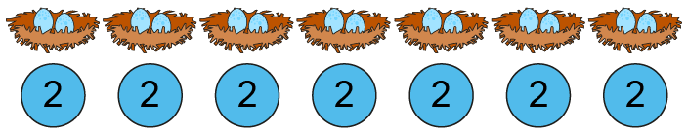
4MD-2 Manipulating the multiplicative relationship
What do you see? Can you write two multiplication equations to represent this picture? What does each number in your equation represent?
How does this compare with the last slide? What do you notice about the equations you have written?
Provide children with similar equations and ask them to draw two pictures to represent them.
2 × 7 = 14
7 × 2 = 14

Slide 12


4MD-2 Manipulating the multiplicative relationship
What is the same/different?
Provide similar cards with different equations and ask children to match these.
Can you write another equation that is equal to 3 x 6? Now can you draw or use counters to represent each of your equations? Repeat for other equations.
2 groups of 7
2 × 7 = 14
7 groups of 2
7 × 2 = 14
2 groups of 7 is equal to 7 groups of 2.

Slide 13
4MD-2 Manipulating the multiplicative relationship
If we know these two equations have the same product, can you write a corresponding division statement? And another? What do you notice?
Return to arrays and ask children to write 2 multiplication and 2 division statements for each.
2 × 7 = 14
7 × 2 = 14
14 ÷ 7 = 2
14 ÷ 2 = 7
Exchange the factors and the product remains the same.
Exchange the divisor and quotient and the dividend remains the same.

Slide 14
4MD-2 Manipulating the multiplicative relationship
What is the same/different?
Provide similar cards with different division equations and ask children to match these.
Can you write another equation that is equal to 15 ÷ 3? Now can you draw or use counters to represent each of your equations? Repeat for other equations.
2 groups of 7
14 ÷ 7 = 2
7 groups of 2
14 ÷ 2 = 7

