Slide 1
4G-3
Identify line symmetry in 2D shapes

Slide 2
4G-3
Identify line symmetry in 2D shapes presented in different orientations. Reflect shapes in a line of symmetry and complete a symmetric figure or pattern with respect to a specified line of symmetry.
The materials in this pack have been collated and written to support the teaching of 4G-3. Before planning and teaching the content, read the teaching guidance and example assessment questions in the non-statutory guidance itself, which can be found here.
A video summarising all of the ready-to-progress criteria Year 4 can be found here.

Slide 3
4G-3
Identify line symmetry in 2D shapes

Slide 4
The following slides contain activities that can be used within the context of pre-teaching, intervention, or as supplementary material integrated into teaching. They do not represent complete lessons and should not be used as such. Also they should not be used all at once, but over the period of a teaching unit. It would be valuable to use many of the activities more than once to build fluency in understanding and application. Also many of them would benefit from the use of manipulatives to support interaction with the ideas. Ensure you engage in rich discussion with the children, asking them to reason and explain the ideas presented. Note that when working with a small group, pupils should also have access to the main teaching delivered by the class teacher and the focus should be directly linked so that the learning is connected and fluency is built.

Slide 5
Guidance for working with a small pre-teaching or intervention group
Take time to build understanding of the key idea. We would recommend no more than four slides in any one session, and probably fewer.
In subsequent sessions, review and practise previous learning before moving on.
Play the animation/observe the image and ask pupils “What do you notice?”.
Encourage pupils to explain what they see, what is happening and why.
Where there is a highlighted sentence, draw out the meaning of this from the image and repeat together and individually.

Slide 6
Guidance for working with a small pre-teaching or intervention group
Engage in the suggested activities, using manipulatives where appropriate, to enhance the interaction and stimulate discussion. However, note that the ultimate aim is to develop fluency in the mathematical ideas such that resources are no longer needed.
Repeat questions, using other numbers/examples where relevant.
Repeat the highlighted language structures wherever relevant to build fluency with the key idea and connect the learning. For example:
10 hundreds are equivalent to 1,000.

Slide 7
4G-3 Identify line symmetry in 2D shapes

Slide 8
4G-3 Identify line symmetry in 2D shapes
Provide children with a selection of 2D paper shapes which have one or more lines of symmetry. Ask them to fold the shapes to identify lines of symmetry. When you open the shape out, can you see that each part either side of the fold (line of symmetry) is a reflection of the other? Can you fold the shape in more than one way to find another line of symmetry?
Can you explain why a shape is/is not symmetrical?
This is a line of symmetry because it splits the shape into two equal parts which are mirror images.

Slide 9
4G-3 Identify line symmetry in 2D shapes
Choose two shapes that are identical. How many different ways can you find to fit these two shapes together to make a shape.
Now use a mirror to decide which of these have a line symmetry. Do any of your shapes have more than one line of symmetry?
This is a line of symmetry because it splits the shape into two equal parts which are mirror images.

Slide 10
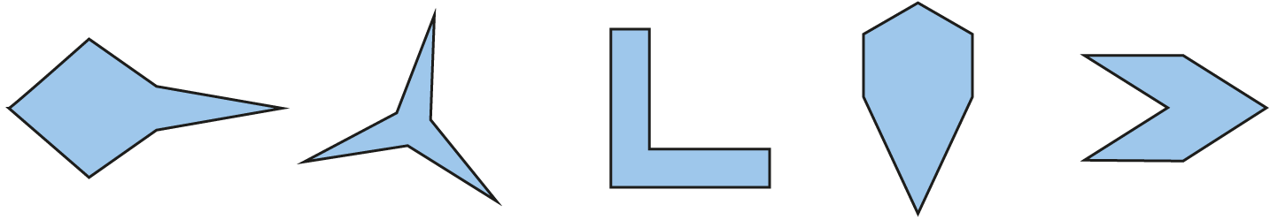




4G-3 Identify line symmetry in 2D shapes
Look at the lines of symmetry in the first two shapes. How many do they have?
Identify the lines of symmetry in the final three shapes.

Slide 11
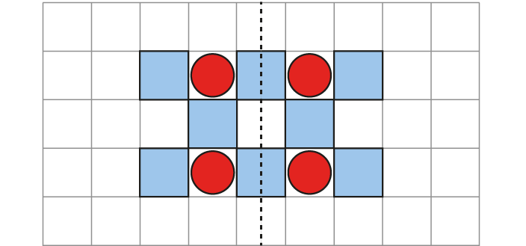


4G-3 Identify line symmetry in 2D shapes
Can you complete the symmetrical pattern?
What is your strategy? Can you start closest to the mirror line?
How can you check your answer?
Can you see another line of symmetry?
Repeat for other patterns.

Slide 12
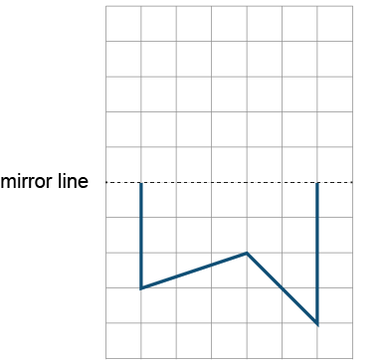


4G-3 Identify line symmetry in 2D shapes
Can you reflect this shape in the mirror line? What is your strategy?
Take one of the points, count how far this is from the mirror line, then reflect on the other side of the mirror line by counting the same. Repeat for the other points.
Name the polygon you have completed.
Progress to diagonal lines of symmetry.

Slide 13

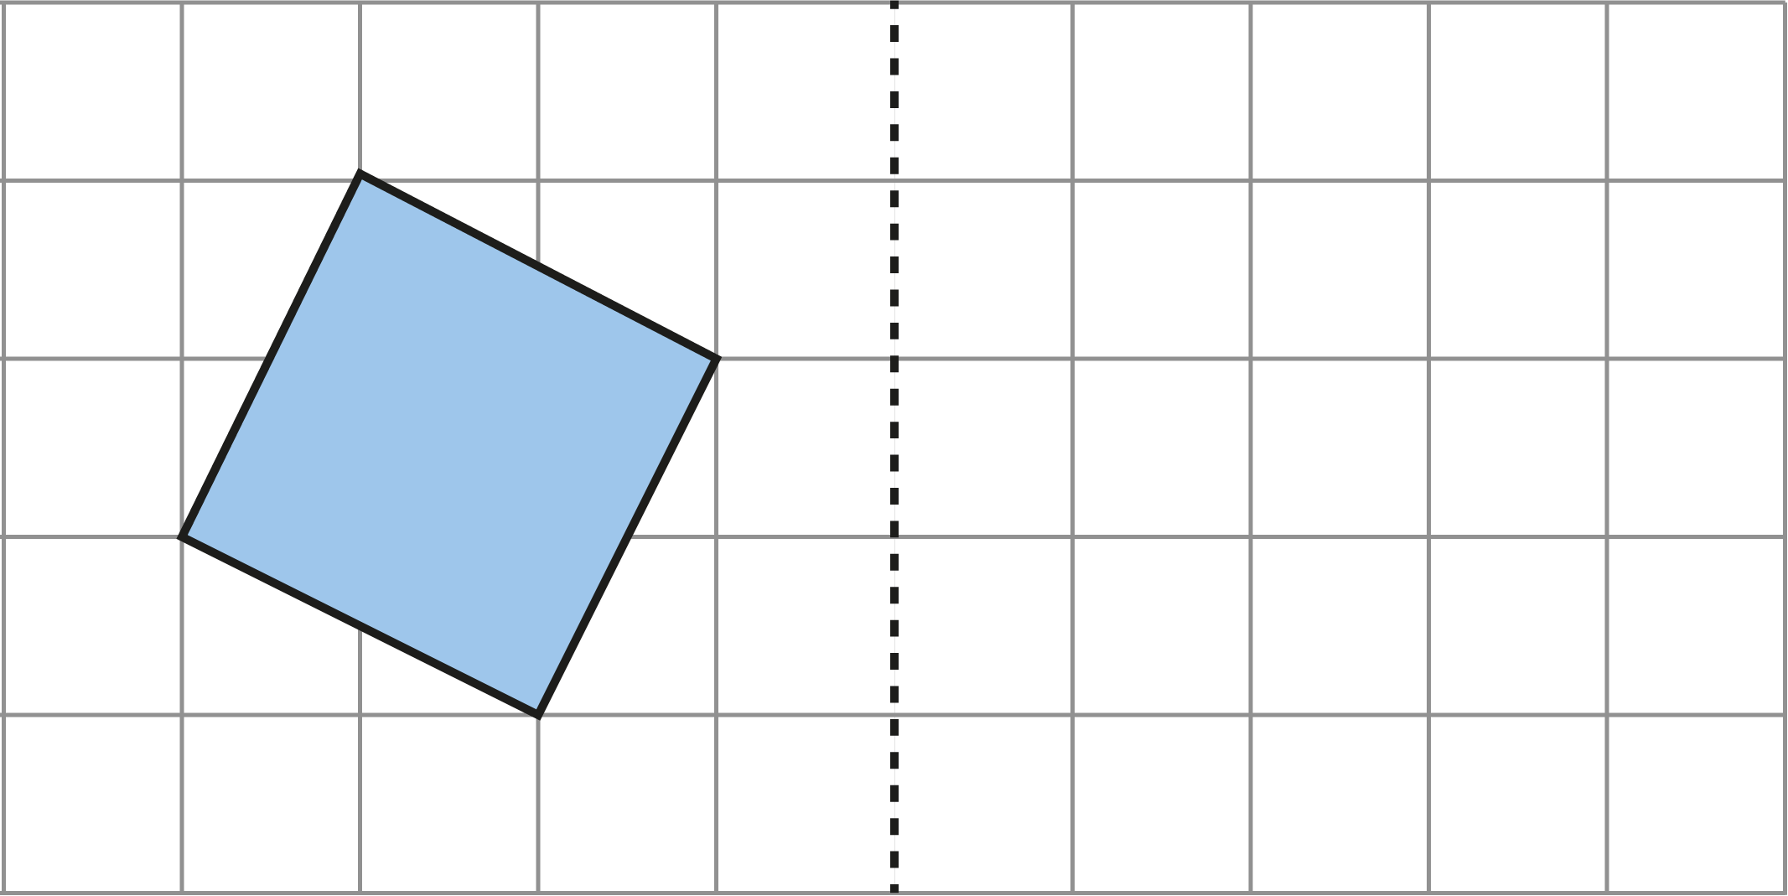




4G-3 Identify line symmetry in 2D shapes
Reflect both shapes in the mirror line by counting the position of each vertex and making a mark. Now join the marks to make your reflected shape.
How could you check your answer?
Repeat the above for other shapes using horizontal, vertical and diagonal mirror lines.

Slide 14
4G-3 Identify line symmetry in 2D shapes
Stringy Quads
https://nrich.maths.org/2913

