Slide 1
4G-2
Perimeter: regular and irregular polygons

Slide 2
4G-2
Identify regular polygons, including equilateral triangles and squares, as those in which the side-lengths are equal and the angles are equal. Find the perimeter of regular and irregular polygons.
The materials in this pack have been collated and written to support the teaching of 4G-2. Before planning and teaching the content, read the teaching guidance and example assessment questions in the non-statutory guidance itself, which can be found here.
A video summarising all of the ready-to-progress criteria for Year 4 can be found here.

Slide 3
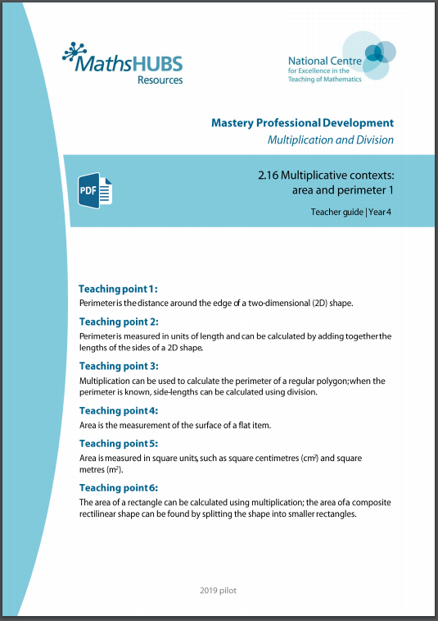
4G-2: Linked mastery PD materials
Additional pedagogical subject knowledge support can be found in the Mastery Professional Development Materials:
2.16 Multiplicative contexts: area and perimeter 1
Several of the activity slides have been taken from these materials.

Slide 4
4G-2
Perimeter: regular and irregular polygons

Slide 5
The following slides contain activities that can be used within the context of pre-teaching, intervention, or as supplementary material integrated into teaching. They do not represent complete lessons and should not be used as such. Also they should not be used all at once, but over the period of a teaching unit. It would be valuable to use many of the activities more than once to build fluency in understanding and application. Also many of them would benefit from the use of manipulatives to support interaction with the ideas. Ensure you engage in rich discussion with the children, asking them to reason and explain the ideas presented. Note that when working with a small group, pupils should also have access to the main teaching delivered by the class teacher and the focus should be directly linked so that the learning is connected and fluency is built.

Slide 6
Guidance for working with a small pre-teaching or intervention group
Take time to build understanding of the key idea. We would recommend no more than four slides in any one session, and probably fewer.
In subsequent sessions, review and practise previous learning before moving on.
Play the animation/observe the image and ask pupils “What do you notice?”.
Encourage pupils to explain what they see, what is happening and why.
Where there is a highlighted sentence, draw out the meaning of this from the image and repeat together and individually.

Slide 7
Guidance for working with a small pre-teaching or intervention group
Engage in the suggested activities, using manipulatives where appropriate, to enhance the interaction and stimulate discussion. However, note that the ultimate aim is to develop fluency in the mathematical ideas such that resources are no longer needed.
Repeat questions, using other numbers/examples where relevant.
Repeat the highlighted language structures wherever relevant to build fluency with the key idea and connect the learning. For example:
10 hundreds are equivalent to 1,000.

Slide 8
4G-2 Perimeter: regular and irregular polygons

Slide 9
4G-2 Perimeter: regular and irregular polygons
For each of these activities and slides it may be useful to provide pupils with an assortment of 2D shapes for them to select from, handle, compare and sort.
Children will also benefit from drawing/sketching 2D shapes.
When exploring regular/irregular shapes, allow children opportunities to create these from geo-strips.
When comparing angles, use the informal language of more/less than a right angle/90˚, straight line/180˚, reflex angle/270˚.
Where possible, provide pupils with real-life contexts, different units of measurement and problems on a larger scale.

Slide 10

4G-2 Perimeter: regular and irregular polygons
All sides equal length
Not all angles equal sized
Not all sides equal length
All angles equal sized
All sides equal length
All angles equal sized
Not all sides equal length
Not all angles equal sized
Look at these shapes. What is the same/different about them?
Can you think how we could sort these shapes? Which shapes have equal sides? Which shapes have equal angles? Which shapes have equal sides and equal angles? What do we call these shapes?
Can you draw/find a shape with equal sides and unequal angles? Equal angles but unequal sides? Equal sides and equal angles? Unequal sides and unequal angles?
Irregular
Irregular
Regular
Irregular
This is a regular polygon, because all of the sides are the same length, and all of the interior angles are equal.

Slide 11
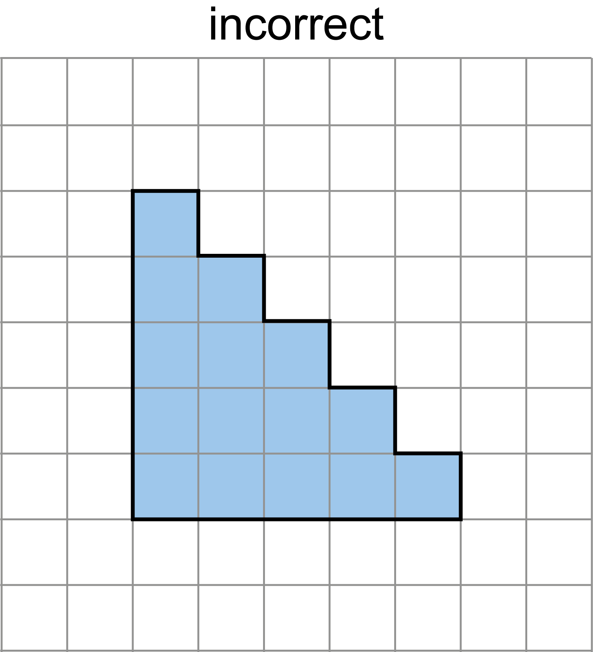
4G-2 Perimeter: regular and irregular polygons
Choose a polygon from the box of shapes and run your finger along the edges, all the way round. What do we call this distance?
Copy this shape on to squared paper sticking to the lines. Mark the side of each square along each edge with a dash. What is the perimeter? Repeat for other shapes.
Now can you draw a shape with a perimeter of exactly 10cm? 15cm? 18cm?
Can you draw a different shape with a perimeter of 10cm? How many different shapes can you draw with this same perimeter?
Perimeter = 20cm

Slide 12
4G-2 Perimeter: regular and irregular polygons
7cm
Look in your box of shapes. Can you find a regular hexagon?
If we know that one side measures 7cm, what is the length of each of the remaining sides? How could we work out the perimeter of this shape? What calculation can you write?
7cm
7cm
7cm
7cm
7cm
For polygons with equal sized lengths, perimeter = side-length x number of sides.
Perimeter:
6 x 7cm = 42cm

Slide 13
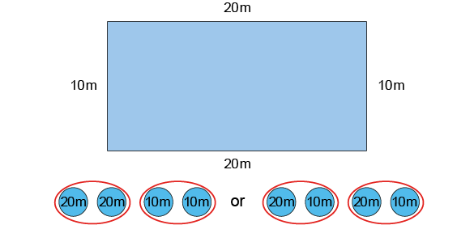
4G-2 Perimeter: regular and irregular polygons
Look at the length and width of this rectangle. How could you find the perimeter?
If we add the two lengths to the two widths what would that be? Is there a quicker way? What if we added one length to one width and doubled this? Do we still get the same answer? Which strategy is more efficient?
Use this strategy to calculate the perimeter of other rectangles with different units of measurement and real life contexts.
40m + 20m
2 x 30m
For rectangles, perimeter = 2 x (length + width)
Perimeter = 60m

Slide 14
4G-2 Perimeter: regular and irregular polygons
What do you notice about the lengths of each side of this triangle? Is this a regular/equilateral triangle?
How can you find the perimeter?
Repeat to calculate the perimeter of other polygons with unequal side lengths using different units of measurement and real life contexts.
5cm
7cm
For polygons with unequal side lengths, perimeter = sum of the side lengths.
4cm
Perimeter:
7cm + 5cm + 4 cm = 16cm

Slide 15
4G-2 Perimeter: regular and irregular polygons
Egyptian Rope
https://nrich.maths.org/982

