Slide 1
4G-1
Draw polygons specified by coordinates or by translation

Slide 2
4G-1
Draw polygons, specified by coordinates in the first quadrant, and translate within the first quadrant.
The materials in this pack have been collated and written to support the teaching of 4G-1. Before planning and teaching the content, read the teaching guidance and example assessment questions in the non-statutory guidance itself, which can be found here.
A video summarising all of the ready-to-progress criteria for Year 4 can be found here.

Slide 3
4G-1
Draw polygons specified by coordinates or by translation

Slide 4
The following slides contain activities that can be used within the context of pre-teaching, intervention, or as supplementary material integrated into teaching. They do not represent complete lessons and should not be used as such. Also they should not be used all at once, but over the period of a teaching unit. It would be valuable to use many of the activities more than once to build fluency in understanding and application. Also many of them would benefit from the use of manipulatives to support interaction with the ideas. Ensure you engage in rich discussion with the children, asking them to reason and explain the ideas presented. Note that when working with a small group, pupils should also have access to the main teaching delivered by the class teacher and the focus should be directly linked so that the learning is connected and fluency is built.

Slide 5
Guidance for working with a small pre-teaching or intervention group
Take time to build understanding of the key idea. We would recommend no more than four slides in any one session, and probably fewer.
In subsequent sessions, review and practise previous learning before moving on.
Play the animation/observe the image and ask pupils “What do you notice?”.
Encourage pupils to explain what they see, what is happening and why.
Where there is a highlighted sentence, draw out the meaning of this from the image and repeat together and individually.

Slide 6
Guidance for working with a small pre-teaching or intervention group
Engage in the suggested activities, using manipulatives where appropriate, to enhance the interaction and stimulate discussion. However, note that the ultimate aim is to develop fluency in the mathematical ideas such that resources are no longer needed.
Repeat questions, using other numbers/examples where relevant.
Repeat the highlighted language structures wherever relevant to build fluency with the key idea and connect the learning. For example:
10 hundreds are equivalent to 1,000.

Slide 7
4G-1 Draw polygons specified by coordinates or by translation

Slide 8

4G-1 Draw polygons specified by coordinates or by translation
Look at polygon A. How would we need to move this for it to cover polygon B?
Count with me as we move the polygon across. In which direction do we need to move it first? How many squares to the right have we moved? Now which direction do we need to move the polygon? How many squares down have we moved?
The polygon has been translated 4 squares to the right and 3 squares down.

Slide 9
4G-1 Draw polygons specified by coordinates or by translation
Children should practise using squared grids and assorted polygons and:
  translate polygons according to given instructions:
  describe the movement left/right and up/down of a polygon which has already been translated.
Model to children how this can be done by translating each point of the polygon individually and joining these points, or alternatively translating and marking one point first then marking the other points of the polygon relative to the translated point.
Provide opportunities for children to practise each of these methods.

Slide 10

4G-1 Draw polygons specified by coordinates or by translation
What can you see? What do we call this? What do we call the horizontal axis? The vertical axis?
Start at the origin and mark a point along 5, and up 4.
If I counted 4 along and up 5 would this be the same point?
Repeat for other points in the first quadrant using axes with no number labels.
First count along the x-axis, then count along the y-axis.

Slide 11
4G-1 Draw polygons specified by coordinates or by translation
Once children are familiar with unlabelled axes, move to axes with number labels, drawing attention to the origin of each and how this is labelled with O, not a zero.
Children should practise on these labelled quadrants by:
  writing the coordinate notation for a given point;
  marking the position of points specified by coordinates.
Activities for the above may include ‘battleships’, coordinate bingo, treasure maps and oversized grids marked out on the floor on which children can manipulate real objects.
Is the point (5,4) the same as the point (4,5)? Why not?

Slide 12
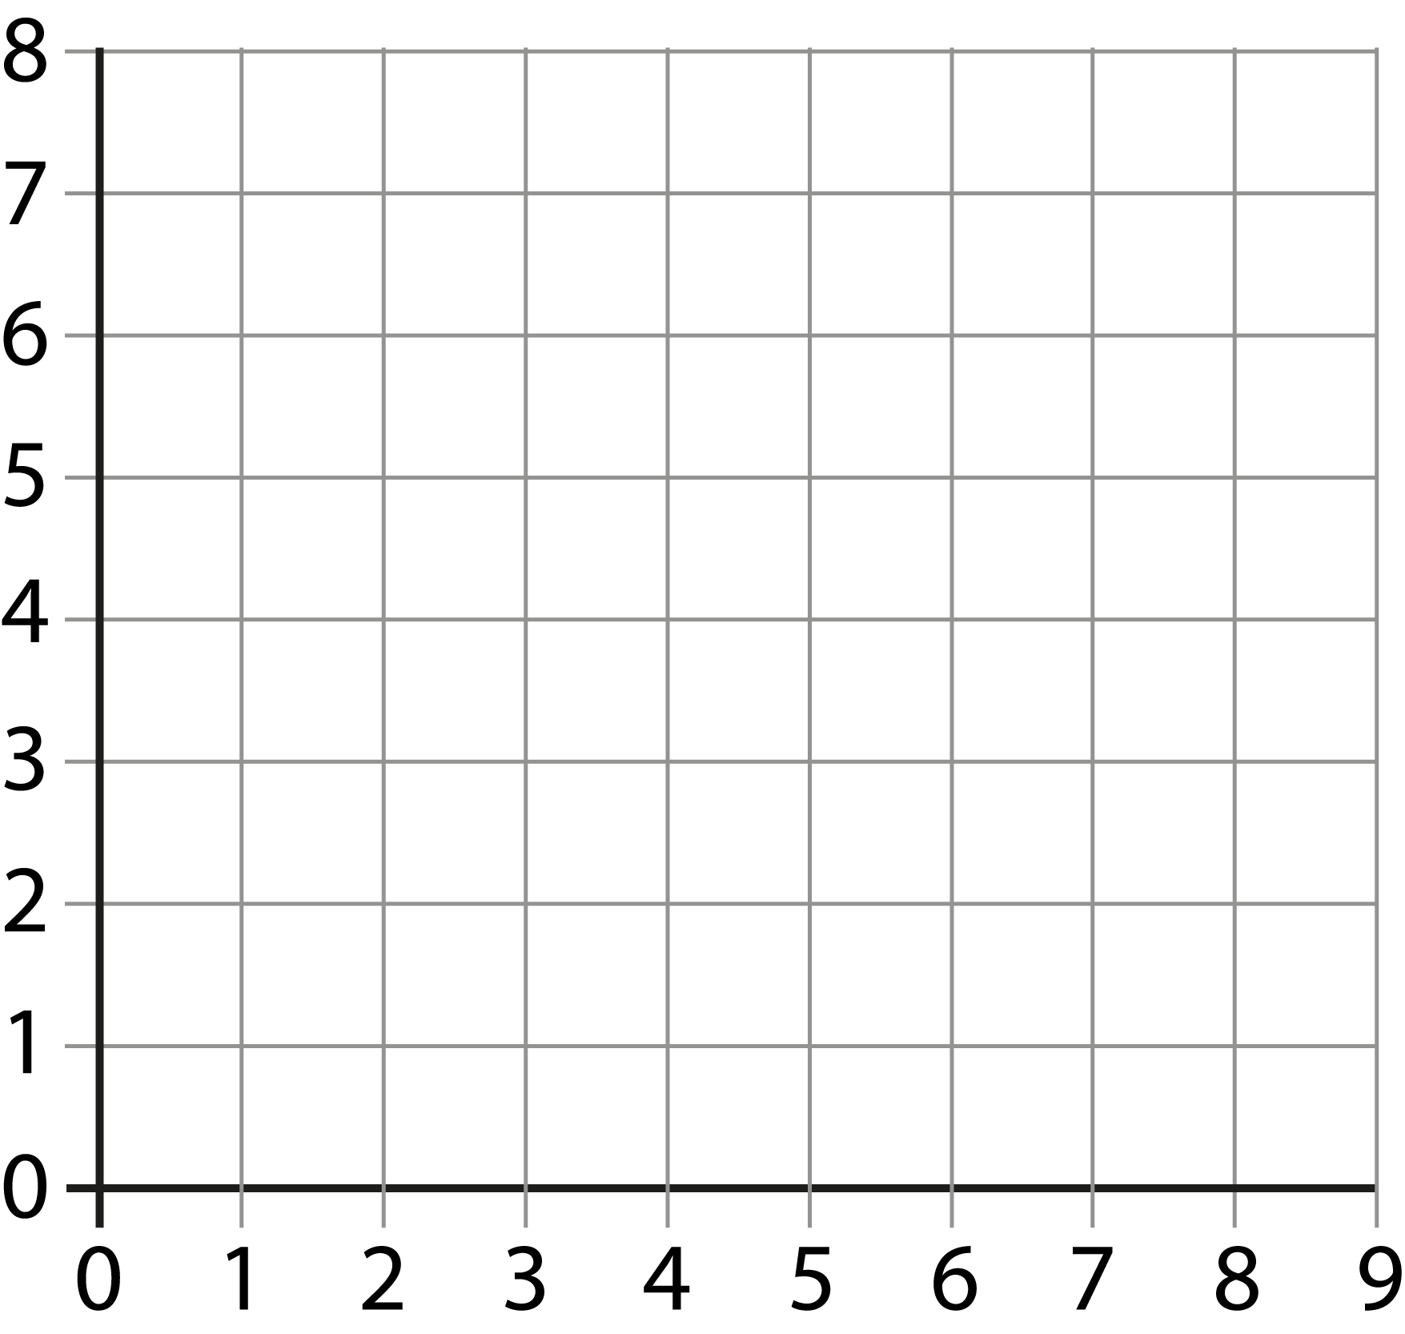


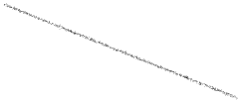
4G-1 Draw polygons specified by coordinates or by translation
(3,5) (5,6) (8,3)
Can you mark these three points on your axes? Now join the points with a ruler. What shape have you made?
What if the first point was changed to (5,3)?
If (1,1), (3,1) and (3,3) are the points of three vertices of a square, at which point would the fourth vertex be?
Repeat, providing lots of practice for children to mark and join specified coordinates.

Slide 13






4G-1 Draw polygons specified by coordinates or by translation
What do we call this shape? Can you describe how point A has moved to point B.
Now can you translate the three remaining points in the same way? When you join the translated points, what do you notice about the two shapes?
Is the new polygon any different to the original polygon?
What if point B was one square up, can you see straight away where the other vertices would need to be?
A
B

Slide 14
4G-1 Draw polygons specified by coordinates or by translation
Once children are familiar with translating polygons and describing the translation of polygons ask them to:
  mark a series of points and join them to make a polygon. Name the polygon they have drawn;
  translate the polygon and give the coordinates of the vertices of this new polygon.

Slide 15
4G-1 Draw polygons specified by coordinates or by translation
A Cartesian Puzzle
https://nrich.maths.org/1110

