Slide 1
4F-3
Add and subtract improper and mixed fractions (same denominator)

Slide 2




4F–3
Add and subtract improper and mixed fractions with the same denominator, including bridging whole numbers, for example:
The materials in this pack have been collated and written to support the teaching of 4F-3. Before planning and teaching the content, read the teaching guidance and example assessment questions in the non-statutory guidance itself, which can be found here.
A video summarising all of the ready-to-progress criteria for Year 4 can be found here.

Slide 3
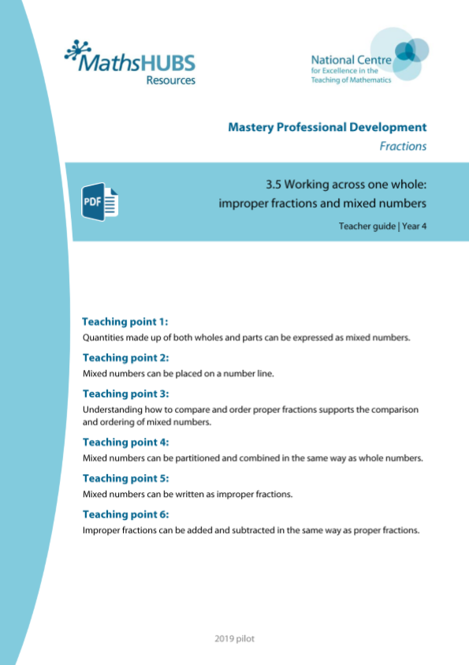
4F-3: Linked mastery PD materials
Additional pedagogical subject knowledge support can be found in the Mastery Professional Development Materials:
3.5 Working across one whole: improper fractions and mixed numbers
Several of the activity slides have been taken from these materials.

Slide 4
4F-3
Add and subtract improper and mixed fractions (same denominator)

Slide 5
The following slides contain activities that can be used within the context of pre-teaching, intervention, or as supplementary material integrated into teaching. They do not represent complete lessons and should not be used as such. Also they should not be used all at once, but over the period of a teaching unit. It would be valuable to use many of the activities more than once to build fluency in understanding and application. Also many of them would benefit from the use of manipulatives to support interaction with the ideas. Ensure you engage in rich discussion with the children, asking them to reason and explain the ideas presented. Note that when working with a small group, pupils should also have access to the main teaching delivered by the class teacher and the focus should be directly linked so that the learning is connected and fluency is built.

Slide 6
Guidance for working with a small pre-teaching or intervention group
Take time to build understanding of the key idea. We would recommend no more than four slides in any one session, and probably fewer.
In subsequent sessions, review and practise previous learning before moving on.
Play the animation/observe the image and ask pupils “What do you notice?”.
Encourage pupils to explain what they see, what is happening and why.
Where there is a highlighted sentence, draw out the meaning of this from the image and repeat together and individually.

Slide 7
Guidance for working with a small pre-teaching or intervention group
Engage in the suggested activities, using manipulatives where appropriate, to enhance the interaction and stimulate discussion. However, note that the ultimate aim is to develop fluency in the mathematical ideas such that resources are no longer needed.
Repeat questions, using other numbers/examples where relevant.
Repeat the highlighted language structures wherever relevant to build fluency with the key idea and connect the learning. For example:
10 hundreds are equivalent to 1,000.

Slide 8
4F-3 Add and subtract improper and mixed fractions (same denominator)

Slide 9


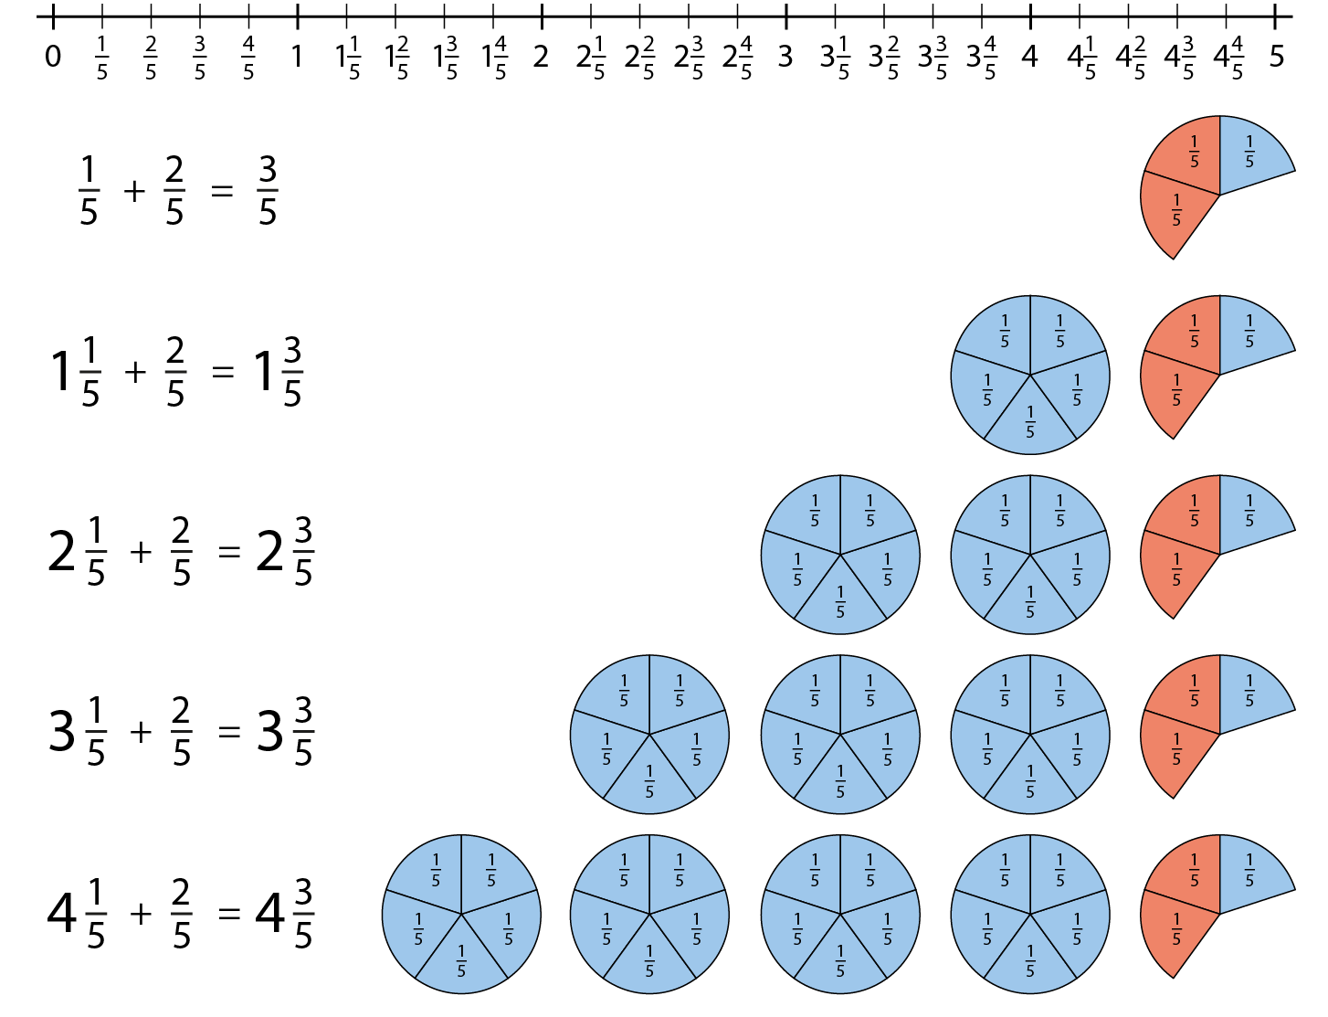


4F-3 Add and subtract improper and mixed fractions (same denominator)
If we have 1 one-fifth and 2 lots of one-fifth, what do we have in total?
Can you draw a diagram, number line or part-part-whole model to show this?
What is the same/different about the next equation? Can you draw a diagram, number line or part-part-whole?
Can you see a pattern? What would the next equation in the sequence be?

Slide 10


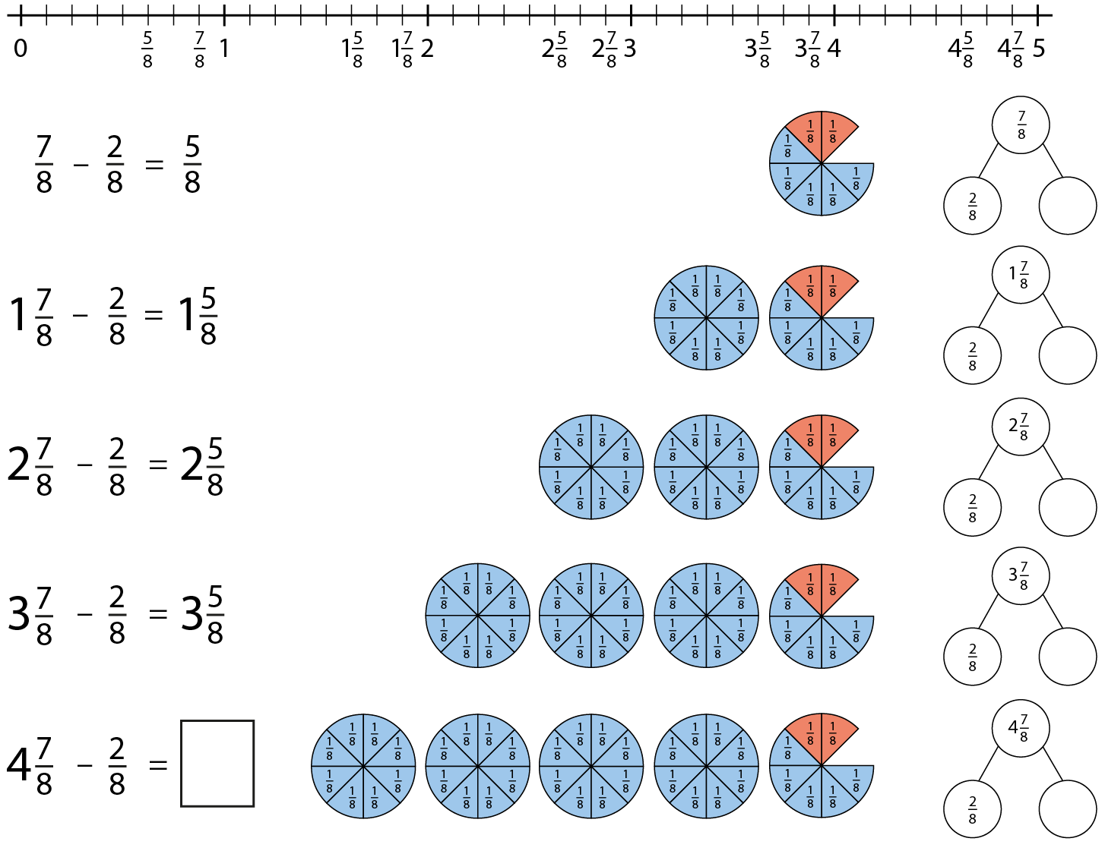

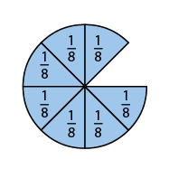
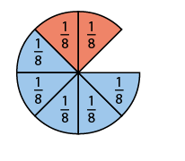
4F-3 Add and subtract improper and mixed fractions (same denominator)
What is different? Can you draw a diagram, number line or part-part-whole model to show this?
What is the same/different about the next equation? Can you draw a diagram, number line or part-part-whole?
Can you see a pattern? What would the next equation in the sequence be?
Can you create your own subtraction sequence?

Slide 11




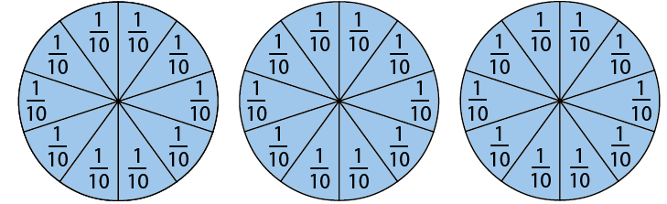
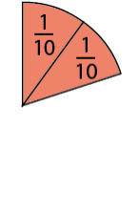
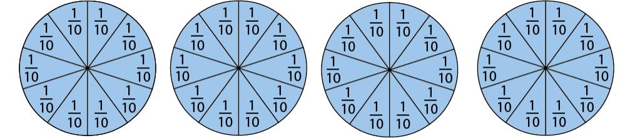
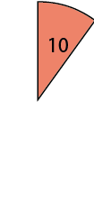
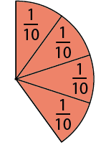
4F-3 Add and subtract improper and mixed fractions (same denominator)
Can you draw a diagram to represent this?
Can you put the whole ones together? How many are there? Now put the extra tenths together. How many tenths?
Can you draw a part-part-whole model to show the parts. What is the total?
Repeat using similar equations.
The parts are __ and __. The total, or whole, is __.

Slide 12
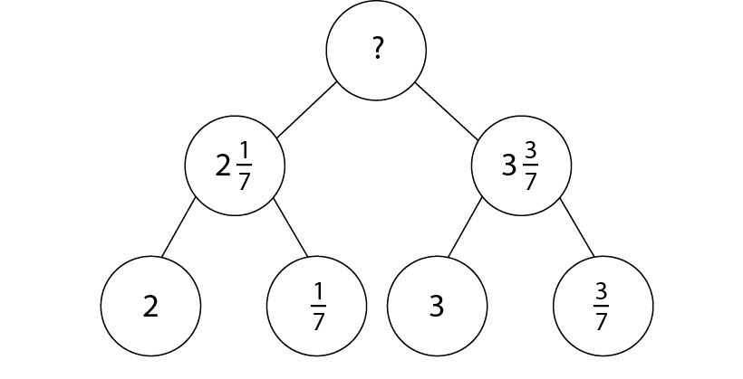
4F-3 Add and subtract improper and mixed fractions (same denominator)
Look at this part-part-whole diagram. Can you draw a diagram to represent the equation?
Can you put the parts together to find the total (whole)? What will you add first?
Provide children with similar diagrams, progressing to children partitioning the mixed numbers themselves

Slide 13
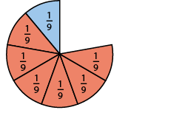
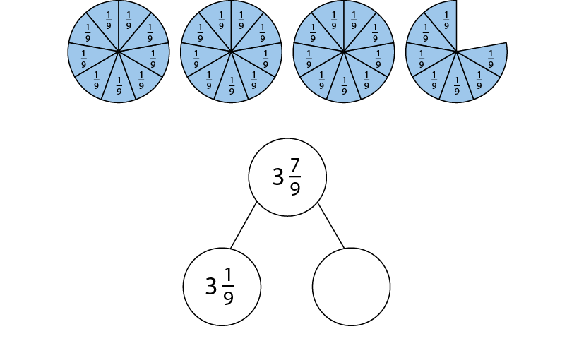
4F-3 Add and subtract improper and mixed fractions (same denominator)
How is this different? What do you need to do? Can you draw a diagram?
Where would each of these numbers be on a number line? Can you find the difference by counting on?
Repeat with similar equations asking children to draw an area model and part- part-whole model then plot both numbers on a number line and count on to find the difference.

Slide 14
4F-3 Add and subtract improper and mixed fractions (same denominator)
For the following two slides, some key questions are provided but it may be useful to provide further similar examples. Children need to be guided to use the language focus:
Children should be given sufficient practice at equations adding fractions with the same denominator where the total becomes an improper fraction to be converted to a mixed number.
When adding fractions with the same denominator, just add the numerators.
When subtracting fractions with the same denominator, just subtract the numerators.

Slide 15



4F-3 Add and subtract improper and mixed fractions (same denominator)
Can you draw a bar model to represent this equation?
How many groups of 5 fifths are there in 10 fifths?
7 one-fifths and 3 one-fifths is equal to 10 one-fifths.

Slide 16


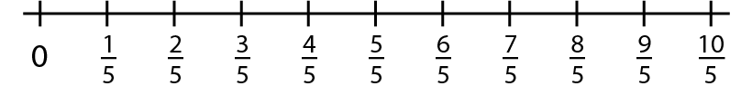
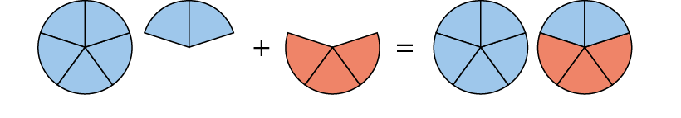


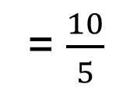
4F-3 Add and subtract improper and mixed fractions (same denominator)
Could you solve the same equation by counting on? Draw a number line to show your working.
What do you notice about adding fractions with the same denominator?
= $\frac{10}{5}$
= $2$

Slide 17
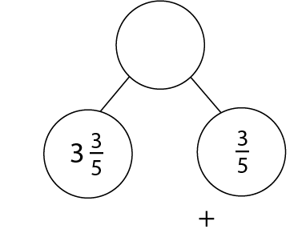
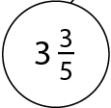
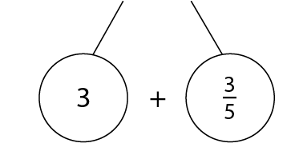
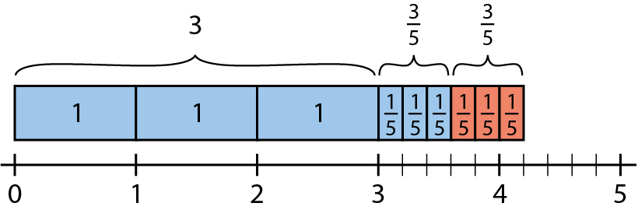
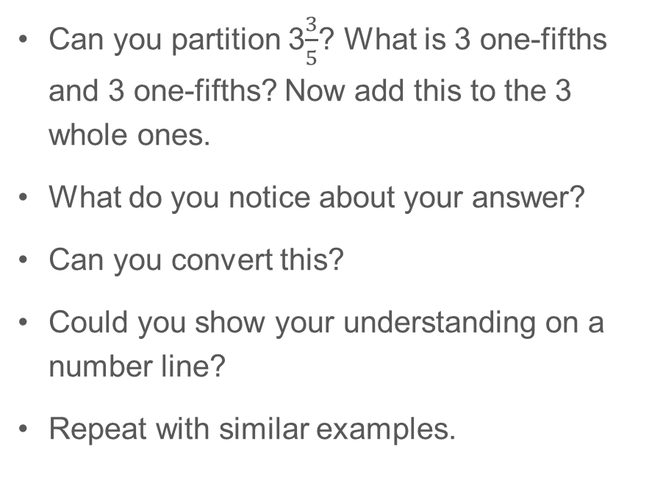
4F-3 Add and subtract improper and mixed fractions (same denominator)
Can you partition 3$\frac{3}{5}$? What is 3 one-fifths and 3 one-fifths? Now add this to the 3 whole ones.
What do you notice about your answer?
Can you convert this?
Could you show your understanding on a number line?
Repeat with similar examples.

Slide 18






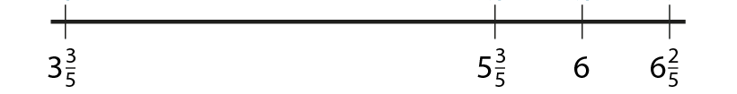
4F-3 Add and subtract improper and mixed fractions (same denominator)
What is different this time?
Can you use a number line to count on? What will you add first? How many more fifths to make the next whole? And how many extra fifths?
Can you solve this another way?
What if you added the whole ones, then added the fractional parts, then put them together? Do you need to convert your answer?

Slide 19

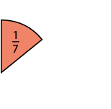
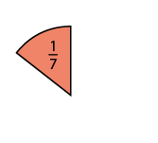
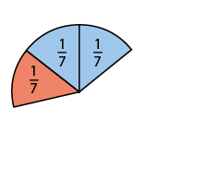
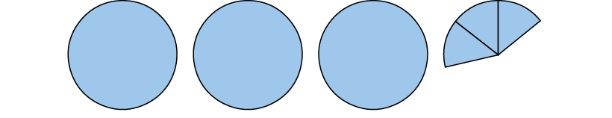
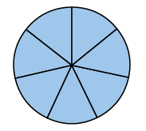
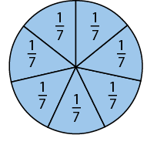
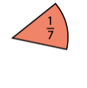






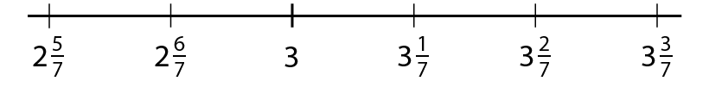
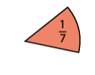
4F-3 Add and subtract improper and mixed fractions (same denominator)
Can you count back in sevenths on a number line?
Can you show your understanding using an area model?
Can you see that we must subtract across the whole?
Now lets try a more efficient method. Can you explain the strategy?
Repeat with similar examples

Slide 20
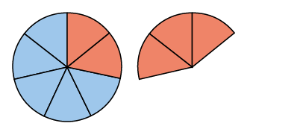
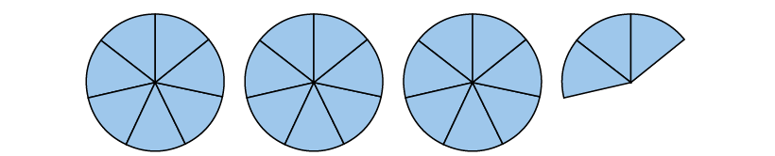
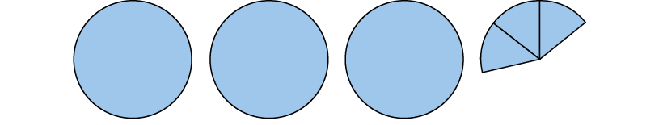
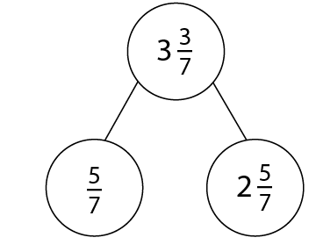
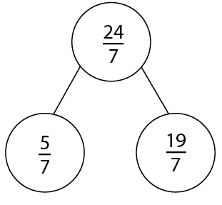


4F-3 Add and subtract improper and mixed fractions (same denominator)
Can we solve this same equation a different way?
Can you represent this using an area model? A part-part-whole model?
Can you convert both parts of the equation to mixed numbers first?
Do you need to convert your answer back to a mixed number?

Slide 21
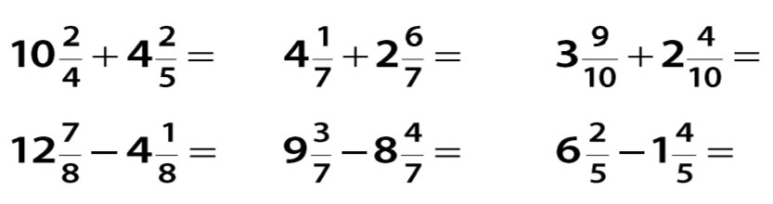
4F-3 Add and subtract improper and mixed fractions (same denominator)
Solve these equations and similar ones to build fluency.

