Slide 1
4F-1
Mixed numbers in the linear number system

Slide 2
4F-1
Reason about the location of mixed numbers in the linear number system.
The materials in this pack have been collated and written to support the teaching of 4F-1. Before planning and teaching the content, read the teaching guidance and example assessment questions in the non-statutory guidance itself, which can be found here.
A video summarising all of the ready-to-progress criteria for Year 4 can be found here.

Slide 3
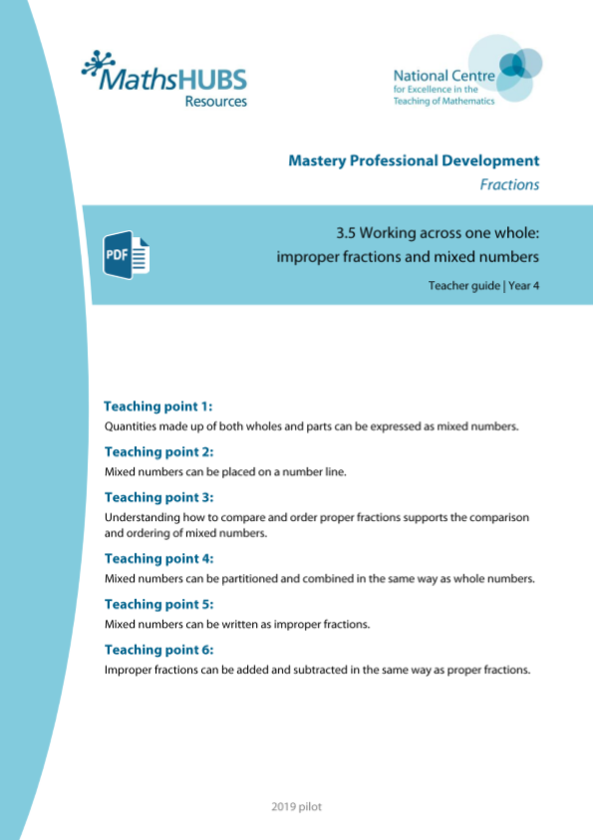
4F-1: Linked mastery PD materials
Additional pedagogical subject knowledge support can be found in the Mastery Professional Development Materials:
3.5 Working across one whole: improper fractions and mixed numbers
Several of the activity slides have been taken from these materials.

Slide 4
4F-1
Mixed numbers in the linear number system

Slide 5
The following slides contain activities that can be used within the context of pre-teaching, intervention, or as supplementary material integrated into teaching. They do not represent complete lessons and should not be used as such. Also they should not be used all at once, but over the period of a teaching unit. It would be valuable to use many of the activities more than once to build fluency in understanding and application. Also many of them would benefit from the use of manipulatives to support interaction with the ideas. Ensure you engage in rich discussion with the children, asking them to reason and explain the ideas presented. Note that when working with a small group, pupils should also have access to the main teaching delivered by the class teacher and the focus should be directly linked so that the learning is connected and fluency is built.

Slide 6
Guidance for working with a small pre-teaching or intervention group
Take time to build understanding of the key idea. We would recommend no more than four slides in any one session, and probably fewer.
In subsequent sessions, review and practise previous learning before moving on.
Play the animation/observe the image and ask pupils “What do you notice?”.
Encourage pupils to explain what they see, what is happening and why.
Where there is a highlighted sentence, draw out the meaning of this from the image and repeat together and individually.

Slide 7
Guidance for working with a small pre-teaching or intervention group
Engage in the suggested activities, using manipulatives where appropriate, to enhance the interaction and stimulate discussion. However, note that the ultimate aim is to develop fluency in the mathematical ideas such that resources are no longer needed.
Repeat questions, using other numbers/examples where relevant.
Repeat the highlighted language structures wherever relevant to build fluency with the key idea and connect the learning. For example:
10 hundreds are equivalent to 1,000.

Slide 8
4F-1 Mixed numbers in the linear number system

Slide 9
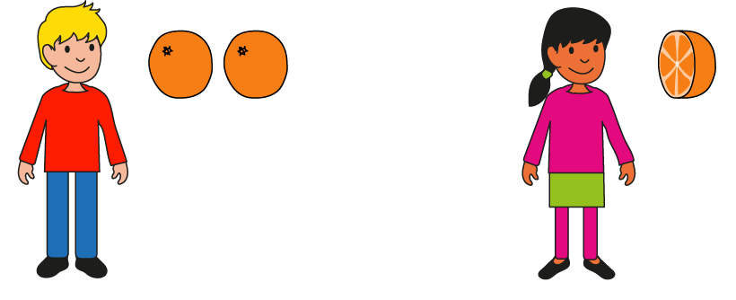
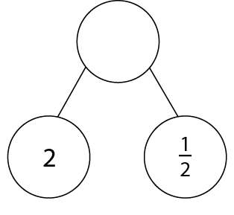


4F-1 Mixed numbers in the linear number system
How many oranges do Johnny and Ellen have altogether?
Are there more than 2 oranges? More than 3? How do you know?
How do we write this number?
Repeat with similar images or real-life concepts.
There are 2 whole oranges. There is half an orange. There are 2 and a half oranges altogether.

Slide 10

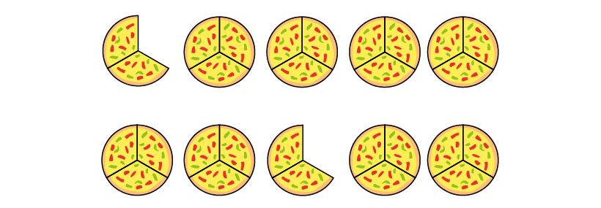
4F-1 Mixed numbers in the linear number system
How many pizzas? How many whole pizzas? And how much more?
And now? And now?
What is the same and what is different about these 3 rows of pizza? Is the quantity of pizza the same or different in each row?
For the pizza that is not a whole what is the fraction of the whole?
There are more than four whole pizzas.
There are less then five whole pizzas.
There are four and two-thirds pizza.

Slide 11

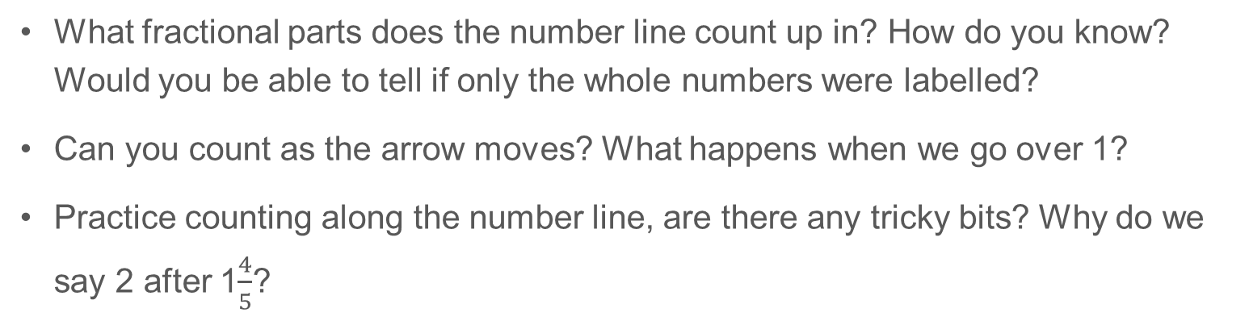
4F-1 Mixed numbers in the linear number system
What fractional parts does the number line count up in? How do you know? Would you be able to tell if only the whole numbers were labelled?
Can you count as the arrow moves? What happens when we go over 1?
Practice counting along the number line, are there any tricky bits? Why do we say 2 after 1$\frac{4}{5}$?
There are ___ parts between zero and one. This means we are counting in units of ­­­­___.

Slide 12
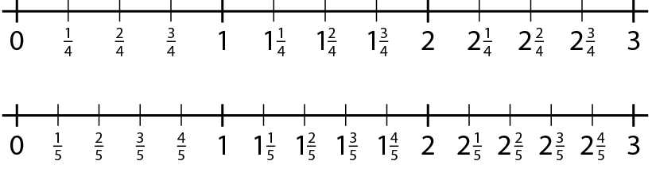
4F-1 Mixed numbers in the linear number system
Tell me any number between 2 and 3.
Tell me a number very close to 3.
Tell me a number greater than 2 that is very close to 2.
Tell me a number smaller than 2 that is very close to 2.

Slide 13



4F-1 Mixed numbers in the linear number system
How many marks between the whole numbers on the number line?
How many spaces (parts) between the whole numbers?
When there are 5 parts we are counting in fifths.
What are we counting in when there are 6 parts? 7 parts? 8 parts?
When there are 5 parts we are counting in ____.

Slide 14


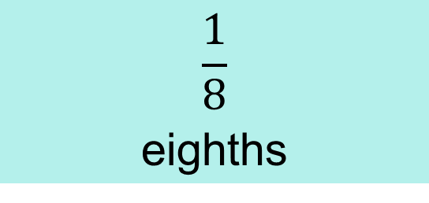
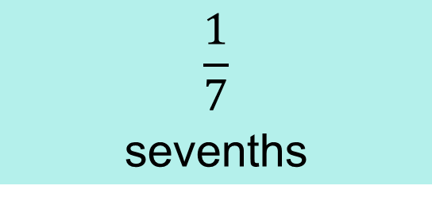
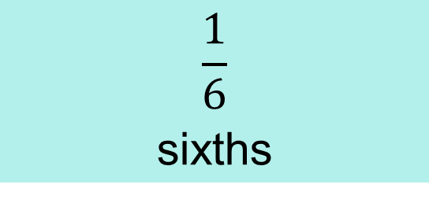
6 parts we count in
5 parts we count in
8 parts we count in
7 parts we count in
3 parts we count in
$$\frac{1}{8}$$
eighths
$$\frac{1}{6}$$
sixths
$$\frac{1}{7}$$
sevenths
$$\frac{1}{5}$$
fifths
$$\frac{1}{3}$$
thirds

Slide 15
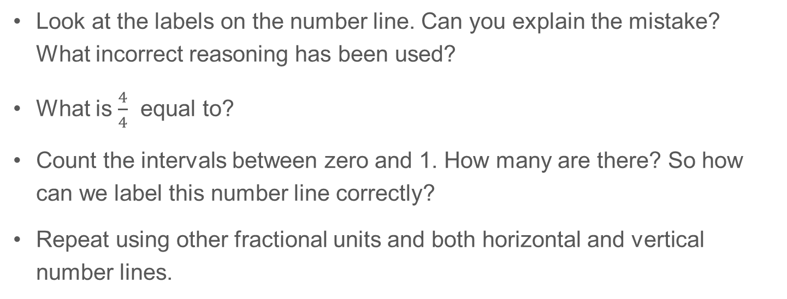
4F-1 Mixed numbers in the linear number system
Look at the labels on the number line. Can you explain the mistake? What incorrect reasoning has been used?
What is $\frac{4}{4}$ equal to?
Count the intervals between zero and 1. How many are there? So how can we label this number line correctly?
Repeat using other fractional units and both horizontal and vertical number lines.

Slide 16

4F-1 Mixed numbers in the linear number system
2
3
4
1
How many intervals between zero and 1?
What fractional steps are there between each whole number?
What fraction is marked by the arrow? Can you explain your thinking?
Repeat by pointing to a different place on the line.

Slide 17





4F-1 Mixed numbers in the linear number system
How many intervals between each whole number?
What fractional steps are there between each whole number?
Can you label each interval correctly?

Slide 18
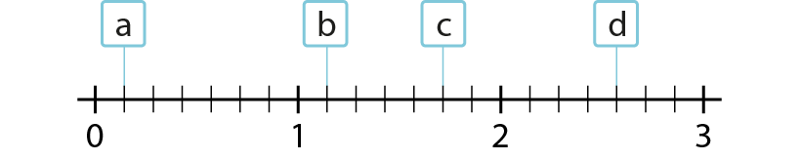

4F-1 Mixed numbers in the linear number system
What number is each letter pointing to?
How many intervals between each whole number? What fractional steps are between each whole number?
Which two whole numbers is each letter between?
1$\frac{1}{7}$ is between 1 and 2. The previous number is 1. The next number is 2.

Slide 19

4F-1 Mixed numbers in the linear number system
Can you position each of these numbers on the number line?
What is the previous whole number? The next whole number?
Do you always need to count on from the previous whole number or can you count back from the next whole number?
2$\frac{2}{5}$ is between 2 and 3. The previous number is 2. The next number is 3.

Slide 20

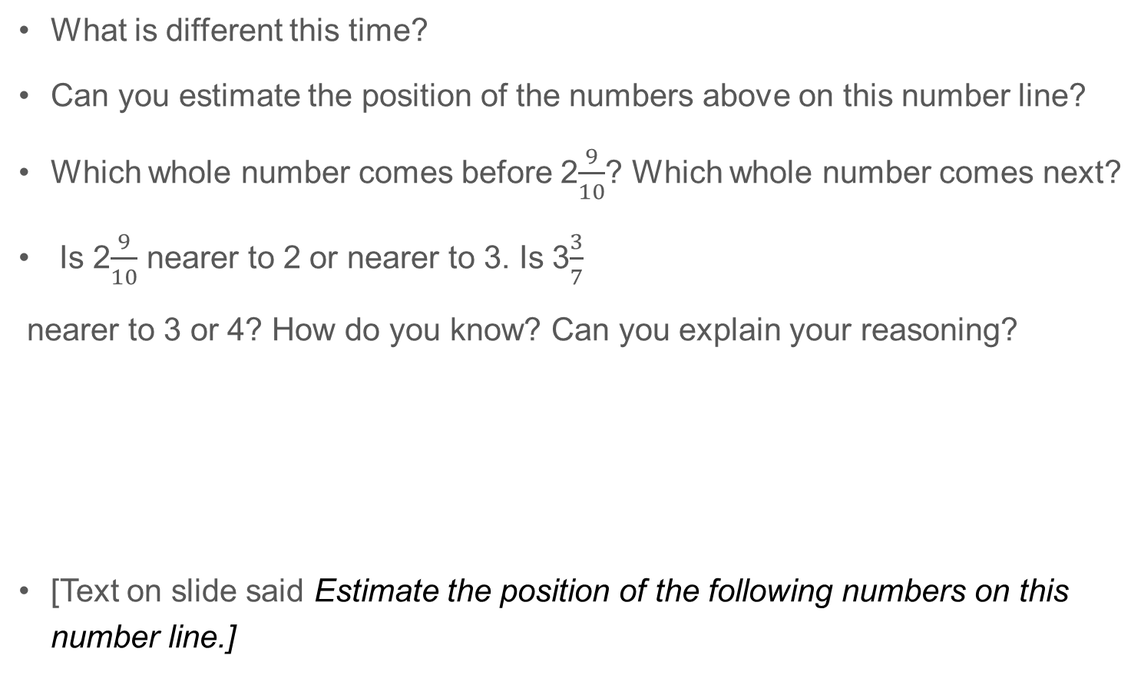
4F-1 Mixed numbers in the linear number system
What is different this time?
Can you estimate the position of the numbers above on this number line?
Which whole number comes before 2$\frac{9}{10}$? Which whole number comes next?
Is 2$\frac{9}{10}$ nearer to 2 or nearer to 3. Is 3$\frac{3}{7}$
nearer to 3 or 4? How do you know? Can you explain your reasoning?
[Text on slide said Estimate the position of the following numbers on this number line.]

Slide 21
4F-1 Mixed numbers in the linear number system
Can you estimate the position of the following numbers on the number line?
What is the previous whole number? The next whole number?
Which of these whole numbers is the arrow nearest to?
Lengths of card and paper clips can be used in a similar way, by specifying a whole number for each end and asking children to slide the paperclip to estimate the position of a mixed number between.

Slide 22
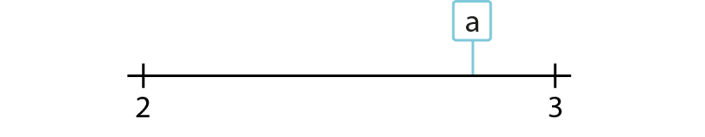
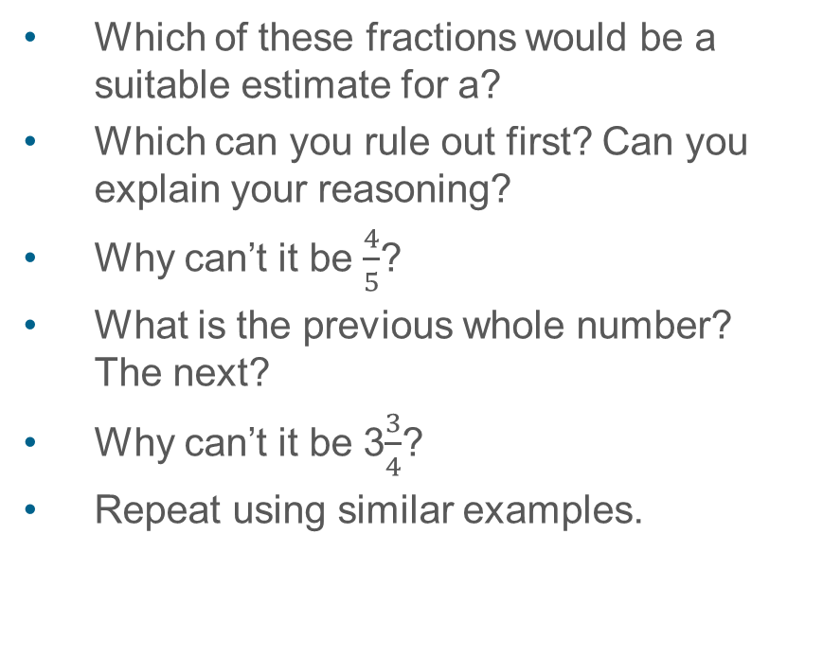
4F-1 Mixed numbers in the linear number system
Which of these fractions would be a suitable estimate for a?
Which can you rule out first? Can you explain your reasoning?
Why can’t it be $\frac{4}{5}$?
What is the previous whole number? The next?
Why can’t it be 3$\frac{3}{4}$?
Repeat using similar examples.
✓

