Slide 1
3NPV-4
Reading scales with 2, 4, 5 or 10 intervals

Slide 2
3NPV-4
Divide 100 into 2, 4, 5 and 10 equal parts, and read scales/number lines marked in multiples of 100 with 2, 4, 5 and 10 equal parts.
The materials in this pack have been collated and written to support the teaching of 3NPV-4. Before planning and teaching the content, read the teaching guidance and example assessment questions in the non-statutory guidance itself, which can be found here.
A video summarising all of the ready-to-progress criteria for Year 3 can be found here.

Slide 3
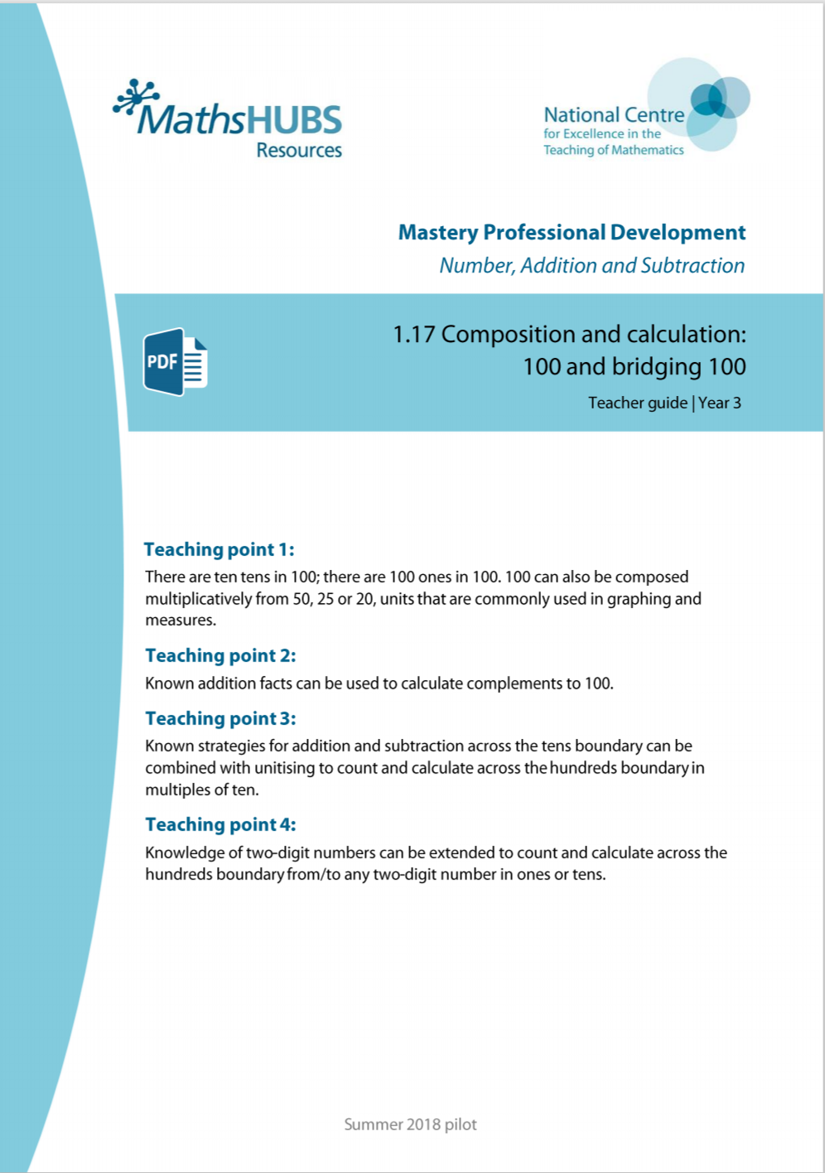
3NPV-4: Linked mastery PD materials
Additional pedagogical subject knowledge support can be found in the Mastery Professional Development Materials:
1.17 Composition and calculation: 100 and bridging 100
Several of the activity slides have been taken from these materials.

Slide 4
3NPV-4
Reading scales with 2, 4, 5 or 10 intervals

Slide 5
The following slides contain activities that can be used within the context of pre-teaching, intervention, or as supplementary material integrated into teaching. They do not represent complete lessons and should not be used as such. Also they should not be used all at once, but over the period of a teaching unit. It would be valuable to use many of the activities more than once to build fluency in understanding and application. Also many of them would benefit from the use of manipulatives to support interaction with the ideas. Ensure you engage in rich discussion with the children, asking them to reason and explain the ideas presented. Note that when working with a small group, pupils should also have access to the main teaching delivered by the class teacher and the focus should be directly linked so that the learning is connected and fluency is built.

Slide 6
Guidance for working with a small pre-teaching or intervention group
Take time to build understanding of the key idea. We would recommend no more than four slides in any one session, and probably fewer.
In subsequent sessions, review and practise previous learning before moving on.
Play the animation/observe the image and ask pupils “What do you notice?”.
Encourage pupils to explain what they see, what is happening and why.
Where there is a highlighted sentence, draw out the meaning of this from the image and repeat together and individually.

Slide 7
Guidance for working with a small pre-teaching or intervention group
Engage in the suggested activities, using manipulatives where appropriate, to enhance the interaction and stimulate discussion. However, note that the ultimate aim is to develop fluency in the mathematical ideas such that resources are no longer needed.
Repeat questions, using other numbers/examples where relevant.
Repeat the highlighted language structures wherever relevant to build fluency with the key idea and connect the learning. For example:
10 hundreds are equivalent to 1,000.

Slide 8
3NPV-4 Reading scales with 2, 4, 5 or 10 intervals

Slide 9
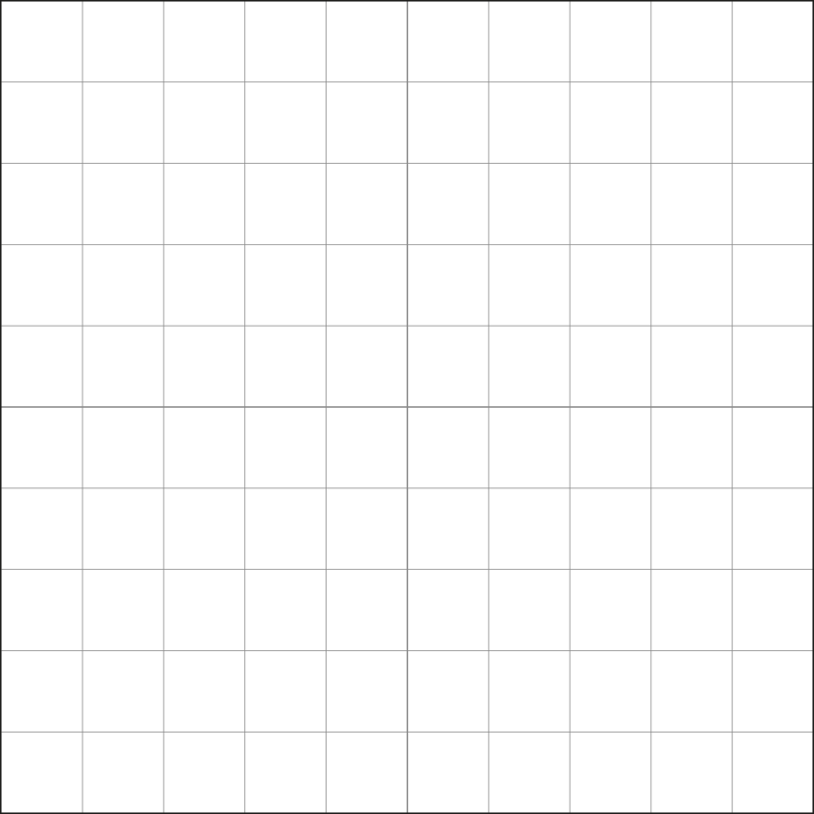
3NPV-4 Reading scales with 2, 4, 5 or 10 intervals
How many equal parts has this one-hundred grid been divided into?
What is the value of each equal part? How do you know?
Use a Dienes hundred square. Show how the hundred square can be divided into two equal parts. Run your finger over each column of 10 to count how many are in each half.
Use a printed hundred grid and draw a line to divide it into 2 equal parts. What is the value of each part?
Write an equation to express the relationship. Can you write a different equation?
100
50
50
100 = 50 + 50
100 = 2 × 50
100 = 50 × 2
100 ÷ 2 = 50
100 ÷ 50 = 2

Slide 10
3NPV-4 Reading scales with 2, 4, 5 or 10 intervals
How many equal parts has this one-hundred grid been divided into?
What is the value of each equal part? How do you know?
Use a Dienes hundred square. Show how the hundred square can be divided into four parts. Run your finger along the rows or columns of 5 to count up to 25 in each of the four parts.
Use a printed hundred grid and draw lines to divide it into 4 equal parts. What is the value of each part?
Write an equation to express the relationship. Can you write a different equation?
100
100 = 25 + 25 + 25 +25
25
25
25
25
100 = 25 × 4
100 = 4 × 25
100 ÷ 4 = 25
100 ÷ 25 = 4

Slide 11
3NPV-4 Reading scales with 2, 4, 5 or 10 intervals
How many equal parts has this one-hundred grid been divided into?
What is the value of each equal part? How do you know?
Use a Dienes hundred square. Show how the hundred square can be divided into five equal parts. Run your finger over each column of 10 to count how many are in each part.
Use a printed hundred grid and draw lines to divide it into 5 equal parts. What is the value of each part?
Write an equation to express the relationship. Can you write a different equation?
100
100 = 20 + 20 + 20 +20 + 20
20
20
20
20
20
100 = 5 × 20
100 = 20 × 5
100 ÷ 5 = 20
100 ÷ 20 = 5

Slide 12
3NPV-4 Reading scales with 2, 4, 5 or 10 intervals
How many equal parts has this one-hundred grid been divided into?
What is the value of each equal part? How do you know?
Use a Dienes hundred square. Show how the hundred square can be divided into ten equal parts.
Use a printed hundred grid and divide it into 10 equal parts. What is the value of each part?
Write an equation to express the relationship. Can you write a different equation?
100
100 = 10 + 10 + 10 + 10 + 10 + 10 + 10 + 10 + 10 + 10
10
10
10
10
10
10
10
10
10
10
100 = 10 × 10
100 ÷ 10 = 10

Slide 13
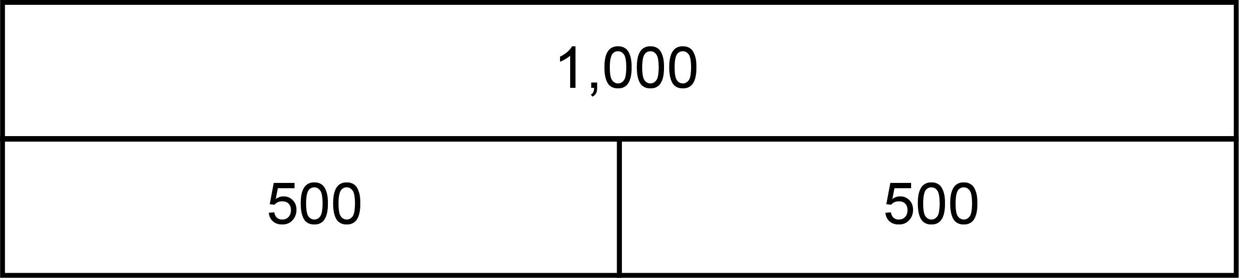
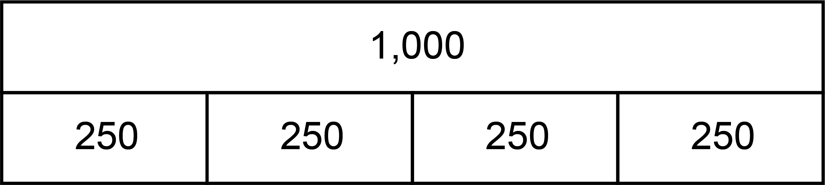
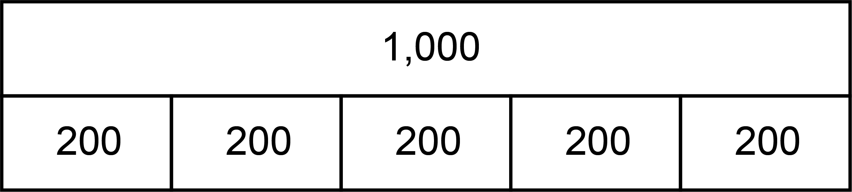
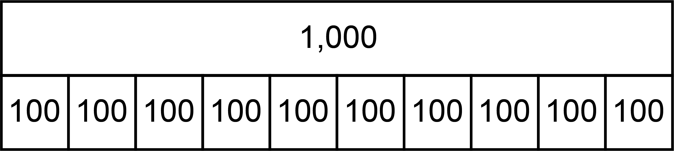
3NPV-4 Reading scales with 2, 4, 5 or 10 intervals
2, 4, 5 and 10 part composition of 100
If we divide the hundred into 2 equal parts, what is the value of each part?
What if we divide the hundred into 4 equal parts?
5 equal parts?
10 equal parts?
100
2 part
50
50
100
4 part
25
25
25
25
100
5 part
20
20
20
20
20
100
10 part
v
v
v
v
v
v
v
v
v
v
v
v
v
v
v
v
v
v
v
v
10
10
10
10
10
10
10
10
10
10

Slide 14
3NPV-4 Reading scales with 2, 4, 5 or 10 intervals
Let’s count in fifties from zero to one hundred.
Now let’s count in steps of twenty-five. Can you count backwards from each of these?
If I count in steps of twenty, what comes after 40? Before 100?
If I count in tens, what comes between 30 and 50?
Practise counting in steps of 50, 25, 20 and 10 to and beyond 100.
100
100
100
100
90
Fifty, one hundred.
80
80
75
70
60
60
50
50
50
40
40
30
25
20
20
10
0
0
0
0

Slide 15
3NPV-4 Reading scales with 2, 4, 5 or 10 intervals
400
10000
700
200
Is the number before or after ___ hundred? How do you know?
How many intervals are there on the number line? How can we use this to decide what we are counting in?
Check by counting from the lower multiple of one hundred.
190
680
180
The number is between ___ hundred and ___ hundred.
975
170
660
160
300
950
150
640
140
130
925
620
120
110
300
900
600
100

Slide 16
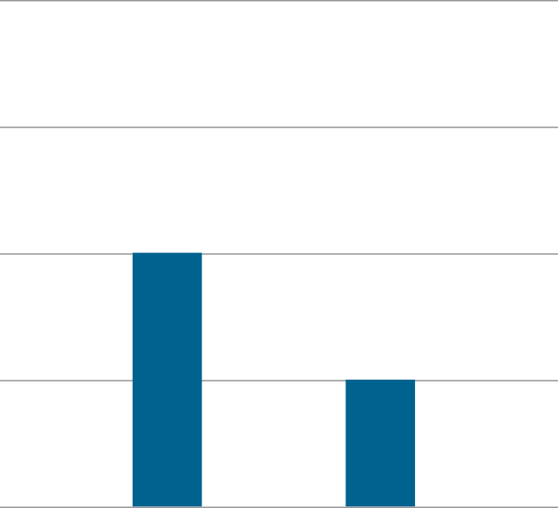
3NPV-4 Reading scales with 2, 4, 5 or 10 intervals
What do you notice about this representation?
How many intervals are there between zero and 100? So, what interval do we need to count up in?
How many did Jenny score?
How many did Asif score?
What is the difference between Asif and Jenny’s scores? How do you know?
What would Jenny’s score be if she scored 25 more?
How far is Asif away from scoring 100? How do you know?
100
75
50
Score
50
25
25
0
Jenny
Asif

Slide 17
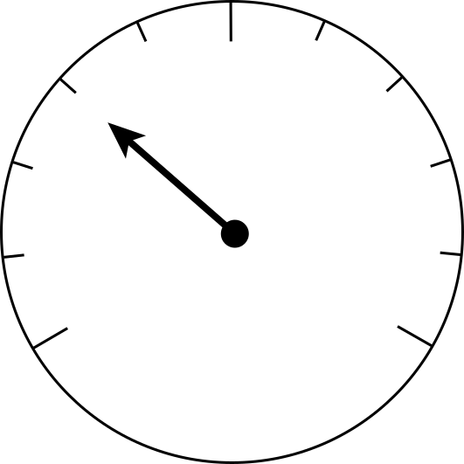
3NPV-4 Reading scales with 2, 4, 5 or 10 intervals
What is different about this representation? Where might you see this?
Has the arrow stopped before or after 100? How do you know?
How many intervals are there between zero and 100? So, what interval do we need to count up in?
What value is the arrow pointing to?
Did you get 60kg? Count in steps of 20 from zero to check if you are correct?
Can you point to where 180kg is on this measuring scale? What about 190kg?
80
100
120
60
140
40
160
20
kg
180
0
200

Slide 18
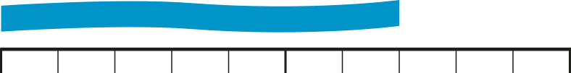
3NPV-4 Reading scales with 2, 4, 5 or 10 intervals
0
10 cm
20 cm
30 cm
40 cm
50 cm
60 cm
70 cm
80 cm
90 cm
1 m
Do you think this ribbon is longer or shorter than 100cm? How do you know?
Could it be 40cm long? Why not?
How many intervals are there between zero and 100cm? So, what interval do we need to count up in?
How long is the ribbon?
Did you get 70cm? Count in steps of 10 to check if you are correct.
How long would the ribbon be if we cut off 20cm?

Slide 19
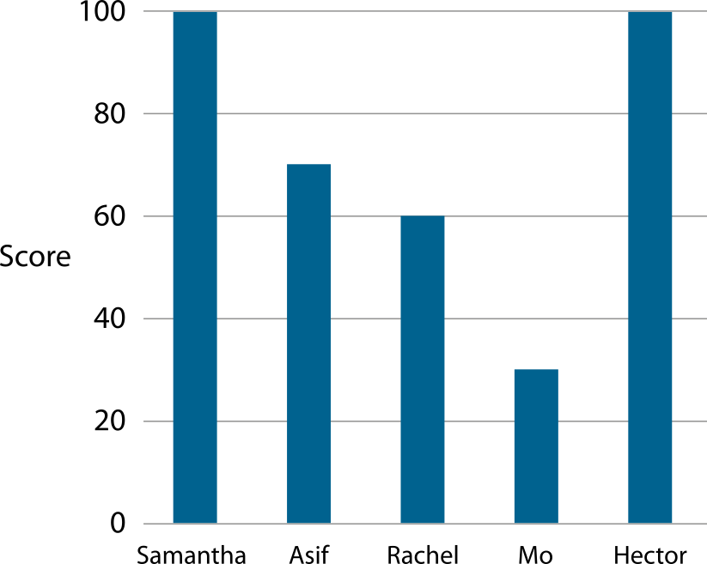
3NPV-4 Reading scales with 2, 4, 5 or 10 intervals
What do you notice about this bar chart?
What interval does the score go up in?
Did any children score the same number of points? How do you know?
Can Asif have scored 80 points? Why not? How many points did Asif score?
How much more did Samantha score than Asif?
How much less did Rachel score than Hector?
Can you make up a question to ask about the bar chart?
80
60
40
20

Slide 20
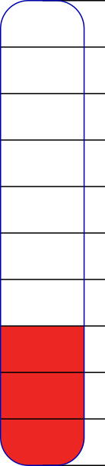
3NPV-4 Reading scales with 2, 4, 5 or 10 intervals
£100
What do you notice about this numberline?
How many intervals are there between zero and £100? So, what interval do we need to count up in?
How much money has been raised so far?
How much more money needs to be raised to reach £100? How do you know?
£70
£30

Slide 21
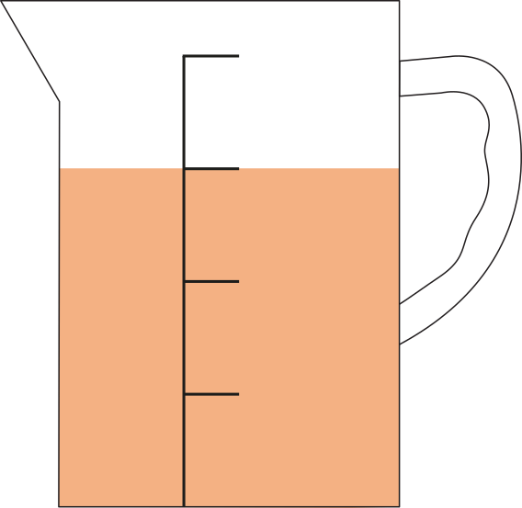
3NPV-4 Reading scales with 2, 4, 5 or 10 intervals
How many intervals are there between zero and 100ml on this measuring jug? So, what interval do we need to count up in?
How much liquid do you think is in the jug?
Did you get 75ml? Count in steps of 25 from zero to check if you are correct.
How much more liquid needs to poured in to reach 100ml? How do you know?
100 ml
25 ml
75 ml
50 ml
25 ml

