Slide 1
3NPV-3
Three-digit numbers in the linear number system

Slide 2
3NPV-3
Reason about the location of any three-digit number in the linear number system, including identifying the previous and next multiple of 100 and 10.
The materials in this pack have been collated and written to support the teaching of 3NPV-3. Before planning and teaching the content, read the teaching guidance and example assessment questions in the non-statutory guidance itself, which can be found here.
A video summarising all of the ready-to-progress criteria for Year 3 can be found here.

Slide 3
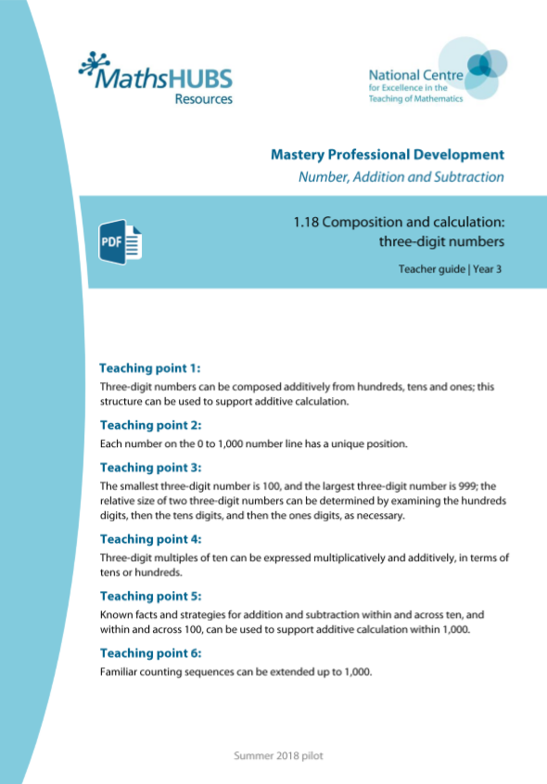
3NPV-3: Linked mastery PD materials
Additional pedagogical subject knowledge support can be found in the Mastery Professional Development Materials:
1.18 Composition and calculation: three-digit numbers
Several of the activity slides have been taken from these materials.

Slide 4
3NPV-3
Three-digit numbers in the linear number system

Slide 5
The following slides contain activities that can be used within the context of pre-teaching, intervention, or as supplementary material integrated into teaching. They do not represent complete lessons and should not be used as such. Also they should not be used all at once, but over the period of a teaching unit. It would be valuable to use many of the activities more than once to build fluency in understanding and application. Also many of them would benefit from the use of manipulatives to support interaction with the ideas. Ensure you engage in rich discussion with the children, asking them to reason and explain the ideas presented. Note that when working with a small group, pupils should also have access to the main teaching delivered by the class teacher and the focus should be directly linked so that the learning is connected and fluency is built.

Slide 6
Guidance for working with a small pre-teaching or intervention group
Take time to build understanding of the key idea. We would recommend no more than four slides in any one session, and probably fewer.
In subsequent sessions, review and practise previous learning before moving on.
Play the animation/observe the image and ask pupils “What do you notice?”.
Encourage pupils to explain what they see, what is happening and why.
Where there is a highlighted sentence, draw out the meaning of this from the image and repeat together and individually.

Slide 7
Guidance for working with a small pre-teaching or intervention group
Engage in the suggested activities, using manipulatives where appropriate, to enhance the interaction and stimulate discussion. However, note that the ultimate aim is to develop fluency in the mathematical ideas such that resources are no longer needed.
Repeat questions, using other numbers/examples where relevant.
Repeat the highlighted language structures wherever relevant to build fluency with the key idea and connect the learning. For example:
10 hundreds are equivalent to 1,000.

Slide 8
3NPV-3 Three-digit numbers in the linear number system

Slide 9
3NPV-3 Three-digit numbers in the linear number system
0
100
200
300
400
500
600
700
800
900
1,000
Can you estimate what number the arrow is pointing to? Would 590 be a good estimate? Why not? Which two multiples of a hundred is the number between? What is the mid-point between these two multiples? How can this help you? How do you know the number comes before 550? How many intervals between each hundred? What does this tell you? Which two multiples of 10 is the number between. What would a suitable estimate be?
Repeat for the other arrows, discussing the corresponding multiples either side.
Where do you think 825 would be on the line? 109? 737? Repeat for other numbers.
The previous multiple of 100 is ___.The next multiple of 100 is ___.

Slide 10
3NPV-3 Three-digit numbers in the linear number system
0
500
1,000
What is different to the number line on the previous slide? What do you notice?
Can you estimate what number the arrow is pointing to? Would 780 be a good estimate? Why not? What could you mark on the line to help you? What would this mid-point be? Reveal the mid-point. How does this help you? Could you add any other landmarks to help you? What would a suitable estimate be?
Repeat for the other arrows discussing adding other landmarks to aid proportional reasoning.
Where do you think 281 would be on the line? Repeat for other numbers

Slide 11
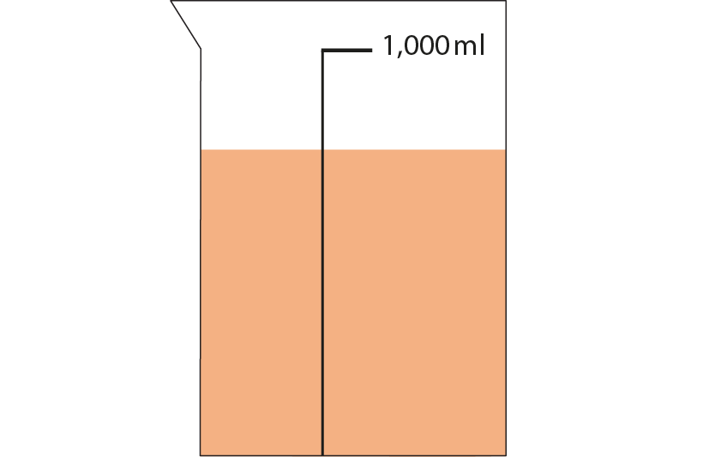
3NPV-3 Three-digit numbers in the linear number system
What do you notice? What could you say about how much liquid is in the jug? Would 30ml be a reasonable estimate? How do you know it is more than 50ml?
Where would 50 be on the scale?
Can you use this to make a reasonable estimate for the amount of liquid?
100ml

Slide 12
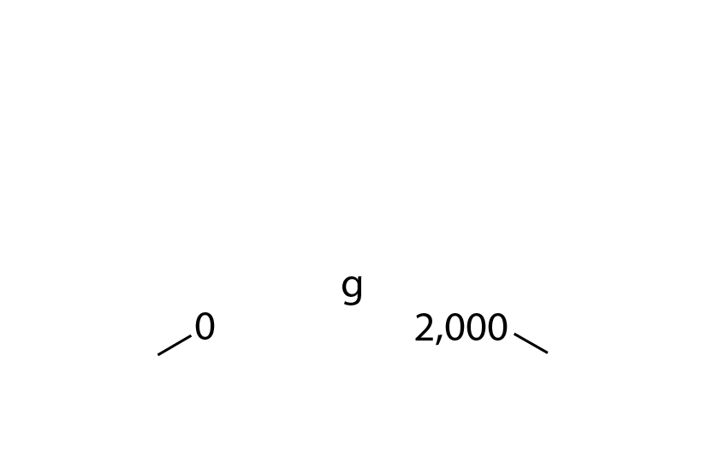
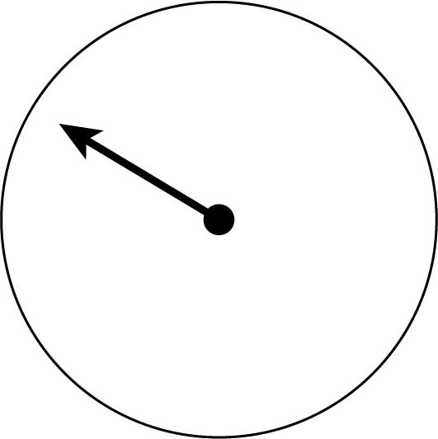
3NPV-3 Three-digit numbers in the linear number system
What is different this time?
Can you estimate where the arrow stops?
What can you do to make your estimation more accurate? Is the arrow pointing to before or after 100?
What landmarks can you put on the scale?
Can you now make a reasonable estimate?
Mark other points on the scale, can you identify their value?
200

Slide 13
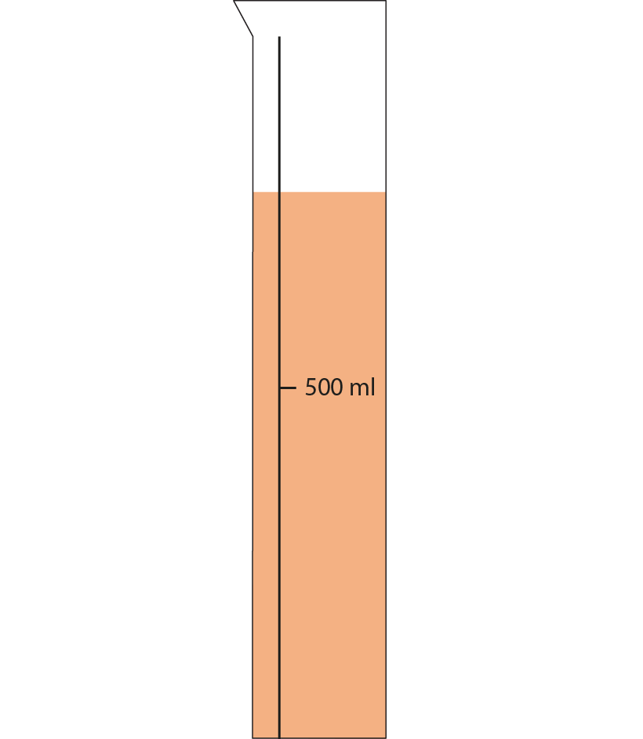
3NPV-3 Three-digit numbers in the linear number system
What do you notice? What could you say about how much liquid is in the jug? Would 900ml be a reasonable estimate? How do you know it is more than 600ml?
Can you put other landmarks on this scale to help you make a reasonable estimate for the amount of liquid shown?

Slide 14
3NPV-3 Three-digit numbers in the linear number system
0
100
200
300
400
500
600
700
800
900
1,000
Can you estimate what number the arrow is pointing to?
Which two multiples of 100 is the number between? What would a suitable estimate be?
Repeat for the other arrows, discussing the corresponding multiples of 100 either side.
Where do you think 620 would be on the line? Repeat for other numbers.
The previous multiple of 100 is ___. The next multiple of 100 is ___.

Slide 15
3NPV-3 Three-digit numbers in the linear number system
500
510
520
530
540
550
560
570
580
590
600
Can you estimate what number the arrow is pointing to? Would 578 be a good estimate? Why not? Which two multiples of 10 is the number between? What would a suitable estimate be?
Repeat for the other arrows, discussing the corresponding multiples of 10 either side.
Where do you think 521 would be on the line? Repeat for other numbers.
The previous multiple of 10 is ___. The next multiple of 10 is ___.

Slide 16
3NPV-3 Three-digit numbers in the linear number system
Look at the 3-digit number. Can you say the previous multiple of 100 and the next multiple of 100?
For the same number, can you say the previous multiple of 10 and the next multiple of 10?
Previous multiple of 100
Next multiple of 100
300
342
400
Previous multiple of 10
Next multiple of 10
The previous multiple of 100 is ___. The next multiple of 100 is ___.
340
342
350
The previous multiple of 10 is ___. The next multiple of 10 is ___.

