Slide 1
3MD-1
Multiplication and division structure

Slide 2
3MD-1
Apply known multiplication and division facts to solve contextual problems with different structures, including quotitive and partitive division.
The materials in this pack have been collated and written to support the teaching of 3MD-1. Before planning and teaching the content, read the teaching guidance and example assessment questions in the non-statutory guidance itself, which can be found here.
A video summarising all of the ready-to-progress criteria for Year 3 can be found here.

Slide 3
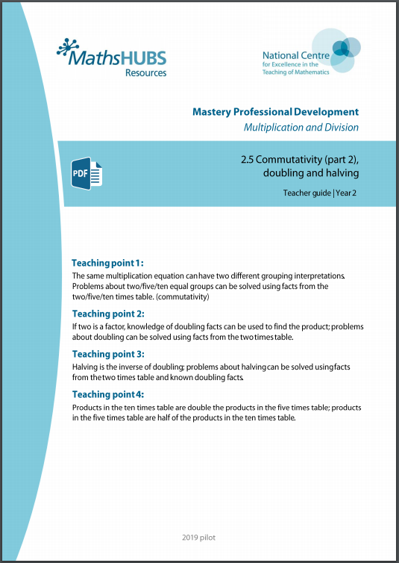
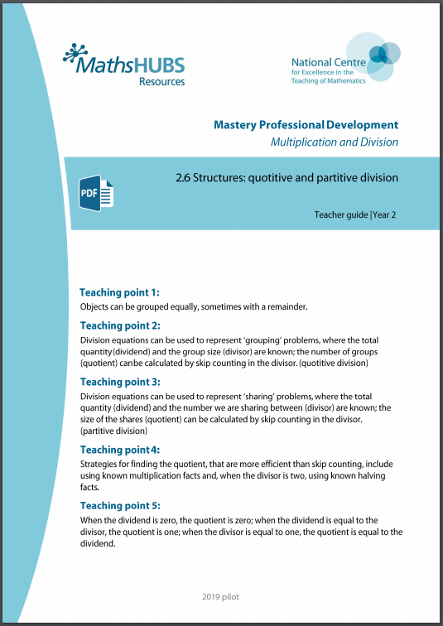
3MD-1: Linked mastery PD materials
Additional pedagogical subject knowledge support can be found in the following Mastery Professional Development materials:
  2.5 Commutativity (part 2), doubling and halving
  2.6 Structures: quotitive and partitive division
Several of the activity slides have been taken from these materials.

Slide 4
3MD-1
Multiplication and division structure

Slide 5
The following slides contain activities that can be used within the context of pre-teaching, intervention, or as supplementary material integrated into teaching. They do not represent complete lessons and should not be used as such. Also they should not be used all at once, but over the period of a teaching unit. It would be valuable to use many of the activities more than once to build fluency in understanding and application. Also many of them would benefit from the use of manipulatives to support interaction with the ideas. Ensure you engage in rich discussion with the children, asking them to reason and explain the ideas presented. Note that when working with a small group, pupils should also have access to the main teaching delivered by the class teacher and the focus should be directly linked so that the learning is connected and fluency is built.

Slide 6
Guidance for working with a small pre-teaching or intervention group
Take time to build understanding of the key idea. We would recommend no more than four slides in any one session, and probably fewer.
In subsequent sessions, review and practise previous learning before moving on.
Play the animation/observe the image and ask pupils “What do you notice?”.
Encourage pupils to explain what they see, what is happening and why.
Where there is a highlighted sentence, draw out the meaning of this from the image and repeat together and individually.

Slide 7
Guidance for working with a small pre-teaching or intervention group
Engage in the suggested activities, using manipulatives where appropriate, to enhance the interaction and stimulate discussion. However, note that the ultimate aim is to develop fluency in the mathematical ideas such that resources are no longer needed.
Repeat questions, using other numbers/examples where relevant.
Repeat the highlighted language structures wherever relevant to build fluency with the key idea and connect the learning. For example:
10 hundreds are equivalent to 1,000.

Slide 8
3MD-1 Multiplication and division structures

Slide 9
3MD-1 Multiplication and division structures
How many counters can you see? Can you describe how they are arranged?
Use 20 counters and arrange them as an array as shown in the representation.
Describe how many groups you can see.
Describe how many counters are in each group.
Show these groupings with your own set of counters.
Can you explain why 4 x 5 and 5 x 4 are equal?
4 × 5 = 5 × 4

Slide 10
3MD-1 Multiplication and division structures
Can you fill in the gaps as you move through these slides.
Can you set some challenges like this for your partner?
3 groups of 8 is 24 8 groups of 3 is 24
3 x 8 = 8 x 3
7 groups of 5 is 35 5 groups of 7 is 35
7 x 5 = 5 x 7
6 groups of 4 is 24 4 groups of 6 is 24
6 x 4 = 4 x 6
Factor times factor is equal to product.
The order of the factors does not affect the product.

Slide 11


3MD-1 Multiplication and division structures
How many conkers are there?
How many children can get 5 conkers each?
What multiplication fact can you use to help you work out the answer to this division calculation?
What does each number represent in the division equation?
Use counters to model what happens if 40 counters are divided into groups of 5. How many groups will there be? What multiplication fact can you use to help you?
20 divided into groups of 5 is equal to 4.
4 x 5 = 20
20 ÷ 5 = 4

Slide 12

3MD-1 Multiplication and division structures
How many conkers are there?
There are 5 children. If the conkers are shared equally between the 5 children, how many will each child get?
What multiplication fact can you use to help you to work out the answer to this division calculation?
What does each number represent in the division equation?
Use counters to model what happens if 45 counters are shared equally between 5 children. What multiplication fact can you use to help you?
20 divided by 5 is equal to 4 each.
5 x 4 = 20
20 ÷ 5 = 4

Slide 13
3MD-1 Multiplication and division structures
Go back to the previous slide and note that for every 5 each child gets 1 each. Repeat the animation, saying:
One 5, one each, two 5s, two each, three 5s, three each…
Then look back at the two slides and note the difference in the structure of the problems.
The first problem was division with grouping (quotative division). We grouped the conkers into groups of 5 and gave each child a group of 5.
The second problem was division by sharing (partitive division). We shared the conkers by taking 5 each time. For every 5 each child received 1 conker each.

Slide 14
3MD-1 Multiplication and division structures
20
I need 20 pens.
There are 5 pens in a pack.
How many packs do I need?
Do you think this question is division with grouping or sharing? Can you explain your thinking?
What multiplication fact can you use to help you work out the answer?
For each story, what does each number in the equation represent?
5
5
5
5
20 ÷ 5 = 4
20
5 children earn £20 between them.
They share the money equally.
How much money do they each get?
4
4
4
4
4

Slide 15
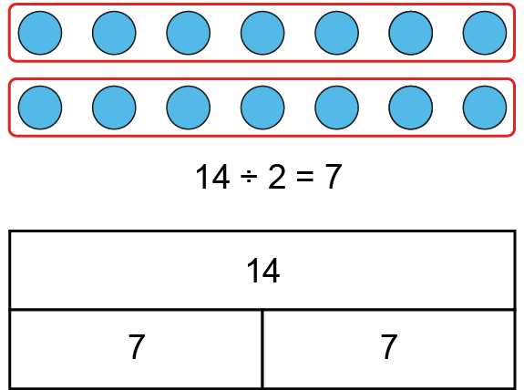
3MD-1 Multiplication and division structures
£14 is shared between 2 children. How much money does each child get?
Use counters and draw a bar model to represent the following story.
£24 is shared between 4 children. How much money does each child get?
What multiplication fact did you use to help you answer the question?
7 times 2 is 14, so 14 divided by 2 is 7.
£14 shared between 2 is equal to £7 each.

Slide 16
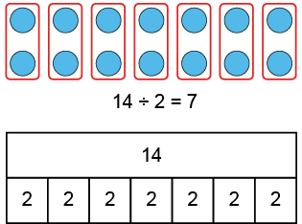
3MD-1 Multiplication and division structures
I need 14 ping-pong balls. There are 2 ping-pong balls in a pack. How many packs do I need?
Use counters and draw a bar model to represent the following story.
I need 16 oranges. There are 4 oranges in a pack. How many packs do I need?
What multiplication fact did you use to help you answer the question?
7 times 2 is 14, so 14 divided by 2 is 7.
14 divided into groups of 2 is equal to 7.

Slide 17
3MD-1 Multiplication and division structure
Birthday Sharing
https://nrich.maths.org/14052

