Slide 1
3G-1
Recognise right angles

Slide 2
3G-1
Recognise right angles as a property of shape or a description of a turn, and identify right angles in 2D shapes presented in different orientations.
The materials in this pack have been collated and written to support the teaching of 3G-1. Before planning and teaching the content, read the teaching guidance and example assessment questions in the non-statutory guidance itself, which can be found here.
A video summarising all of the ready-to-progress criteria for Year 3 can be found here.

Slide 3
3G-1
Recognise right angles

Slide 4
The following slides contain activities that can be used within the context of pre-teaching, intervention, or as supplementary material integrated into teaching. They do not represent complete lessons and should not be used as such. Also they should not be used all at once, but over the period of a teaching unit. It would be valuable to use many of the activities more than once to build fluency in understanding and application. Also many of them would benefit from the use of manipulatives to support interaction with the ideas. Ensure you engage in rich discussion with the children, asking them to reason and explain the ideas presented. Note that when working with a small group, pupils should also have access to the main teaching delivered by the class teacher and the focus should be directly linked so that the learning is connected and fluency is built.

Slide 5
Guidance for working with a small pre-teaching or intervention group
Take time to build understanding of the key idea. We would recommend no more than four slides in any one session, and probably fewer.
In subsequent sessions, review and practise previous learning before moving on.
Play the animation/observe the image and ask pupils “What do you notice?”.
Encourage pupils to explain what they see, what is happening and why.
Where there is a highlighted sentence, draw out the meaning of this from the image and repeat together and individually.

Slide 6
Guidance for working with a small pre-teaching or intervention group
Engage in the suggested activities, using manipulatives where appropriate, to enhance the interaction and stimulate discussion. However, note that the ultimate aim is to develop fluency in the mathematical ideas such that resources are no longer needed.
Repeat questions, using other numbers/examples where relevant.
Repeat the highlighted language structures wherever relevant to build fluency with the key idea and connect the learning. For example:
10 hundreds are equivalent to 1,000.

Slide 7
3G-1 Recognise right angles

Slide 8
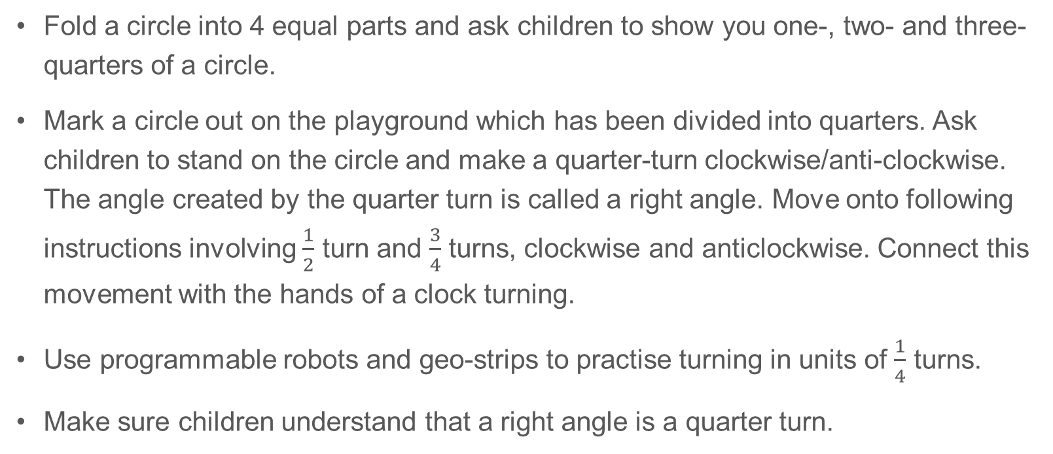
3G-1 Recognise right angles
Fold a circle into 4 equal parts and ask children to show you one-, two- and three-quarters of a circle.
Mark a circle out on the playground which has been divided into quarters. Ask children to stand on the circle and make a quarter-turn clockwise/anti-clockwise. The angle created by the quarter turn is called a right angle. Move onto following instructions involving $\frac{1}{2}$ turn and $\frac{3}{4}$ turns, clockwise and anticlockwise. Connect this movement with the hands of a clock turning.
Use programmable robots and geo-strips to practise turning in units of $\frac{1}{4}$ turns.
Make sure children understand that a right angle is a quarter turn.
A right angle is the amount of turn between two lines that creates a quarter of a full turn.

Slide 9
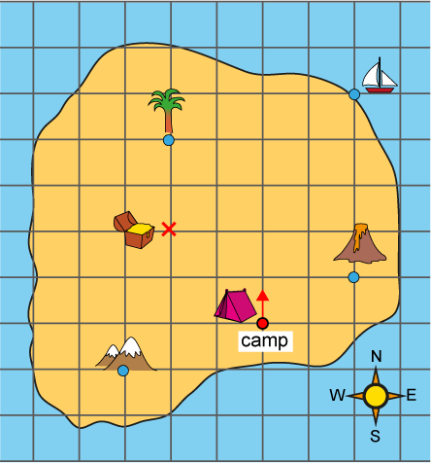
3G-1 Recognise right angles
Give children a copy of the treasure island map shown. Children need to use their finger and start at the camp, facing north.
Ask children to follow a range of instructions, for example:
- Go forwards 4 squares. Make a quarter turn anti-clockwise. Go forwards 2 squares. Where are you?
- Make a three-quarter turn clockwise. Go forward 2 squares. Mark the point and draw a lake.
Draw another feature on the map and write instructions on how to get there from the camp.
Use squared paper and design a map of your own like this. Can you write instructions for someone to find features on your map?

Slide 10

3G-1 Recognise right angles
What do you notice about this shape?
How many sides has the shape got?
How many vertices?
Do you think there are any right angles in the shape? Use a right-angle checker to help you. This could be a card circle with a quarter cut out or a piece of paper folded in half and then half again to create a right angle.
Is it a regular shape or an irregular shape? How do you know?
Can you name the shape?
Use squared or dotty paper. Can you draw an irregular pentagon with only two right angles? What about only one right angle?
Repeat this activity with other polygons.

Slide 11
3G-1 Recognise right angles
Children should be able to identify right angles in polygons.
It will be useful to provide pupils with an assortment of 2D shapes for them to select from, handle, compare and sort. Put shapes into a feely bag and see if children can pick out shapes which have right angles. This helps children to feel and visualise right angles.
Images of shapes should also be used and presented in a variety of orientations. Children should identify, check and mark right angles on images using the standard convention as shown on the previous slide.
Children should use 2D shapes and images and state whether angles are bigger than or smaller than right angles.

Slide 12
3G-1 Recognise right angles
Children should recognise right angles when they look peculiar. The POG ‘Peculiar, Ordinary, General’ activity can be used to encourage children to think about drawing right angles with different length lines and in different orientations. Start by drawing an ordinary right angle and move to drawing peculiar right angles. Children should focus on what the essential features of a right angle are – the 90⁰ turn between two lines and that one line is perpendicular to the other, creating a square corner. Look at all the peculiar right angles and discuss what is the same or general about them all.
Walk around the school environment and practise identifying right angles, e.g. the corner of a book, hands on a clock at 3 o’clock, corners of bricks and paving slabs etc.
Work in pairs. Child A holds a piece of string out straight. Child B uses their finger to move the string to make a right angle. Does your finger always have to be in the same place on the string to make a right angle? Can you shift your finger and the string so the angle is not a right angle any more? Can you make the angle more than 90⁰? Can you it less than 90⁰?

Slide 13
3G-1 Recognise right angles
Seeing Squares
https://nrich.maths.org/13125

