Slide 1
3F-4
Add and subtract fractions within 1

Slide 2
3F-4
Add and subtract fractions with the same denominator, within 1.
The materials in this pack have been collated and written to support the teaching of 3F-4. Before planning and teaching the content, read the teaching guidance and example assessment questions in the non-statutory guidance itself, which can be found here.
A video summarising all of the ready to progress criteria for Year 3 can be found here.

Slide 3
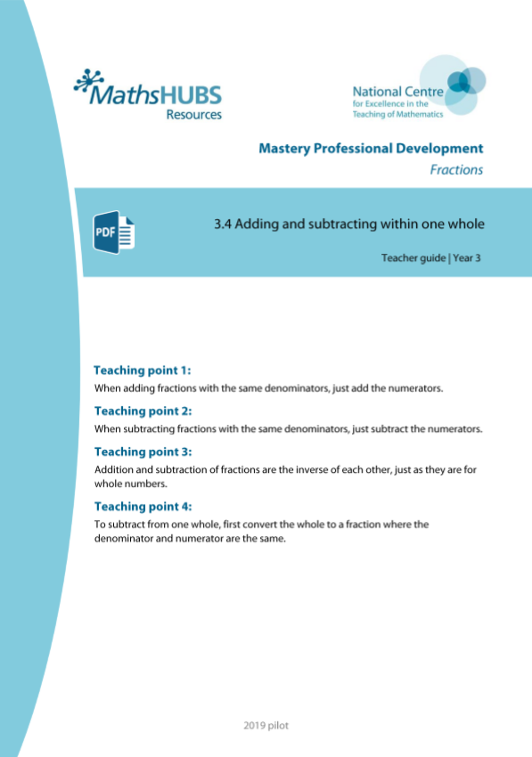
3F-4: Linked mastery PD materials
Additional pedagogical subject knowledge support can be found in the Mastery Professional Development Materials:
3.4 Adding and subtracting within one whole
Several of the activity slides have been taken from these materials.

Slide 4
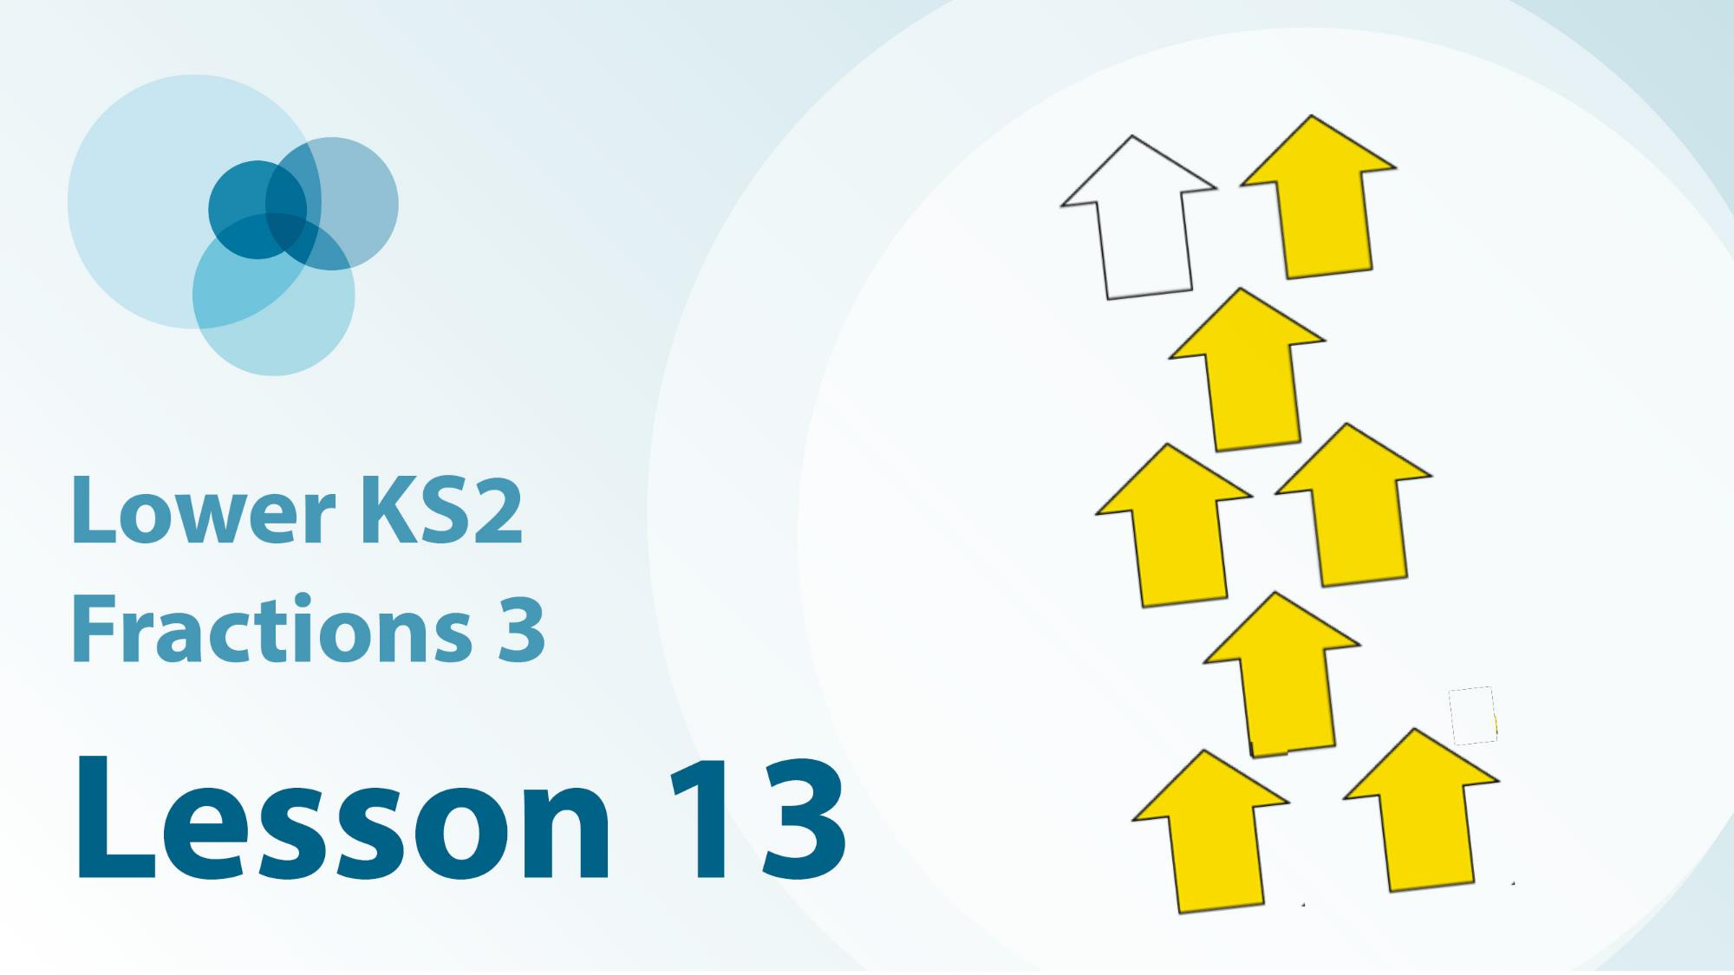
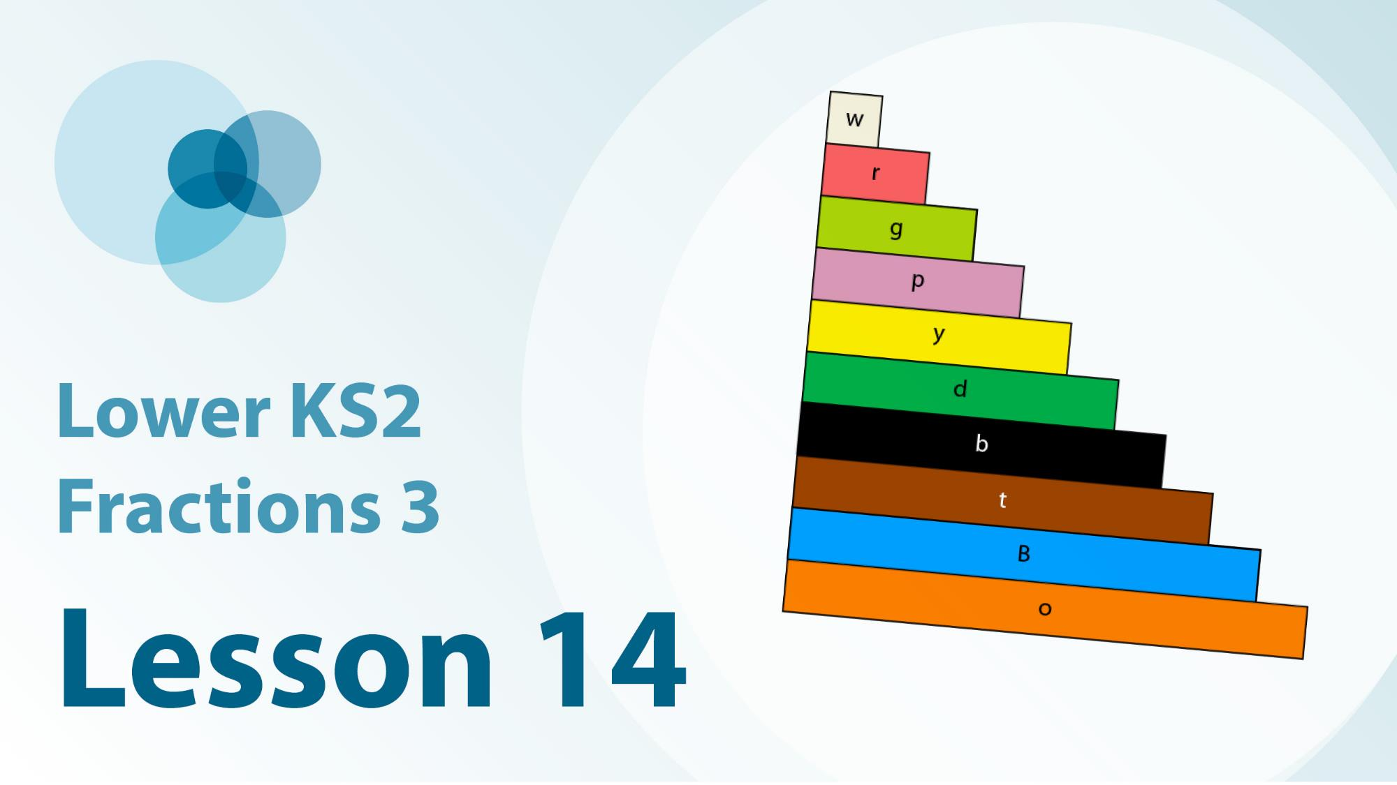
3F-4 Linked video lessons
Lower Key Stage 2 Fractions 3
Begin to write repeated addition equations to represent non-unit fractions
Practise writing repeated addition equations of unit fractions.

Slide 5
3F-4
Add and subtract fractions within 1

Slide 6
The following slides contain activities that can be used within the context of pre-teaching, intervention, or as supplementary material integrated into teaching. They do not represent complete lessons and should not be used as such. Also they should not be used all at once, but over the period of a teaching unit. It would be valuable to use many of the activities more than once to build fluency in understanding and application. Also many of them would benefit from the use of manipulatives to support interaction with the ideas. Ensure you engage in rich discussion with the children, asking them to reason and explain the ideas presented. Note that when working with a small group, pupils should also have access to the main teaching delivered by the class teacher and the focus should be directly linked so that the learning is connected and fluency is built.

Slide 7
Guidance for working with a small pre-teaching or intervention group
Take time to build understanding of the key idea. We would recommend no more than four slides in any one session, and probably fewer.
In subsequent sessions, review and practise previous learning before moving on.
Play the animation/observe the image and ask pupils “What do you notice?”.
Encourage pupils to explain what they see, what is happening and why.
Where there is a highlighted sentence, draw out the meaning of this from the image and repeat together and individually.

Slide 8
Guidance for working with a small pre-teaching or intervention group
Engage in the suggested activities, using manipulatives where appropriate, to enhance the interaction and stimulate discussion. However, note that the ultimate aim is to develop fluency in the mathematical ideas such that resources are no longer needed.
Repeat questions, using other numbers/examples where relevant.
Repeat the highlighted language structures wherever relevant to build fluency with the key idea and connect the learning. For example:
10 hundreds are equivalent to 1,000.

Slide 9
3F-4 Add and subtract fractions within 1

Slide 10
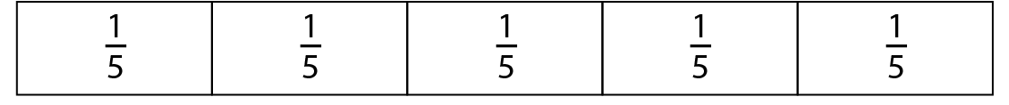

3F-4 Add and subtract fractions within 1
How many equal parts has this bar been divided into?
What fraction of the whole is each part?
How many one-fifths have been shaded?
The unit fraction is one-fifth. There are three one-fifths in three-fifths.
Three-fifths is made up of one-fifth, add another one-fifth, and another one-fifth.

Slide 11





3F-4 Add and subtract fractions within 1
Describe what is happening on this number line.
You can use the language focus box below to help you.
What would happen if I were to add another one-fifth?
How many more one-fifths would I need to add to reach one whole?
I have one-fifth… and another one-fifth… and another one-fifth.
Altogether I have three-fifths.

Slide 12
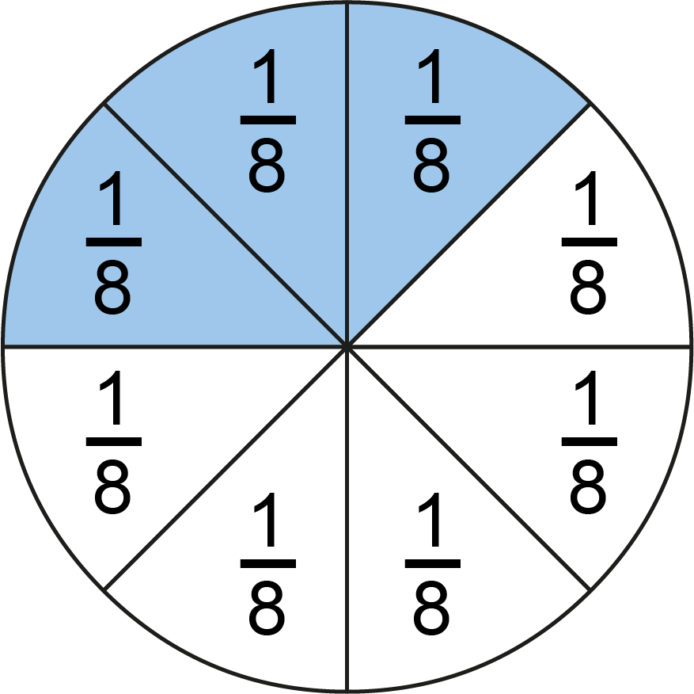
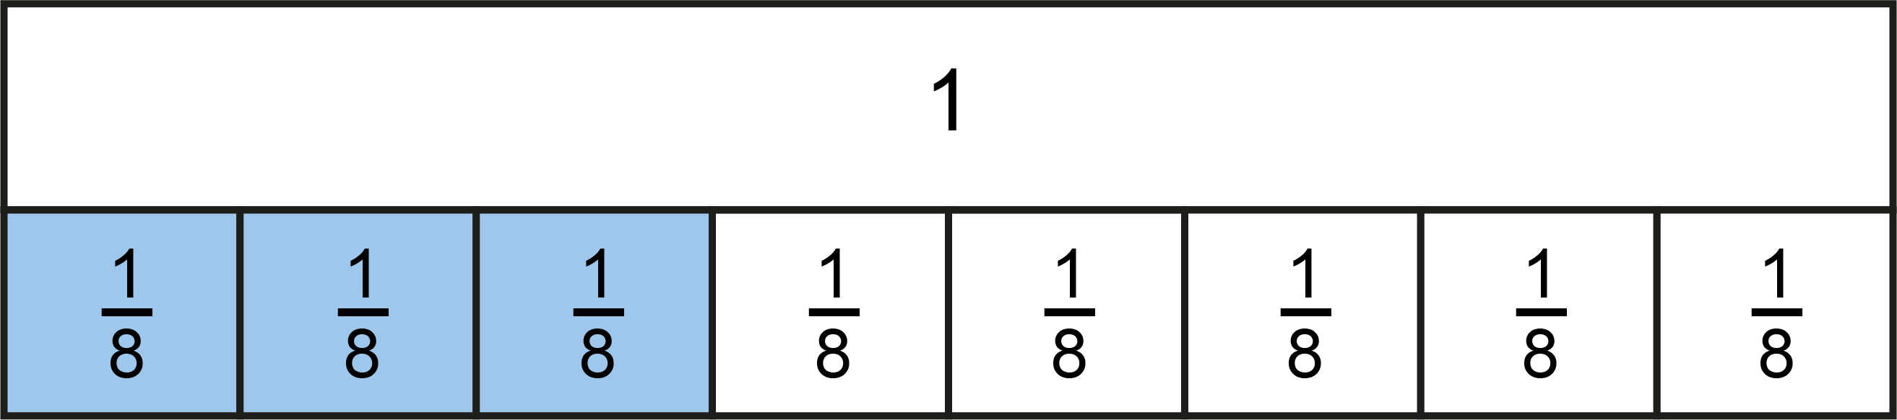
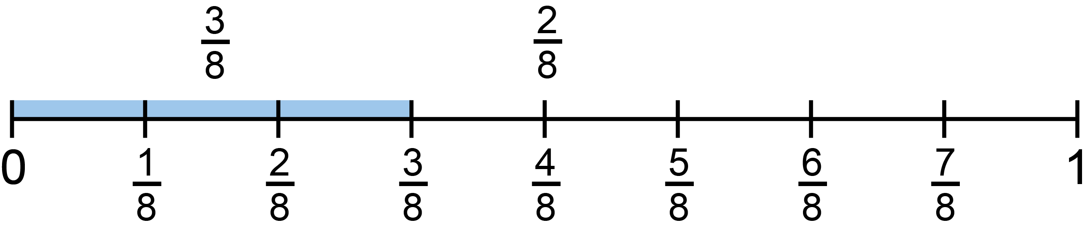
3F-4 Add and subtract fractions within 1
How many one-eighths are blue?
How many one-eighths are yellow?
How many one-eighths are shaded altogether?
Try adding a different number of one-eighths to 3 one-eighths? How many one-eighths do you have?
3 one-eighths plus 2 one-eighths is equal to 5 one-eighths.

Slide 13
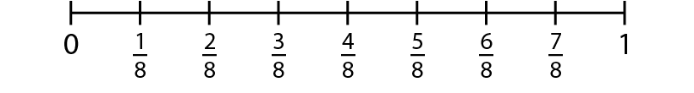

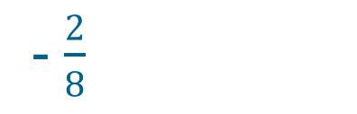
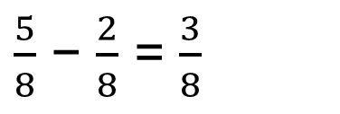
3F-4 Add and subtract fractions within 1
We know that 3 + 2 = 5. We can use this to help us work out $\frac{3}{8}$ + $\frac{2}{8}$
We know that 5 − 2 = 3. We can use this to help us work out $\frac{5}{8}$ − $\frac{2}{8}$
3 one-eighths plus 2 one-eighths is equal to 5 one-eighths.
Three-eighths, plus two-eighths is equal to five-eighths.
- $\frac{2}{8}$
5 one eighths minus 2 one-eighths is equal to 3 one-eighths.
Five-eighths, minus two-eighths is equal to three-eighths.
$\frac{5}{8}$ − $\frac{2}{8}$ = $\frac{3}{8}$

Slide 14
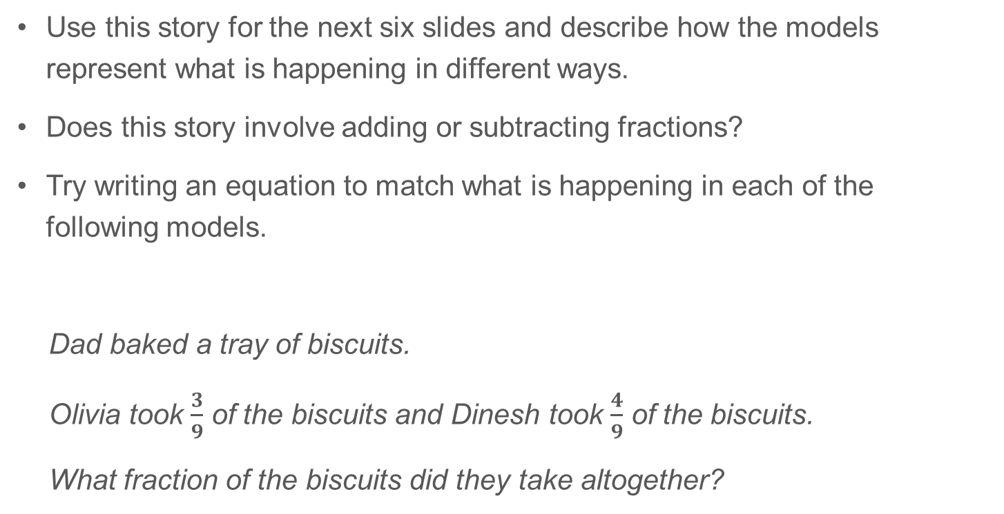
3F-4 Add and subtract fractions within 1
Use this story for the next six slides and describe how the models represent what is happening in different ways.
Does this story involve adding or subtracting fractions?
Try writing an equation to match what is happening in each of the following models.
Dad baked a tray of biscuits.
Olivia took $\frac{3}{9}$ of the biscuits and Dinesh took $\frac{4}{9}$ of the biscuits.
What fraction of the biscuits did they take altogether?

Slide 15


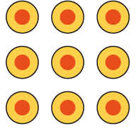
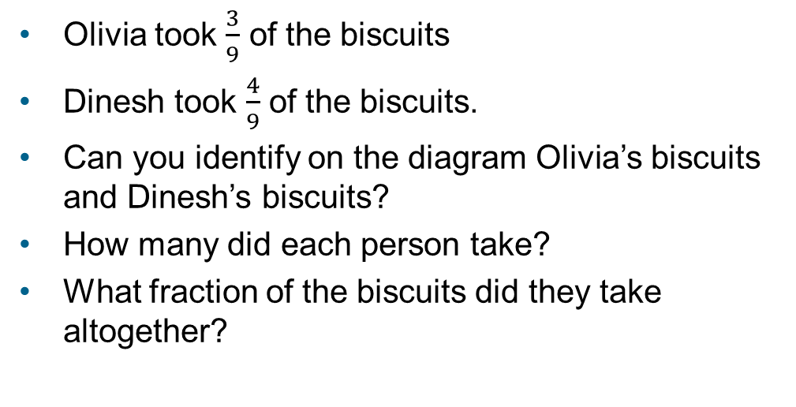
3F-4 Add and subtract fractions within 1
Method 1 – using a diagram
Olivia took $\frac{3}{9}$ of the biscuits
Dinesh took $\frac{4}{9}$ of the biscuits.
Can you identify on the diagram Olivia’s biscuits and Dinesh’s biscuits?
How many did each person take?
What fraction of the biscuits did they take altogether?
The whole tray has 9 biscuits. The whole is divided into 9 equal parts.
Each biscuit is $\frac{1}{9}$ of the whole tray of biscuits.

Slide 16
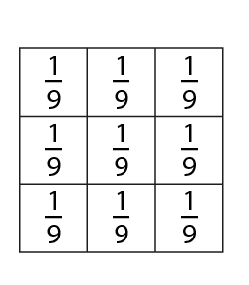
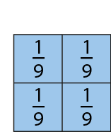

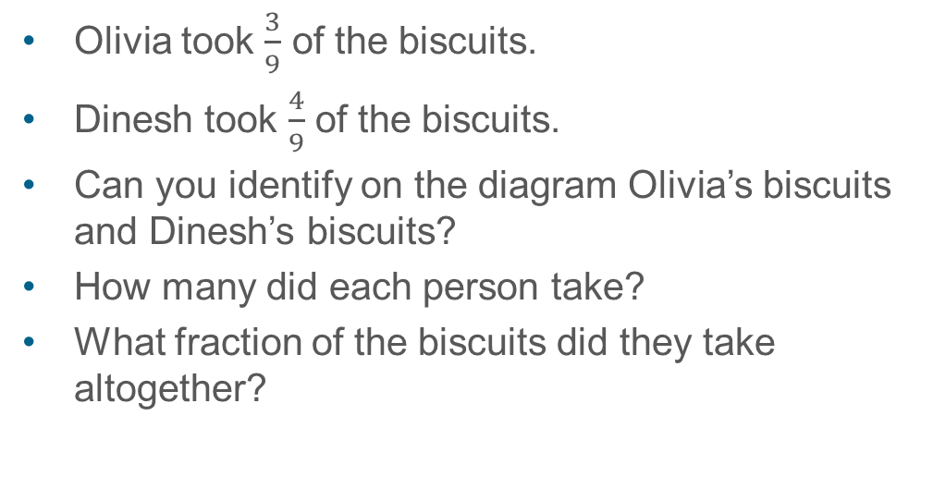
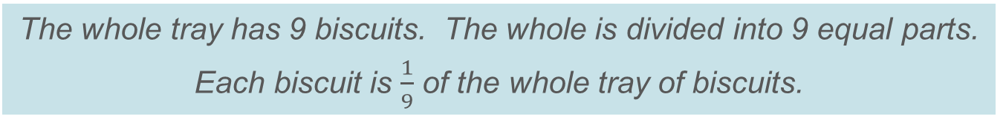
3F-4 Add and subtract fractions within 1
Method 1 – using a diagram
Olivia took $\frac{3}{9}$ of the biscuits.
Dinesh took $\frac{4}{9}$ of the biscuits.
Can you identify on the diagram Olivia’s biscuits and Dinesh’s biscuits?
How many did each person take?
What fraction of the biscuits did they take altogether?
The whole tray has 9 biscuits. The whole is divided into 9 equal parts.
Each biscuit is $\frac{1}{9}$ of the whole tray of biscuits.

Slide 17
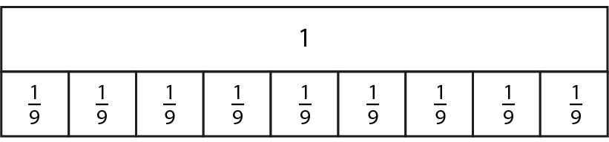


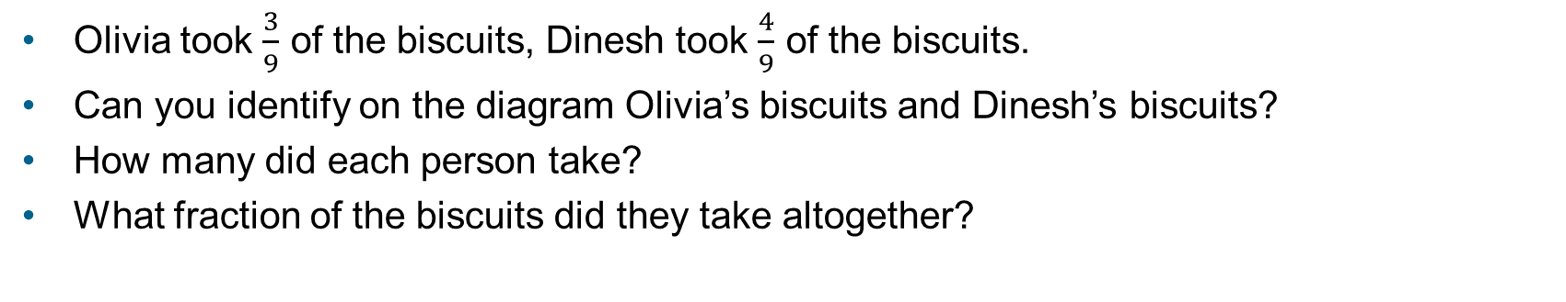
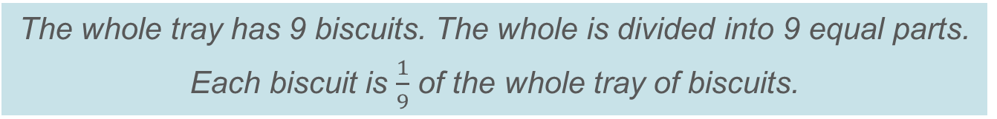
3F-4 Add and subtract fractions within 1
Method 1 – using a diagram
Olivia took $\frac{3}{9}$ of the biscuits, Dinesh took $\frac{4}{9}$ of the biscuits.
Can you identify on the diagram Olivia’s biscuits and Dinesh’s biscuits?
How many did each person take?
What fraction of the biscuits did they take altogether?
The whole tray has 9 biscuits. The whole is divided into 9 equal parts.
Each biscuit is $\frac{1}{9}$ of the whole tray of biscuits.
Notes:
Dad baked a tray of biscuits.
Olivia took $\frac{3}{9}$ of the biscuits and Dinesh took $\frac{4}{9}$ of the biscuits.
What fraction did they take altogether?

Slide 18
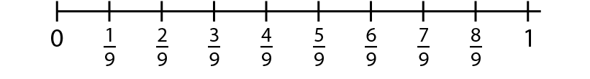
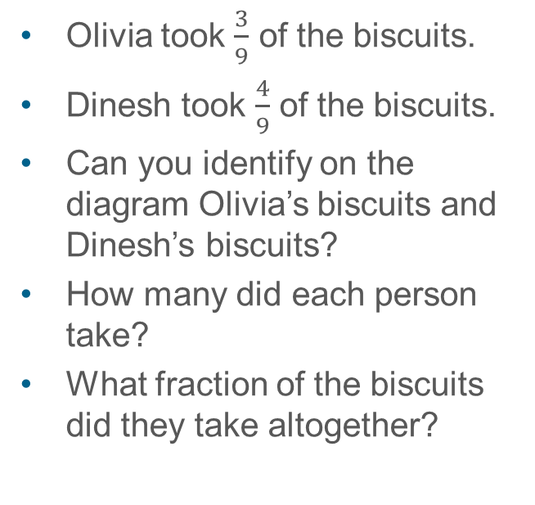
3F-4 Add and subtract fractions within 1
Method 2 – using a number line
Olivia took $\frac{3}{9}$ of the biscuits.
Dinesh took $\frac{4}{9}$ of the biscuits.
Can you identify on the diagram Olivia’s biscuits and Dinesh’s biscuits?
How many did each person take?
What fraction of the biscuits did they take altogether?
3 one-ninths plus 4 one-ninths is equal to 7 one-ninths.
3 ninths plus 4 ninths is equal to 7 ninths.

Slide 19
3F-4 Add and subtract fractions within 1
Method 3 – verbal reasoning

Slide 20
3F-4 Add and subtract fractions within 1

Slide 21
3F-4 Add and subtract fractions within 1
Use this story for the next six slides and describe how the models represent what is happening in different ways.
Does this story involve adding or subtracting fractions?
Try writing an equation to match what is happening in each of the following models.
A full box holds nine biscuits.
There is eight-ninths of a full box of biscuits.
If three biscuits are taken, what fraction of the box remains?

Slide 22
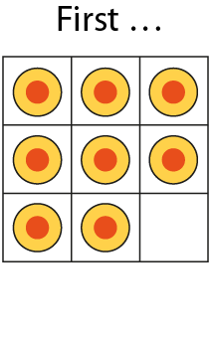
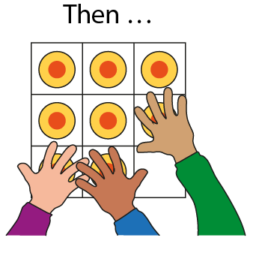
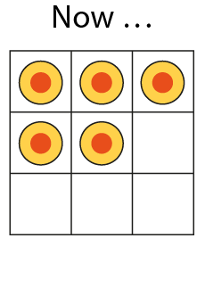
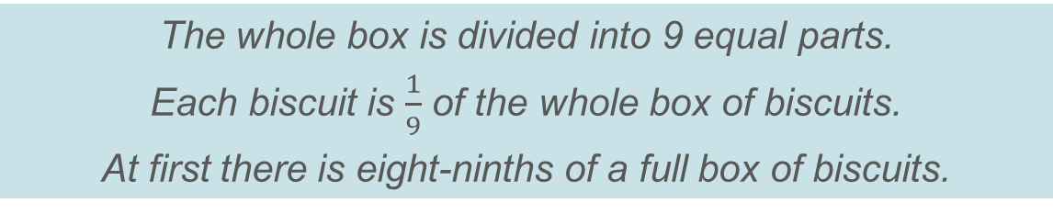
3F-4 Add and subtract fractions within 1
Method 1 – using a diagram
The whole box is divided into 9 equal parts.
Each biscuit is $\frac{1}{9}$ of the whole box of biscuits.
At first there is eight-ninths of a full box of biscuits.

Slide 23
3F-4 Add and subtract fractions within 1
8 one-ninths minus 3 one-ninths is equal to 5 one-ninths.
8 ninths minus 3 ninths is equal to 5 ninths.

Slide 24
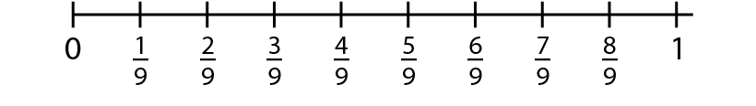
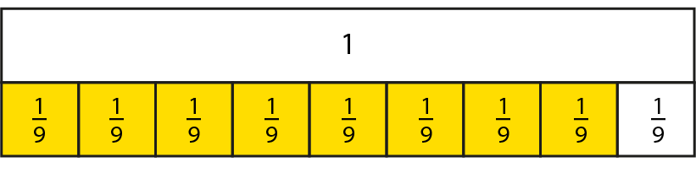



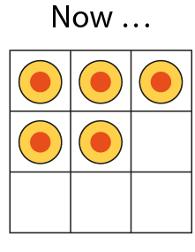
3F-4 Add and subtract fractions within 1

Slide 25


3F-4 Add and subtract fractions within 1
Method 1 – using a diagram

Slide 26
3F-4 Add and subtract fractions within 1
Method 2 – using a number line
8 one-ninths minus 3 one-ninths is equal to 5 one-ninths.
8 ninths minus 3 ninths is equal to 5 ninths.

Slide 27
3F-4 Add and subtract fractions within 1
Method 3 – verbal reasoning

Slide 28

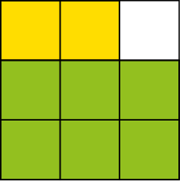
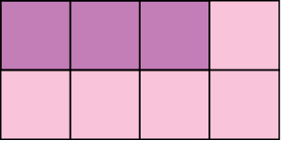


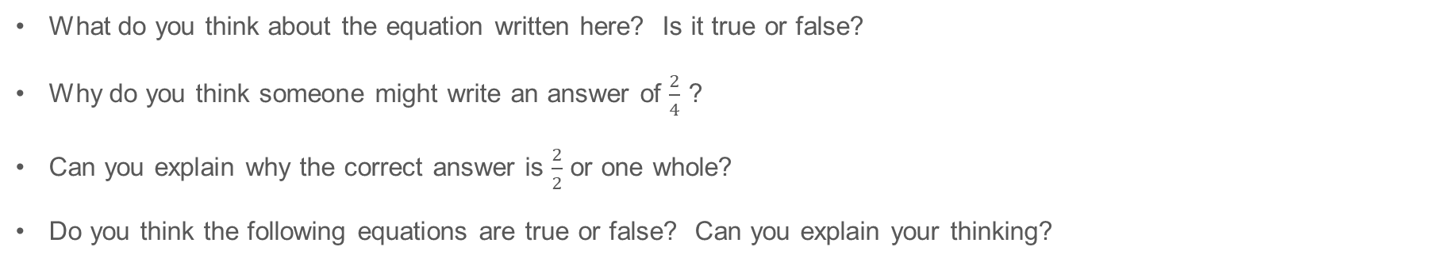
3F-4 Add and subtract fractions within 1
✓
✓
What do you think about the equation written here? Is it true or false?
Why do you think someone might write an answer of $\frac{2}{4}$ ?
Can you explain why the correct answer is $\frac{2}{2}$ or one whole?
Do you think the following equations are true or false? Can you explain your thinking?
When adding fractions with the same denominator, just add the numerators.

Slide 29
3F-4 Add and subtract fractions within 1
Do you think the following equations are true or false?
You could draw a model to explain your thinking.
✓
When subtracting fractions with the same denominator, just subtract the numerators.

