Slide 1
3F-3
Fractions within 1 in the linear number system

Slide 2
3F-3
Reason about the location of any fraction within 1 in the linear number system.
The materials in this pack have been collated and written to support the teaching of 3F-3. Before planning and teaching the content, read the teaching guidance and example assessment questions in the non-statutory guidance itself, which can be found here.
A video summarising all of the ready-to-progress criteria for Year 3 can be found here.

Slide 3
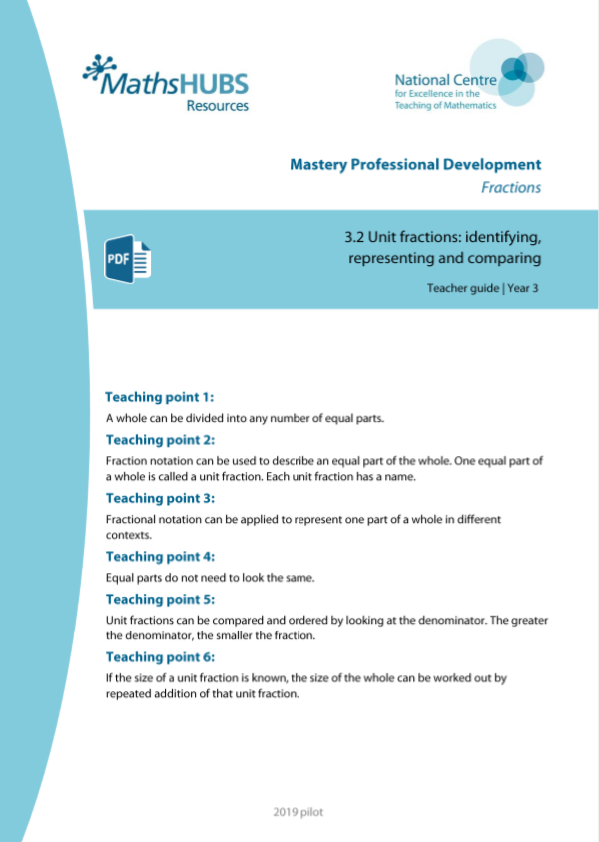
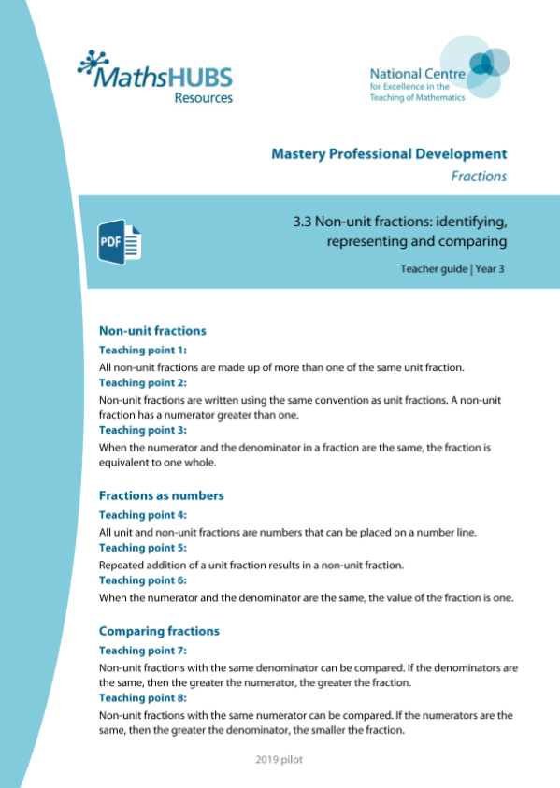
3F-3: Linked mastery PD materials
Additional pedagogical subject knowledge support can be found in the following Mastery Professional Development materials:
  3.2 Unit fractions: identifying, representing and comparing
  3.3 Non-unit fractions: identifying, representing and comparing
Several of the activity slides have been taken from these materials.

Slide 4
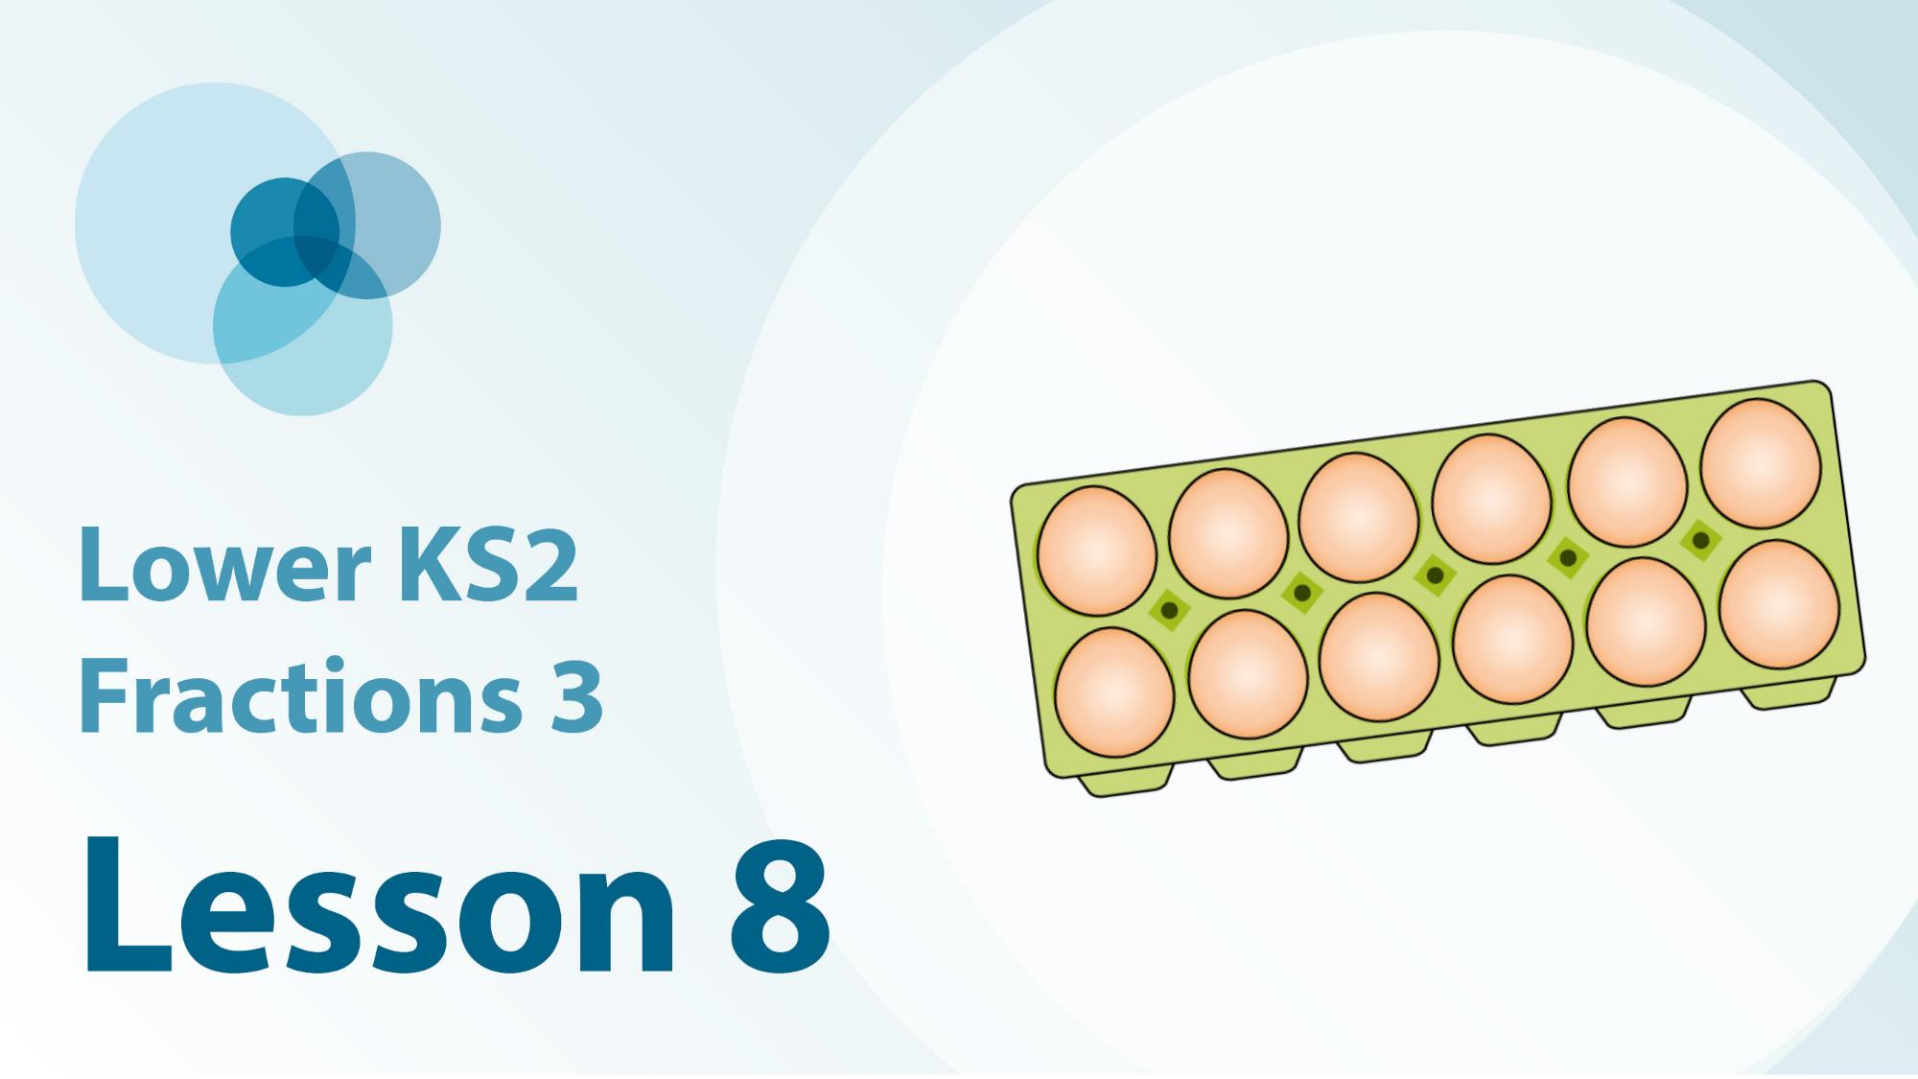

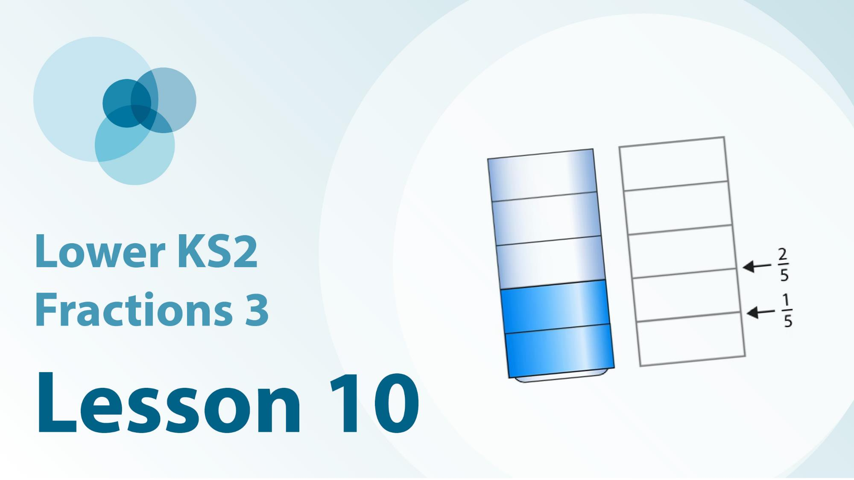
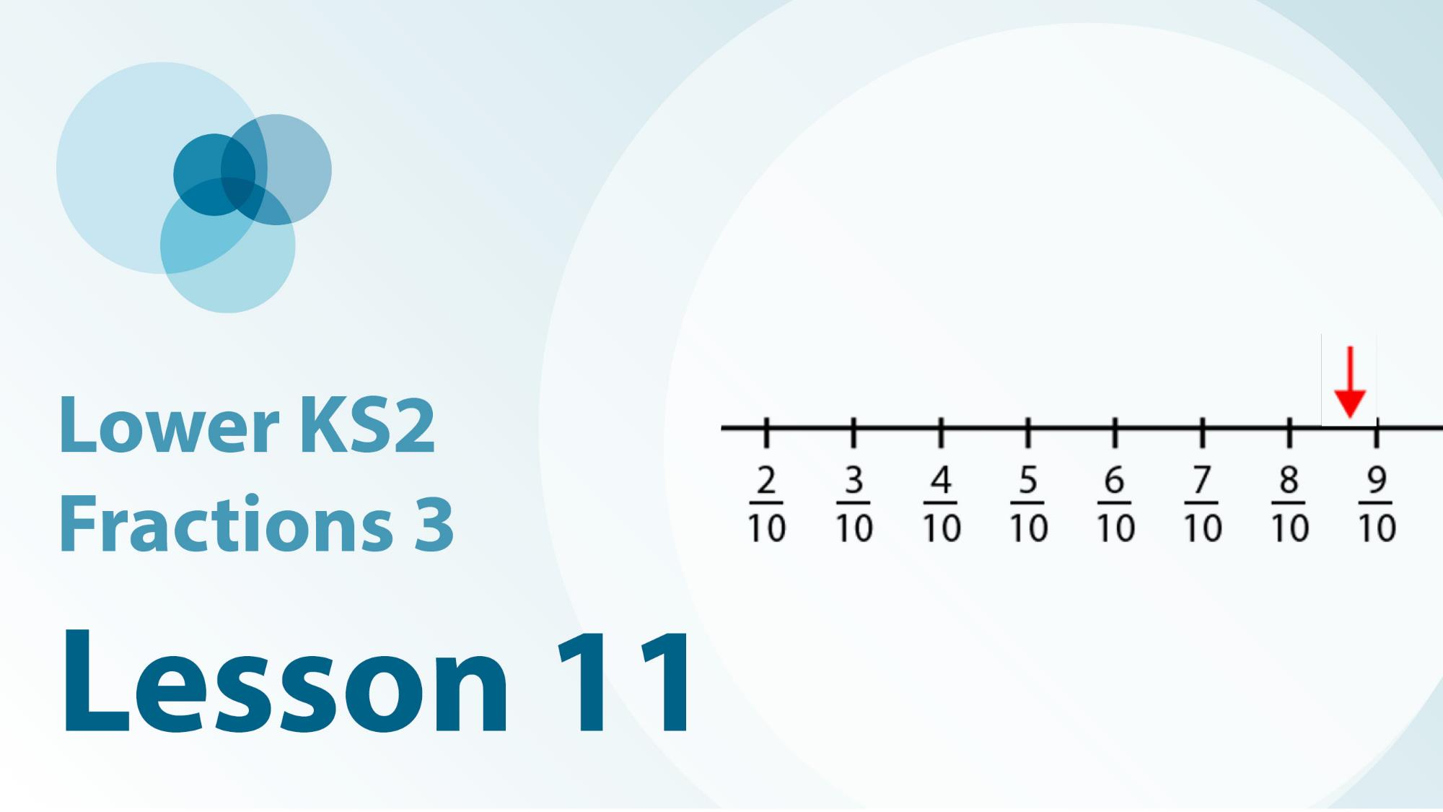
3F-3 Linked video lessons
Lower Key Stage 2 Fractions 3
One tenth and one hundredth as fractions and decimals
Visualise and estimate non-unit fractions
Fractions as numbers on a numberline
Additional experience of fractions on a numberline

Slide 5
3F-3
Fractions within 1 in the linear number system

Slide 6
The following slides contain activities that can be used within the context of pre-teaching, intervention, or as supplementary material integrated into teaching. They do not represent complete lessons and should not be used as such. Also they should not be used all at once, but over the period of a teaching unit. It would be valuable to use many of the activities more than once to build fluency in understanding and application. Also many of them would benefit from the use of manipulatives to support interaction with the ideas. Ensure you engage in rich discussion with the children, asking them to reason and explain the ideas presented. Note that when working with a small group, pupils should also have access to the main teaching delivered by the class teacher and the focus should be directly linked so that the learning is connected and fluency is built.

Slide 7
Guidance for working with a small pre-teaching or intervention group
Take time to build understanding of the key idea. We would recommend no more than four slides in any one session, and probably fewer.
In subsequent sessions, review and practise previous learning before moving on.
Play the animation/observe the image and ask pupils “What do you notice?”.
Encourage pupils to explain what they see, what is happening and why.
Where there is a highlighted sentence, draw out the meaning of this from the image and repeat together and individually.

Slide 8
Guidance for working with a small pre-teaching or intervention group
Engage in the suggested activities, using manipulatives where appropriate, to enhance the interaction and stimulate discussion. However, note that the ultimate aim is to develop fluency in the mathematical ideas such that resources are no longer needed.
Repeat questions, using other numbers/examples where relevant.
Repeat the highlighted language structures wherever relevant to build fluency with the key idea and connect the learning. For example:
10 hundreds are equivalent to 1,000.

Slide 9
3F-3 Fractions within 1 in the linear number system

Slide 10

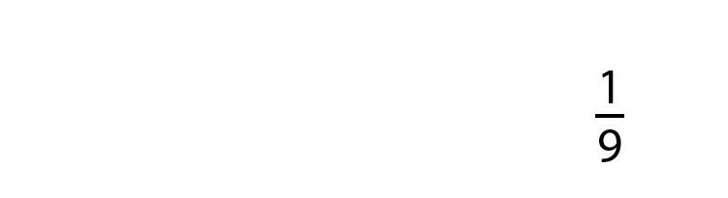
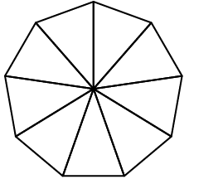








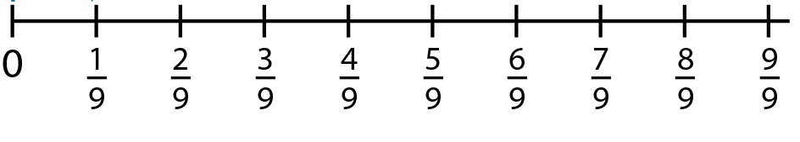
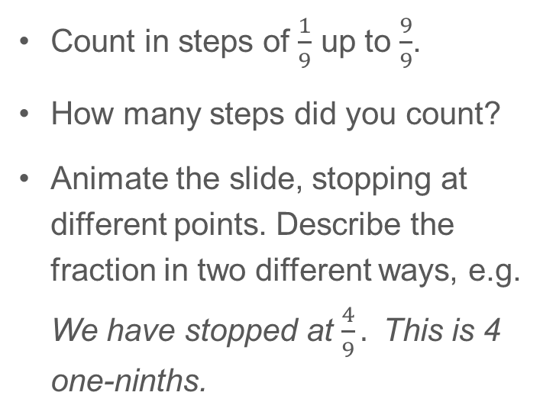
3F-3 Fractions within 1 in the linear number system
The whole is divided into 9 equal parts. Each part is one-ninth of the whole.
Count in steps of $\frac{1}{9}$ up to $\frac{9}{9}$.
How many steps did you count?
Animate the slide, stopping at different points. Describe the fraction in two different ways, e.g. We have stopped at $\frac{4}{9}.$ This is 4 one-ninths.

Slide 11
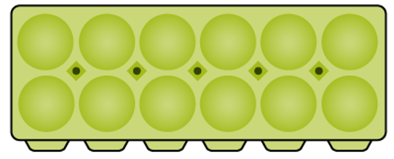

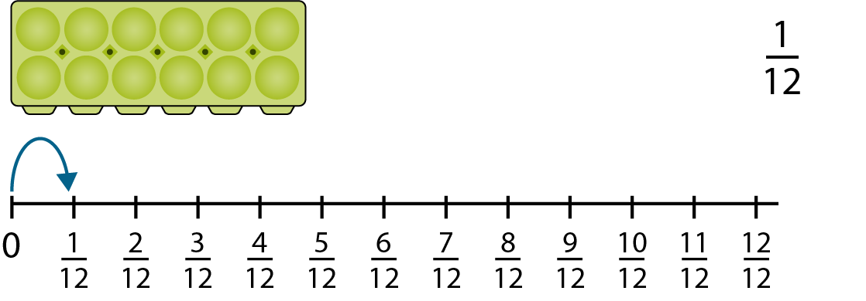









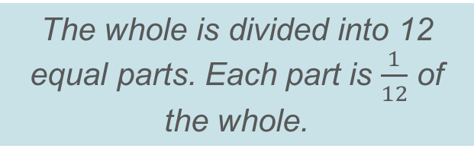
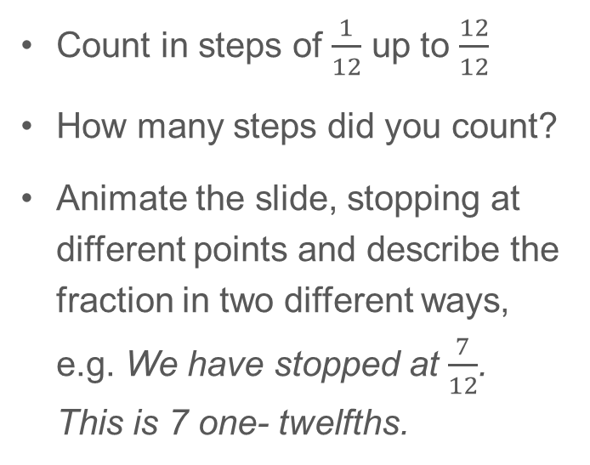
3F-3 Fractions within 1 in the linear number system
The whole is divided into 12 equal parts. Each part is $\frac{1}{12}$ of the whole.
Count in steps of $\frac{1}{12}$ up to $\frac{12}{12}$
How many steps did you count?
Animate the slide, stopping at different points and describe the fraction in two different ways, e.g. We have stopped at $\frac{7}{12}$. This is 7 one- twelfths.

Slide 12

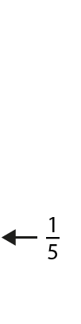
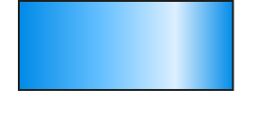
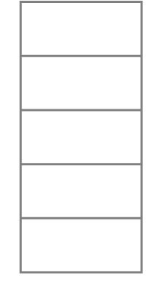
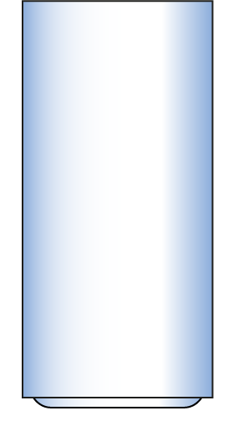

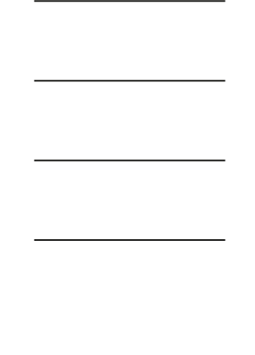


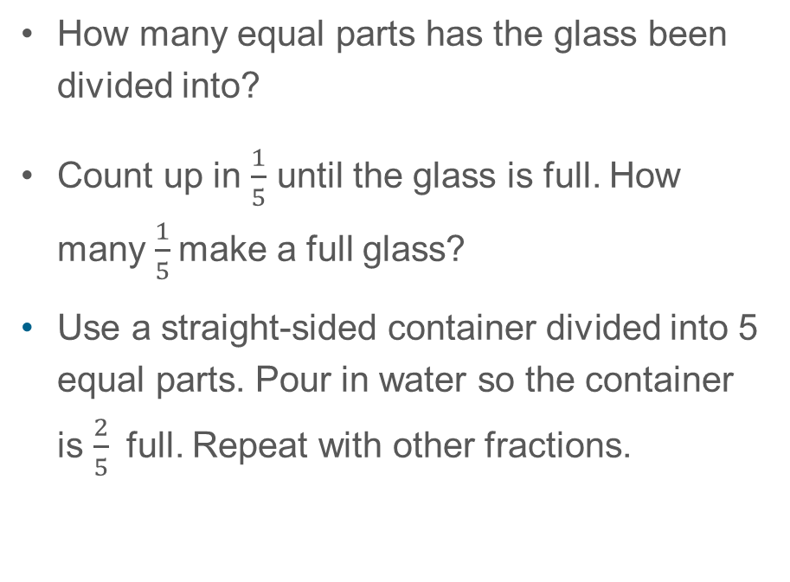
3F-3 Fractions within 1 in the linear number system
How many equal parts has the glass been divided into?
Count up in $\frac{1}{5}$ until the glass is full. How many $\frac{1}{5}$make a full glass?
Use a straight-sided container divided into 5 equal parts. Pour in water so the container is $\frac{2}{5}$ full. Repeat with other fractions.

Slide 13

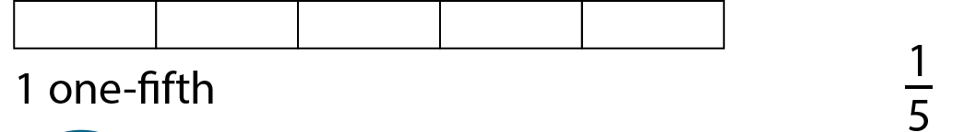

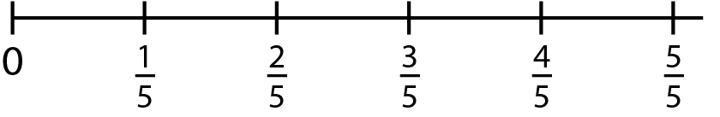
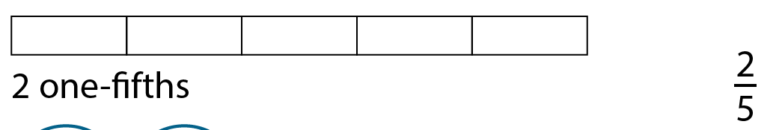


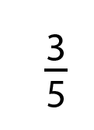



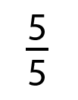

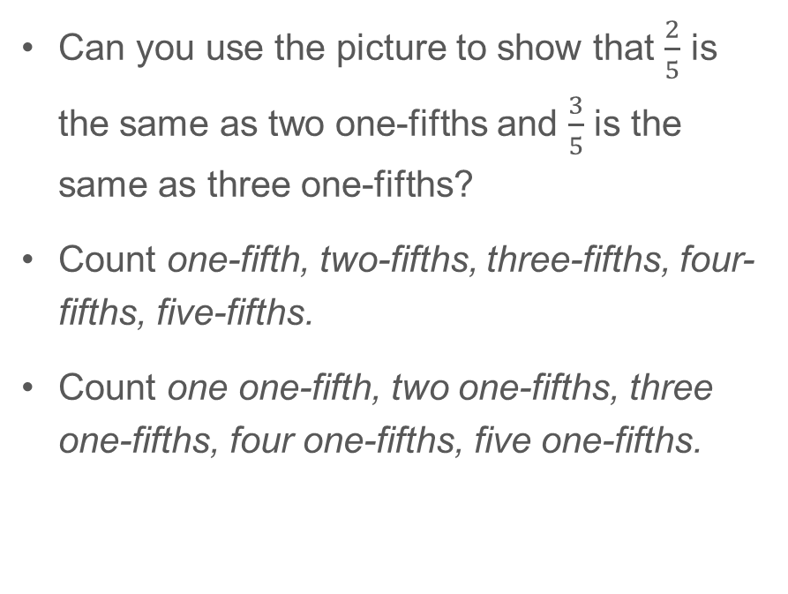
3F-3 Fractions within 1 in the linear number system
Can you use the picture to show that $\frac{2}{5}$ is the same as two one-fifths and $\frac{3}{5}$ is the same as three one-fifths?
Count one-fifth, two-fifths, three-fifths, four-fifths, five-fifths.
Count one one-fifth, two one-fifths, three one-fifths, four one-fifths, five one-fifths.
There are three one-fifths in three-fifths.

Slide 14
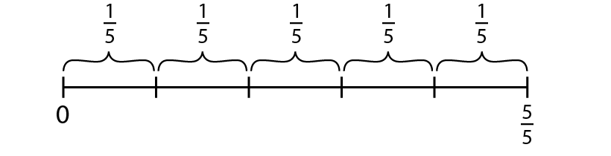
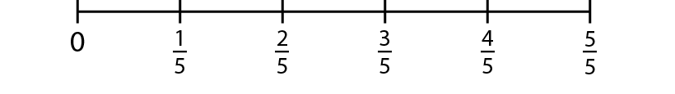
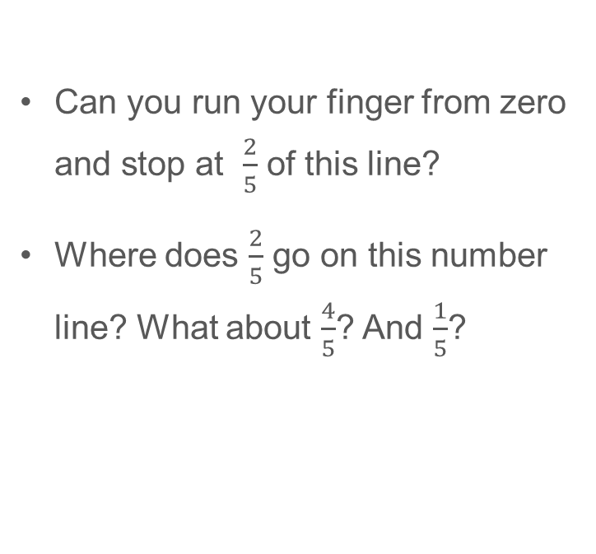
3F-3 Fractions within 1 in the linear number system
Fractions as part of a whole
Can you run your finger from zero and stop at $\frac{2}{5}$ of this line?
Where does $\frac{2}{5}$ go on this number line? What about $\frac{4}{5}$? And $\frac{1}{5}$?
Fractions as numbers

Slide 15
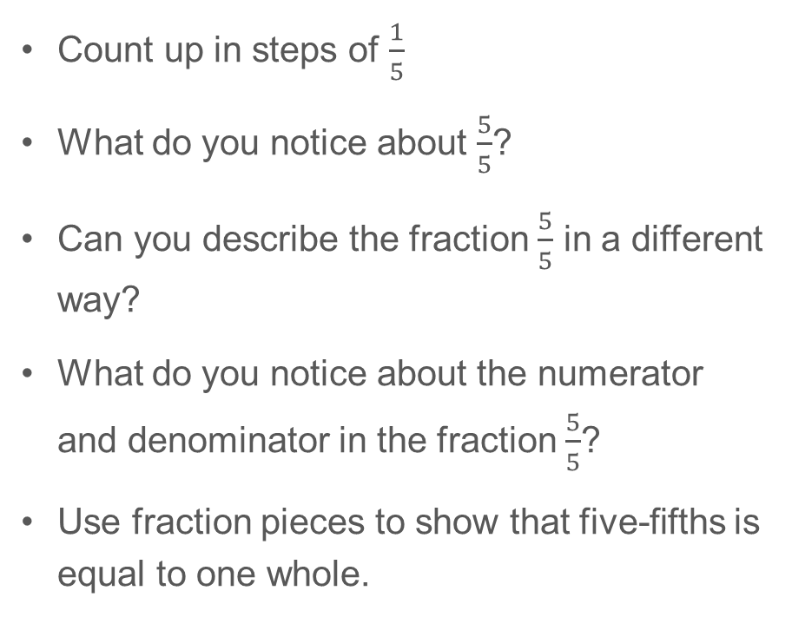
3F-3 Fractions within 1 in the linear number system
Count up in steps of $\frac{1}{5}$
What do you notice about $\frac{5}{5}$?
Can you describe the fraction $\frac{5}{5}$ in a different way?
What do you notice about the numerator and denominator in the fraction $\frac{5}{5}$?
Use fraction pieces to show that five-fifths is equal to one whole.
0
1
2
3
4
5
1
5
5
5
5
5
When the numerator and denominator are the same, the fraction has a value of one.

Slide 16

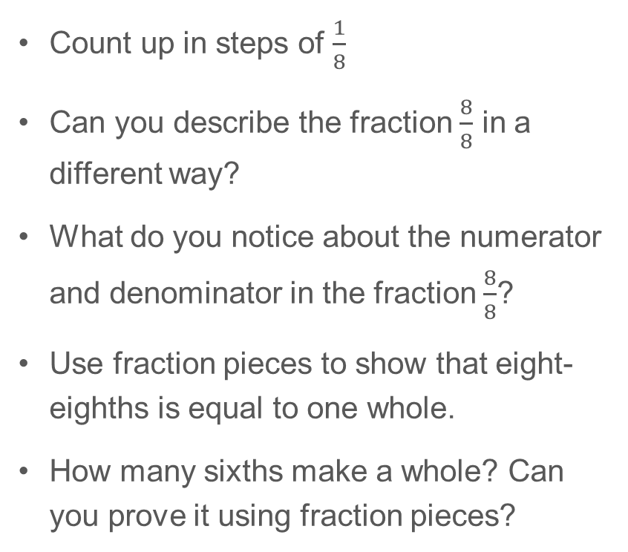
3F-3 Fractions within 1 in the linear number system
Count up in steps of $\frac{1}{8}$
Can you describe the fraction $\frac{8}{8}$ in a different way?
What do you notice about the numerator and denominator in the fraction $\frac{8}{8}$?
Use fraction pieces to show that eight-eighths is equal to one whole.
How many sixths make a whole? Can you prove it using fraction pieces?
1
2
3
4
5
6
7
8
0
1
8
8
8
8
8
8
8
8
When the numerator and denominator are the same, the fraction has a value of one.

Slide 17

3F-3 Fractions within 1 in the linear number system
How many equal parts has the line been divided into?
What fraction of the whole line is each part?
What fraction is marked by the arrow? Can you explain your thinking?
Repeat by pointing to a different place on the line.
1
1
1
1
4
4
4
4
0
1
2
3
1
4
4
4

Slide 18

3F-3 Fractions within 1 in the linear number system
How many equal parts has the line been divided into?
What fraction of the whole line is each part?
What fraction is marked by the arrow? Can you explain your thinking?
Repeat by pointing to a different place on the line.
0
1
2
3
4
5
6
1
7
7
7
7
7
7

Slide 19
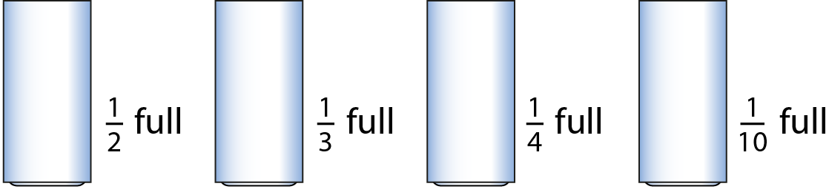




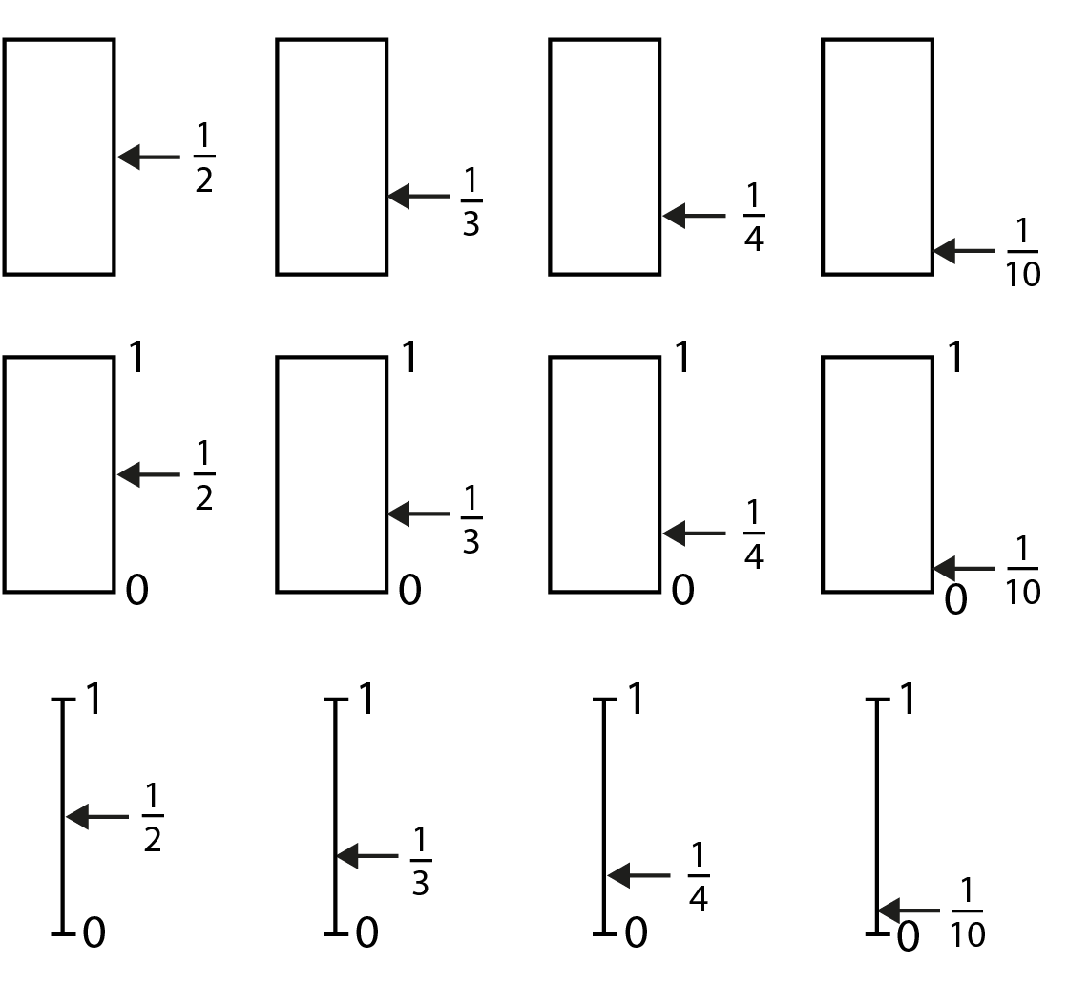
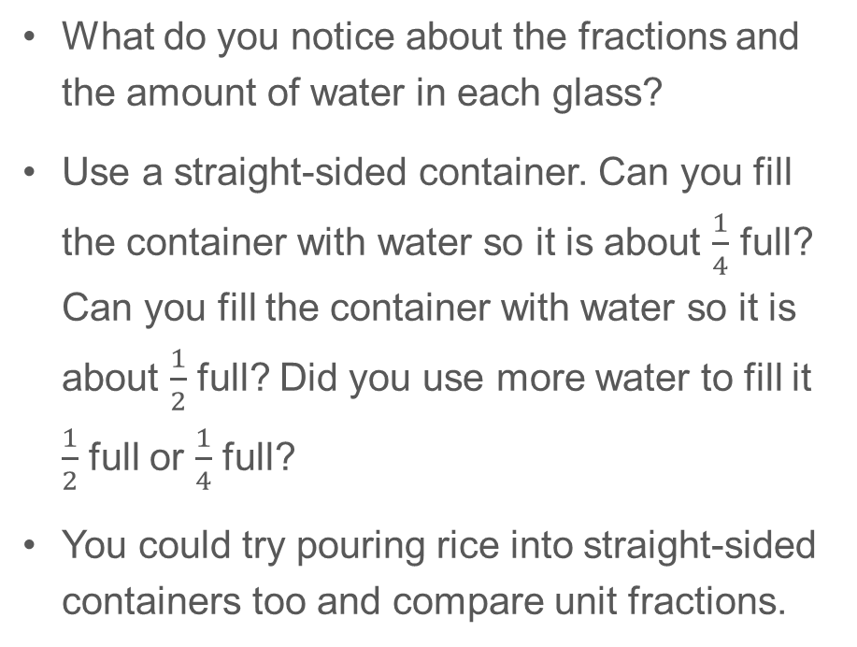
3F-3 Fractions within 1 in the linear number system
What do you notice about the fractions and the amount of water in each glass?
Use a straight-sided container. Can you fill the container with water so it is about $\frac{1}{4}$ full? Can you fill the container with water so it is about $\frac{1}{2}$ full? Did you use more water to fill it $\frac{1}{2}$ full or $\frac{1}{4}$ full?
You could try pouring rice into straight-sided containers too and compare unit fractions.

Slide 20
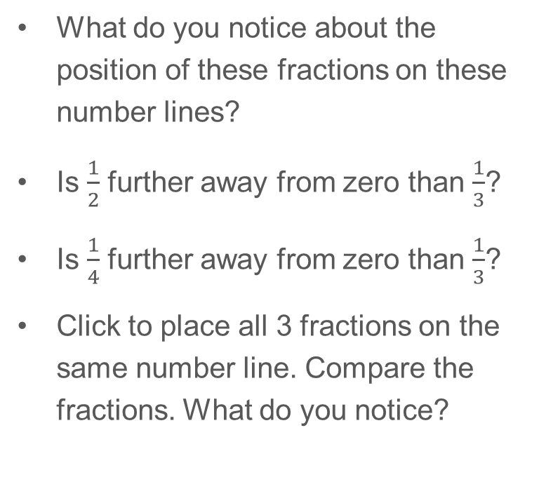
00
0
1
What do you notice about the position of these fractions on these number lines?
Is $\frac{1}{2}$ further away from zero than $\frac{1}{3}$?
Is $\frac{1}{4}$ further away from zero than $\frac{1}{3}$?
Click to place all 3 fractions on the same number line. Compare the fractions. What do you notice?
1
4
0
1
1
3
0
1
1
2

Slide 21
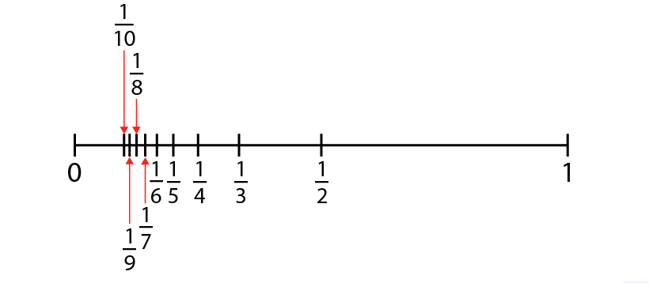
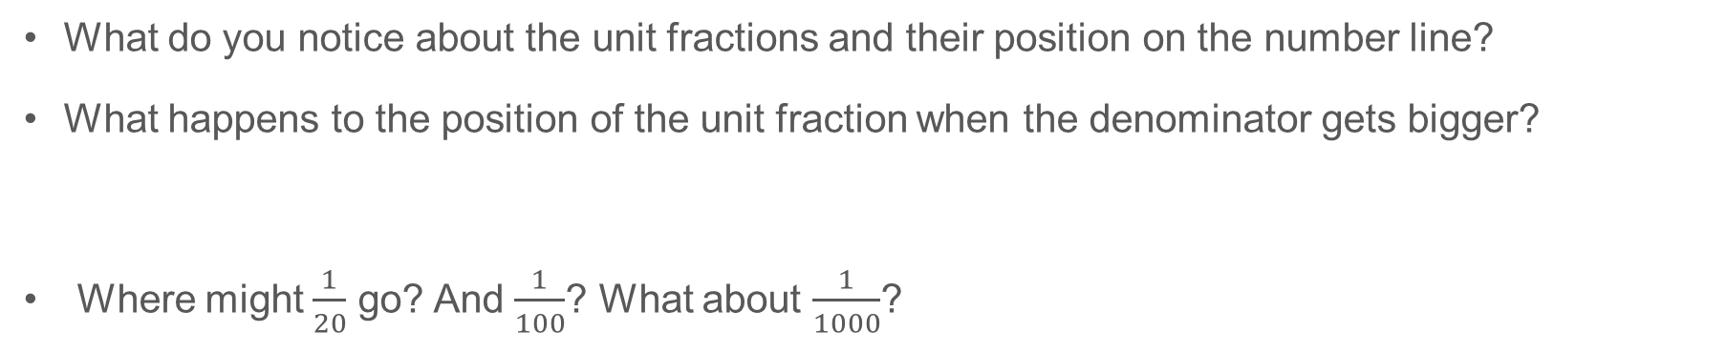
3F-3 Fractions within 1 in the linear number system
What do you notice about the unit fractions and their position on the number line?
What happens to the position of the unit fraction when the denominator gets bigger?
Where might $\frac{1}{20}$ go? And $\frac{1}{100}$? What about $\frac{1}{1000}$?
When comparing unit fractions, the greater the denominator, the smaller the fraction.
Notes:
When comparing unit fractions, the greater the denominator, the smaller the fraction.
Where might $\frac{1}{20}$ go? And $\frac{1}{100}$? What about $\frac{1}{1000}$?

