Slide 1
3F-2
Find unit fractions of quantities

Slide 2
3F-2
Find unit fractions of quantities using known division facts (multiplication tables fluency).
The materials in this pack have been collated and written to support the teaching of 3F-2. Before planning and teaching the content, read the teaching guidance and example assessment questions in the non-statutory guidance itself, which can be found here.
A video summarising all of the ready-to-progress criteria for Year 3 can be found here.

Slide 3
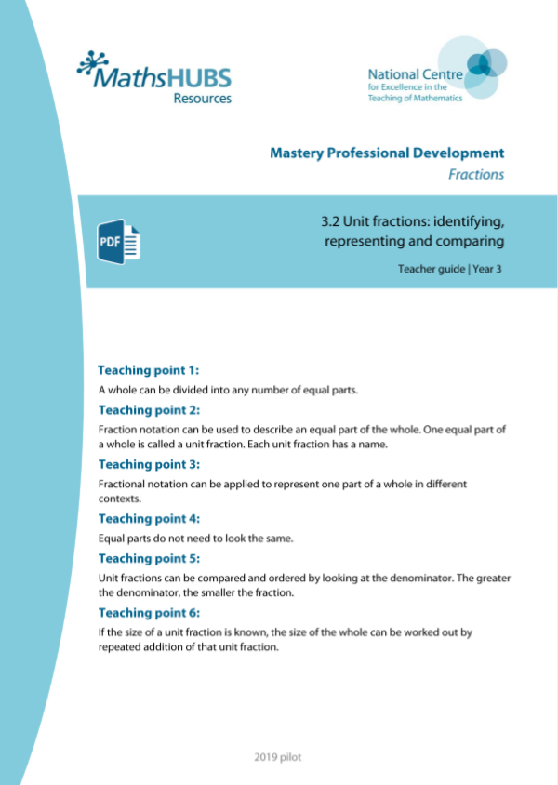
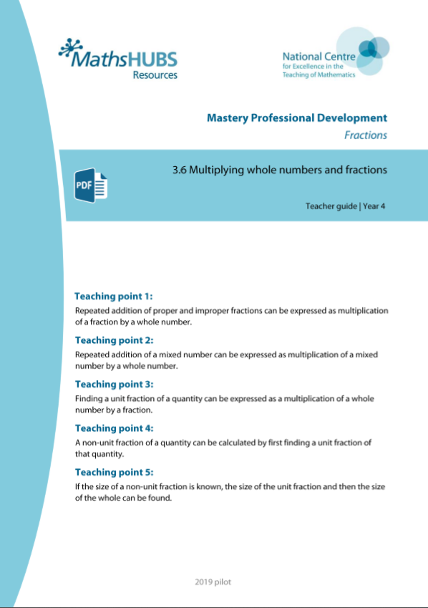
3F-2: Linked mastery PD materials
Additional pedagogical subject knowledge support can be found in the following Mastery Professional Development materials:
  3.2 Unit fractions: identifying, representing and comparing
  3.6 Multiplying whole numbers and fractions
Several of the activity slides have been taken from these materials.

Slide 4
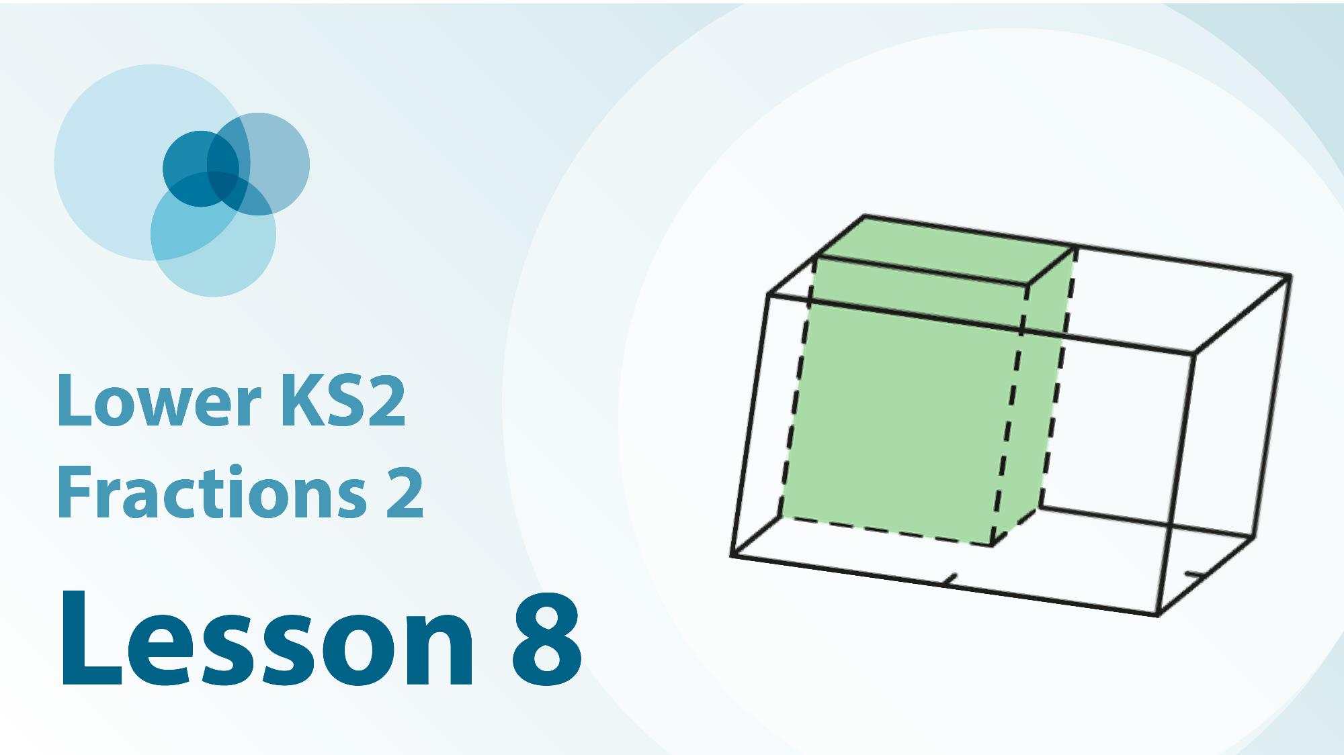
3F-2 Linked video lesson
Lower Key Stage 2 Fractions 2
Recognise and reasoning about unit fractions in a variety of contexts

Slide 5
3F-2
3F–2 Find unit fractions of quantities

Slide 6
The following slides contain activities that can be used within the context of pre-teaching, intervention, or as supplementary material integrated into teaching. They do not represent complete lessons and should not be used as such. Also they should not be used all at once, but over the period of a teaching unit. It would be valuable to use many of the activities more than once to build fluency in understanding and application. Also many of them would benefit from the use of manipulatives to support interaction with the ideas. Ensure you engage in rich discussion with the children, asking them to reason and explain the ideas presented. Note that when working with a small group, pupils should also have access to the main teaching delivered by the class teacher and the focus should be directly linked so that the learning is connected and fluency is built.

Slide 7
Guidance for working with a small pre-teaching or intervention group
Take time to build understanding of the key idea. We would recommend no more than four slides in any one session, and probably fewer.
In subsequent sessions, review and practise previous learning before moving on.
Play the animation/observe the image and ask pupils “What do you notice?”.
Encourage pupils to explain what they see, what is happening and why.
Where there is a highlighted sentence, draw out the meaning of this from the image and repeat together and individually.

Slide 8
Guidance for working with a small pre-teaching or intervention group
Engage in the suggested activities, using manipulatives where appropriate, to enhance the interaction and stimulate discussion. However, note that the ultimate aim is to develop fluency in the mathematical ideas such that resources are no longer needed.
Repeat questions, using other numbers/examples where relevant.
Repeat the highlighted language structures wherever relevant to build fluency with the key idea and connect the learning. For example:
10 hundreds are equivalent to 1,000.

Slide 9
3F-2 Find unit fractions of quantities

Slide 10
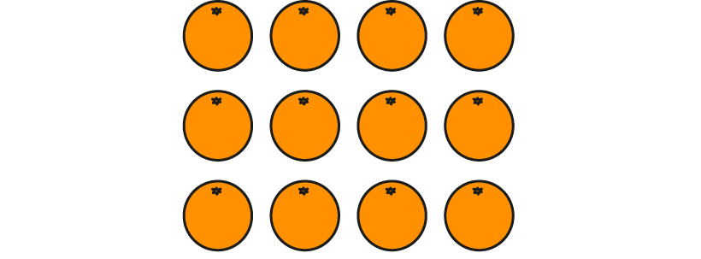
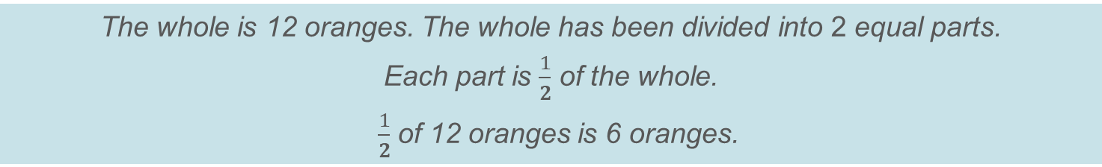
3F-2 Find unit fractions of quantities
How many oranges are there in the whole set?
How many equal parts has the whole set of oranges been divided into?
What fraction of the whole is each part?
How many oranges are there in each part?
Use the language focus box below to help you describe what is happening in each representation.
The whole is 12 oranges. The whole has been divided into 2 equal parts.
Each part is $\frac{1}{2}$ of the whole.
$\frac{1}{2}$ of 12 oranges is 6 oranges.

Slide 11





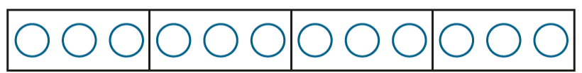
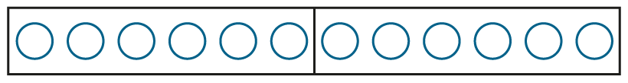
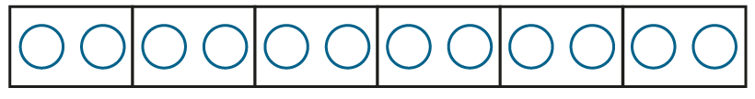

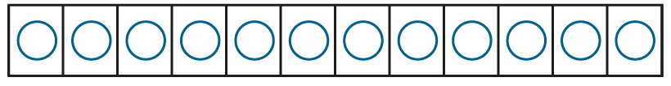

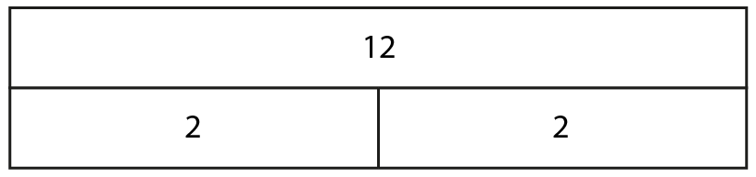
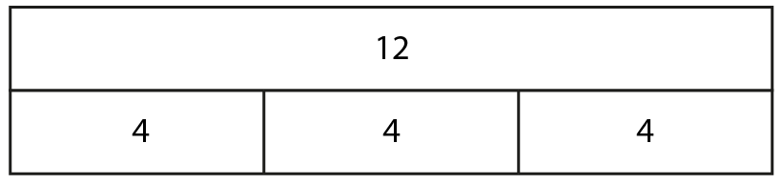
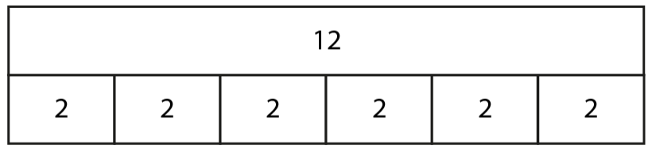
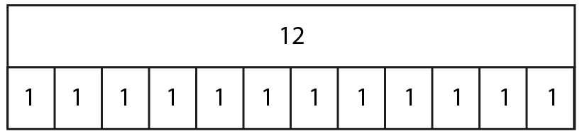
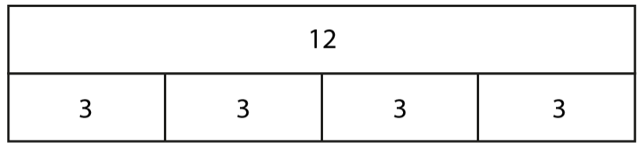
3F-2 Find unit fractions of quantities
How many apples are in the whole set?
How many equal parts has the whole set of apples been divided into?
What fraction of the whole is each part? How many apples are in each equal part?
Put 12 counters on a whiteboard. Divide them into the number of equal parts shown.
What fraction of the whole is each part?
How many counters are there in each part?
What do you notice about the equations written below?
Repeat this activity with the following representations.
12 ÷ 6 = 2
12 ÷ 12 = 1
12 ÷ 3 = 4
12 ÷ 2 = 6
12 ÷ 4 = 3
1
1
1
1
1
of 12 = 3
of 12 = 6
of 12 = 1
of 12 = 4
of 12 = 2
12
4
2
3
6

Slide 12

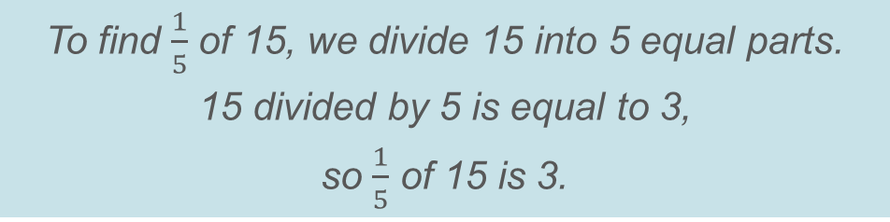
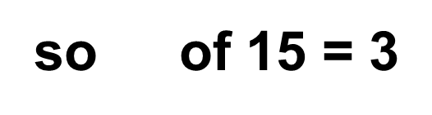
3F-2 Find unit fractions of quantities
1
of 15
Can you use your division facts to help you find fractions of quantities?
How many equal parts has 15 been divided into?
What do you notice about the devisor and the denominator?
Use the language focus sentences below to help you describe what is happening.
5
15
3
3
3
3
3
1
5
15 ÷ 5 = 3
To find $\frac{1}{5}$ of 15, we divide 15 into 5 equal parts.
15 divided by 5 is equal to 3,
so $\frac{1}{5}$ of 15 is 3.
1
so of 15 = 3
5

Slide 13
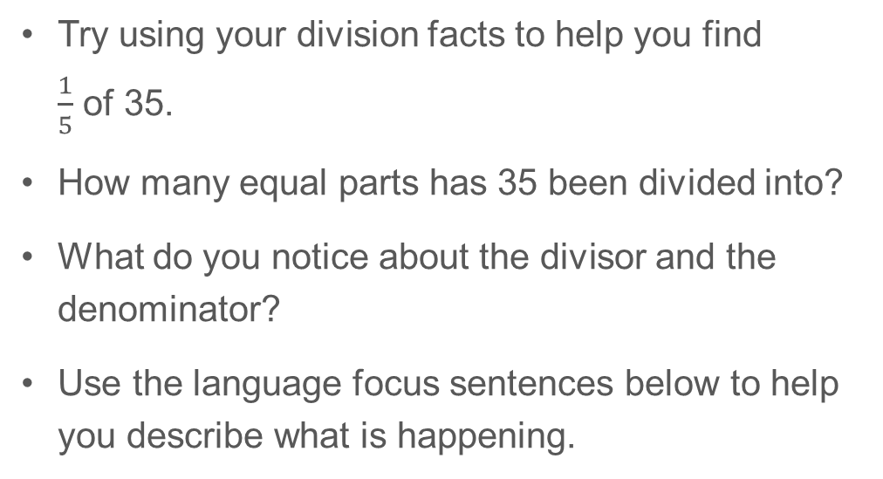
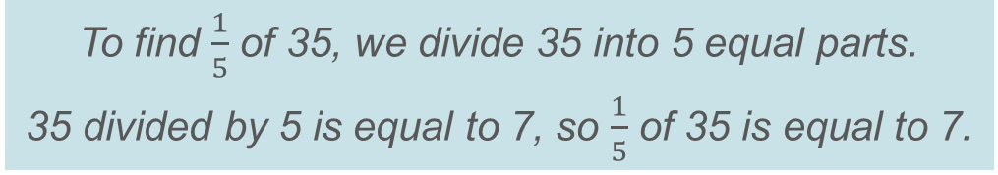
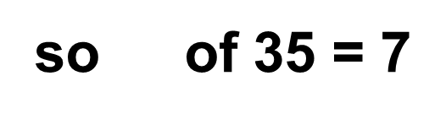
3F-2 Find unit fractions of quantities
1
of 35
Try using your division facts to help you find $\frac{1}{5}$ of 35.
How many equal parts has 35 been divided into?
What do you notice about the divisor and the denominator?
Use the language focus sentences below to help you describe what is happening.
5
35
7
7
7
7
7
1
5
35 ÷ 5 = 7
To find $\frac{1}{5}$ of 35, we divide 35 into 5 equal parts.
35 divided by 5 is equal to 7, so $\frac{1}{5}$ of 35 is equal to 7.
1
so of 35 = 7
5

Slide 14
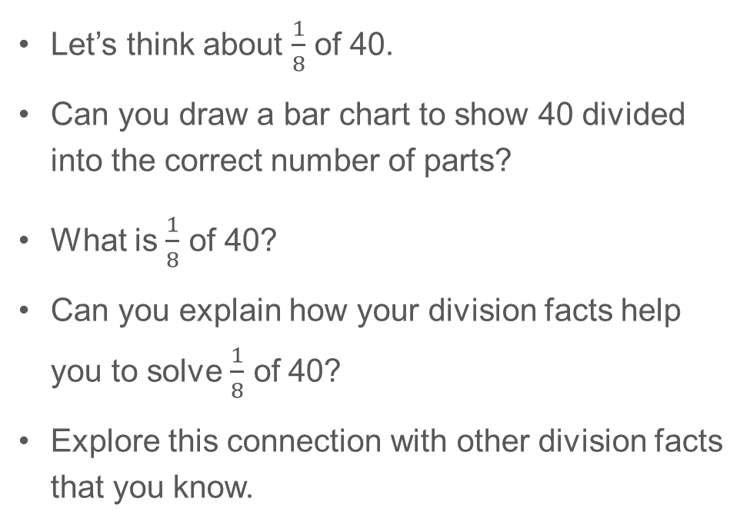
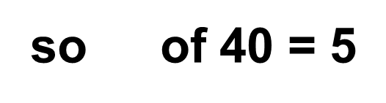
3F-2 Find unit fractions of quantities
1
of 40
Let’s think about $\frac{1}{8}$ of 40.
Can you draw a bar chart to show 40 divided into the correct number of parts?
What is $\frac{1}{8}$ of 40?
Can you explain how your division facts help you to solve $\frac{1}{8}$ of 40?
Explore this connection with other division facts that you know.
8
40 ÷ 8 = 5
1
so of 40 = 5
8

Slide 15
3F-2 Find unit fractions of quantities
Fair Feast
https://nrich.maths.org/2361

