Slide 1
2NPV-1
Place value in two-digit numbers

Slide 2
2NPV-1
Recognise the place value of each digit in two-digit numbers, and compose and decompose two-digit numbers using standard and non-standard partitioning.
The materials in this pack have been collated and written to support the teaching of 2NPV-1. Before planning and teaching the content, read the teaching guidance and example assessment questions in the non-statutory guidance itself, which can be found here.
A video summarising all of the ready-to-progress criteria for Year 2 can be found here.

Slide 3
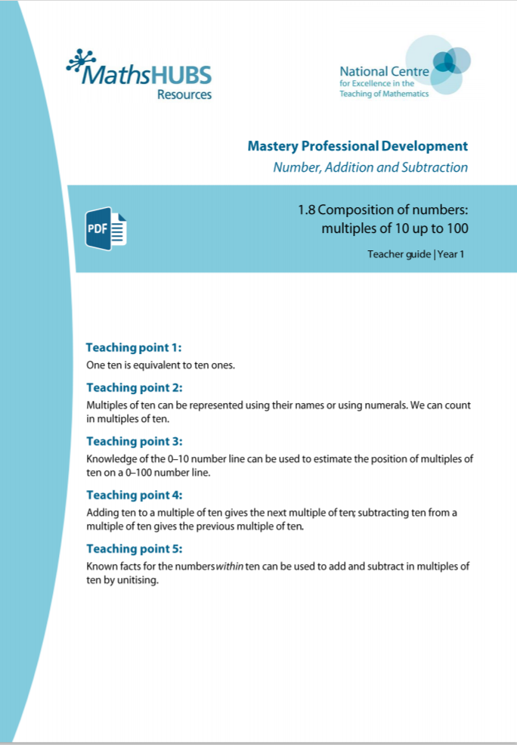


2NPV-1: Linked mastery PD materials
Additional pedagogical subject knowledge support can be found in the following Mastery Professional Development materials:
  1.8 Composition of numbers: multiples of 10 up to 100
  1.9 Composition of numbers: 20–100
  1.10 Composition of numbers: 11–19
Several of the activity slides have been taken from these materials.

Slide 4
2NPV-1
Place value in two-digit numbers

Slide 5
The following slides contain activities that can be used within the context of pre-teaching, intervention, or as supplementary material integrated into teaching. They do not represent complete lessons and should not be used as such. Also they should not be used all at once, but over the period of a teaching unit. It would be valuable to use many of the activities more than once to build fluency in understanding and application. Also many of them would benefit from the use of manipulatives to support interaction with the ideas. Ensure you engage in rich discussion with the children, asking them to reason and explain the ideas presented. Note that when working with a small group, pupils should also have access to the main teaching delivered by the class teacher and the focus should be directly linked so that the learning is connected and fluency is built.

Slide 6
Guidance for working with a small pre-teaching or intervention group
Take time to build understanding of the key idea. We would recommend no more than four slides in any one session, and probably fewer.
In subsequent sessions, review and practise previous learning before moving on.
Play the animation/observe the image and ask pupils “What do you notice?”.
Encourage pupils to explain what they see, what is happening and why.
Where there is a highlighted sentence, draw out the meaning of this from the image and repeat together and individually.

Slide 7
Guidance for working with a small pre-teaching or intervention group
Engage in the suggested activities, using manipulatives where appropriate, to enhance the interaction and stimulate discussion. However, note that the ultimate aim is to develop fluency in the mathematical ideas such that resources are no longer needed.
Repeat questions, using other numbers/examples where relevant.
Repeat the highlighted language structures wherever relevant to build fluency with the key idea and connect the learning. For example:
10 hundreds are equivalent to 1,000.

Slide 8
2NPV-1 Place value in two-digit numbers

Slide 9


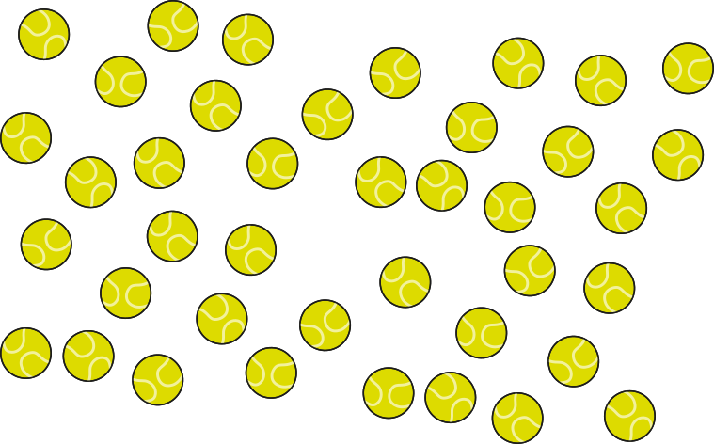



2NPV-1 Place value in two-digit numbers
How can we count the balls efficiently? What equal groups could we put them into?
There are lots of balls so let’s put them in groups of ten.
How many groups of ten can we make? How many are left over?
So there are… balls altogether?
There are 4 groups of ten and 2 extra ones. That makes 42 altogether.

Slide 10



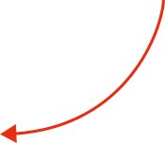

2NPV-1 Place value in two-digit numbers
forty-two
Read the number. What does the ‘forty’ part tell us about the number forty-two?
What does the ‘two’ part tell us?
So the 4 means… and the 2 means…?
This is the number 42. The 4 shows we have 4 groups of ten. The 2 shows we have 2 extra ones.

Slide 11
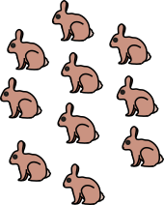
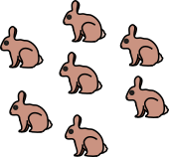
2NPV-1 Place value in two-digit numbers
Say what you see! How are the rabbits arranged?
Do you think all the groups have ten rabbits in them?
How many rabbits are not in a group of ten?
Let’s put the total number of rabbits in the place value chart.
Why do we write 2 in the tens column? Why do we write 7 in the ones column?
10s | 1s
2
7

Slide 12
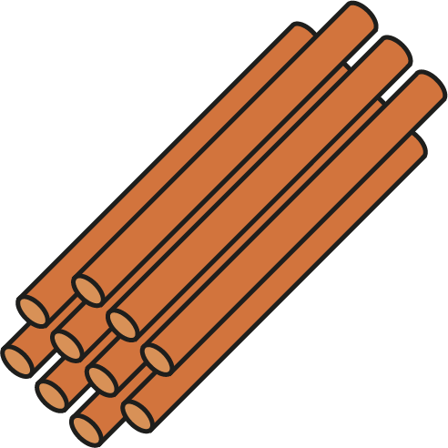



2NPV-1 Place value in two-digit numbers
How many straws do you think is in each bundle?
What does the 2 in 23 represent?
What does the 3 in 23 represent?
If we move the straws around, will the total number of straws change?
Now you make some numbers using straws in bundles of tens with some ‘extra ones’.
2
3
The two represents 2 groups of ten.
The 3 represents 3 extra ones.

Slide 13
2NPV-1 Place value in two-digit numbers
2
3
23 ones
We can think of 23 as 2 tens and 3 extra ones, or 23 ones.

Slide 14
2NPV-1 Place value in two-digit numbers
2 tens and 3 ones
23 ones
When we re-group our tens we can make 2 tens and 3 extra ones again.

Slide 15
2NPV-1 Place value in two-digit numbers
2
3
Have we still got 23 straws?
How do you know?
Does it matter how we arrange our 2 tens and 3 extra ones?
Now make your own number with straws, re-arrange it and ask your friend to say your number. Take turns to practise!
We can re-arrange the objects but the total number of objects stays the same.

Slide 16
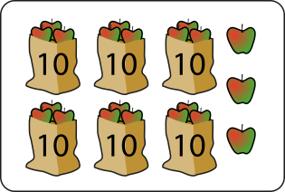

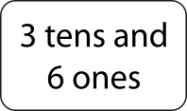
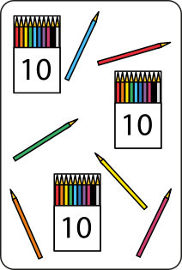

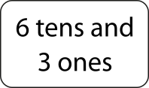
2NPV-1 Place value in two-digit numbers
Look at the pictures of apples and pencils. What is the same? What is different?
Can you find the words and number to match each picture?
Why might someone get this wrong?

Slide 17
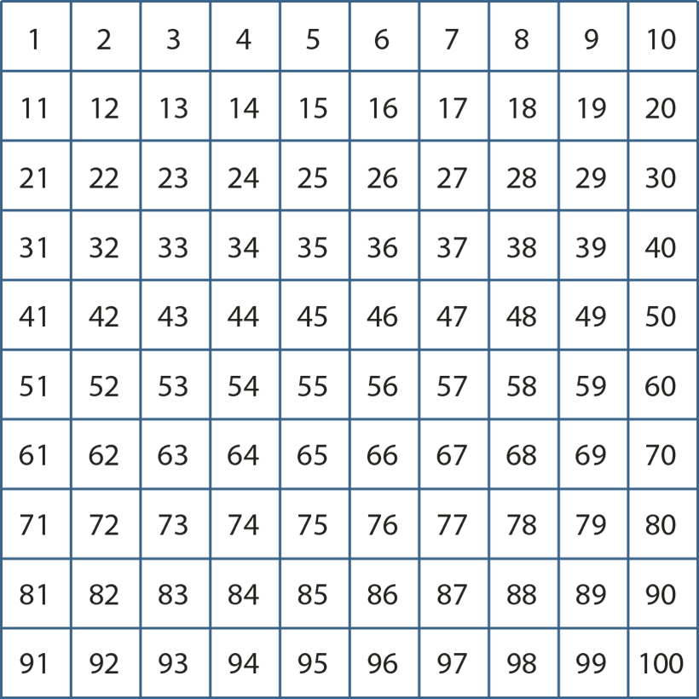
2NPV-1 Place value in two-digit numbers
Find 25 on the hundred square. Which digit is the tens digit, the 2 or the 5? Which is the ones digit?
Can you say some other numbers which have a 2 as the tens digit? What do you notice about where these numbers are on the hundred square?
Can you find some other numbers with 5 as the ones digit? What do you notice?
Choose another number and repeat.

Slide 18
2NPV-1 Place value in two-digit numbers
Let’s make some numbers on the hundred square. How can you say what number is represented without counting in ones?
How would you write this in a place value chart? What do you notice when you write the digits in the chart?
10s | 1s

Slide 19
2NPV-1 Place value in two-digit numbers
1000 | 2000 | 3000 | 4000 | 5000 | 6000 | 7000 | 8000 | 9000
100 | 200 | 300 | 400 | 500 | 600 | 700 | 800 | 900
10 | 20 | 30 | 40 | 50 | 60 | 70 | 80 | 90
1 | 2 | 3 | 4 | 5 | 6 | 7 | 8 | 9
Tap out some numbers on a chart.
Can you say the numbers I am tapping? How do you know?
Can you write the numbers I tap in your place value chart?
How do I tap twenty-five? Do we need to write a zero as one of our digits? Why not?
When I tap seventeen on the chart, which number do I tap first? Which part of the number do I say first? Which digits do you use to write seventeen? What do you notice?

Slide 20
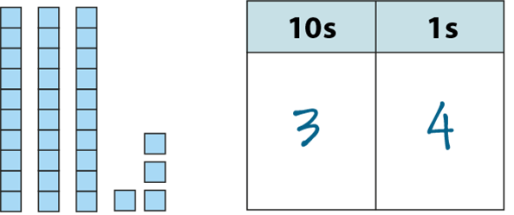



2NPV-1 Place value in two-digit numbers
What number is represented by the base 10 blocks?
It has… tens and… ones.
We write... We say…
How could we change 34 into 35? What would we need to change?
How could we change 34 in to 24? What would we need to change?
Can you make other numbers for your friend to say and write?

Slide 21
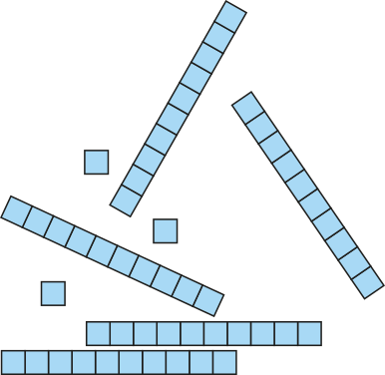
2NPV-1 Place value in two-digit numbers
What number is represented here by the blocks? Can you explain how you know?
Can you make the same number using base 10 equipment? Could you make it using other objects grouped in tens and ones?
How can you change 53 into 63, 64, 54 and back to 53? What did you need to change each time?
53

Slide 22
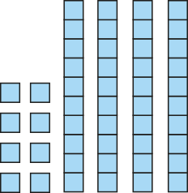
2NPV-1 Place value in two-digit numbers
What do you notice about how the base 10 blocks are arranged?
What number do you think is represented here?
Maybe it is… 84? Am I right?
Can you explain your thinking?
48

Slide 23
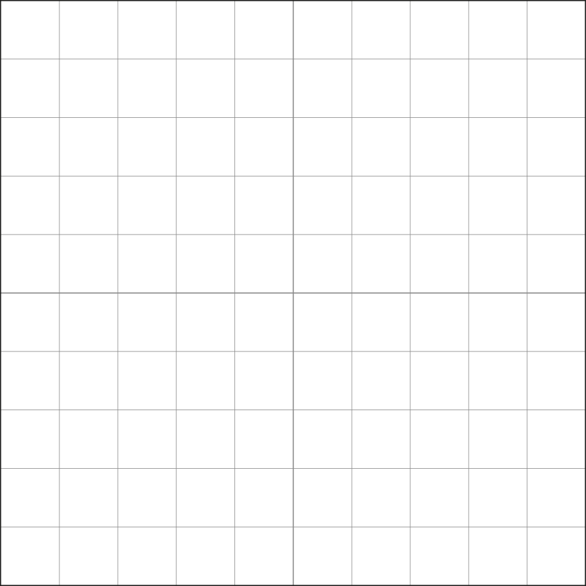
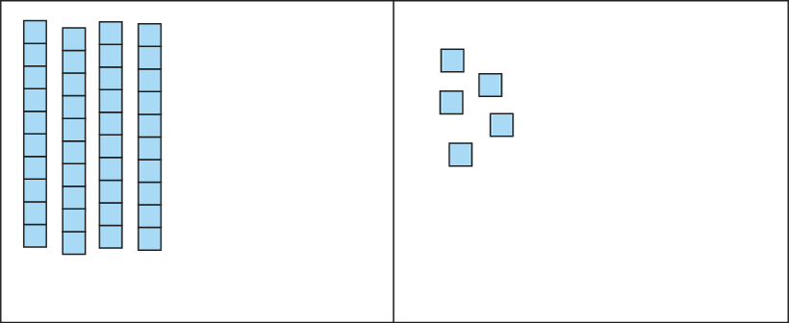
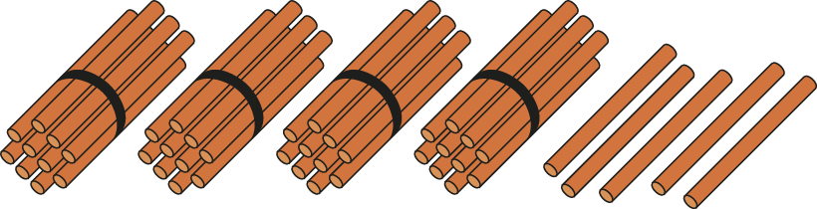
2NPV-1 Place value in two-digit numbers
45
What do you notice about each picture?
What’s the same? What’s different?
Can you describe what the ‘4’ in 45 means?
Where can you see the 4 tens in each picture?

Slide 24
2NPV-1 Place value in two-digit numbers
29
If I colour in 29 little squares, what will the hundred square look like?
How many full rows do you think I will need to colour in? How do you know that?
Can you say how many tens and how many ones in 29?
Look at the last row I have coloured. Why are all of the little squares not coloured?
twenty-nine
2 tens and 9 ones

Slide 25
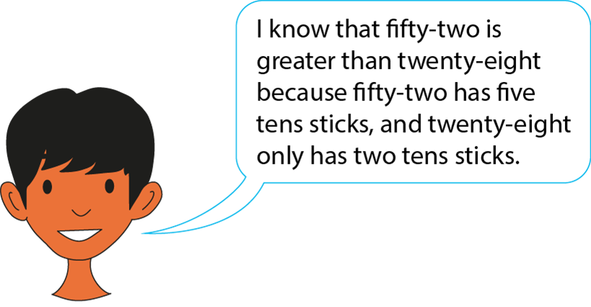
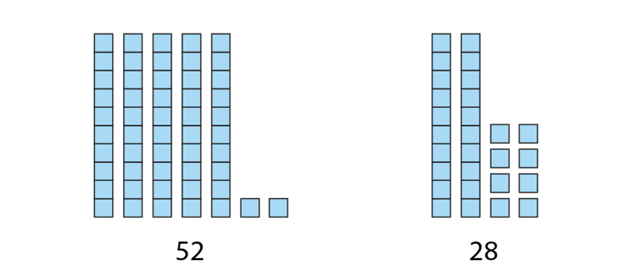
2NPV-1 Place value in two-digit numbers
Look at the two numbers represented and describe what you see.
Are they the same or different?
Which number do you think is greater?
How can we explain how we know?
Now use base 10 blocks to make some other pairs of numbers. Can your friend explain how they know which number is greater?

Slide 26
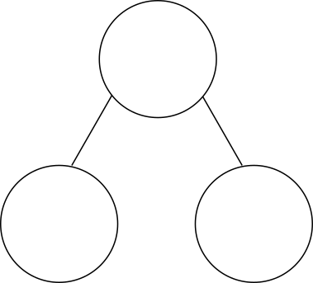


2NPV-1 Place value in two-digit numbers
Look at the straws. How have they been partitioned?
What do you think will be the total (whole) number of straws when we combine the two parts? How do you know?
So, what does the 3 in 34 represent? What does the 4 represent?
34
30
4
We can combine tens and ones to make the whole.
We can partition the whole into tens and ones.

Slide 27
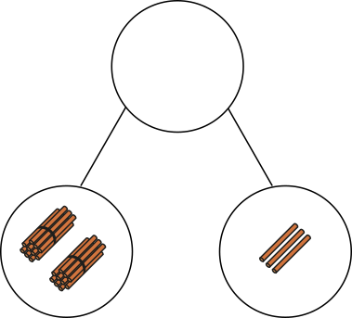
2NPV-1 Place value in two-digit numbers
Can you say what the total (whole) will be without needing to put the straws together? Can you imagine the straws moving to help you?
How will we write the whole?
Now use straws or base 10 blocks in a part-part-whole diagram. Can you say what the whole will be when you combine the parts?
23
?

Slide 28
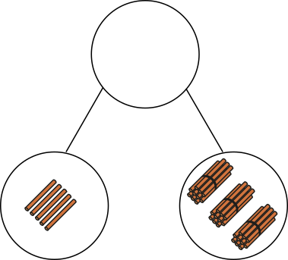
2NPV-1 Place value in two-digit numbers
What do you notice about how the straws have been arranged?
What do you think the whole will be?
Maybe it will be… 53? Am I right? Can you explain why I was wrong?
35
?

Slide 29
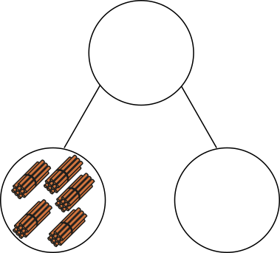

2NPV-1 Place value in two-digit numbers
The part-part-whole diagram shows us that the whole is…?
Which part of the number can you see represented by the straws? The tens part or the ones part?
How can we find the missing part?
57
?
If we know the whole and the tens or the ones part, we can say what the missing part is.

Slide 30
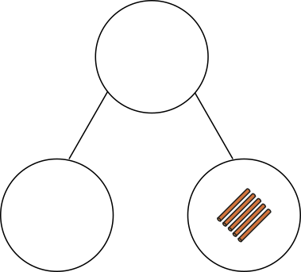

2NPV-1 Place value in two-digit numbers
The part-part-whole diagram shows us that the whole is…?
Which part of the number can you see represented by the straws? The tens part or the ones part?
How can we find the missing part?
Can you show the missing part using bundles of straws?
35
?

Slide 31
2NPV-1 Place value in two-digit numbers
2 tens and 3 ones
Let’s look at other ways to represent the tens and ones parts of two-digit numbers.
How can the part-part-whole diagrams help us understand each set of equations?
Can you find the whole in each equation?
Can you say which numbers are the parts?
What’s the same and what’s different about each pair of equations?
23
20 + 3 = 23
3 + 20 = 23
20
3
23 = 20 + 3
23 = 3 + 20
23 – 20 = 3
23 – 3 = 20
23
20
3
3 = 23 – 20
20 = 23 – 3

Slide 32
2NPV-1 Place value in two-digit numbers
Two-digit Targets
https://nrich.maths.org/6343

