Slide 1
2NPV-2
Two-digit numbers in the linear number system

Slide 2
2NPV-2
Reason about the location of any two-digit number in the linear number system, including identifying the previous and next multiple of 10.
The materials in this pack have been collated and written to support the teaching of 2NPV-2. Before planning and teaching the content, read the teaching guidance and example assessment questions in the non-statutory guidance itself, which can be found here.
A video summarising all of the ready-to-progress criteria for Year 2 can be found here.

Slide 3



2NPV-1: Linked mastery PD materials
Additional pedagogical subject knowledge support can be found in the following Mastery Professional Development materials:
  1.8 Composition of numbers: multiples of 10 up to 100
  1.9 Composition of numbers: 20–100
  1.10 Composition of numbers: 11–19
Several of the activity slides have been taken from these materials.

Slide 4
2NPV-2
Two-digit numbers in the linear number system

Slide 5
The following slides contain activities that can be used within the context of pre-teaching, intervention, or as supplementary material integrated into teaching. They do not represent complete lessons and should not be used as such. Also they should not be used all at once, but over the period of a teaching unit. It would be valuable to use many of the activities more than once to build fluency in understanding and application. Also many of them would benefit from the use of manipulatives to support interaction with the ideas. Ensure you engage in rich discussion with the children, asking them to reason and explain the ideas presented. Note that when working with a small group, pupils should also have access to the main teaching delivered by the class teacher and the focus should be directly linked so that the learning is connected and fluency is built.

Slide 6
Guidance for working with a small pre-teaching or intervention group
Take time to build understanding of the key idea. We would recommend no more than four slides in any one session, and probably fewer.
In subsequent sessions, review and practise previous learning before moving on.
Play the animation/observe the image and ask pupils “What do you notice?”.
Encourage pupils to explain what they see, what is happening and why.
Where there is a highlighted sentence, draw out the meaning of this from the image and repeat together and individually.

Slide 7
Guidance for working with a small pre-teaching or intervention group
Engage in the suggested activities, using manipulatives where appropriate, to enhance the interaction and stimulate discussion. However, note that the ultimate aim is to develop fluency in the mathematical ideas such that resources are no longer needed.
Repeat questions, using other numbers/examples where relevant.
Repeat the highlighted language structures wherever relevant to build fluency with the key idea and connect the learning. For example:
10 hundreds are equivalent to 1,000.

Slide 8
2NPV-2 Two-digit numbers in the linear number system

Slide 9
2NPV-2 Two-digit numbers in the linear number system
32
How many beads are on the bead bar? How can you find out?
If I separate my beads like this…, how can I find out how many there at the start of the bar, without needing to count them?
Can you describe the number using the language of ‘tens and ones’?
Use a class bead bar or a bead string to practise making and saying two-digit numbers.

Slide 10
2NPV-2 Two-digit numbers in the linear number system
How is our bead string similar to the number line?
What sort of numbers can you see on the number line?
Which multiple of ten is half-way between zero and one hundred?
Which numbers are half-way between the multiples of ten? What do you notice about the ones digit in these numbers?

Slide 11
2NPV-2 Two-digit numbers in the linear number system
21
35
52
67
84
99
0
10
20
30
40
50
60
70
80
90
100
Look carefully at where the missing numbers are.
Point to the missing numbers which are between these multiples of 10: 20 and 30; 80 and 90.
Which numbers are close to a multiple of ten? Which are just after or just before?
Which are half-way between multiples of 10?
How can you find out the other numbers?

Slide 12
2NPV-2 Two-digit numbers in the linear number system
0
10
20
30
40
50
60
70
80
90
100
Move the arrow to a number.
Can you reason about the number the arrow is pointing at? Think about how to use multiples of ten and numbers which are half-way between other pairs of numbers.
Say some numbers which would be between these pairs of numbers:70 and 80; 40 and 50; 0 and 10; 25 and 35; 45 and 55.
Can you say ‘stop!’ when I move the arrow to a number with a 9 as the ones digit?

Slide 13
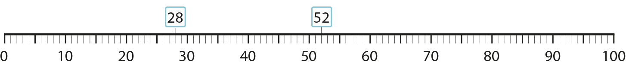

2NPV-2 Two-digit numbers in the linear number system
Read the two numbers shown above the number line.
Which number is greater? How do you know?
If you count from zero to the greater number, will you say the other number in your count?
Choose some other numbers and decide which one is greater.

Slide 14
2NPV-2 Two-digit numbers in the linear number system
36
72
0
10
20
30
40
50
60
70
80
90
100
Look at the first number above the line. Which two multiples of ten is it between? Which is the previous multiple of ten? Which is the next multiple of ten?
Which two multiples of ten is 72 between? Which is the previous multiple of ten? Which is the next multiple of ten?
36 is between 30 and 40.
The previous multiple of 10 is 30. The next multiple of 10 is 40.

Slide 15

2NPV-2 Two-digit numbers in the linear number system
4
7
6
2
0
10
20
30
40
50
60
70
80
90
100
Look at the number 47. What is the previous multiple of ten? What do you notice about the tens digit in 47 and the previous multiple of ten?
Look at the number 62. What do you notice about the previous multiple of ten?

Slide 16
2NPV-2 Two-digit numbers in the linear number system
60
60
60
0
50
100
What do you notice about the number line? Which number sits half-way between zero and one hundred?
Can you say some numbers which come before 50? After 50?
Where would 60 sit on the number line? Would it be nearer to 50 or to 100? How do you know?

Slide 17
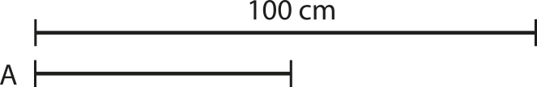
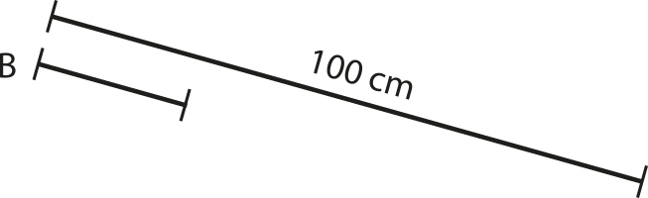
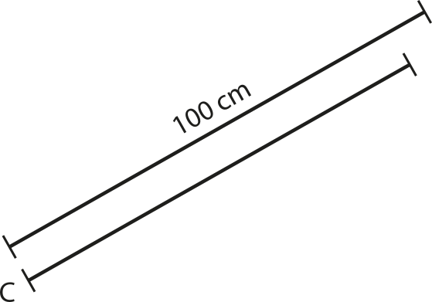
2NPV-2 Two-digit numbers in the linear number system
What do you notice about the lines in the picture? Are they really 100cm long? Make some lines on the playground which are 100cm!
Can you place some objects against your lines and estimate how long each object is? Where should you place each of your objects?
How can you use the mid-way point between 0 and 100 to help you estimate? How else can you make a sensible estimate?
How can you check how accurate your estimate is?

