Slide 1
2AS-4
Add and subtract within 100 – part 2

Slide 2
2AS-4
Add and subtract within 100 by applying related one-digit addition and subtraction facts: add and subtract any 2 two-digit numbers.
The materials in this pack have been collated and written to support the teaching of 2AS-4. Before planning and teaching the content, read the teaching guidance and example assessment questions in the non-statutory guidance itself, which can be found here.
A video summarising all of the ready-to-progress criteria Year 2 can be found here.

Slide 3

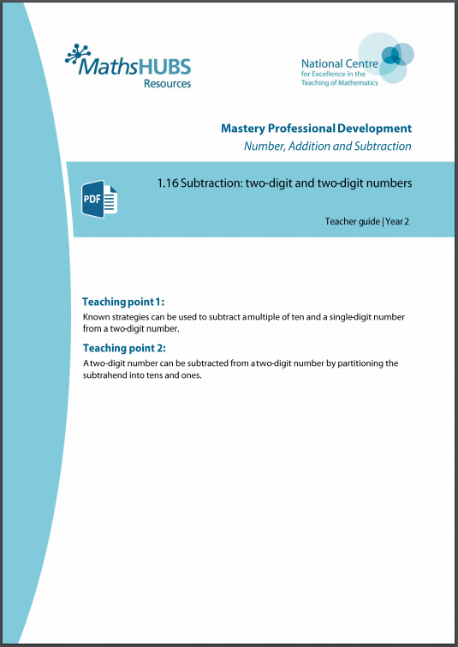
2AS-4: Linked mastery PD materials
Additional pedagogical subject knowledge support can be found in the following Mastery Professional Development materials:
  1.15 Addition: two-digit and two-digit numbers
  1.16 Subtraction: two-digit and two-digit numbers
Several of the activity slides have been taken from these materials.

Slide 4
2AS-4
Add and subtract within 100 – part 2

Slide 5
The following slides contain activities that can be used within the context of pre-teaching, intervention, or as supplementary material integrated into teaching. They do not represent complete lessons and should not be used as such. Also they should not be used all at once, but over the period of a teaching unit. It would be valuable to use many of the activities more than once to build fluency in understanding and application. Also many of them would benefit from the use of manipulatives to support interaction with the ideas. Ensure you engage in rich discussion with the children, asking them to reason and explain the ideas presented. Note that when working with a small group, pupils should also have access to the main teaching delivered by the class teacher and the focus should be directly linked so that the learning is connected and fluency is built.

Slide 6
Guidance for working with a small pre-teaching or intervention group
Take time to build understanding of the key idea. We would recommend no more than four slides in any one session, and probably fewer.
In subsequent sessions, review and practise previous learning before moving on.
Play the animation/observe the image and ask pupils “What do you notice?”.
Encourage pupils to explain what they see, what is happening and why.
Where there is a highlighted sentence, draw out the meaning of this from the image and repeat together and individually.

Slide 7
Guidance for working with a small pre-teaching or intervention group
Engage in the suggested activities, using manipulatives where appropriate, to enhance the interaction and stimulate discussion. However, note that the ultimate aim is to develop fluency in the mathematical ideas such that resources are no longer needed.
Repeat questions, using other numbers/examples where relevant.
Repeat the highlighted language structures wherever relevant to build fluency with the key idea and connect the learning. For example:
10 hundreds are equivalent to 1,000.

Slide 8
2AS-4 Add and subtract within 100 – part 2

Slide 9


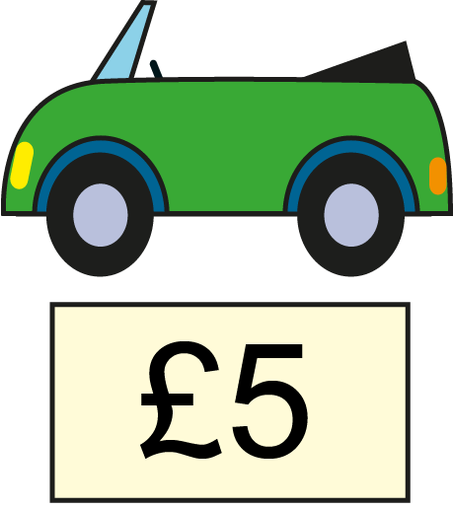

2AS-4 Add and subtract within 100 – part 2
Can you read the prices? What do you notice about them?
How can we add the prices to find the total cost of all the items?
If we add the multiples of ten, what is the total? What number facts help us calculate without counting? What is the total for the prices which are one-digit numbers?
How do we know what 60 plus 8 is without counting?
40 + 5 + 20 + 3
= 68
40 + 20 = 60
5 + 3 = 8

Slide 10
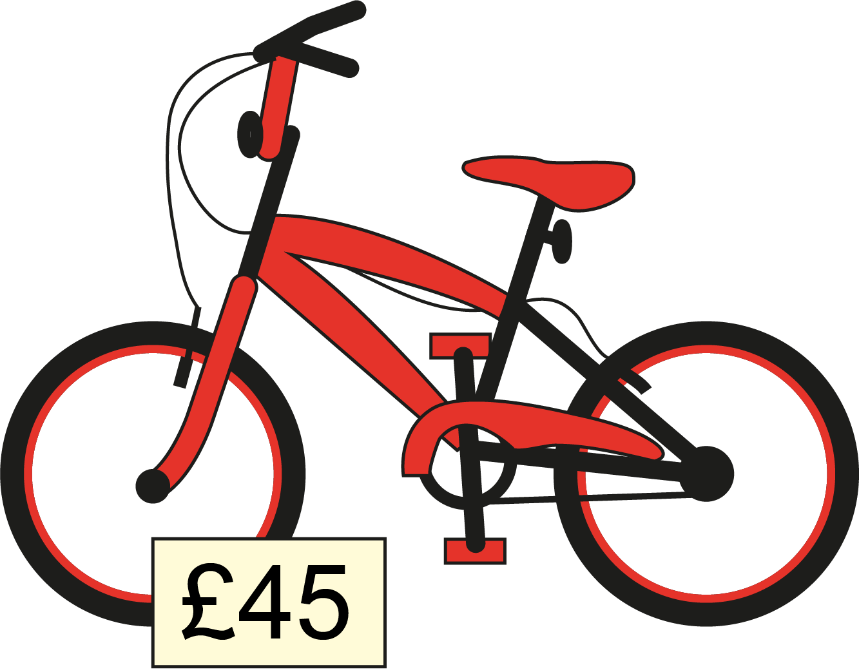
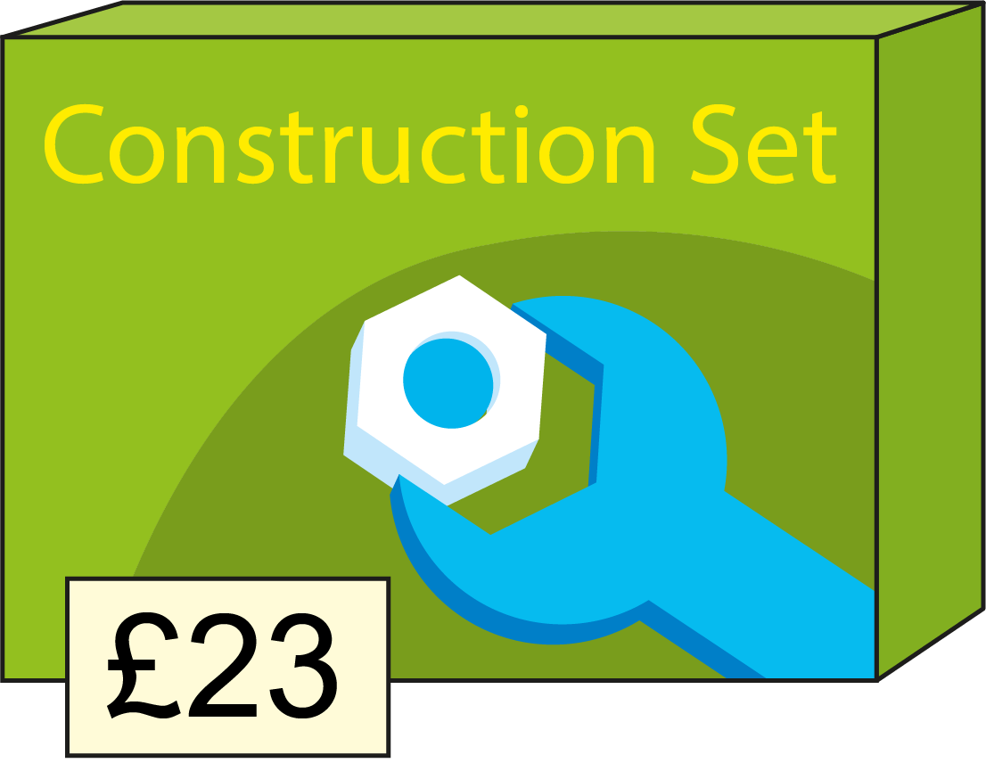
2AS-4 Add and subtract within 100 – part 2
What do you notice about these prices?
Can we partition the numbers to help us add tens and ones?
What multiples of ten can you add?
How can you combine the tens and ones without needing to count?
45 + 23
= 68
40 + 20 = 60
First I partition both numbers.
Then I add the tens. Then I add the ones.
Then I combine all of the tens and all of the ones.
5 + 3 = 8

Slide 11
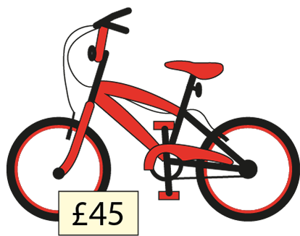
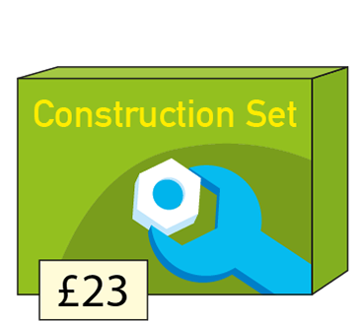

2AS-4 Add and subtract within 100 – part 2
40 + 5 + 20 + 3
45 + 23
Compare the sets of prices. What do you notice?
Why did they have the same total?
Which numbers did you need to partition to calculate?
Why did we not need to partition the first set of prices?

Slide 12


2AS-4 Add and subtract within 100 – part 2
45 + 23
Can you make these numbers with your own equipment?
Can you partition them and record the calculation to add the tens parts? Then do the same with the ones parts.
What is the total when you combine the tens and the ones?
40 + 20 = 60
5 + 3 = 8
We can partition both addends to help us add efficiently.
60 + 8 = 68

Slide 13
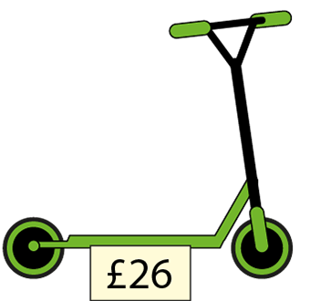
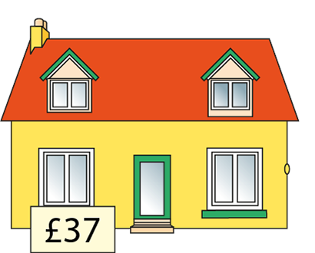










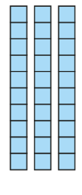





2AS-4 Add and subtract within 100 – part 2
Can you make these numbers with your own equipment?
Partition the numbers into tens and ones. Can you combine all the tens together, then the ones, and record the totals?
What do you notice about the total of the ones digits? Can you exchange 10 ones for 1 ten using your own equipment?
Now can you find the total?
= £63
First I partition both numbers.
Then I add the tens. Then I add the ones.
Then I combine all of the tens and all of the ones.

Slide 14
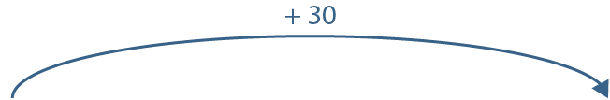
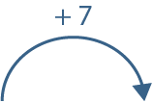





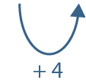

2AS-4 Add and subtract within 100 – part 2
26 + 37 =
63
Let’s look at a different strategy using a number line.
Have both addends been partitioned or just one of them?
How can we add 37 to 26 if we only partition 37?
What jumps do we need to make on the number line?
How can we add 7 to 56 by jumping to a multiple of 10?
We can partition one addend and count on in tens and ones.

Slide 15
2AS-4 Add and subtract within 100 – part 2
Complete these calculations, thinking about when you need to partition. Write the partitioned numbers before you calculate.
40 + 6 =
50 + 6 =
50 + 7 =
40 + 5 + 10 + 2 =
20 + 3 + 10 + 1 =
50 + 10 + 3 + 2 =
45 + 12 =
23 + 11 =
34 + 21 =
21 + 34 =
41 + 21 =
55 + 20 =

Slide 16






2AS-4 Add and subtract within 100 – part 2
45
− 20
− 3
= 22
Let’s think about how we can subtract tens and ones from two-digit numbers.
Make 45 using your own equipment.
Can you say what will be left if you subtract 20 from 45? And then what will be left if you subtract 3?
We can subtract from any two-digit number by subtracting tens then ones.
Notes:
At first I had forty-five biscuits. Then I sold twenty biscuits, and then I dropped three biscuits. How many are left?

Slide 17
2AS-4 Add and subtract within 100 – part 2
45
− 3
− 20
= 22
What’s the same and what’s different about this calculation?
Can you predict what will happen if we subtract the ones then the tens?
Try this with your equipment.
Now try these calculations and check whether it makes a difference what order you subtract the tens and ones in.
53 − 2 − 30 53 − 30 − 2

Slide 18








2AS-4 Add and subtract within 100 – part 2
Let’s look at this calculation on the number line.
Can you describe the jumps? Was it a jump of tens or ones to begin?
Now compare it to the next number line. What’s the same? What’s different?
45 – 23
= 22
45
− 20
− 3
= 22
45
− 3
− 20
= 22

Slide 19









2AS-4 Add and subtract within 100 – part 2
59 – 27
= 32
Draw your own number line and record the calculation.
Which number do you need to partition, the minuend (59) or subtrahend (27)? What parts will you partition it into? How does the partition help you decide which jumps to do?
Can you explain why you don’t need to partition the minuend? (59)
First I partition the subtrahend into tens and ones.
Then I subtract the tens, then subtract the ones.

Slide 20
2AS-4 Add and subtract within 100 – part 2
Complete these calculations, thinking about when you need to partition. Write the partitioned numbers before you calculate. Think do you need to partition the minuend (the first number) when you subtract.
40 – 20 =
42 – 20 =
54 – 2 =
54 – 22 =
65 – 44 =
66 – 44 =
44 – 21 =
44 – 22 =
44 – 23 =
52 – 11 =
68 – 15 =
66 – 22 =

Slide 21
2AS-4 Add and subtract within 100 – part 2
Arranging Additions and Sorting Subtractions
https://nrich.maths.org/14726

