Slide 1
1NPV-2
Numbers to 20 in the linear number system

Slide 2
1NPV-2
Reason about the location of numbers to 20 within the linear number system, including comparing using < > and = .
The materials in this pack have been collated and written to support the teaching of 1NPV-2. Before planning and teaching the content in 1NPV-2, read the teaching guidance and example assessment questions in the non-statutory guidance itself, which can be found here.
A video summarising all of the ready-to-progress criteria for Year 1 can be found here.

Slide 3
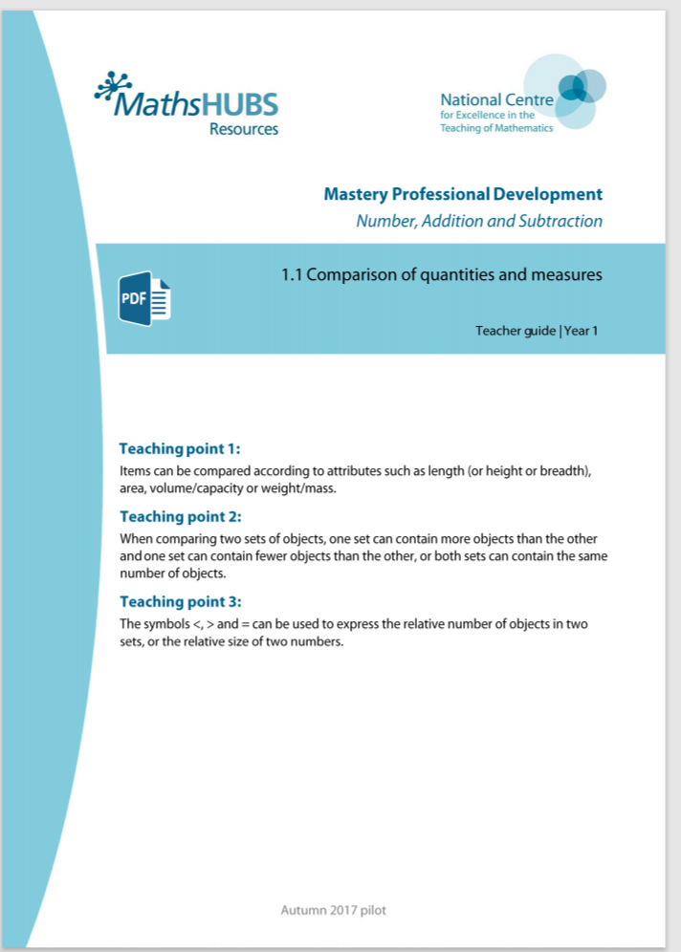
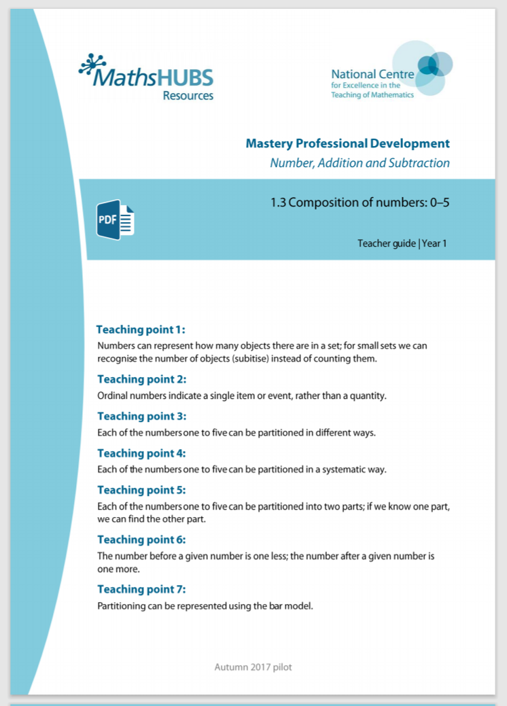
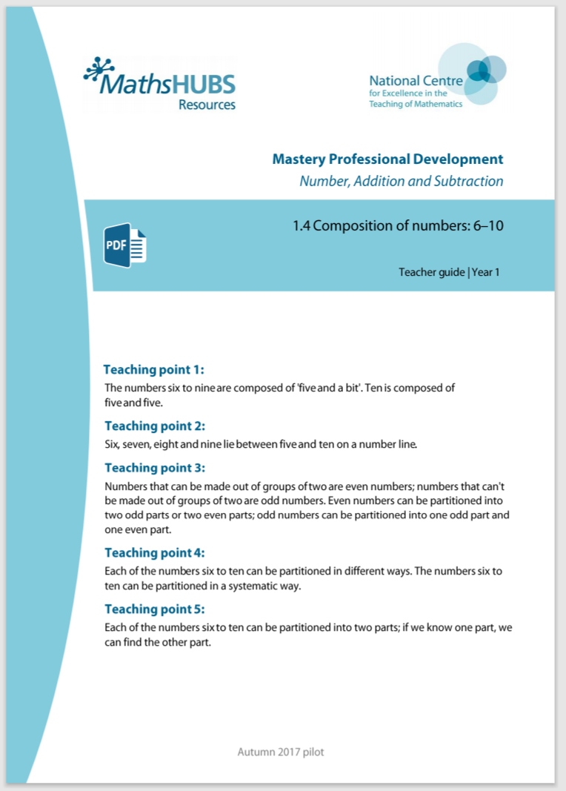
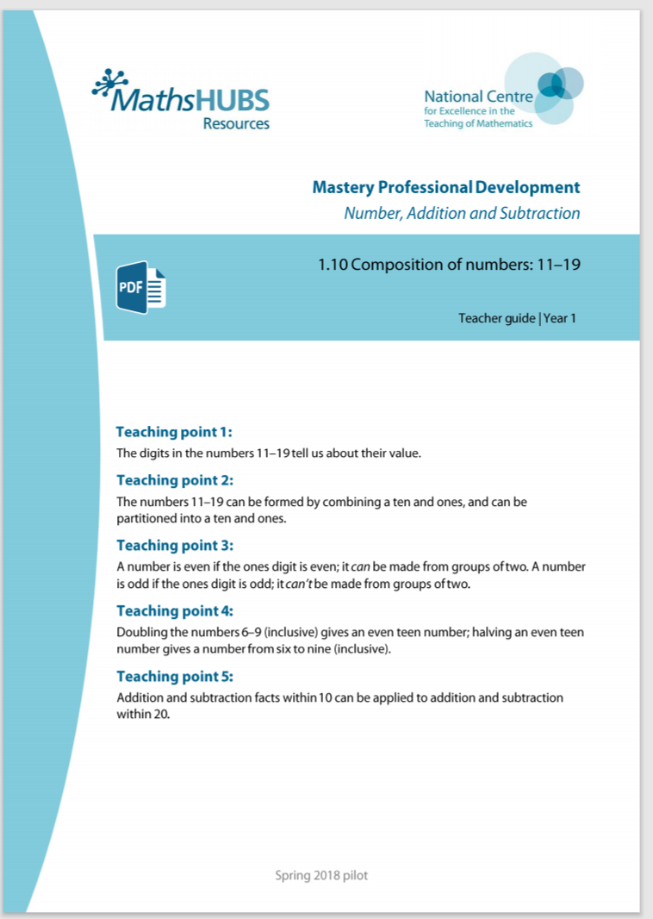
1NPV-2: Linked mastery PD materials
Additional pedagogical subject knowledge support can be found in the Mastery Professional Development Materials:
1.1 Comparison of quantities and measures
1.3 Composition of numbers: 0 – 5
1.4 Composition of numbers: 6 – 10
1.10 Composition of numbers: 11 – 19
Several of the activity slides have been taken from these materials.

Slide 4
1NPV-2
Numbers to 20 in the linear number system

Slide 5
The following slides contain activities that can be used within the context of pre-teaching, intervention, or as supplementary material integrated into teaching. They do not represent complete lessons and should not be used as such. Also they should not be used all at once, but over the period of a teaching unit. It would be valuable to use many of the activities more than once to build fluency in understanding and application. Also many of them would benefit from the use of manipulatives to support interaction with the ideas. Ensure you engage in rich discussion with the children, asking them to reason and explain the ideas presented. Note that when working with a small group, pupils should also have access to the main teaching delivered by the class teacher and the focus should be directly linked so that the learning is connected and fluency is built.

Slide 6
Guidance for working with a small pre-teaching or intervention group
Take time to build understanding of the key idea. We would recommend no more than four slides in any one session, and probably fewer.
In subsequent sessions, review and practise previous learning before moving on.
Play the animation/observe the image and ask pupils “What do you notice?”.
Encourage pupils to explain what they see, what is happening and why.
Where there is a highlighted sentence, draw out the meaning of this from the image and repeat together and individually.

Slide 7
Guidance for working with a small pre-teaching or intervention group
Engage in the suggested activities, using manipulatives where appropriate, to enhance the interaction and stimulate discussion. However, note that the ultimate aim is to develop fluency in the mathematical ideas such that resources are no longer needed.
Repeat questions, using other numbers/examples where relevant.
Repeat the highlighted language structures wherever relevant to build fluency with the key idea and connect the learning. For example:
10 hundreds are equivalent to 1,000.

Slide 8
1NPV-2 Numbers to 20 in the linear number system

Slide 9



1NPV-2 Numbers to 20 in the linear number system
0
1
2
3
4
5
6
7
8
9
10
1
2
4
6
8
9
What is the smallest number shown on the number line? What is the largest?
Which number is half-way between zero and ten?
Can you join in with me as we count forwards and backwards?
Can you tell me some of the numbers between one and five? And those between five and ten? Where do 7, 3 and 5 sit on the number line? How do you know?
Five is half-way between zero and ten.

Slide 10
1NPV-2 Numbers to 20 in the linear number system
0
1
2
3
4
5
6
7
8
9
10
11
12
13
14
15
16
17
18
19
20
What is different about this number line from the one on the previous slide? What are the smallest and largest numbers shown here?
Which number is half-way between zero and twenty?
What do you notice about the numbers before ten? And the numbers after ten?
Can you find these numbers on a ruler? Is ten half-way between zero and twenty on the ruler?
Ten is half-way between zero and twenty.

Slide 11
1NPV-2 Numbers to 20 in the linear number system
What do you notice about each number line?
Can you remember the number which sits half-way between zero and ten?
Which number sits half-way between ten and twenty?
Look at 9 on the top line, then find 19 on the next line, what do you notice? Repeat for other ‘teen’ numbers.
0
1
2
3
4
5
6
7
8
9
10
10
11
12
13
14
15
16
17
18
19
20

Slide 12

1NPV-2 Numbers to 20 in the linear number system
What do you notice about the number line on the bottom?
Which number do you think sits underneath six on the bottom number line?
How do you think we could use the number line on the top to help us place other numbers on the bottom line?
Five is half-way between zero and ten.
Fifteen is half-way between ten and twenty.

Slide 13
1NPV-2 Numbers to 20 in the linear number system
5
19
0
1
2
3
4
5
6
7
8
9
10
11
12
13
14
15
16
17
18
19
20
Can you remember the numbers which sit half-way between zero and twenty, half-way between zero and ten, and half-way between ten and twenty?
Can you tell me some numbers which sit between zero and ten, and between ten and twenty?
Can you say which numbers sit where the arrow is pointing? Can you explain how you know, without needing to count from zero?

Slide 14
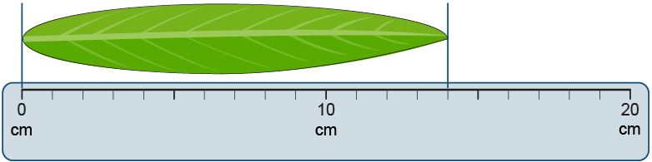
1NPV-2 Numbers to 20 in the linear number system
What do you notice about the numbers on the picture of the ruler? How is the ruler similar to a number line?
What does the ‘cm’ on the ruler mean?
Can you describe how the leaf is placed against the ruler? Why? So, can you say how long the leaf is, using the word ‘centimetres’?
Let’s look at our classroom rulers! What numbers can we see on them?
Can we use our rulers to measure some things in our classroom? What must we remember to do and say?

Slide 15
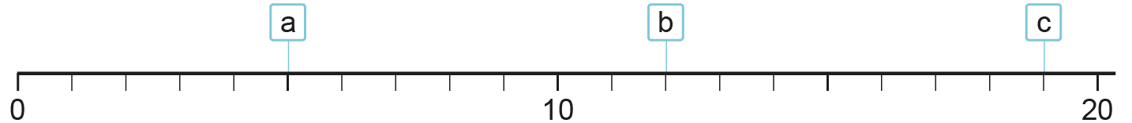
1NPV-2 Numbers to 20 in the linear number system
16
16
16
v
1
2
3
4
5
6
7
8
9
10
11
12
13
14
15
16
17
18
19
What do you notice about the number line?
Can you remember which number sits half-way between zero and twenty?
How can we use what we know about the numbers between 10 and 20 to place 16 on the number line?
Where do you think these numbers sit: 19, 9, 11, 2? Can you explain why?
Ten is half-way between zero and twenty.

Slide 16
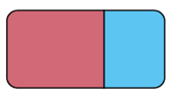
1NPV-2 Numbers to 20 in the linear number system
10cm
10cm
Someone has lost their ruler! But they have two strips of paper to use to measure things. What do you notice about the paper strips? How can they use their number knowledge to help them?
Why do you think they might have placed the rubber where they did?
So, about how long is the rubber, do you think? How could they check with a ruler?
Can you use two paper strips to say about how long some classroom objects are?
My [object] is about ____ centimetres long.

