Slide 1
1NF-1
Fluently add and subtract within 10

Slide 2
1NF-1
Develop fluency in addition and subtraction facts within 10.
The materials in this pack have been collated and written to support the teaching of 1NF-1. Before planning and teaching the content, read the teaching guidance and example assessment questions in the non-statutory guidance itself, which can be found here.
A video summarising all of the ready-to-progress criteria for Year 1 can be found here.

Slide 3
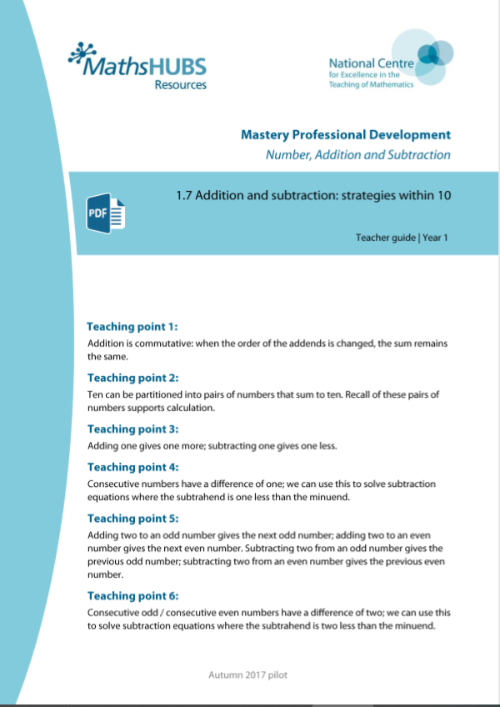
1NF-1: Linked mastery PD materials
Additional pedagogical subject knowledge support can be found in the Mastery Professional Development Materials:
1.7 Addition and subtraction: strategies within 10
Several of the activity slides have been taken from these materials.

Slide 4
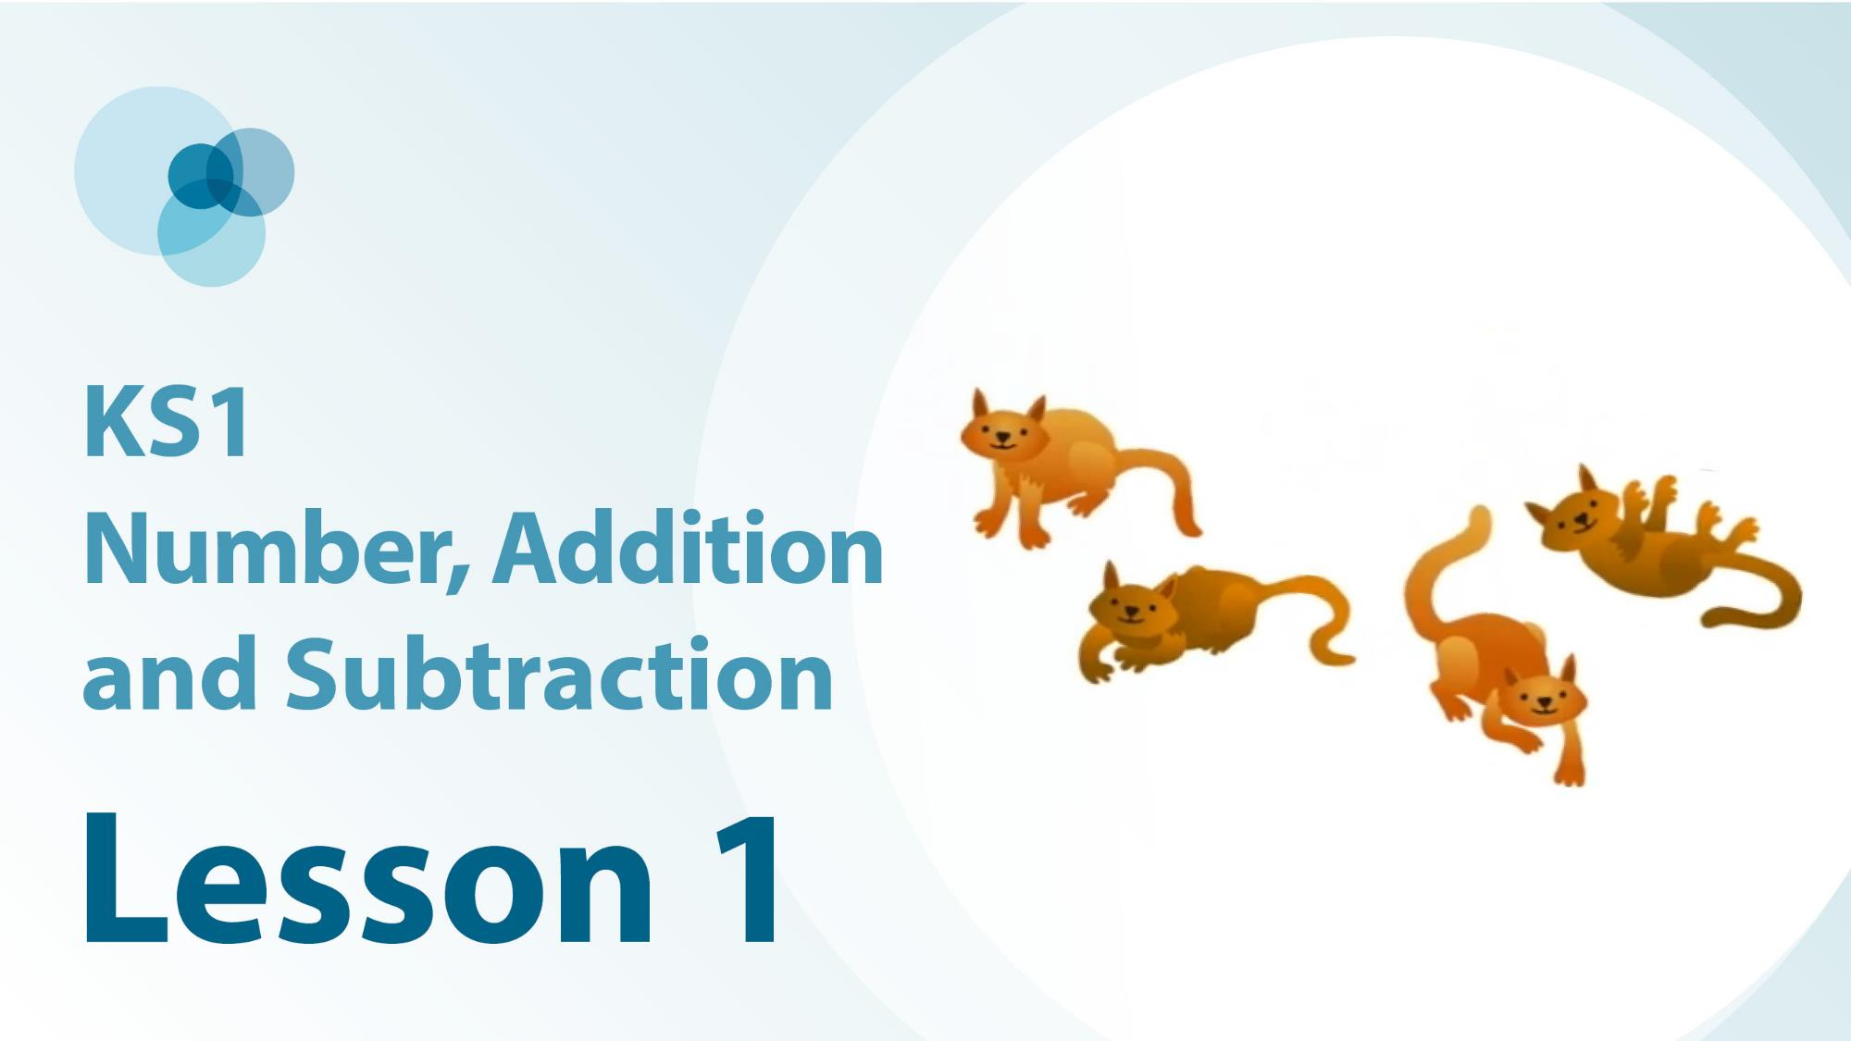
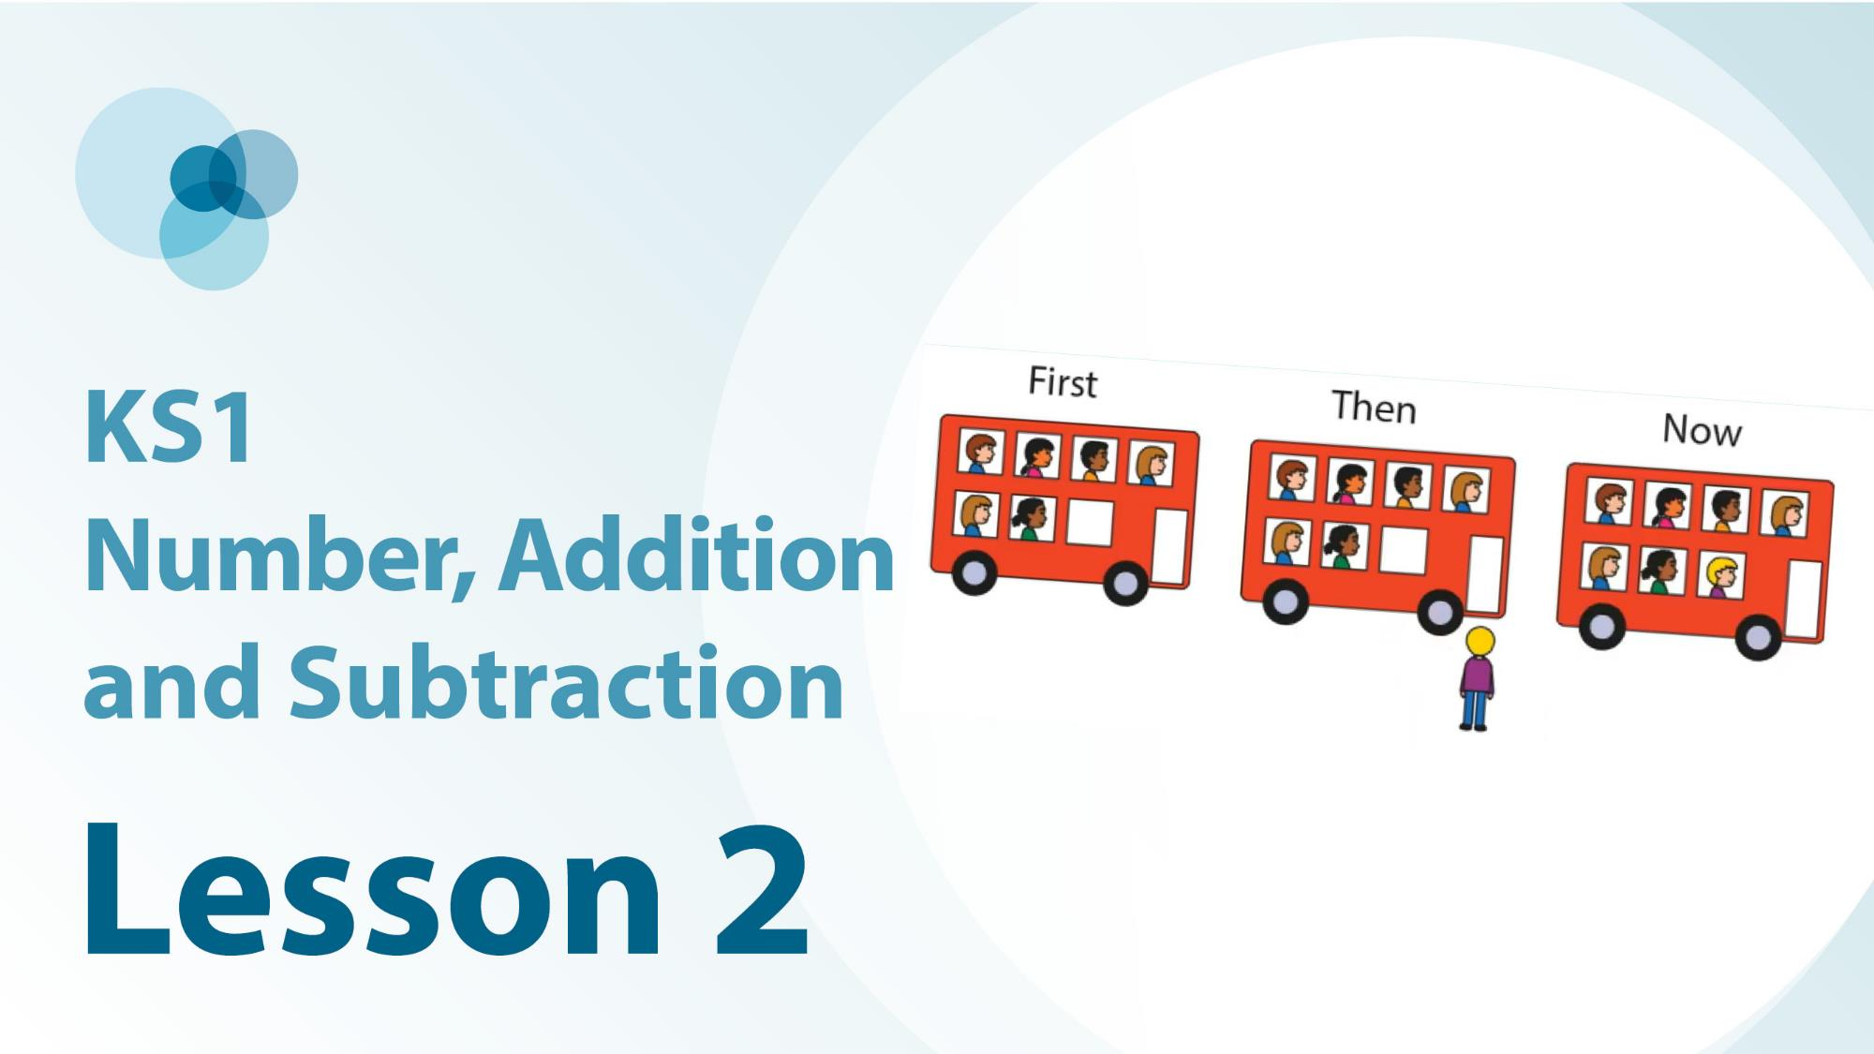
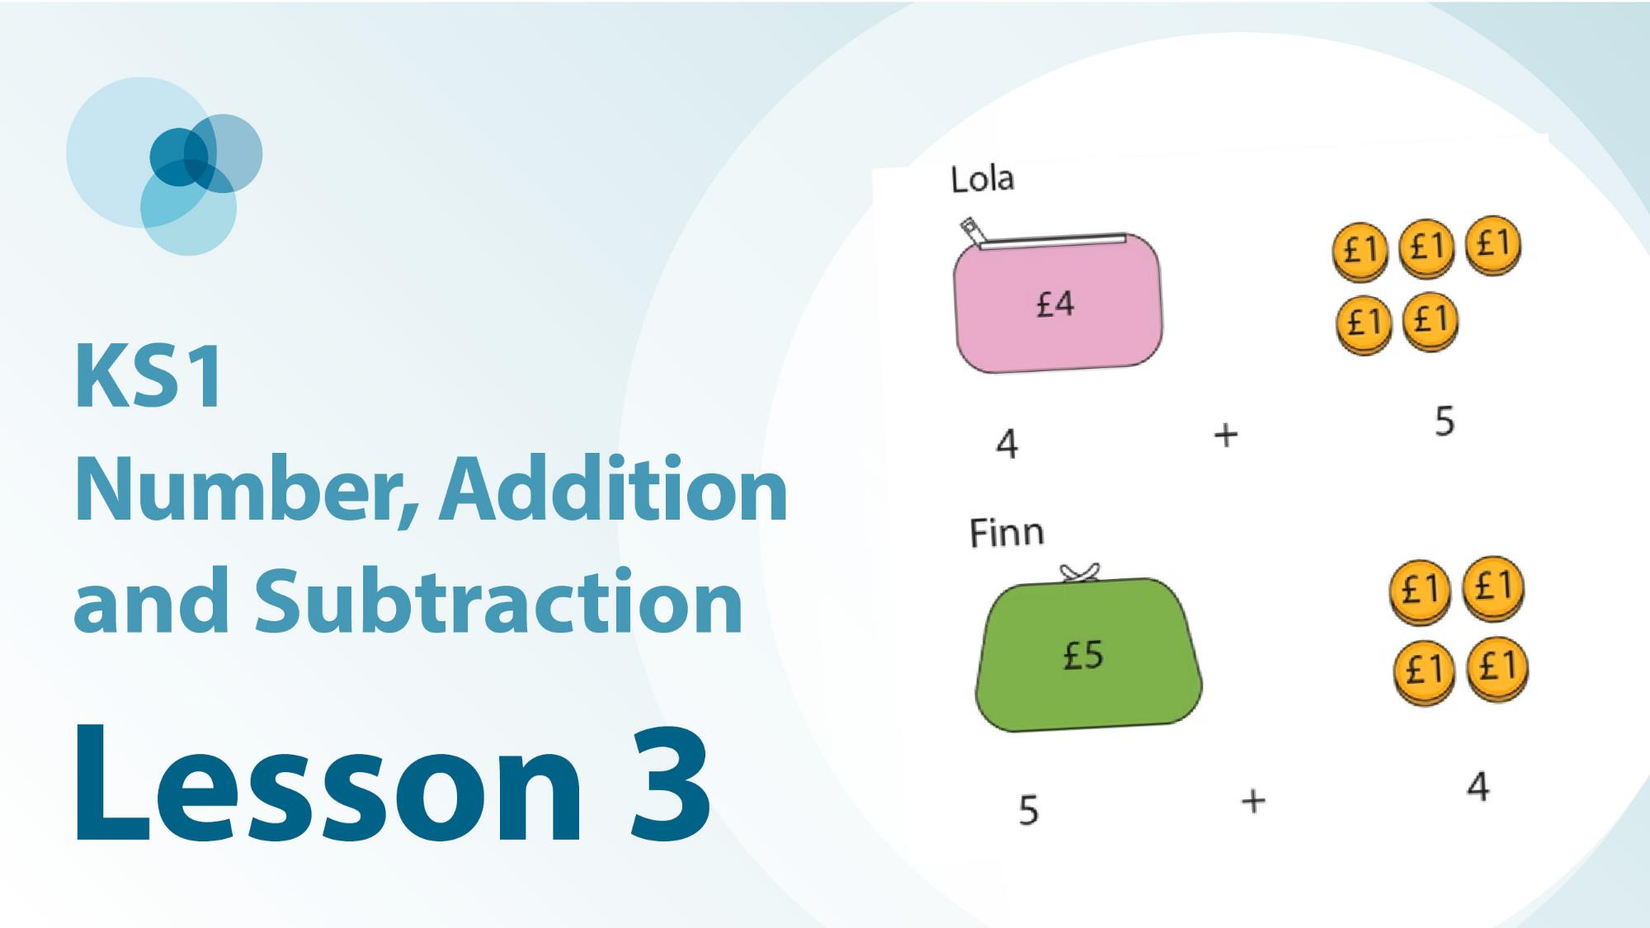
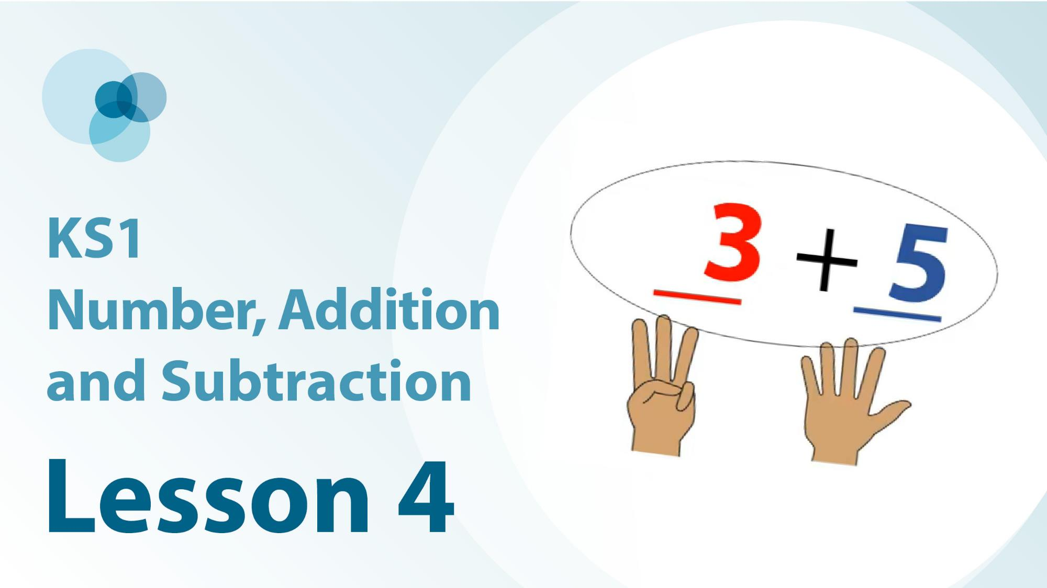
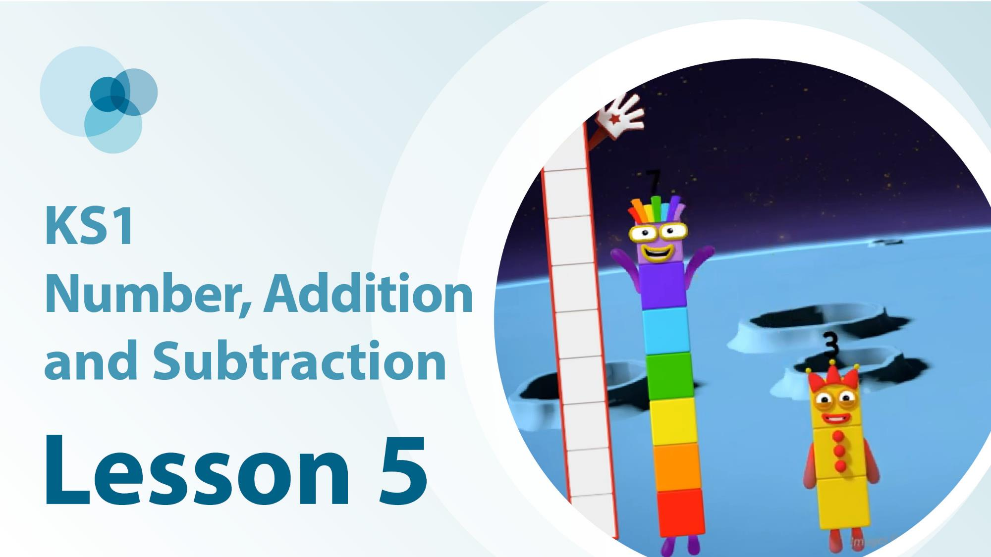
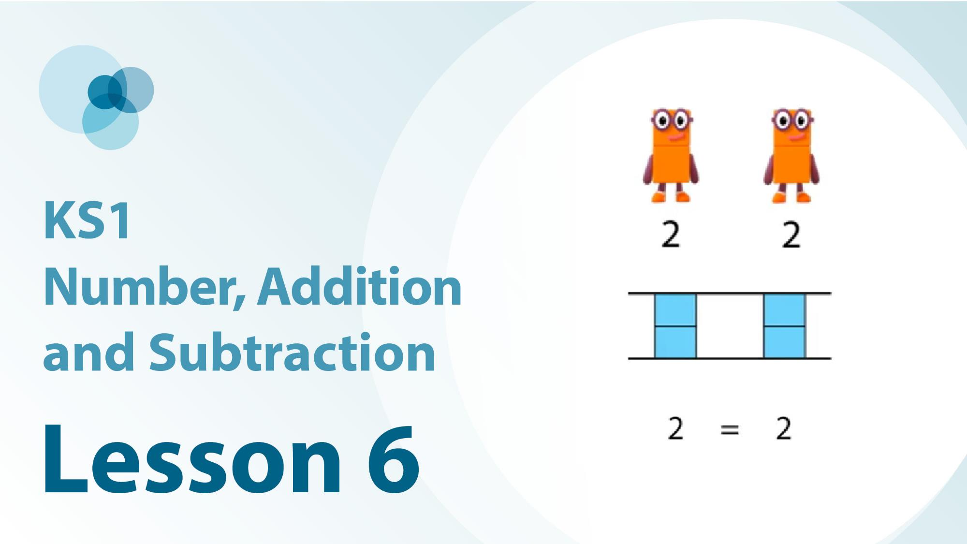
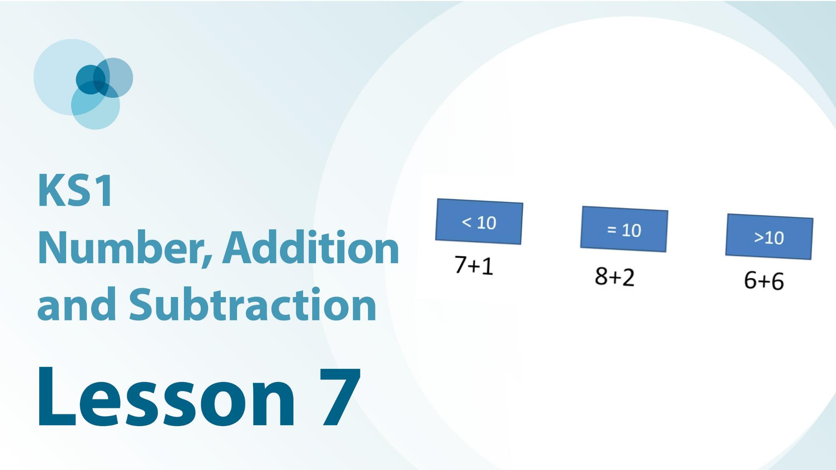
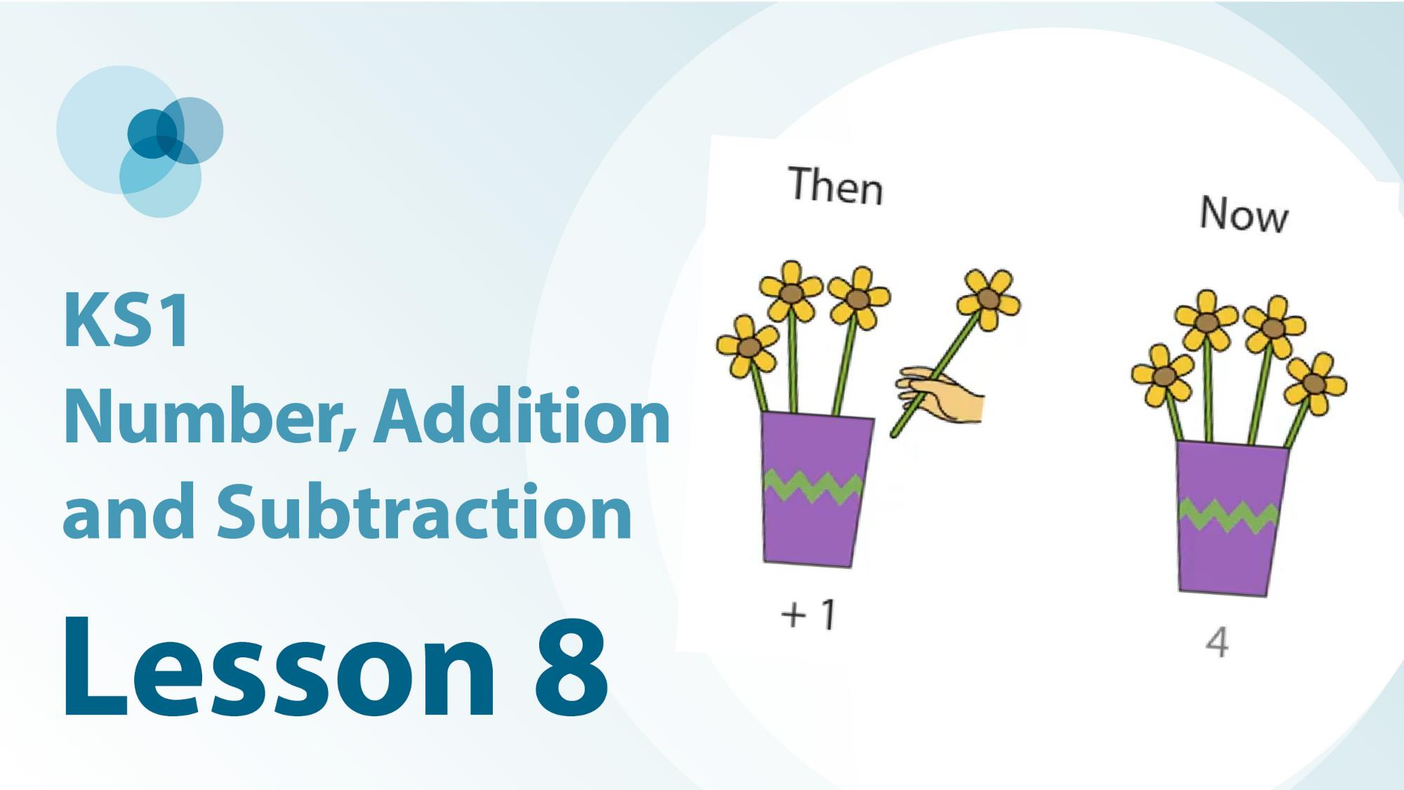
1NF-1 Linked video lessons
Key Stage 1 number, addition and subtraction
The commutative law of addition using aggregation
The commutative law of addition using augmentation
Measures contexts to show the commutative law of addition
Embedding understanding of equivalent expressions
Ten can be partitioned into pairs of numbers that sum to ten
Reasoning about expressions using number bonds to 10
Use knowledge of pairs of numbers that sum to 10, to subtract from 10
Adding one gives one more

Slide 5
1NF-1
Fluently add and subtract within 10

Slide 6
The following slides contain activities that can be used within the context of pre-teaching, intervention, or as supplementary material integrated into teaching. They do not represent complete lessons and should not be used as such. Also they should not be used all at once, but over the period of a teaching unit. It would be valuable to use many of the activities more than once to build fluency in understanding and application. Also many of them would benefit from the use of manipulatives to support interaction with the ideas. Ensure you engage in rich discussion with the children, asking them to reason and explain the ideas presented. Note that when working with a small group, pupils should also have access to the main teaching delivered by the class teacher and the focus should be directly linked so that the learning is connected and fluency is built.

Slide 7
Guidance for working with a small pre-teaching or intervention group
These slides are designed to build fluency in key facts. Use the ideas at the start to ensure understanding is secure.
Play some games to provide practice
Use the retrieval slides once children have built some recall, to provide regular practice to build fluency.

Slide 8
Guidance for working with a small pre-teaching or intervention group
Engage in the suggested activities, using manipulatives where appropriate, to enhance the interaction and stimulate discussion. However, note that the ultimate aim is to develop fluency in the mathematical ideas such that resources are no longer needed.
Repeat questions, using other numbers/examples where relevant.
Repeat the highlighted language structures wherever relevant to build fluency with the key idea and connect the learning. For example:
10 hundreds are equivalent to 1,000.

Slide 9
1NF-1 Fluently add and subtract within 10

Slide 10
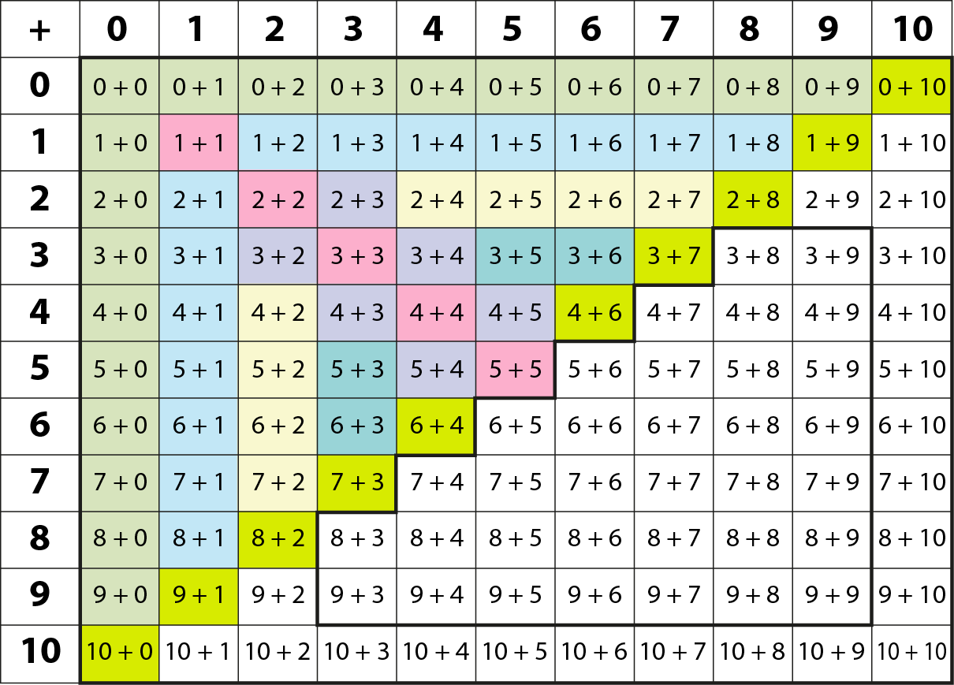
1NF-1 Fluently add and subtract within 10 – All Year 1 addition facts
Y1 facts
Y2
facts
This grid shows the addition facts within 10 and strategies to recall or derive them.
Children should also be fluent in the corresponding subtractions to be ready to progress to Year 2.
Adding 1
Adding 2
Bonds to 10
Adding 0
Doubles
Near doubles

Slide 11
1NF-1 Fluently add and subtract within 10 – bonds to 10
Using the ten frame images, check that children understand that a full ten frame has 10 counters. Agree which bond of ten each image shows. Encourage children to subitise the number of counters rather than count.
Can children copy the arrangement by making it on their own ten frame? Ask children to show you on their fingers this bond of ten by putting some fingers up and some down. You could look at other arrangements of 10, e.g. using a coat hanger with 10 pegs, five of one colour and five of another.
Ensure children recognise that addition is commutative, so if they see 10 as 9 and 1 on their fingers, they know both facts: 10 = 9 + 1 and 10 = 1 + 9, perhaps showing this by switching their hands around. They can also reason that if they know 9 + 1 = 10, they also know 10 – 1 = 9.
Use the following slides to practise recalling the bonds of ten. Keep encouraging children to connect the bond of ten to a mental image of it on their fingers or a ten frame.

Slide 12
1NF-1 Fluently add and subtract within 10 – bonds to 10
Ensure children have plenty of opportunities to re-visit bonds of ten in different contexts. Games which involve hiding a part of a set of 10 objects can be especially helpful. Play the beady snake game: our beady ten snake is hiding part of his body under a stone to keep cool, how many parts is he hiding? Using a set of 10 shells, hide some of them in the sand tray, show children shells not hidden and ask them to predict how many they will need to find to have them all. Using a coat hanger with 10 pegs, hide some under a piece of cloth and children can tell you how many are hiding.
Use a bead string with 10 beds (starting with five red and five white, then progressing to all of the same colour).
Play shopping games with ten one-penny coins. If you buy something for 6p, how many pennies will you have left?
Using written addition expressions, children can be encouraged to sort them into ‘bonds of 10’ and not ‘bonds of 10’.

Slide 13
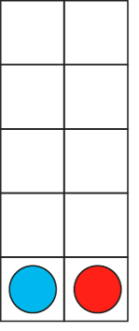
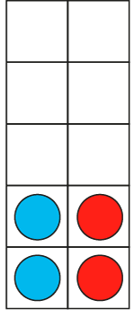
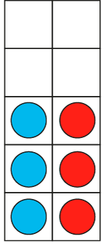
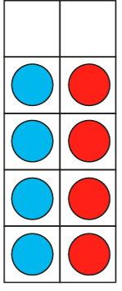
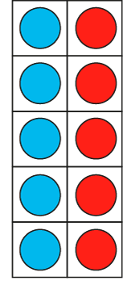
1NF-1 Fluently add and subtract within 10 – bonds to 10
1 + 9 = 10
9 + 1 = 10
2 + 8 = 10
8 + 2 = 10
3 + 7 = 10
7 + 3 = 10
4 + 6 = 10
6 + 4 = 10
5 + 5 = 10
I know that 2 plus 8 is equal to 10 so I know 8 plus 2 is equal to 10.

Slide 14












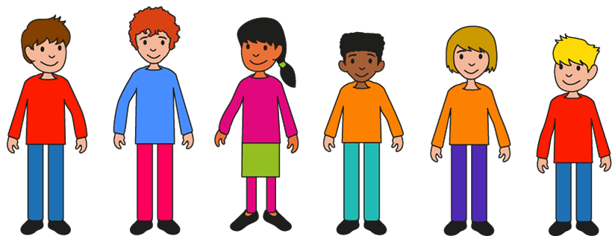
1NF-1 Fluently add and subtract within 10 – bonds to 10

Slide 15
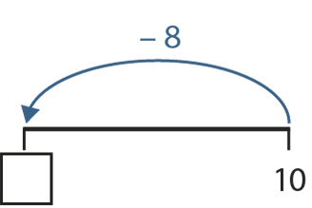
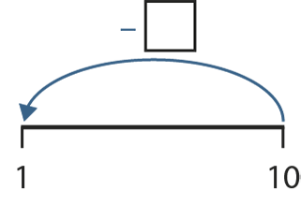
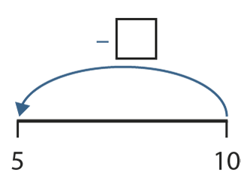
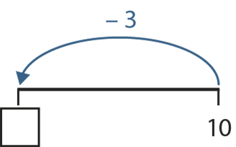
1NF-1 Fluently add and subtract within 10 – bonds to 10
9
2
5
7
I know that 2 + 8 is equal to 10 so I know 10 minus 8 is equal to 2.

Slide 16
1NF-1 Fluently add and subtract within 10 – bonds to 10
5 + 5 =
10

Slide 17
1NF-1 Fluently add and subtract within 10 – bonds to 10
1 + 9 =
10

Slide 18
1NF-1 Fluently add and subtract within 10 – bonds to 10
6 + 4 =
10

Slide 19
1NF-1 Fluently add and subtract within 10 – bonds to 10
3 + 7 =
10

Slide 20
1NF-1 Fluently add and subtract within 10 – bonds to 10
4 + 6 =
10

Slide 21
1NF-1 Fluently add and subtract within 10 – bonds to 10
10 – 9 =
1

Slide 22
1NF-1 Fluently add and subtract within 10 – bonds to 10
10 – 4 =
6

Slide 23
1NF-1 Fluently add and subtract within 10 – bonds to 10
10 – 5 =
5

Slide 24
1NF-1 Fluently add and subtract within 10 – bonds to 10
10 – 3 =
7

Slide 25
1NF-1 Fluently add and subtract within 10 – bonds to 10
7 + 3 =
10

Slide 26
1NF-1 Fluently add and subtract within 10 – bonds to 10
10 – 7 =
3

Slide 27
1NF-1 Fluently add and subtract within 10 – bonds to 10
10 – 2 =
8

Slide 28
1NF-1 Fluently add and subtract within 10 – bonds to 10
10 – 8 =
2

Slide 29
1NF-1 Fluently add and subtract within 10 – bonds to 10
2 + 8 =
10

Slide 30
1NF-1 Fluently add and subtract within 10 – bonds to 10
8 + 2 =
10

Slide 31
1NF-1 Fluently add and subtract within 10 – bonds to 10
10 – 1 =
9

Slide 32
1NF-1 Fluently add and subtract within 10 – bonds to 10
9 + 1 =
10

Slide 33
1NF-1 Fluently add and subtract within 10 – bonds to 10
10 – 6 =
4

Slide 34
1NF-1 Fluently add and subtract within 10 – adding and subtracting 1
Look at the slides of flowers and talk about what is happening. Can children make their own number story with objects involving one more? Can they describe the story as one more than __ is __, and write an equation using +1? Can they draw a picture to match a +1 calculation?
Look at the picture of doughnuts. What is happening? Can they act out a similar story with objects? If they were to draw the picture, how would they show that one object was being taken away? Do they recognise that when we subtract 1, it is the same as one less than? Practise saying subtractions as one less than, e.g. 7 – 1= 6 can be described as one less than 7 is 6.
Use songs and rhymes to develop fluency with one less than. Use props to act out songs, e.g. Ten Green Bottles, Ten Little Monkeys, Five Little Ducks, Five Currant Buns.
Count out a set of objects into a pot: after agreeing how many in the pot, you can put in and take out one object at a time, asking children how many now? Can they convince you?
Children could also be given a selection of addition or subtraction expressions and asked to identify which ones represent one more than or one less than a number.

Slide 35







1NF-1 Fluently add and subtract within 10 – adding and subtracting 1, difference of 1
I know that one more than 3 is 4, so I know that 3 plus 1 is 4.

Slide 36
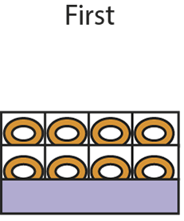
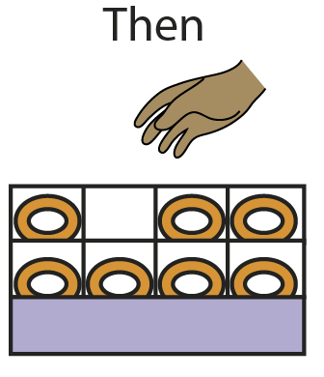
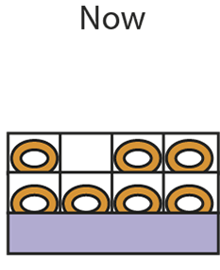






1NF-1 Fluently add and subtract within 10 – adding and subtracting 1, difference of 1
I know that one less than 8 is 7, so I know that 8 minus 1 is 7.

Slide 37
1NF-1 Fluently add and subtract within 10 - adding and subtracting 1, difference of 1
4 + 1 =
5

Slide 38
1NF-1 Fluently add and subtract within 10 - adding and subtracting 1, difference of 1
1 + 6 =
7

Slide 39
1NF-1 Fluently add and subtract within 10 - adding and subtracting 1, difference of 1
8 – 1 =
7

Slide 40
1NF-1 Fluently add and subtract within 10 - adding and subtracting 1, difference of 1
5 – 1 =
4

Slide 41
1NF-1 Fluently add and subtract within 10 - adding and subtracting 1, difference of 1
2 + 1 =
3

Slide 42
1NF-1 Fluently add and subtract within 10 - adding and subtracting 1, difference of 1
7 + 1 =
8

Slide 43
1NF-1 Fluently add and subtract within 10 - adding and subtracting 1, difference of 1
7 – 1 =
6

Slide 44
1NF-1 Fluently add and subtract within 10 - adding and subtracting 1, difference of 1
1 + 3 =
4

Slide 45
1NF-1 Fluently add and subtract within 10 - adding and subtracting 1, difference of 1
1 + 9 =
10

Slide 46
1NF-1 Fluently add and subtract within 10 – difference of 1
Look at the picture of the children playing football. How many are there to start? How many are left? Act out the story and check that it is correct – do we only have one person left? Try making other examples of when there is only one left. Find the numbers used in the stories on a number line – what do children notice? Make the link to next door numbers having a difference of one.
Can children draw a picture of a story in which there is only one left, choosing a way to show the number of objects which are taken away? Can they predict how many objects will need to be crossed off their friend’s picture to show only one left?
Use story books to look for situations in which there might be only one left, e.g. Mouse Count, Handa’s Surprise.
Using a collection of objects counted into a pot or basket, ask children to say how many you need to take out so that there is only one left.
Give children a selection of subtraction expressions; can they identify those with a difference of 1?

Slide 47

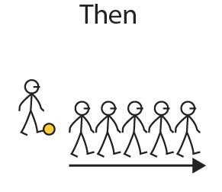





1NF-1 Fluently add and subtract within 10 – adding and subtracting 1, difference of 1
Consecutive numbers have a difference of one.
So I know that 6 minus 5 is equal to 1.

Slide 48
1NF-1 Fluently add and subtract within 10 – adding and subtracting 1, difference of 1
4 – 3 =
1

Slide 49
1NF-1 Fluently add and subtract within 10 – adding and subtracting 1, difference of 1
7 – 6 =
1

Slide 50
1NF-1 Fluently add and subtract within 10 – adding and subtracting 1, difference of 1
9 – 8 =
1

Slide 51
1NF-1 Fluently add and subtract within 10 – adding and subtracting 2, difference of 2
Ensure that children are fluent in counting in twos, both forwards and backwards, from 0 and know that the numbers we say in these counts are even numbers.
What number are we adding each time if we count in twos? What does that look like on a ten frame or with cubes? So what could we say about what happens when we add two to any even number?
Look at the second number line. Can children predict what numbers we will say if we start our counting at 1, and count on 2 each time? What sort of numbers are 1, 3, 5, 7 and 9? So what could we say about what happens when we add 2 to an odd number?
Use games which involve number tracks, e.g. Snakes and Ladders. Can children predict where they will land if they roll 2? If using two dice, can they spot a combination with includes 2 and use the plus 2 strategy to know the total on two dice?
Ensure that children understand that these facts can be expressed in any order. So 6 + 2 = 2 + 6.
When using the slides with equations, you could focus on a few examples to discuss the strategy, or use them as quick fire questions as children’s fluency improves.

Slide 52
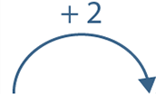
1NF-1 Fluently add and subtract within 10 – adding and subtracting 2, difference of 2
Adding 2 to an even number gives the next even number.

Slide 53



1NF-1 Fluently add and subtract within 10 – adding and subtracting 2, difference of 2
Adding 2 to an odd number gives the next odd number.

Slide 54
1NF-1 Fluently add and subtract within 10 – adding and subtracting 2, difference of 2
5 + 2 =
7

Slide 55
1NF-1 Fluently add and subtract within 10 – adding and subtracting 2, difference of 2
3 + 2 =
5

Slide 56
1NF-1 Fluently add and subtract within 10 – adding and subtracting 2, difference of 2
2 + 4 =
6

Slide 57
1NF-1 Fluently add and subtract within 10 – adding and subtracting 2, difference of 2
6 – 4 =
2

Slide 58
1NF-1 Fluently add and subtract within 10 – adding and subtracting 2, difference of 2
6 – 2 =
4

Slide 59
1NF-1 Fluently add and subtract within 10 – adding and subtracting 2, difference of 2
9 – 7 =
2

Slide 60
1NF-1 Fluently add and subtract within 10 – adding and subtracting 2, difference of 2
2 + 7 =
9

Slide 61
1NF-1 Fluently add and subtract within 10 – adding and subtracting 2, difference of 2
8 – 6 =
2

Slide 62
1NF-1 Fluently add and subtract within 10 – adding and subtracting 2, difference of 2
8 + 2 =
10

Slide 63
1NF-1 Fluently add and subtract within 10 – adding and subtracting 2, difference of 2
2 + 6 =
8

Slide 64
1NF-1 Fluently add and subtract within 10 – adding and subtracting 2, difference of 2
7 – 2 =
5

Slide 65
1NF-1 Fluently add and subtract within 10 – adding and subtracting 2, difference of 2
9 – 2 =
7

Slide 66
1NF-1 Fluently add and subtract within 10 – adding and subtracting 0
Look at the bus stories and talk about what is happening. Can children identify what the zero means in each story? How does the number of children change in the picture each time?
Act out a similar bus story, checking that children understand whether it is a story which starts with no children, or in which no more children get on at the bus stop to ensure understanding of the zero in the equation. Agree what equation we can write each time we have a story like this. What do they notice about the total? Why is the total the same as one of the addends?
Look at the eggs and basket story and talk about what is happening. Focus on the lack of any change when zero is subtracted.
When using the equation slides, pause at some and check children’s understanding by asking them to give you an example of a story which matches the equation, as well as using them for quick recall.

Slide 67
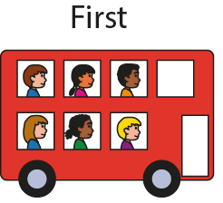
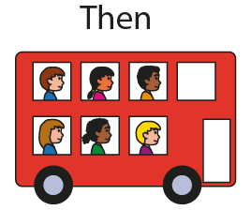





1NF-1 Fluently add and subtract within 10 – adding and subtracting 0
When zero is added to a number, the number remains unchanged.

Slide 68
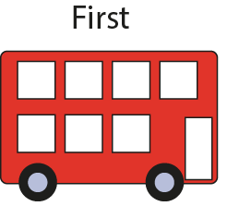
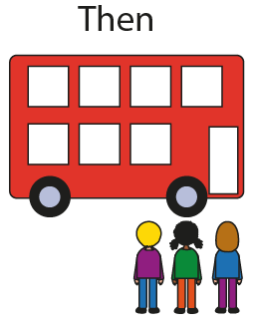
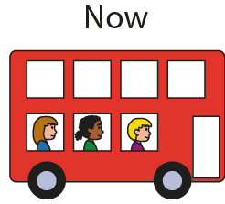



1NF-1 Fluently add and subtract within 10 – adding and subtracting 0

Slide 69
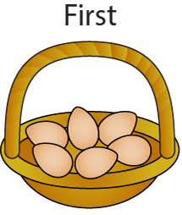


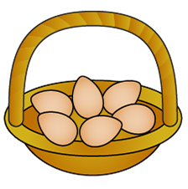







1NF-1 Fluently add and subtract within 10 – adding and subtracting 0
When zero is subtracted from a number, the number remains unchanged.

Slide 70
1NF-1 Fluently add and subtract within 10 – adding and subtracting 0
5 + 0 =
5

Slide 71
1NF-1 Fluently add and subtract within 10 – adding and subtracting 0
2 + 0 =
5

Slide 72
1NF-1 Fluently add and subtract within 10 – adding and subtracting 0
2 – 0 =
2

Slide 73
1NF-1 Fluently add and subtract within 10 – adding and subtracting 0
0 + 8 =
8

Slide 74
1NF-1 Fluently add and subtract within 10 – adding and subtracting 0
0 + 3 =
3

Slide 75
1NF-1 Fluently add and subtract within 10 – adding and subtracting 0
7 – 0 =
7

Slide 76
1NF-1 Fluently add and subtract within 10 – adding and subtracting 0
0 + 4 =
4

Slide 77
1NF-1 Fluently add and subtract within 10 – adding and subtracting 0
7 + 0 =
7

Slide 78
1NF-1 Fluently add and subtract within 10 – differences of zero
Look at the egg story and talk about what is happening. Focus on why there is a difference of zero. What other number stories about eggs would leave none left?
What other stories could children think of which would have none left? Can children tell a story to match an equation? How can we describe an equation which shows none left? (It has a difference of zero.)
Use the equation slides to practise recalling these facts and as a way to check that the generalisation is understood.
Children could also be presented with a selection of expressions and asked to identify which ones will have a difference of zero.
Subtracting a number from itself gives a difference of zero.

Slide 79

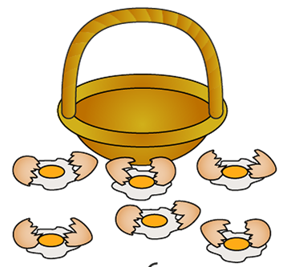

1NF-1 Fluently add and subtract within 10 – subtracting the same number leaves 0
Subtracting a number from itself gives a difference of zero.

Slide 80
1NF-1 Fluently add and subtract within 10 – adding and subtracting 0
5 – 5 =
0

Slide 81
1NF-1 Fluently add and subtract within 10 – adding and subtracting 0
9 – 9 =
0

Slide 82
1NF-1 Fluently add and subtract within 10 – adding and subtracting 0
3 – 3 =
0

Slide 83
1NF-1 Fluently add and subtract within 10 – doubles, halves and near doubles
Look at the ten frames images of doubles – can children show this double using their fingers and on their own ten frame? Can they match a double equation to a ten frame? What do children notice about the totals when we double a (whole) number? Is it even or odd?
When we make a double, and then un-do our double, what can we say we have found? (We have found half.) What will the equations look like? (4 + 4 = 8, 8 – 4 = 4) What do children notice about the subtraction which can un-do the double?
If we know doubles, can we derive some other facts? What if we make one of the addends in a double addition one more or one less? What can we call this strategy? (Near doubles.)
Use stories to look for and talk about images which show doubles, e.g. ladybirds. What would happen if the ladybird lost a spot? What he gave a spot to his friend?
If we know some near doubles facts, can you use these to spot some subtractions which un-do a near double?
When using the equation slides, ask children to identify the strategy which helps this become a ‘known fact’ as well as for practice in quick recall.

Slide 84











1NF-1 Fluently add and subtract within 10 – doubles, halves and near doubles

Slide 85
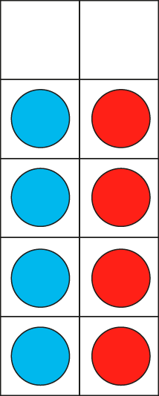
1NF-1 Fluently add and subtract within 10 – doubles, halves and near doubles
I know that 4 + 4 is equal to 8.
So I know 8 subtract 4 is equal to 4.
4 + = 8
4
8 − = 4
4

Slide 86
1NF-1 Fluently add and subtract within 10 – doubles, halves and near doubles
I know that double 3 is equal to 6.
So I know 4 plus 3 is equal to 7.
4 + 3 = 7
3 + 3 = 6

Slide 87
1NF-1 Fluently add and subtract within 10 – doubles, halves and near doubles
5 + 5 =
10

Slide 88
1NF-1 Fluently add and subtract within 10 – doubles, halves and near doubles
10 – 5 =
5

Slide 89
1NF-1 Fluently add and subtract within 10 – doubles, halves and near doubles
2 – 1 =
1

Slide 90
1NF-1 Fluently add and subtract within 10 – doubles, halves and near doubles
2 + 2 =
4

Slide 91
1NF-1 Fluently add and subtract within 10 – doubles, halves and near doubles
4 – 2 =
2

Slide 92
1NF-1 Fluently add and subtract within 10 – doubles, halves and near doubles
7 – 4 =
3

Slide 93
1NF-1 Fluently add and subtract within 10 – doubles, halves and near doubles
6 – 3 =
3

Slide 94
1NF-1 Fluently add and subtract within 10 – doubles, halves and near doubles
8 – 4 =
4

Slide 95
1NF-1 Fluently add and subtract within 10 – doubles, halves and near doubles
4 + 5 =
9

Slide 96
1NF-1 Fluently add and subtract within 10 – doubles, halves and near doubles
1 + 1 =
2

Slide 97
1NF-1 Fluently add and subtract within 10 – doubles, halves and near doubles
2 + 3 =
5

Slide 98
1NF-1 Fluently add and subtract within 10 – doubles, halves and near doubles
3 + 2 =
5

Slide 99
1NF-1 Fluently add and subtract within 10 – doubles, halves and near doubles
4 + 3 =
7

Slide 100
1NF-1 Fluently add and subtract within 10 – doubles, halves and near doubles
5 + 4 =
9

Slide 101
1NF-1 Fluently add and subtract within 10 – doubles, halves and near doubles
4 + 4 =
8

Slide 102
1NF-1 Fluently add and subtract within 10 – doubles, halves and near doubles
9 – 5 =
4

Slide 103
1NF-1 Fluently add and subtract within 10 – doubles, halves and near doubles
7 – 3 =
4

Slide 104
1NF-1 Fluently add and subtract within 10 – doubles, halves and near doubles
9 – 4 =
5

Slide 105
1NF-1 Fluently add and subtract within 10 – doubles, halves and near doubles
5 – 3 =
2

Slide 106
1NF-1 Fluently add and subtract within 10 – doubles, halves and near doubles
3 + 3 =
6

Slide 107
1NF-1 Fluently add and subtract within 10 – doubles, halves and near doubles
3 + 4 =
7

Slide 108
1NF-1 Fluently add and subtract within 10 – doubles, halves and near doubles
5 – 2 =
3

Slide 109
1NF-1 Fluently add and subtract within 10 – remaining facts
The final facts, 5 + 3 and 6 + 3 (and their related facts) do not fit into any of the strategies exemplified so far. Using images could be a useful way to explore these facts.
5 and 3 can be shown helpfully on a ten frame when presented fives-wise, on hands, or using a coat hanger with pegs.
6 and 3 can be also shown on a ten frame. Becoming familiar with an array of 9, e.g. in the Numberblock character Nine, often helps children understand that 9 can be composed of 6 and 3, and then begin to relate these number facts to it.
Once children are familiar with these facts, they can begin to relate derived facts from them, e.g. subtraction facts 8 – 5, 8 – 3, 9 – 6, 9 – 3.
Both facts could be found on two dice, so encourage children to look out for these facts without a family when they play games with dice.

Slide 110



1NF-1 Fluently add and subtract within 10 – remaining facts
5 and 3 fingers are 8.
5 and 3 counters are 8.

Slide 111
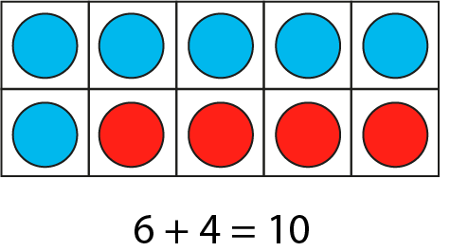
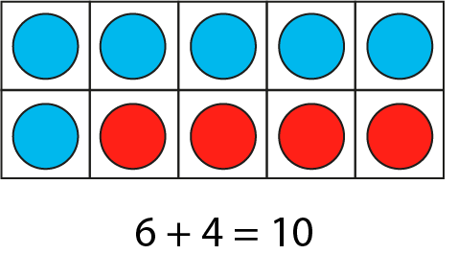

1NF-1 Fluently add and subtract within 10 – remaining facts

Slide 112

1NF-1 Fluently add and subtract within 10 – remaining facts
Click to show Nine is made from 6 and 3.

Slide 113
1NF-1 Fluently add and subtract within 10 – remaining facts
5 + 3 =
8

Slide 114
1NF-1 Fluently add and subtract within 10 – remaining facts
3 + 6 =
9

Slide 115
1NF-1 Fluently add and subtract within 10 – remaining facts
8 – 3 =
5

Slide 116
1NF-1 Fluently add and subtract within 10 – remaining facts
9 – 3 =
6

Slide 117
1NF-1 Fluently add and subtract within 10 – remaining facts
3 + 5 =
8

Slide 118
1NF-1 Fluently add and subtract within 10 – remaining facts
9 – 6 =
3

Slide 119
1NF-1 Fluently add and subtract within 10 – remaining facts
8 – 5 =
3

Slide 120
1NF-1 Fluently add and subtract within 10 – remaining facts
6 + 3 =
9

