Slide 1
1AS-2
Read, write and interpret additive equations

Slide 2
1AS-2
Read, write and interpret equations containing addition (+), subtraction (-) and equals (=) symbols, and relate additive expressions and equations to real-life contexts.
The materials in this pack have been collated and written to support the teaching of 1AS-2. Before planning and teaching the content, read the teaching guidance and example assessment questions in the non-statutory guidance itself, which can be found here.
A video summarising all of the ready-to-progress criteria for Year 1 can be found here.

Slide 3
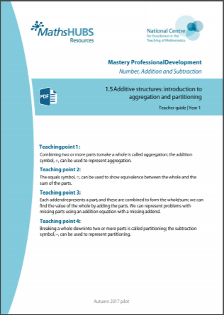
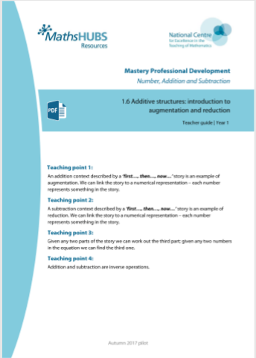
1AS-2: Linked mastery PD materials
Additional pedagogical subject knowledge support can be found in the following Mastery Professional Development materials:
  1.5 Additive structures: introduction to aggregation and partitioning
  1.6 Additive structures: introduction to augmentation and reduction
Several of the activity slides have been taken from these materials.

Slide 4
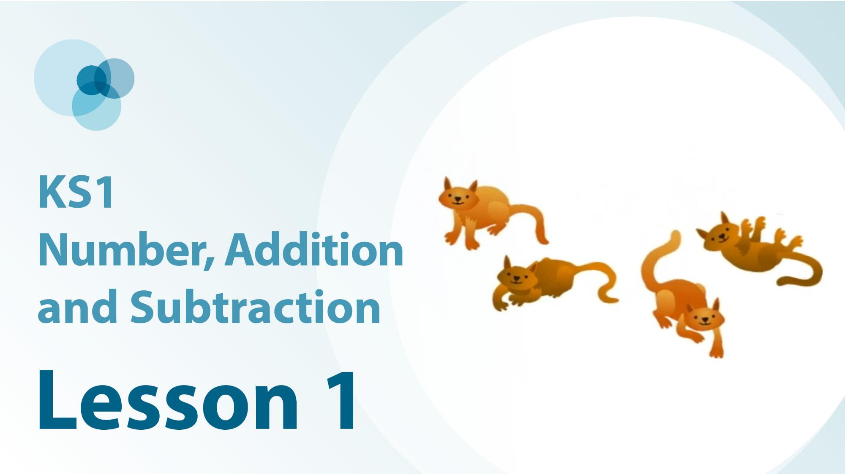
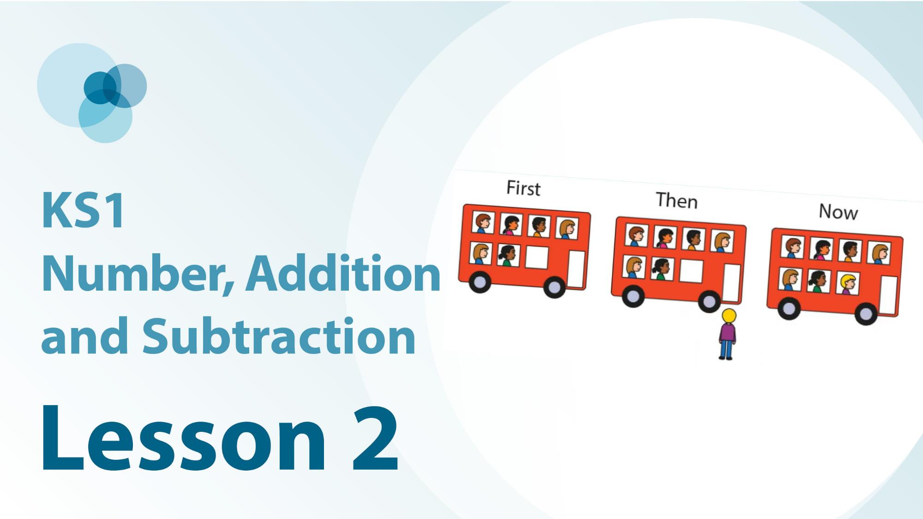
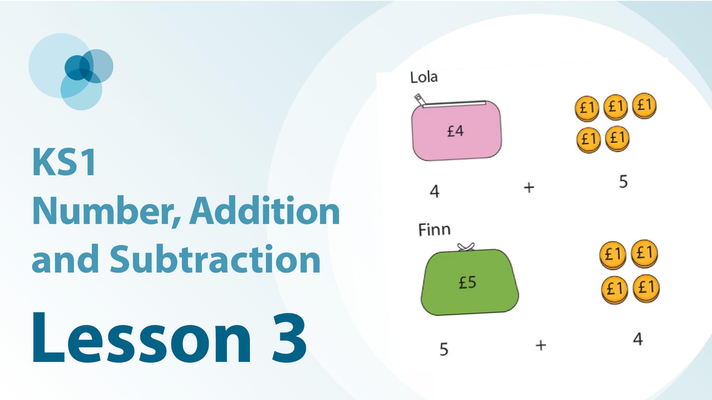
1AS-2 Linked video lessons
Key stage 1 number, addition and subtraction
The commutative law of addition using aggregation
The commutative law of addition using augmentation
Measures contexts to show the commutative law of addition

Slide 5
1AS-2
Read, write and interpret additive equations

Slide 6
The following slides contain activities that can be used within the context of pre-teaching, intervention, or as supplementary material integrated into teaching. They do not represent complete lessons and should not be used as such. Also they should not be used all at once, but over the period of a teaching unit. It would be valuable to use many of the activities more than once to build fluency in understanding and application. Also many of them would benefit from the use of manipulatives to support interaction with the ideas. Ensure you engage in rich discussion with the children, asking them to reason and explain the ideas presented. Note that when working with a small group, pupils should also have access to the main teaching delivered by the class teacher and the focus should be directly linked so that the learning is connected and fluency is built.

Slide 7
Guidance for working with a small pre-teaching or intervention group
Take time to build understanding of the key idea. We would recommend no more than four slides in any one session, and probably fewer.
In subsequent sessions, review and practise previous learning before moving on.
Play the animation/observe the image and ask pupils “What do you notice?”.
Encourage pupils to explain what they see, what is happening and why.
Where there is a highlighted sentence, draw out the meaning of this from the image and repeat together and individually.

Slide 8
Guidance for working with a small pre-teaching or intervention group
Engage in the suggested activities, using manipulatives where appropriate, to enhance the interaction and stimulate discussion. However, note that the ultimate aim is to develop fluency in the mathematical ideas such that resources are no longer needed.
Repeat questions, using other numbers/examples where relevant.
Repeat the highlighted language structures wherever relevant to build fluency with the key idea and connect the learning. For example:
10 hundreds are equivalent to 1,000.

Slide 9
1AS-2 Read, write and interpret additive equations

Slide 10

1AS-2 Read, write and interpret additive equations
What do you notice about the flowers?
How can we write an expression using numbers and the addition sign to tell us about the picture?
Make the addition sign with your fingers and remember to say plus or add when you see it.
What does the 4 mean? What does the 3 mean?
The 4 represents the 4 yellow flowers.
The 3 represents the 3 red flowers.
We can write this as 4 plus 3.
4
+
3

Slide 11
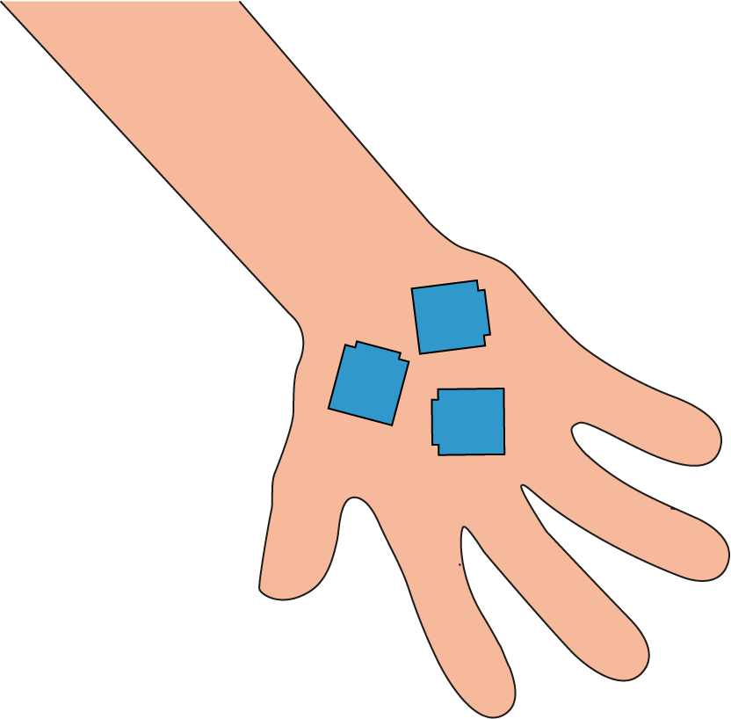
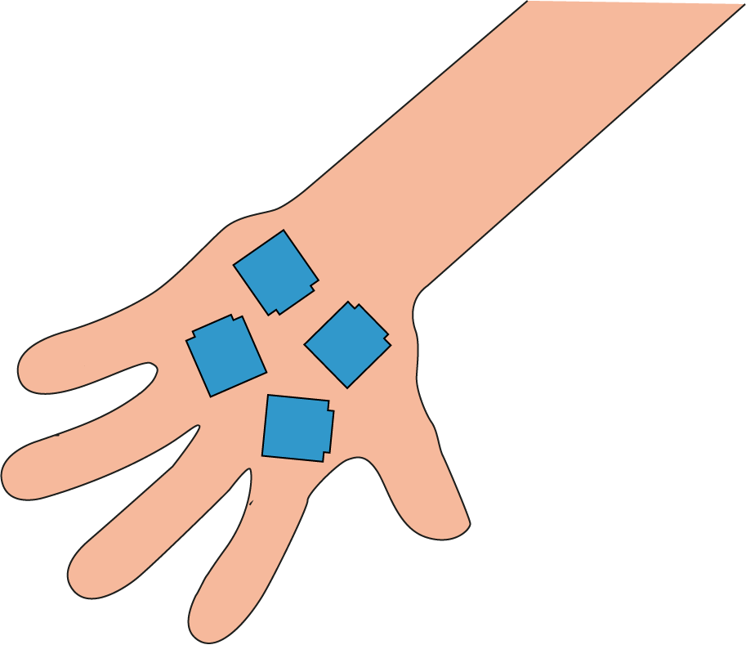
1AS-2 Read, write and interpret additive equations
How can we write an expression to show the cubes in these hands?
How could we write the expression if the hands switch around?
Did you see that the position of the addends changed? Why did they change?
Put some cubes in your hands. You friend can write an expression, then switch your hands for them to write a new expression!
3
+
4
We can write the addends in either order.

Slide 12

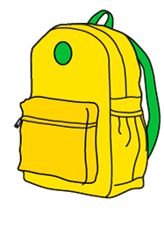
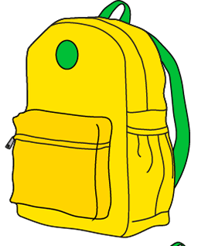


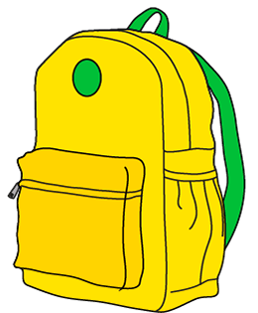

1AS-2 Read, write and interpret additive equations
Look at the rucksacks. How could you sort them in different ways?
Can you write some expressions using the addition sign to show the different sizes or different colours?
Can you say what the numbers mean in each of my expressions?
Can you think of another expression we could write?
2
5
+
+
5
5
2
4
+
+
3
2
3
+
4
2
+
5

Slide 13


1AS-2 Read, write and interpret additive equations
How many flowers are in each bunch? How many flowers will there be if we combine the bunches?
What equation could we write to show this?
What symbols will we need in our equation? Can you make the equals sign with your fingers and remember to say is equal to when you see it?
Can you describe what each number means?
We can write 5 plus 2 is equal to 7.
The 5 represents the number of flowers in 1 bunch.
The 2 represents the number in the other bunch.
The 7 represents the total number of flowers.
5
+
2
=
7

Slide 14
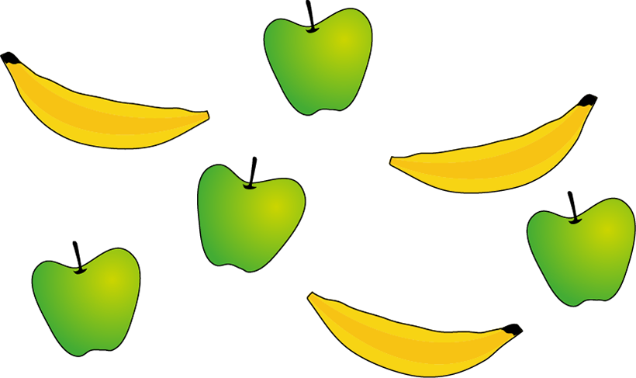
1AS-2 Read, write and interpret additive equations
Can you help me decide which of my equations matches the picture?
Why are some of the equations not correct?
Can you describe what the numbers mean in the correct equation?
The 4 represents the 4 apples.
The 3 represents the 3 bananas.
The 7 represents the total number of fruit.
3
+
3
=
6
4
+
3
=
7
5
=
4
+
1
8
=
4
+
3

Slide 15






1AS-2 Read, write and interpret additive equations
Let’s think about a partitioning story.
Look at what the children are wearing. How many children are not wearing coats?
We can partition the children into those with coats and those without coats and record this using subtraction.
Which number in the equation shows the whole?
Which numbers show the parts which have been partitioned?
6
−
2
=
4
4 children are not wearing coats
Subtraction can tell us about partitioning.

Slide 16


1AS-2 Read, write and interpret additive equations
How can you partition the set of pencils?
Let’s write a subtraction equation to represent this. What numbers will we need?
Can you show the subtract sign with your fingers? Remember to say minus or subtract when you see it.
Make the equals sign and say is equal to.
Which number shows the whole? Which numbers show the parts which have been partitioned?
There are 8 pencils altogether.
5 pencils are sharp. 3 pencils are not sharp.
We can write this as 8 minus 5 is equal to 3.
8
−
5
=
3
3 pencils are not sharp

Slide 17





1AS-2 Read, write and interpret additive equations
We can use addition and subtraction when we combine and partition the same set of objects.
Look at how the cakes have been partitioned.
What is the whole if we combine them again?
Partitioning and combining undo each other!
3
5
2

Slide 18
1AS-2 Read, write and interpret additive equations
Now we can use addition and subtraction equations to tell us about number stories for combining and partitioning!
Can you read each equation using the correct words: plus, minus, is equal to?
Can you describe each equation? What does each number represent? Does it tell us about a partitioning or combining story?
2 + 3 = 5
3 + 2 = 5
5 – 3 = 2
5 – 2 = 3

Slide 19


1AS-2 Read, write and interpret additive equations
Putting together
Taking apart
Addition
Subtraction
Watch the cubes move and say what you see!
Can you link combining and partitioning to addition and subtraction?
You can try this using some cubes - can your friend say if you are adding or subtracting?
Addition can tell us about combining objects.
Subtraction can tell us about partitioning objects.

Slide 20
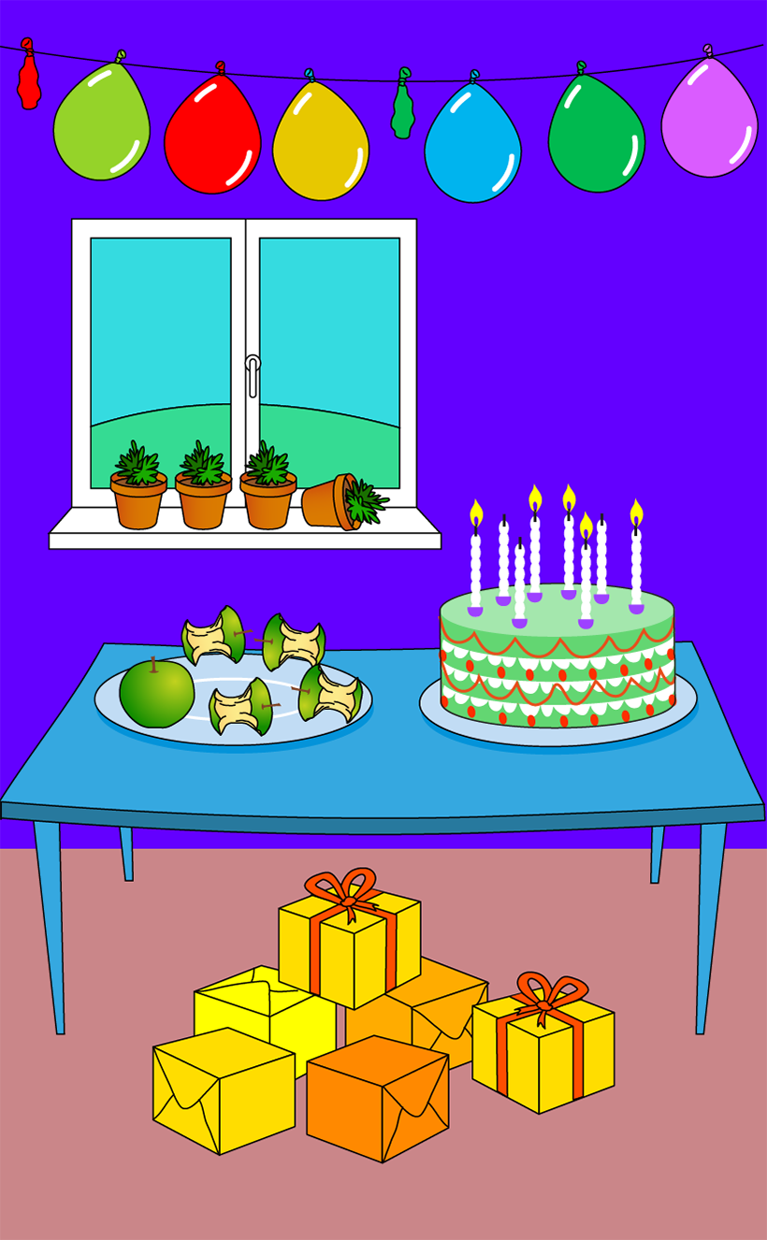
1AS-2 Read, write and interpret additive equations
Let’s practise telling and writing addition and subtraction number stories.
Look at the picture - can you see the apples?
Look at my equations. Which one shows a partitioning story about the apples? Which one shows a combining story? What does each number mean?
Can you show this story using cubes?
What other number stories can you make from the picture? Use cubes to help you show your story then write the equation.
5 – 1 = 4
1 + 4 = 5

Slide 21
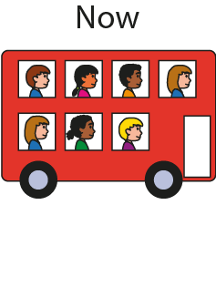
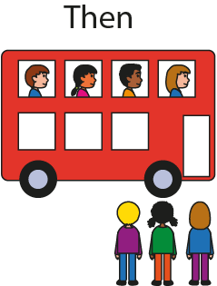
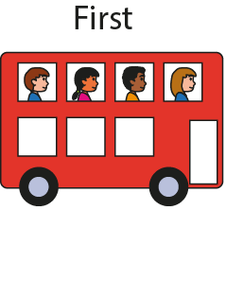
1AS-2 Read, write and interpret additive equations
Now
Look at the picture - how many people are on the bus at first?
What happens then? Do you think the number of people on the bus will change when the other children get on?
How many people are on the bus now?
Do you think this is an addition or subtraction story? Let’s use equations to record some first, then, now addition stories.
Then
First
Addition can tell us about a quantity increasing.

Slide 22
1AS-2 Read, write and interpret additive equations
First
Then
Now
4
+ 3
7
4 + 3 = 7

Slide 23
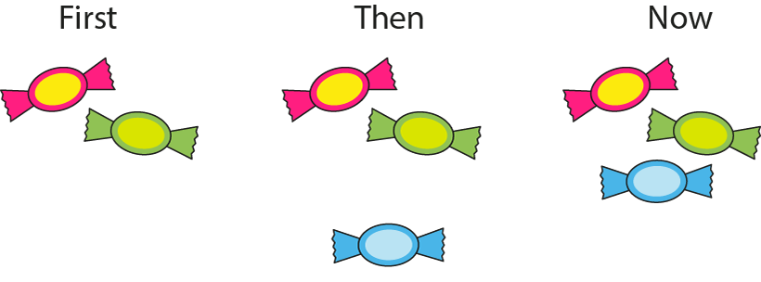
1AS-2 Read, write and interpret additive equations
2
+ 1
3
2 + 1 = 3

Slide 24
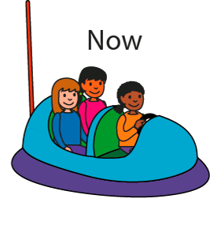
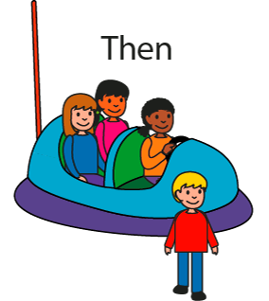
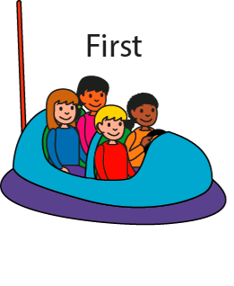
1AS-2 Read, write and interpret additive equations
Look at the children in the car at first.
What happens then? How many are in the car now?
Is this an addition or subtraction story?
Try acting out the story!
Can you write a subtraction equation to match this first, then, now story?
Say what each number and sign means.
First
Now
Then
Subtraction can tell us about taking away
We can write this as 4 minus 1 is equal to 3.

Slide 25
1AS-2 Read, write and interpret additive equations
First
Then
Now
4
– 1
3
4 – 1 = 3

Slide 26
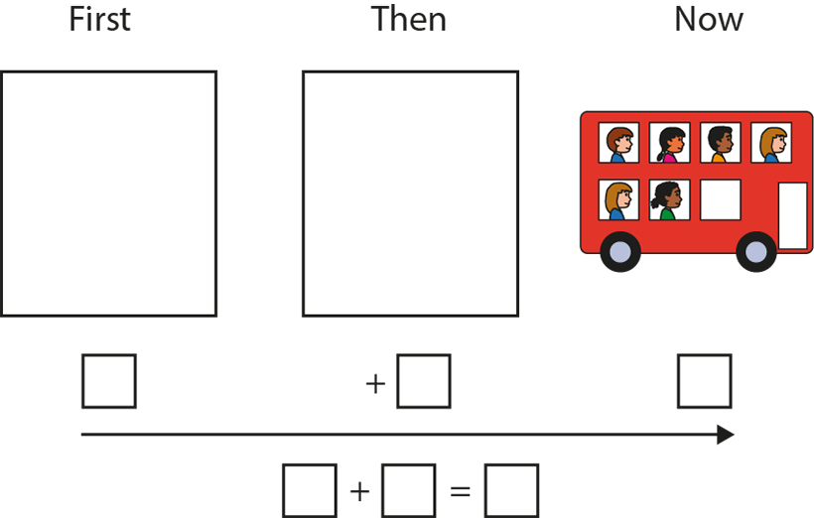
1AS-2 Read, write and interpret additive equations
Look at the picture. Which part of the story does it show?
Can you think what the start of the story might have been? Would there be more or fewer children at the start of an addition story?
Can you use objects to help you make up a story that ends with 6 children on the bus?

Slide 27
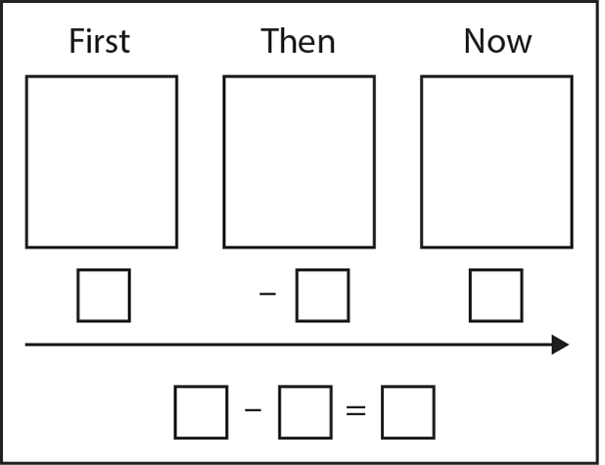
1AS-2 Read, write and interpret additive equations
It’s your turn to practise telling some first, then, now stories for addition!
Use a set of objects (e.g. toy cars in a car-park, animals in a field, bears on a picnic rug) and make up and tell your own simple story.
See if you can record your story in different ways - as a picture and as an equation. Make sure you say what each number and symbol means.
+
+

Slide 28
1AS-2 Read, write and interpret additive equations
It’s your turn to practise telling some first, then, now stories for subtraction!
Use a set of objects (e.g. toy cars in a car-park, animals in a field, bears on a picnic rug) and make up and tell your own simple story.
See if you can record your story in different ways - as a picture and as an equation. Make sure you say what each number and symbol means.

Slide 29




1AS-2 Read, write and interpret additive equations
When we make an addition story, how can we undo it, so we are back to the number we started with?
How could you undo a subtraction story?
Look at the next story and see what happens! Can you act out the story and see if you get back to the number of children you started with?
See if you can make up more pairs of stories which undo each other.
Addition and subtraction undo each other.

Slide 30
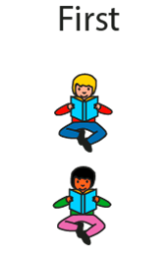
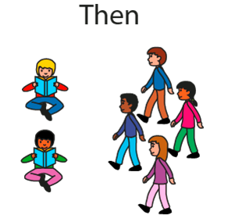
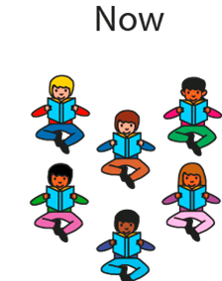


1AS-2 Read, write and interpret additive equations

Slide 31
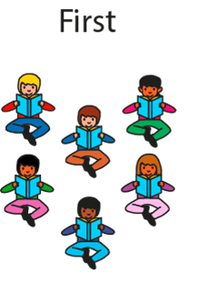
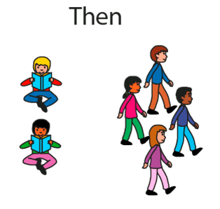
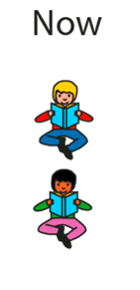




1AS-2 Read, write and interpret additive equations

Slide 32
1AS-2 Read, write and interpret additive equations
Complete these calculations. How do you think about them? Do you think about adding on, combining, partitioning or take away?
Can you think of the same equation in different ways?
5 + 2 =
2 + 5 =
9 – 3 =
9 – 4 =
9 – 5 =
6 – 4 =
6 – 5 =
6 + 1 =
6 + 2 =
6 + 3 =
6 + 4 =
6 – 1 =
6 – 2 =
6 – 3 =

Slide 33
1AS-2 Read, write and interpret additive equations
What Could It Be?
https://nrich.maths.org/10479

