Slide 1
1AS-1
Compose and partition numbers to 10

Slide 2
1AS-1
Compose numbers to 10 from 2 parts, and partition numbers to 10 into parts, including recognising odd and even numbers.
The materials in this pack have been collated and written to support the teaching of 1AS-1. Before planning and teaching the content in 1AS-1, read the teaching guidance and example assessment questions in the non-statutory guidance itself, which can be found here.
A video summarising all of the ready-to-progress criteria for Year 1 can be found here.

Slide 3
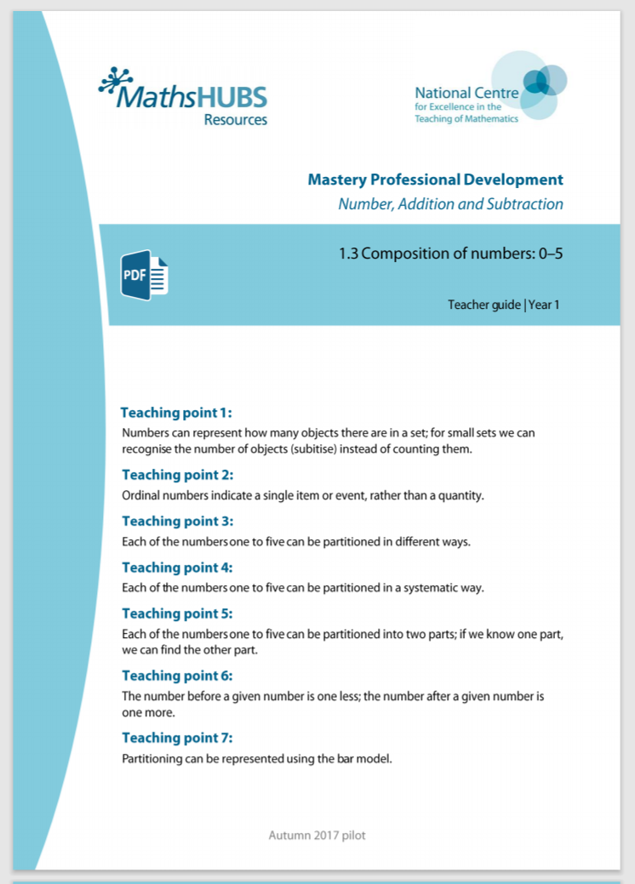
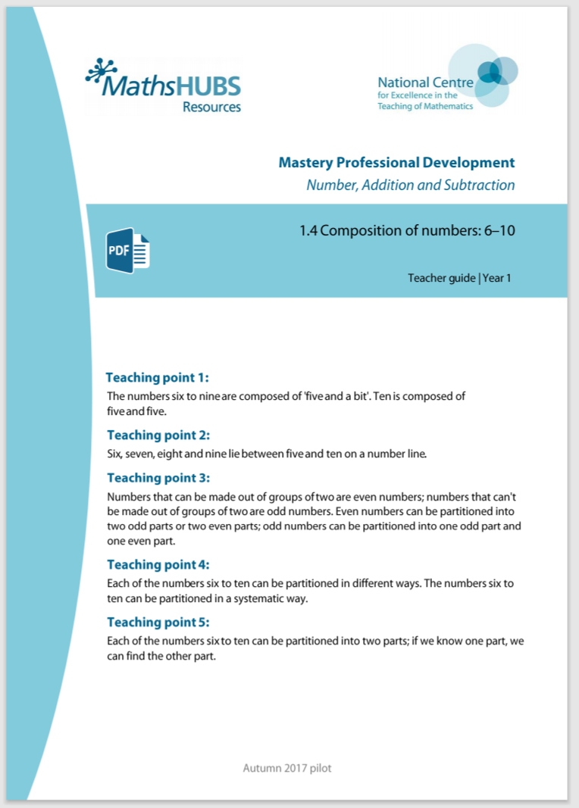
1AS-1: Linked mastery PD materials
Additional pedagogical subject knowledge support can be found in the following Mastery Professional Development materials:
  1.3 Composition of numbers: 0 – 5
  1.4 Composition of numbers: 6 – 10
  Several of the activity slides have been taken from these materials.

Slide 4
1AS-1
Compose and partition numbers to 10

Slide 5
The following slides contain activities that can be used within the context of pre-teaching, intervention, or as supplementary material integrated into teaching. They do not represent complete lessons and should not be used as such. Also they should not be used all at once, but over the period of a teaching unit. It would be valuable to use many of the activities more than once to build fluency in understanding and application. Also many of them would benefit from the use of manipulatives to support interaction with the ideas. Ensure you engage in rich discussion with the children, asking them to reason and explain the ideas presented. Note that when working with a small group, pupils should also have access to the main teaching delivered by the class teacher and the focus should be directly linked so that the learning is connected and fluency is built.

Slide 6
Guidance for working with a small pre-teaching or intervention group
Take time to build understanding of the key idea. We would recommend no more than four slides in any one session, and probably fewer.
In subsequent sessions, review and practise previous learning before moving on.
Play the animation/observe the image and ask pupils “What do you notice?”.
Encourage pupils to explain what they see, what is happening and why.
Where there is a highlighted sentence, draw out the meaning of this from the image and repeat together and individually.

Slide 7
Guidance for working with a small pre-teaching or intervention group
Engage in the suggested activities, using manipulatives where appropriate, to enhance the interaction and stimulate discussion. However, note that the ultimate aim is to develop fluency in the mathematical ideas such that resources are no longer needed.
Repeat questions, using other numbers/examples where relevant.
Repeat the highlighted language structures wherever relevant to build fluency with the key idea and connect the learning. For example:
10 hundreds are equivalent to 1,000.

Slide 8
1AS-1 Compose and partition numbers to 10

Slide 9
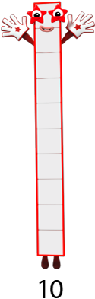









1AS-1 Compose and partition numbers to 10
Make your own set of Numberblocks 1 to 10 and put them in order.
Which Numberblock is the shortest? Which is the tallest?
Can you show me the right number of fingers to match the name of each Numberblock?
Now try putting down your fingers as we count backwards!
Images © 2017 Alphablocks Ltd. All Rights Reserved.

Slide 10
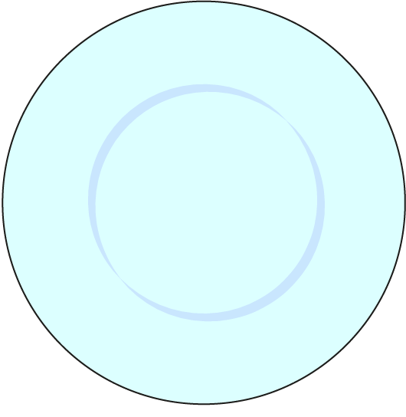


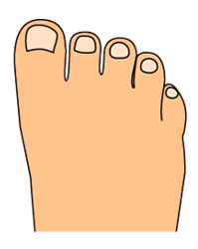




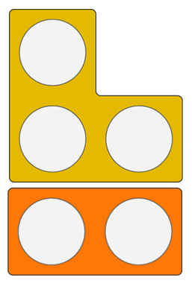


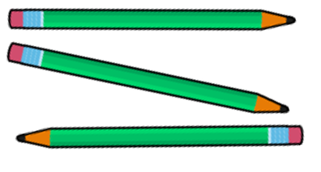








1AS-1 Compose and partition numbers to 10
Tell me what you see!
Did you notice each picture represents five of something?
Can you describe how you can see five in each picture?
Now you can make a ‘Five Museum’ for Numberblock Five using things in your classroom!
Can you make a museum for a different Numberblock? Try to guess your friend’s number!

Slide 11


1AS-1 Compose and partition numbers to 10
Watch closely each time another block appears. Can you describe what you see? Watch again…
What happened to the numbers each time another red block appeared? How did the number change?
Why is there not a block by zero?
Can you make your own ‘staircase’ using cubes?
Each number is made up of the previous number and one more.
0
1
1
2
2
3
3
4
4
5
5
6

Slide 12



1AS-1 Compose and partition numbers to 10
Can you say how many birds there are, without needing to count?
How could we show five without drawing the birds? Can you show me five on your fingers? Now in a different way?
Can you collect five cubes (or other objects)?
Repeat with a different number of objects.

Slide 13


1AS-1 Compose and partition numbers to 10
What do you notice about these birds? Are you sure there are still five birds?
Can you collect two different colour cubes and make five as three and two?
Can you collect objects (e.g. bears, toy cars) in two colours to show that other numbers can be made of different parts?
A number can be made of different parts.

Slide 14





1AS-1 Compose and partition numbers to 10
What do you notice about the cakes in the picture? Why have they been partitioned (separated) in this way?
Which part of the diagram shows the whole and which show the parts? What does a whole mean? It’s a ‘part-part-whole’ diagram!
What happens when we re-combine the parts back together?
3
5
2
There are 5 cakes, 2 have cherries, 3 do not.
5 is the whole, 3 is a part and 2 is a part.

Slide 15


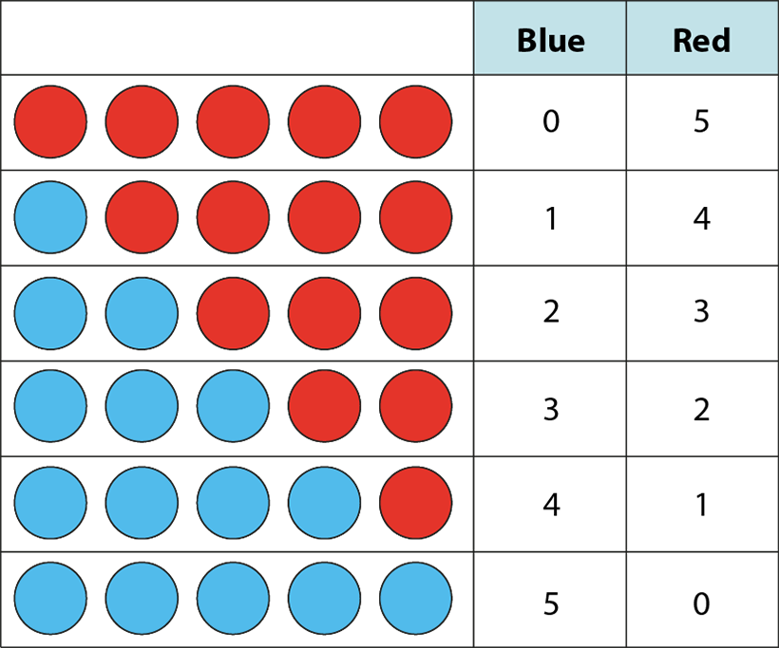
1AS-1 Compose and partition numbers to 10
Can you say how many blue and red counters there are each time?
What do you notice about the pattern in the counters for each new row? What’s the same? What’s different?
Read the numbers for the blue counters - what do you notice? Is the pattern the same for the red counters?
Can you see any number pairs which are similar? (e.g. 1 blue/4 red and 4 blue/1 red)?
Now you try. Copy this pattern or try your own with a smaller or larger number of counters. Can you be systematic?
0
5
1
4
2
3
3
2
4
1
5
0

Slide 16
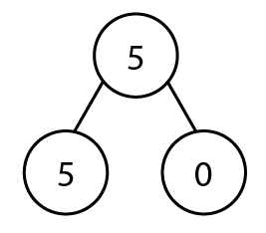
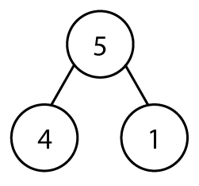
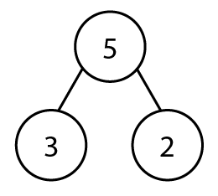
1AS-1 Compose and partition numbers to 10
Let’s see how many ways we can partition five… How many ways do you think we might find?
Have we found all the ways? If the diagrams represented coloured counters, could the middle diagram represent 4 red and 1 blue and also 4 blue and 1 red?
Try this with other numbers using counters and part-part-whole diagrams.

Slide 17



1AS-1 Compose and partition numbers to 10
There are 5 counters altogether. Can you guess how many counters are hiding?
Let’s try it ourselves. Collect five objects and hide some from your friend. Can they say how many are hiding? Now take turns and you try!
Can you do this with more objects?
If we know how many objects there are in total, we can find a missing part.

Slide 18

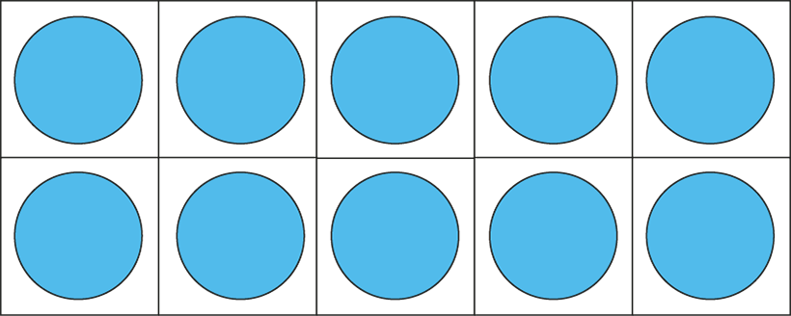
1AS-1 Compose and partition numbers to 10
Which numbers can you see here? Show them on your fingers in the same way.
What do you notice about the ten frames? Do they all have the top row filled? Why?
Use your ten frames to make these numbers. You could use a different colour for the top row so you can see five as a part.
Show me five! Can you quickly change five into… 6, 9, 7, 8, 10? Try not to count!
6
7
8
9
10
Five is a part of 6, 7, 8, 9 and 10.

Slide 19
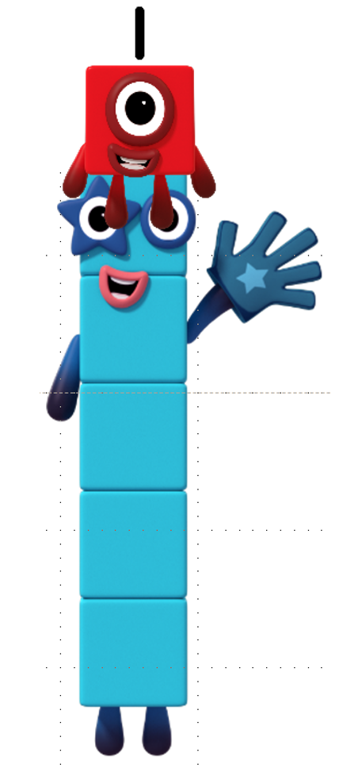
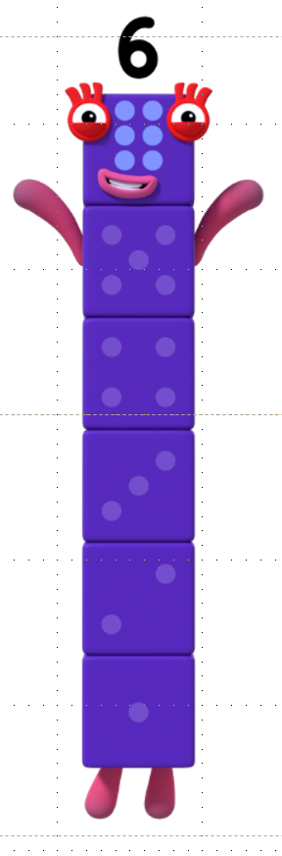


1AS-1 Compose and partition numbers to 10
Numberblock Five wants to become Five and a bit! Can you help her?
What can she make if she joins with Numberblock One? Get out some of your own cubes and see if you can help her find out. Use five of one colour and one of a different colour.
Let’s use the Numberblocks to count the blocks in Six and find the Five inside!
Repeat for 5 and 2, 5 and 3, 5 and 4, and 5 and 5.
Play my game! Count some cubes into a bag. Can we take out five? If so, how many would be left? If not, how many more do we need to put in the bag?
Images © 2017 Alphablocks Ltd. All Rights Reserved.

Slide 20
1AS-1 Compose and partition numbers to 10
What Could It Be?
https://nrich.maths.org/10479

