Slide 1
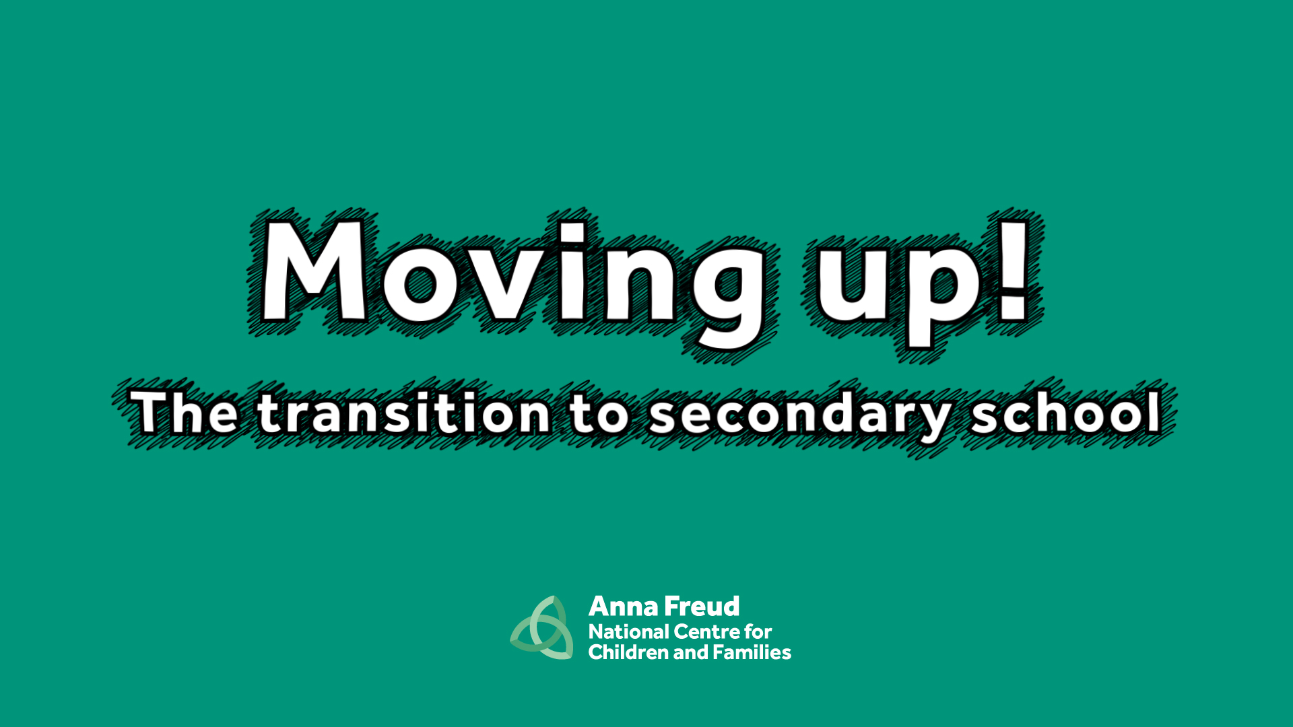

Slide 2
Throughout our lives we experience lots of changes. For example starting a new school, moving house, going to university or starting a new job.
Change can affect us in different ways, we might feel excited or nervous.

Slide 3
We are now going to watch an animation
that shows four pupils starting secondary school.
As you watch, think about the problem each character has and how they solve them.

Slide 4
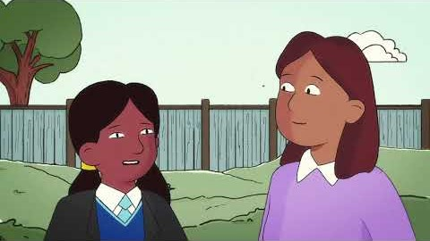
Watch online

Slide 5
What were the characters worried about before they started secondary school?
Why were they worried?

Slide 6
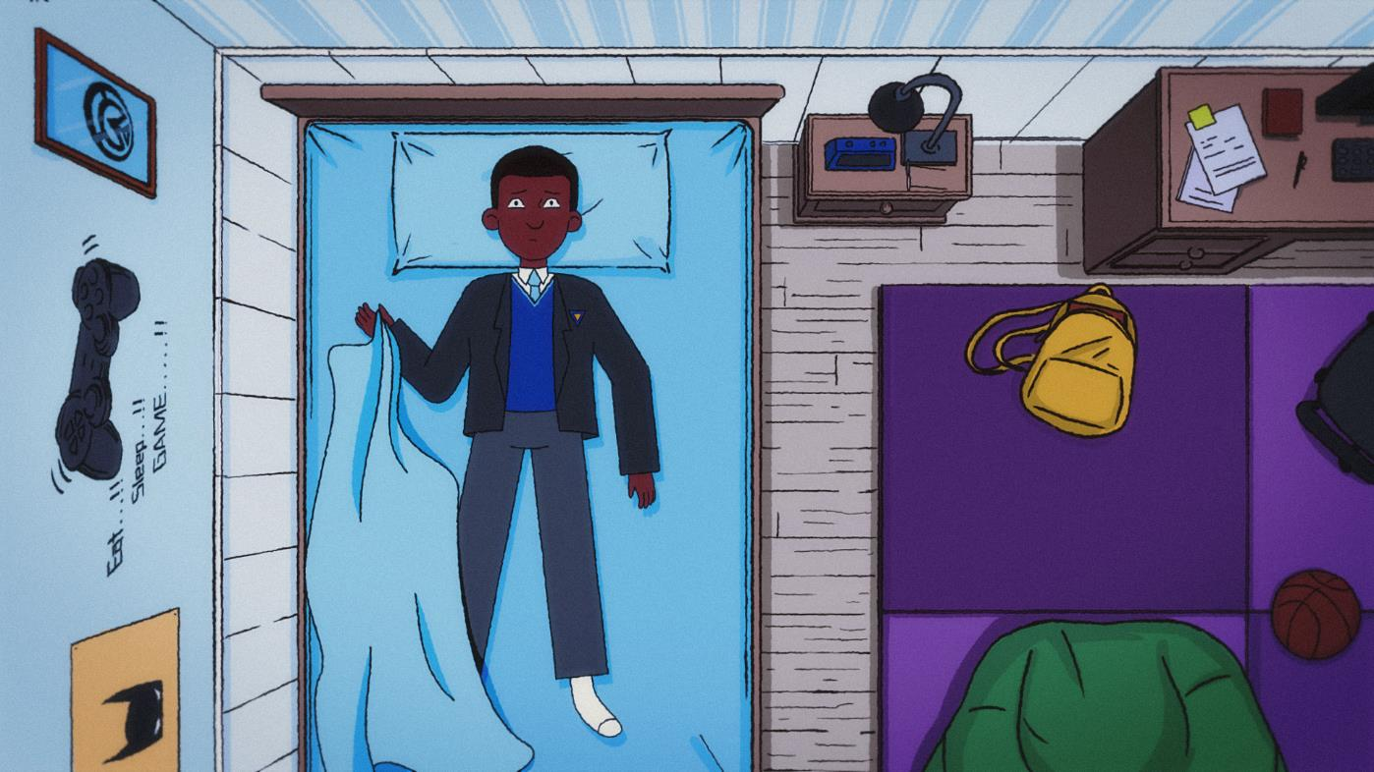

Slide 7
How did Albie, Alisha, Dele and
Eliza solve their problems?

Slide 8
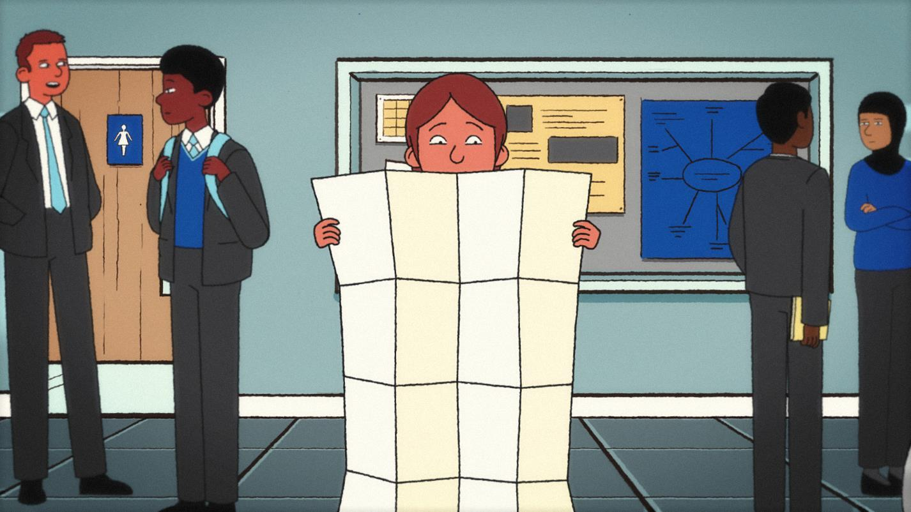

Slide 9
It’s important to think about self-care, as
self-care can help us to feel better if we’re feeling down, and can help keep us feeling good.
It’s a great way to look after our own mental health and wellbeing.

Slide 10
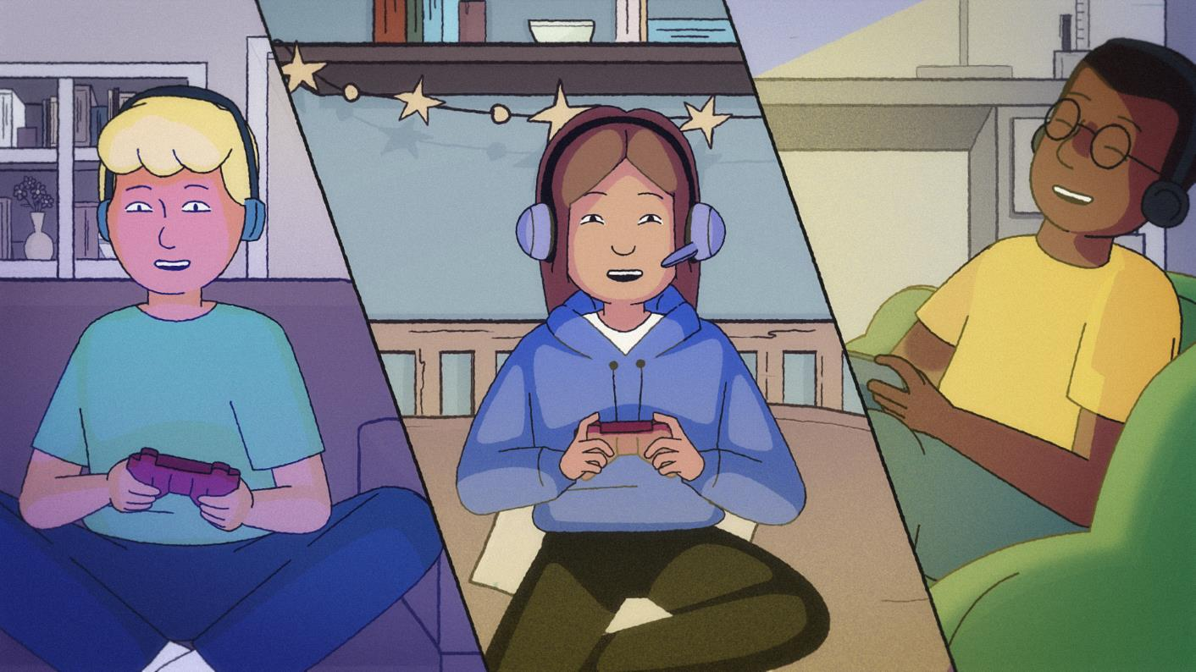

Slide 11
Why is it good to tell someone when you are worried about something?
Who could you speak to in school if you are worried?

Slide 12
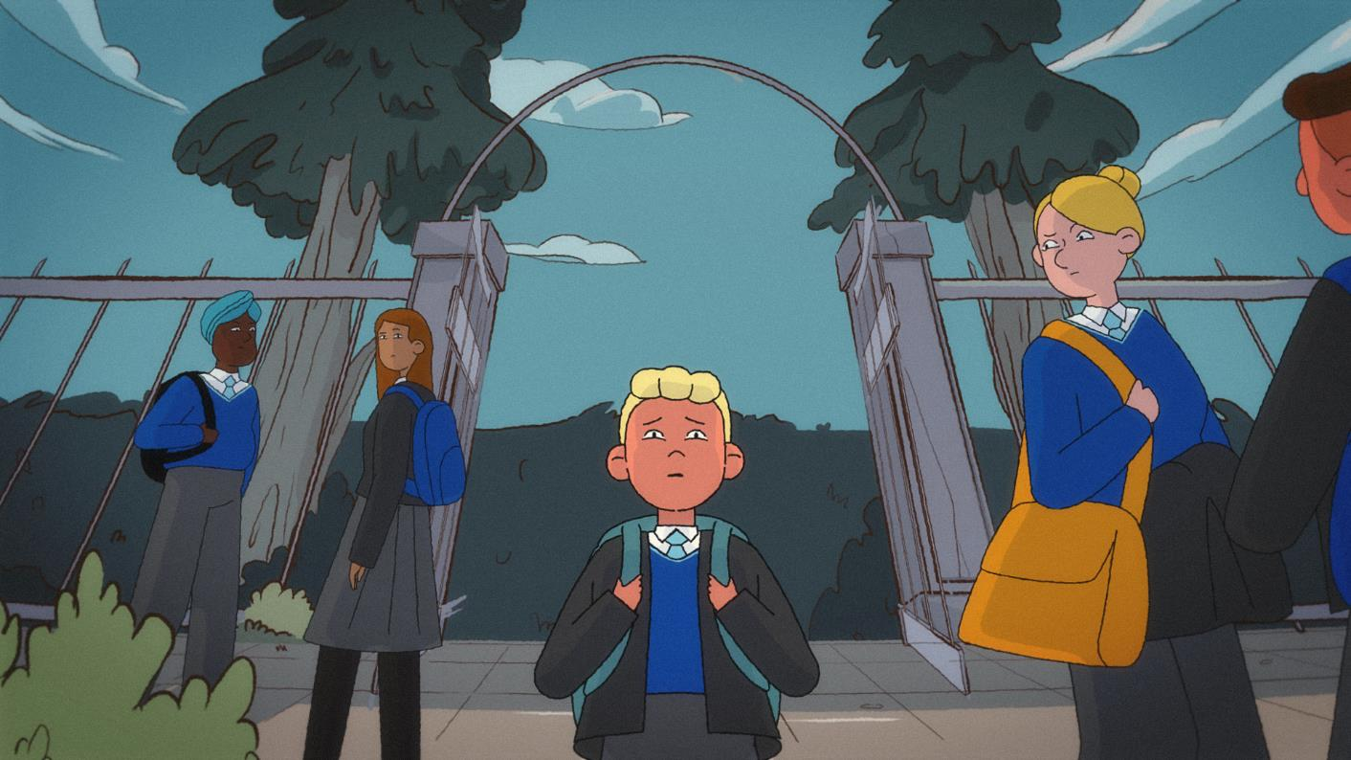

Slide 13
In school you can talk to…
[Insert support options at your school]

Slide 14
Other places
On My Mind – www.annafreud.org/on-my-mind/
Youth Wellbeing Directory – www.annafreud.org/on-my-mind/youth-wellbeing/
Self Care pages - https://www.annafreud.org/on-my-mind/self-care/
Urgent Help – https://www.annafreud.org/on-my-mind/urgent-help/
Anna Freud Centre – www.annafreud.org/
[Optional: insert any other organisations in your local area where young people can find support]

