Slide 1



Summer water safety quiz

Slide 2
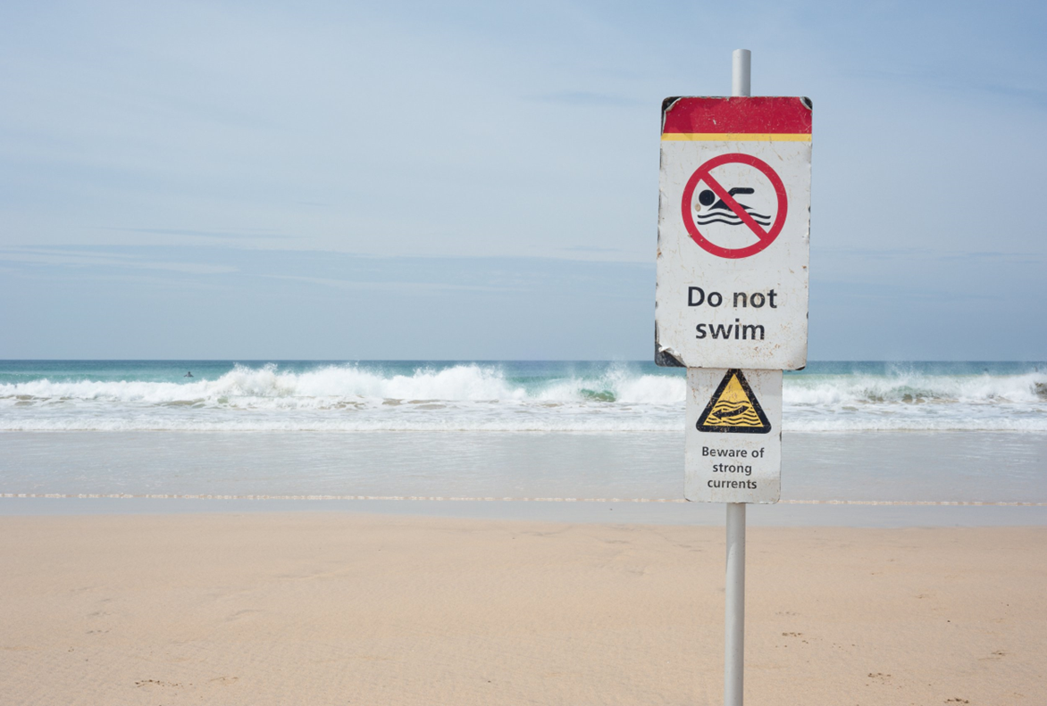
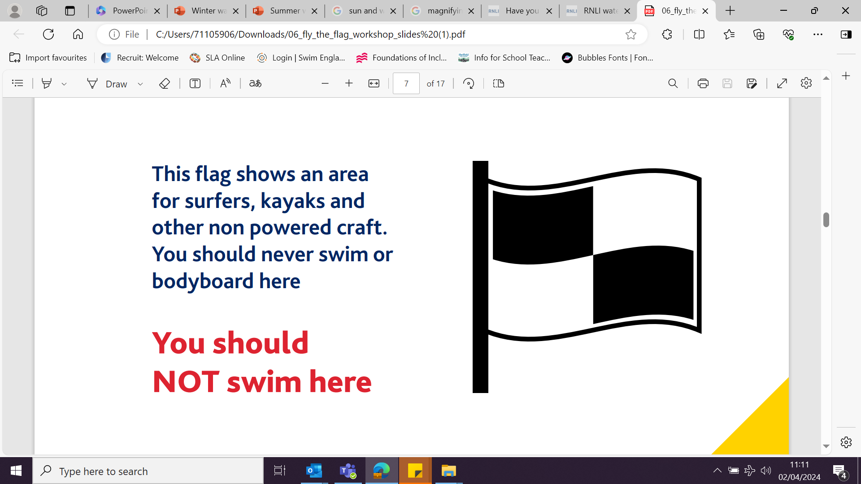
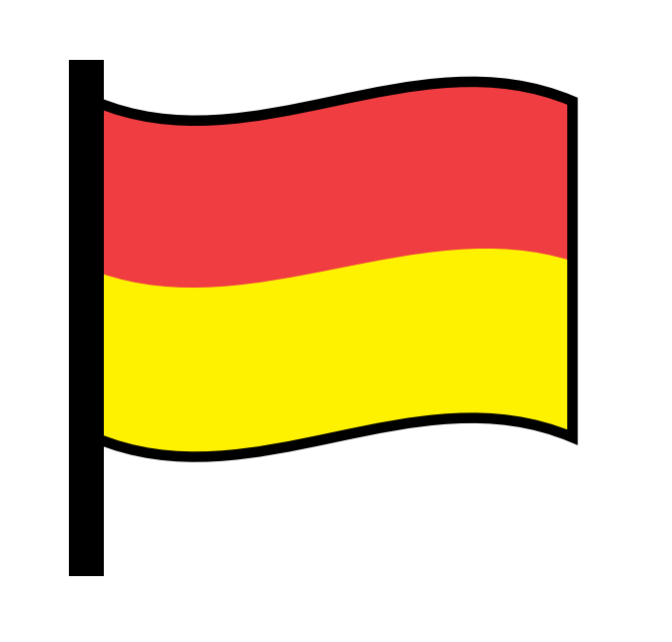
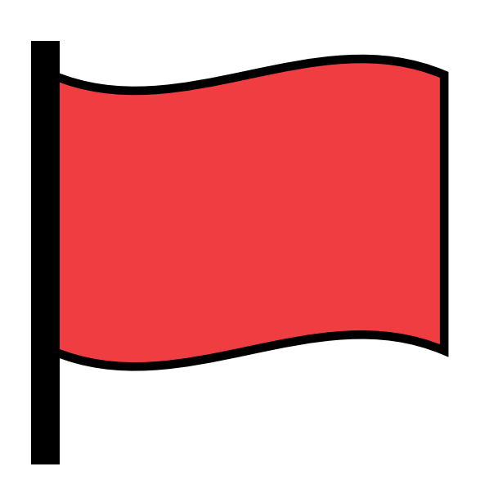
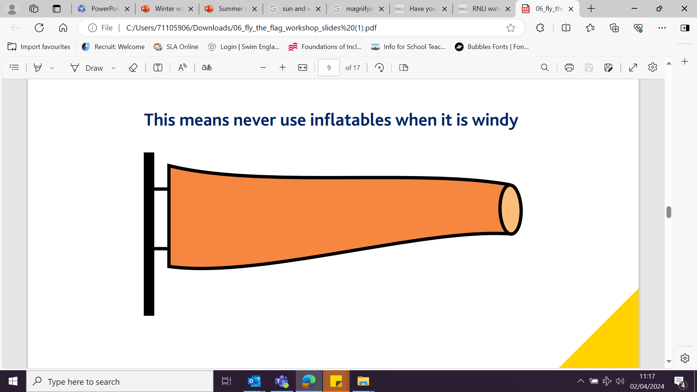
What flag should we see at this beach and why?

Slide 3

This means the water is dangerous – DO NOT ENTER.

Slide 4
Which flag shows us it is a safe place to swim?
Why is this a safe place to swim?

Slide 5
It is safe to swim between the red and yellow flags the lifeguard can see you.

Slide 6
What does this flag mean?

Slide 7
It is too windy for inflatables.

Slide 8
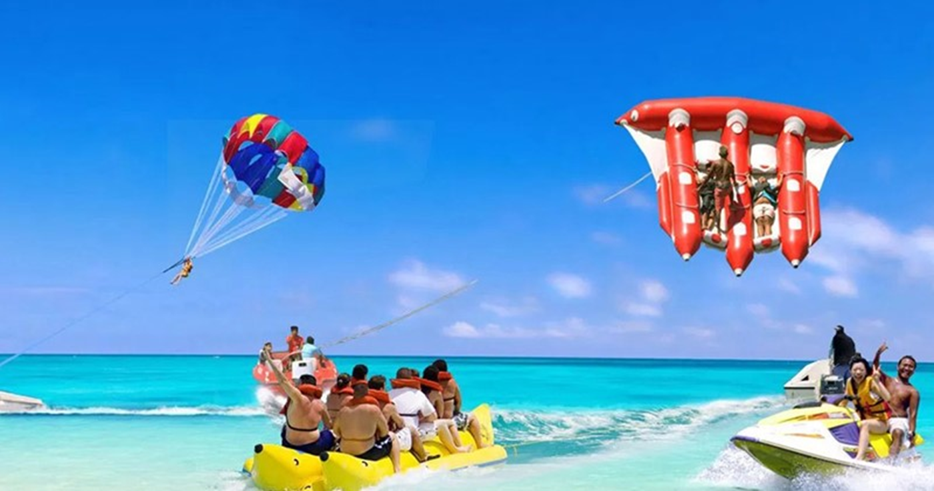
What flag should we see at this beach and why?

Slide 9

Water sports are taking place – DO NOT SWIM IN THIS AREA.

Slide 10
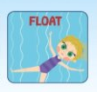
Shout for help
If we needed help in the water what would we do?
Stay calm

Slide 11



Great job everyone! You know how to be safe near water in the summer.

