Slide 1



Summer water safety

Slide 2
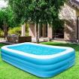

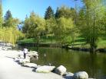






inflatable swimming pool
swimming pool
river
ponds
What places with water might you spend time this Summer?
lake
the sea
hot tub
canal

Slide 3

Look out for these flags at the beach this Summer. They help us stay safe!
The safest place to swim. The lifeguard can see you stay in between these flags.

Slide 4

This flag means there are boats and watersports in this area.
DO NOT SWIM IN THIS AREA.
Why should we not swim here?

Slide 5

This flag means the water is dangerous.
DO NOT GET IN THE WATER WHEN YOU SEE THIS FLAG.
Why could the water be dangerous?

Slide 6

This flag means never use inflatables when it's windy.
What may happen if you used an inflatable when it is windy?

Slide 7
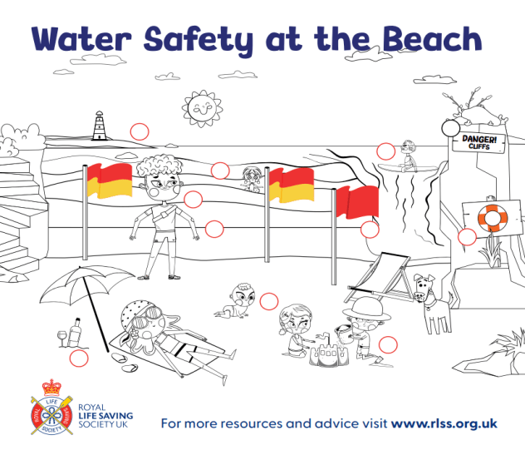

Can you spot the hazards?

Slide 9
How can I keep safe near water?
Water Safety - Summer Series - Twinkl - YouTube
The RNLI's Seaside Safety Song (youtube.com)

Slide 10
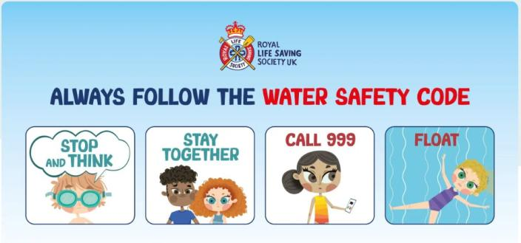
Remember in an emergency:
Get to know your Water Safety Code with RLSS UK (youtube.com)

