Slide 1
5NPV-3
Decimal fractions in the linear number system

Slide 2
5NPV-3 Reason about the location of any number with up to 2 decimals places in the linear number system, including identifying the previous and next multiple of 1 and 0.1 and rounding to the nearest of each.
The materials in this pack have been collated and written to support the teaching of 5NPV-3. Before planning and teaching the content, read the teaching guidance and example assessment questions in the non-statutory guidance itself, which can be found here.
A video summarising all of the ready-to-progress criteria for Year 5 can be found here.

Slide 3
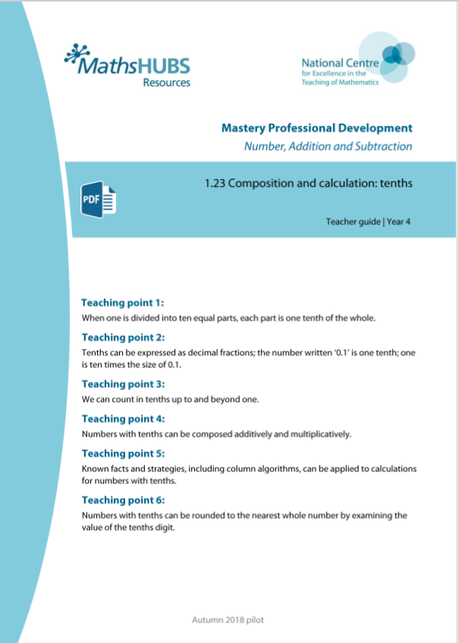
5NPV-1: Linked mastery PD materials
Additional pedagogical subject knowledge support can be found in the following Mastery Professional Development materials:
1.23 Composition and calculation: tenths
1.24 Composition and calculation: hundredths and thousandths
Several of the activity slides have been taken from these materials.

Slide 4
5NPV-3
Decimal fractions in the linear number system

Slide 5
The following slides contain activities that can be used within the context of pre-teaching, intervention, or as supplementary material integrated into teaching. They do not represent complete lessons and should not be used as such. Also they should not be used all at once, but over the period of a teaching unit. It would be valuable to use many of the activities more than once to build fluency in understanding and application. Also many of them would benefit from the use of manipulatives to support interaction with the ideas. Ensure you engage in rich discussion with the children, asking them to reason and explain the ideas presented. Note that when working with a small group, pupils should also have access to the main teaching delivered by the class teacher and the focus should be directly linked so that the learning is connected and fluency is built.

Slide 6
Guidance for working with a small pre-teaching or intervention group
Take time to build understanding of the key idea. We would recommend no more than four slides in any one session, and probably fewer.
In subsequent sessions, review and practise previous learning before moving on.
Play the animation/observe the image and ask pupils “What do you notice?”.
Encourage pupils to explain what they see, what is happening and why.
Where there is a highlighted sentence, draw out the meaning of this from the image and repeat together and individually.

Slide 7
Guidance for working with a small pre-teaching or intervention group
Engage in the suggested activities, using manipulatives where appropriate, to enhance the interaction and stimulate discussion. However, note that the ultimate aim is to develop fluency in the mathematical ideas such that resources are no longer needed.
Repeat questions, using other numbers/examples where relevant.
Repeat the highlighted language structures wherever relevant to build fluency with the key idea and connect the learning. For example:
10 hundreds are equivalent to 1,000.

Slide 8
5NPV-3 Decimal fractions in the linear number system

Slide 9
5NPV-3 Decimal fractions in the linear number system
0
10
20
30
40
50
60
70
80
90
100
0
1
2
3
4
5
6
7
8
9
10
0
0.1
0.2
0.3
0.4
0.5
0.6
0.7
0.8
0.9
1
0
0.01
0.02
0.03
0.04
0.05
0.06
0.07
0.08
0.09
0.1
What ten intervals would be found between each circled section? How do you know?
Choose an unlabelled interval within each circle and identify the number represented by that location.

Slide 10
5NPV-3 Decimal fractions in the linear number system
0
1
2
3
4
5
6
7
8
9
10
What is the value of each unlabelled interval on the number line? How do you know?
Which two single-digit numbers is the arrow between?
What number is the arrow pointing to? How do you know?
Repeat for the other arrows.
Where would 2.6 be on the line? 7.5? 9.9? Repeat for other numbers.
The arrow is pointing to 5.4 because it is 4 one-tenth intervals after 5 and because it is
1 one-tenth interval before the half-way point between 5 and 6.

Slide 11
5NPV-3 Decimal fractions in the linear number system
20
21
22
23
24
25
26
27
28
29
30
Is the arrow pointing exactly at 27? Can you estimate what number the arrow is pointing to? Which 2 two-digit numbers is the arrow between?
Would 26.5 be a good estimate? Why not? Would the number that the arrow is pointing to be greater or smaller than 26.5? Why?
Repeat for the other arrows, discussing the corresponding numbers either side and which the arrow is closer to.
Where do you think 21.8 would be on the line? Repeat for other numbers.

Slide 12
5NPV-3 Decimal fractions in the linear number system
0
0.05
0.1
0.15
0.2
0.25
0.3
0.35
0.4
0.45
0.5
0.55
0.6
0.65
0.7
0.75
0.8
0.85
0.9
0.95
1
Look at the number line. What do you notice? Is there anything that surprises you?
What is the value of each interval?
Can you explain why 0.1 comes after 0.05?
What given values is the arrow between? Is it quicker to count forwards or backwards from either of these known values to calculate the value that the arrow is pointing to? Why?
Repeat for other the arrows.
Where would 0.73 be on the line? 0.22? 0.97? Repeat for other numbers.

Slide 13
5NPV-3 Decimal fractions in the linear number system
5
5.1
5.2
5.3
5.4
5.5
5.6
5.7
5.8
5.9
6
Look at the number line. What do you notice?
What is the value of each interval? If ten intervals were added in between each marked value, what would the size of each interval be?
What given values is the arrow between? Would 5.65 be a good estimate? Why not? Would the number that the arrow is pointing to be greater or smaller than 5.65? Why?
Repeat for the other arrows.
Where would 5.15 be on the line? 5.99? 5.81? Repeat for other numbers.

Slide 14
5NPV-3 Decimal fractions in the linear number system
0.5
0
1
What is different about this number line? What do you notice?
Can you estimate what number the arrow is pointing to?
Would 0.1 be a good estimate? Why not? What could you mark on the line to help you? What would the mid-point be? Reveal the mid-point. How does this help you? Could you add any other landmarks to help you? What would a suitable estimate be?
Repeat for the other arrows discussing adding other landmarks to aid proportional reasoning.
Where do you think 0.6 would be on the line? 0.02? Repeat for other numbers.

Slide 15
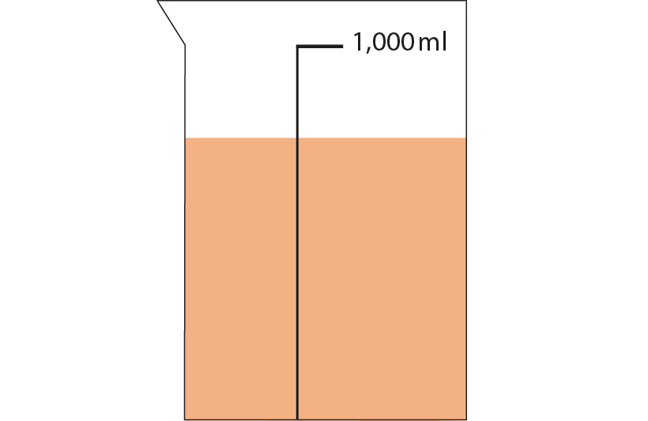
5NPV-3 Decimal fractions in the linear number system
What do you notice? What could you say about how much liquid is in the jug?
Would 0.3 litres be a reasonable estimate?
How do you know it is more than 0.5 litres?
Where would 0.5 litres be on the scale?
Can you use this to make a reasonable estimate for the amount of liquid?
1 litre

Slide 16
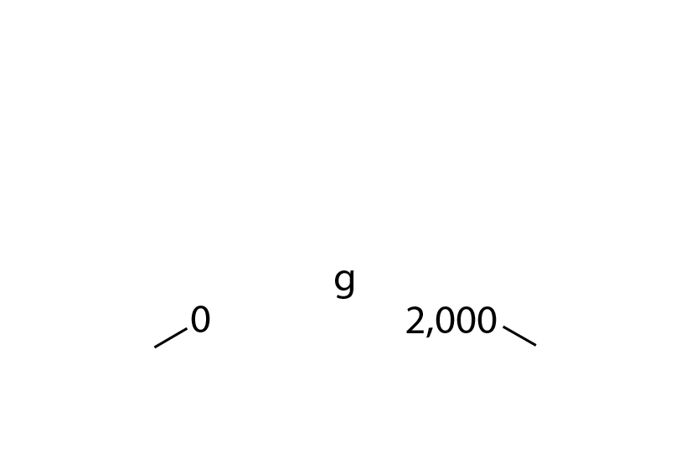
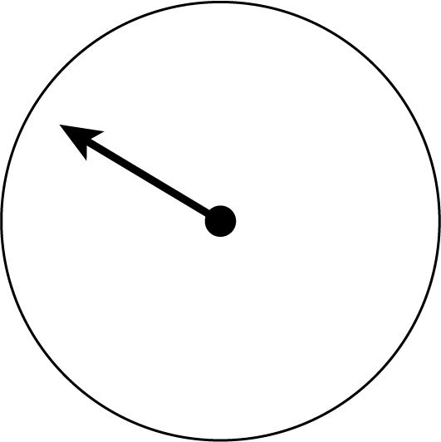
5NPV-3 Decimal fractions in the linear number system
What is different this time?
Can you estimate where the arrow stops?
What can you do to make your estimation more accurate? Is the arrow pointing to before or after 1kg?
What landmarks can you put on the scale?
Can you now make a reasonable estimate?
kg
2

Slide 17
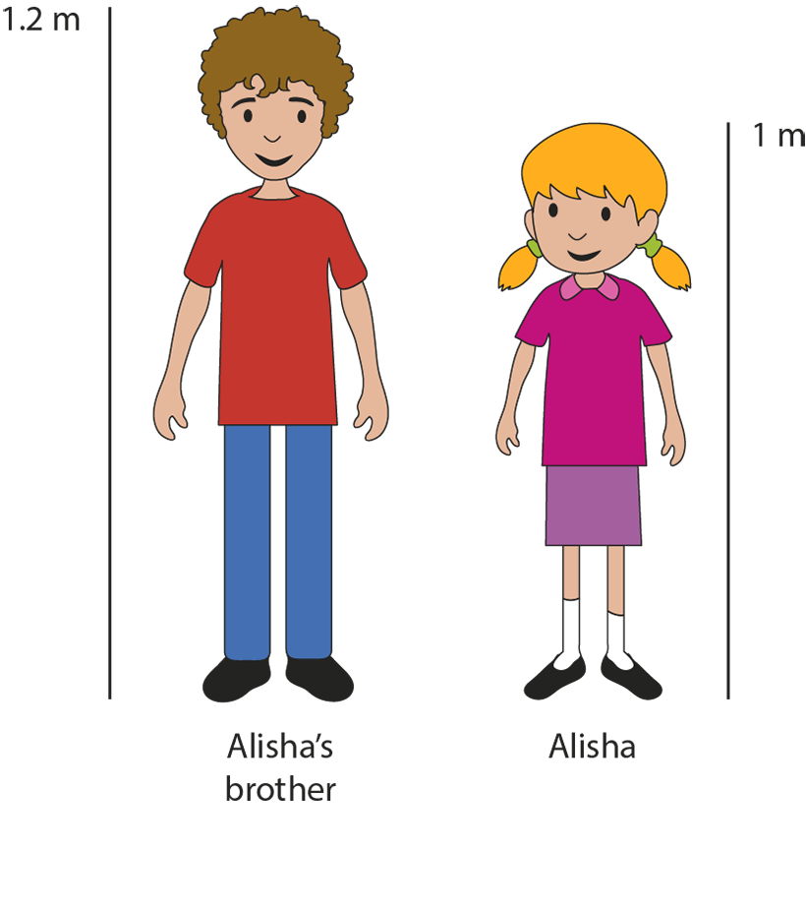
5NPV-3 Decimal fractions in the linear number system
What are the known and unknown values in the picture?
How can we use Alisha’s height to estimate the height of her brother?
Is the difference between Alisha and her brother’s height greater than or less than half of her height? How can this be used to make an accurate estimate?
Notes:
How much shorter is Alisha than her brother?

Slide 18
5NPV-3 Decimal fractions in the linear number system
For each letter on the number line, say which two whole numbers the value is between.
Use this to work out the value of each letter.
1
a
2
a is 1.3 because it is 2 tenths less than the midpoint of 1 and 2.
2
b
3
b is 2.6 because it is 1 tenth more than 2.5.
4
c
5
c is 4.1 because it is 1 tenth more than 4.

Slide 19
5NPV-3 Decimal fractions in the linear number system
3.42
0
1
2
3
4
5
6
7
8
9
10
Identify the two whole numbers that 3.42 is found between.
Is it closer to three or four? How do you know? Which whole number would 3.42 round to?
Repeat for other numbers.
3.42 is closer to three than four.
I know this because 3.5 would be half-way between both numbers and 3.42 < 3.5
We can therefore say 3.42, rounded to the nearest multiple of 1, is equal to 3.

Slide 20
5NPV-3 Decimal fractions in the linear number system
3.42
3
3.1
3.2
3.3
3.4
3.5
3.6
3.7
3.8
3.9
4
Identify the two labelled numbers that 3.42 is found between.
Is it closer to 3.4 or 3.5? How do you know? What multiple of 0.1 is 3.42 rounded to?
Repeat for other numbers.
3.42 is closer to 3.4 than 3.5.
I know this because 3.45 would be half-way between both numbers and 3.42 < 3.45.
We can therefore say 3.42 rounded to the nearest multiple of 0.1 is equal to 3.4.

Slide 21
5NPV-3 Decimal fractions in the linear number system
Identify the multiple of 1 before and after the given number.
Which multiple is it closest to? How do you know?
Identify the multiple of 0.1 before and after the given number.
Which multiple is it closest to? How do you know?
Repeat for other numbers.
Previous multiple of 1
Next multiple of 1
3
3.42
4
Previous multiple of 0.1
Next multiple of 0.1
3.4
3.42
3.5

Slide 22
5NPV-3 Decimal fractions in the linear number system
When rounding to the nearest 0.1, what do you notice about the answer? Which digit is critical?
When rounding to the nearest 1, what do you notice about your answer? Which digit is critical?
Repeat this activity for other numbers.
5 7 . 6 2
5 7 . 6
nearest 0.1
5 8
nearest 1

Slide 23
5NPV-3 Decimal fractions in the linear number system
Round the Dice Decimals 1
https://nrich.maths.org/10438

