Slide 1
5NPV-1
Tenths and hundredths

Slide 2
5NPV-1 Know that 10 tenths are equivalent to 1 one, and that 1 is 10 times the size of 0.1. Know that 100 hundredths are equivalent to 1 one, and that 1 is 100 times the size of 0.01. Know that 10 hundredths are equivalent to 1 tenth, and that 0.1 is 10 times the size of 0.01.
The materials in this pack have been collated and written to support the teaching of 5NPV-1. Before planning and teaching the content, read the teaching guidance and example assessment questions in the non-statutory guidance itself, which can be found here.
A video summarising all of the ready-to-progress criteria for Year 5 can be found here.

Slide 3
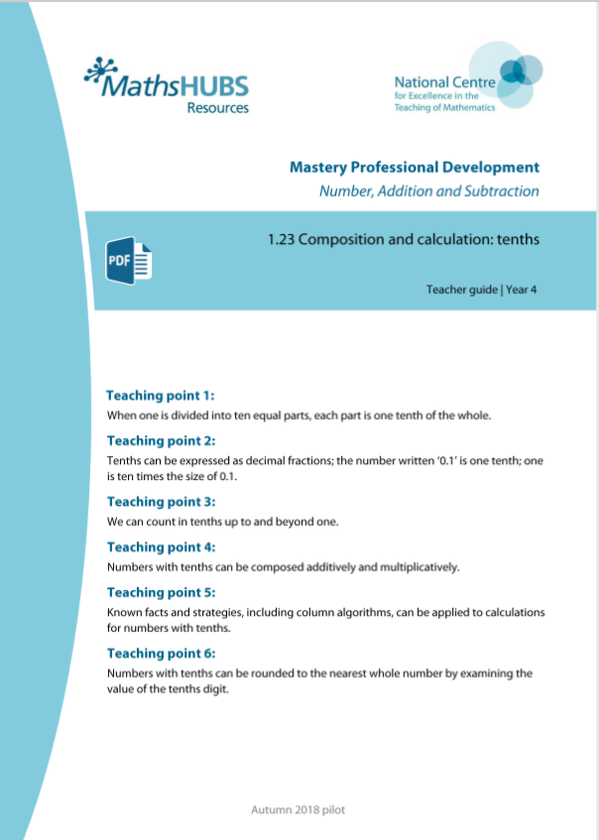
5NPV-1: Linked mastery PD materials
Additional pedagogical subject knowledge support can be found in the following Mastery Professional Development materials:
1.23 Composition and calculation: tenths
1.24 Composition and calculation: hundredths and thousandths
Several of the activity slides have been taken from these materials.

Slide 4
5NPV-1
Tenths and hundredths

Slide 5
The following slides contain activities that can be used within the context of pre-teaching, intervention, or as supplementary material integrated into teaching. They do not represent complete lessons and should not be used as such. Also they should not be used all at once, but over the period of a teaching unit. It would be valuable to use many of the activities more than once to build fluency in understanding and application. Also many of them would benefit from the use of manipulatives to support interaction with the ideas. Ensure you engage in rich discussion with the children, asking them to reason and explain the ideas presented. Note that when working with a small group, pupils should also have access to the main teaching delivered by the class teacher and the focus should be directly linked so that the learning is connected and fluency is built.

Slide 6
Guidance for working with a small pre-teaching or intervention group
Take time to build understanding of the key idea. We would recommend no more than four slides in any one session, and probably fewer.
In subsequent sessions, review and practise previous learning before moving on.
Play the animation/observe the image and ask pupils “What do you notice?”.
Encourage pupils to explain what they see, what is happening and why.
Where there is a highlighted sentence, draw out the meaning of this from the image and repeat together and individually.

Slide 7
Guidance for working with a small pre-teaching or intervention group
Engage in the suggested activities, using manipulatives where appropriate, to enhance the interaction and stimulate discussion. However, note that the ultimate aim is to develop fluency in the mathematical ideas such that resources are no longer needed.
Repeat questions, using other numbers/examples where relevant.
Repeat the highlighted language structures wherever relevant to build fluency with the key idea and connect the learning. For example:
10 hundreds are equivalent to 1,000.

Slide 8
5NPV-1 Tenths and hundredths

Slide 9
5NPV-1 Tenths and hundredths
10 tenths are equivalent to one.
0.1
0.1
0.1
0.1
0.1
Count in steps of 0.1 to 1
How many steps did you count?
Why do we not record 10 tenths as 0.10?
1
0.1
0.1
0.1
0.1
0.1

Slide 10
5NPV-1 Tenths and hundredths
10 hundredths are equivalent to one-tenth.
0.01
0.01
0.01
0.01
0.01
Count in steps of 0.01 to 0.1
How many steps did you count?
0.1
0.01
0.01
0.01
0.01
0.01

Slide 11
5NPV-1 Tenths and hundredths
1 one
1 tenth
1 hundredth
Use Dienes blocks to show that 10 tenths are equivalent to one.
Also that 10 hundredths are equivalent to one tenth.

Slide 12
5NPV-1 Tenths and hundredths
0.1
0.1
0.1
0.1
10 tenths are equivalent to one.
18 tenths are equivalent to 1.8.
0.1
0.1
0.1
0.1
Take a handful of 0.1 counters and write and say the number you have. Say it two ways: saying the number of tenths you have, and saying the way the number is normally read.
Repeat the activity with a different number of counters.
1.8
0.1
0.1
0.1
0.1
0.1
0.1
0.1
0.1
0.1
0.1

Slide 13
5NPV-1 Tenths and hundredths
0.01
0.01
0.01
0.01
10 hundredths are equivalent to 0.1.
18 hundredths are equivalent to 0.18.
0.01
0.01
0.01
0.01
Take a handful of 0.01 counters, and write and say the number you have. Say it two ways: saying the number of hundredths you have, and saying the way the number is normally read.
Repeat the activity with a different number of counters.
0.18
0.01
0.01
0.01
0.01
0.01
0.01
0.01
0.01
0.01
0.01

Slide 14
5NPV-1 Tenths and hundredths
0.1
0.1
0.1
0.1
0.1
0.1
0.1
0.1
0.1
0.1
0.1
0.1
0.1
0.1
0.1
0.1
0.1
0.1
0.1
0.1
0.1
0.1
0.1
0.1
0.1
0.1
0.1
0.1
0.1
0.1
0.1
0.1
0.1
0.1
0.1
0.1
0.1
0.1
0.1
0.1
0.1
0.1
0.1
0.1
0.1
0.1
0.1
0.1
0.1
0.1
Count up in 0.1s. Stop at a number. How many tenths do you have in total?
How would you normally say this number?

Slide 15
5NPV-1 Tenths and hundredths
0.01
0.01
0.01
0.01
0.01
0.01
0.01
0.01
0.01
0.01
0.01
0.01
0.01
0.01
0.01
0.01
0.01
0.01
0.01
0.01
0.01
0.01
0.01
0.01
0.01
0.01
0.01
0.01
0.01
0.01
0.01
0.01
0.01
0.01
0.01
0.01
0.01
0.01
0.01
0.01
0.01
0.01
0.01
0.01
0.01
0.01
0.01
0.01
0.01
0.01
Count up in 0.01s. Stop at a number. How many hundredths do you have in total?
How would you normally say this number?

Slide 16
5NPV-1 Tenths and hundredths
0.1
0.2
0.3
0.4
0.5
0.6
0.7
0.8
0.9
1
Count in tenths. What do you notice when you get to the end of each row?
Choose a number and say how many tenths it is made from.
1.1
1.2
1.3
1.4
1.5
1.6
1.7
1.8
1.9
2
2.1
2.2
2.3
2.4
2.5
2.6
2.7
2.8
2.9
3
3.1
3.2
3.3
3.4
3.5
3.6
3.7
3.8
3.9
4
4.1
4.2
4.3
4.4
4.5
4.6
4.7
4.8
4.9
5
5.1
5.2
5.3
5.4
5.5
5.6
5.7
5.8
5.9
6
6.1
6.2
6.3
6.4
6.5
6.6
6.7
6.8
6.9
7
7.1
7.2
7.3
7.4
7.5
7.6
7.7
7.8
7.9
8
8.1
8.2
8.3
8.4
8.5
8.6
8.7
8.8
8.9
9
9.1
9.2
9.3
9.4
9.5
9.6
9.7
9.8
9.9
10

Slide 17
5NPV-1 Tenths and hundredths
0.1
0.1
0.1
0.1
0.1
0.1
0.1
0.1
0.1
0.1
What do you notice about the value of the each row? And of the whole grid?
Click to reveal a number of tenths.
How many tenths are there? What is the total value of those tenths?
Highlight some of the tenths in a grid yourself. How many tenths are there? What is the number you have made?
0.1
0.1
0.1
0.1
0.1
0.1
0.1
0.1
0.1
0.1
0.1
0.1
0.1
0.1
0.1
0.1
0.1
0.1
0.1
0.1
0.1
0.1
0.1
0.1
0.1
0.1
0.1
0.1
0.1
0.1
0.1
0.1
0.1
0.1
0.1
0.1
0.1
0.1
0.1
0.1
0.1
0.1
0.1
0.1
0.1
0.1
0.1
0.1
0.1
0.1
0.1
0.1
0.1
0.1
0.1
0.1
0.1
0.1
0.1
0.1
0.1
0.1
0.1
0.1
0.1
0.1
0.1
0.1
0.1
0.1
0.1
0.1
0.1
0.1
0.1
0.1
0.1
0.1
0.1
0.1
0.1
0.1
0.1
0.1
0.1
0.1
0.1
0.1
0.1
0.1

Slide 18
5NPV-1 Tenths and hundredths
0.01
0.02
0.03
0.04
0.05
0.06
0.07
0.08
0.09
0.1
Count in hundredths. What do you notice when you get to the end of each row?
Choose a number and say how many hundredths it is made from.
0.11
0.12
0.13
0.14
0.15
0.16
0.17
0.18
0.19
0.2
0.21
0.22
0.23
0.24
0.25
0.26
0.27
0.28
0.29
0.3
0.31
0.32
0.33
0.34
0.35
0.36
0.37
0.38
0.39
0.4
0.41
0.42
0.43
0.44
0.45
0.46
0.47
0.48
0.49
0.5
0.51
0.52
0.53
0.54
0.55
0.56
0.57
0.58
0.59
0.6
0.61
0.62
0.63
0.64
0.65
0.66
0.67
0.68
0.69
0.7
0.61
0.72
0.73
0.74
0.75
0.76
0.77
0.78
0.79
0.8
0.81
0.82
0.83
0.84
0.85
0.86
0.87
0.88
0.89
0.9
0.91
0.92
0.93
0.94
0.95
0.96
0.97
0.98
0.99
1

Slide 19
5NPV-1 Tenths and hundredths
0.01
0.01
0.01
0.01
0.01
0.01
0.01
0.01
0.01
0.01
What do you notice about the value of the each row? And of the whole grid?
Click to reveal a number of hundredths.
How many hundredths are there? What is the total value of those hundredths?
Highlight some of the hundredths in a grid yourself. How many hundredths are there? What is the number you have made?
0.01
0.01
0.01
0.01
0.01
0.01
0.01
0.01
0.01
0.01
0.01
0.01
0.01
0.01
0.01
0.01
0.01
0.01
0.01
0.01
0.01
0.01
0.01
0.01
0.01
0.01
0.01
0.01
0.01
0.01
0.01
0.01
0.01
0.01
0.01
0.01
0.01
0.01
0.01
0.01
0.01
0.01
0.01
0.01
0.01
0.01
0.01
0.01
0.01
0.01
0.01
0.01
0.01
0.01
0.01
0.01
0.01
0.01
0.01
0.01
0.01
0.01
0.01
0.01
0.01
0.01
0.01
0.01
0.01
0.01
0.01
0.01
0.01
0.01
0.01
0.01
0.01
0.01
0.01
0.01
0.01
0.01
0.01
0.01
0.01
0.01
0.01
0.01
0.01
0.01

Slide 20
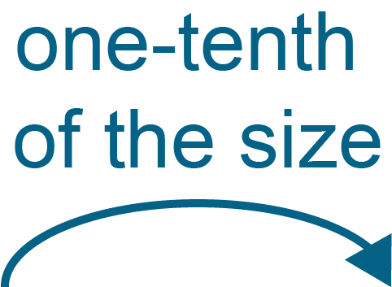
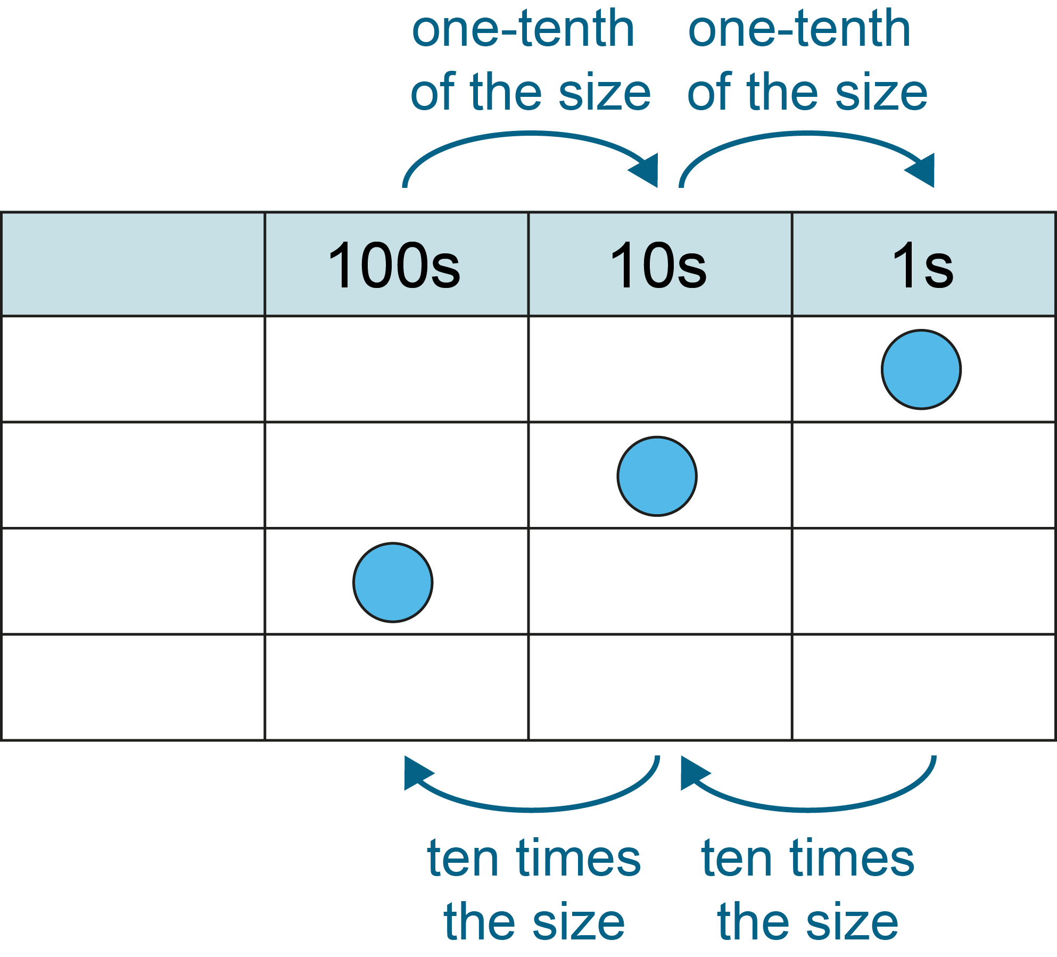
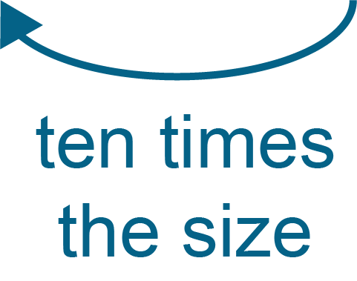
5NPV-1 Tenths and hundredths
If the blue counter has a value of 1, what happens to its value when it moves from the ones column to the tenths column? And from the tenths column to the hundredths column?
What happens to the counter’s value when you move it the other way?
1s
0.1s
0.01s

Slide 21
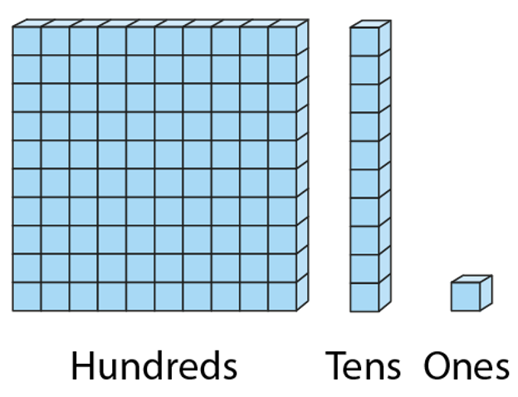
5NPV-1 Tenths and hundredths
Compare the value of the units. What do you notice?
1 one
1 tenth
1 hundredth

Slide 22
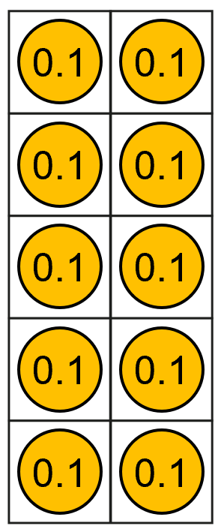
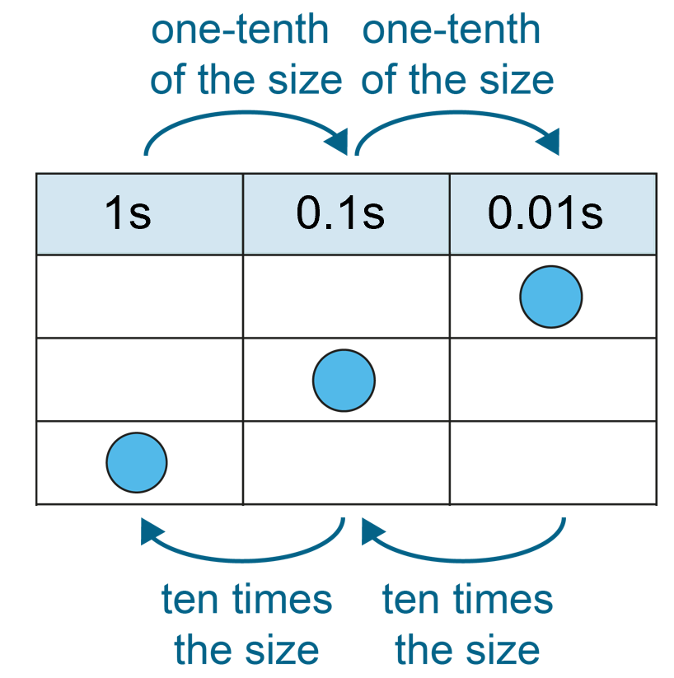
5NPV-1 Tenths and hundredths
Grouping and exchange model
Scaling model
10 tenths are equivalent
to one.
1 is ten times the size of 0.1.
0.1 is one-tenth the size of 1.
Practise describing the relationship between 0.1 and 1 in these two different ways.

Slide 23
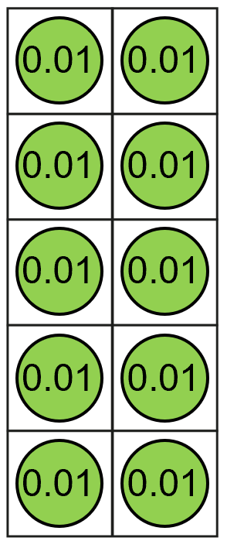
5NPV-1 Tenths and hundredths
Grouping and exchange model
Scaling model
10 hundredths are equivalent to
1 tenth
0.1 is ten times the size of 0.01
0.01 is one-tenth the size of 0.1
Practise describing the relationship between 0.1 and 0.01 in these two different ways.

Slide 24
5NPV-1 Tenths and hundredths
The Deca Tree
https://nrich.maths.org/2006

