Slide 1
5MD-3
Multiply using a formal written method

Slide 2
5MD-3 Multiply any whole number with up to 4 digits by any one-digit number using a formal written method.
The materials in this pack have been collated and written to support the teaching of 5MD-3. Before planning and teaching the content, read the teaching guidance and example assessment questions in the non-statutory guidance itself, which can be found here.
A video summarising all of the ready-to-progress criteria for Year 5 can be found here.

Slide 3
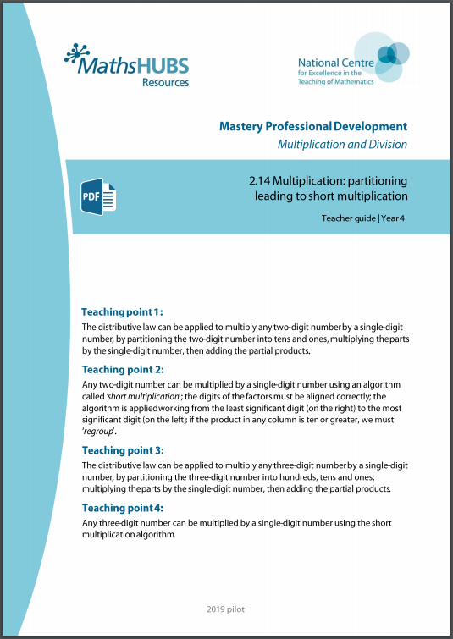
5MD-3: Linked mastery PD materials
Additional pedagogical subject knowledge support can be found in the Mastery Professional Development Materials:
2.14 Multiplication: partitioning leading to short multiplication
Several of the activity slides have been taken from these materials.

Slide 4
5MD-3
Multiply using a formal written method

Slide 5
The following slides contain activities that can be used within the context of pre-teaching, intervention, or as supplementary material integrated into teaching. They do not represent complete lessons and should not be used as such. Also they should not be used all at once, but over the period of a teaching unit. It would be valuable to use many of the activities more than once to build fluency in understanding and application. Also many of them would benefit from the use of manipulatives to support interaction with the ideas. Ensure you engage in rich discussion with the children, asking them to reason and explain the ideas presented. Note that when working with a small group, pupils should also have access to the main teaching delivered by the class teacher and the focus should be directly linked so that the learning is connected and fluency is built.

Slide 6
Guidance for working with a small pre-teaching or intervention group
Take time to build understanding of the key idea. We would recommend no more than four slides in any one session, and probably fewer.
In subsequent sessions, review and practise previous learning before moving on.
Play the animation/observe the image and ask pupils “What do you notice?”.
Encourage pupils to explain what they see, what is happening and why.
Where there is a highlighted sentence, draw out the meaning of this from the image and repeat together and individually.

Slide 7
Guidance for working with a small pre-teaching or intervention group
Engage in the suggested activities, using manipulatives where appropriate, to enhance the interaction and stimulate discussion. However, note that the ultimate aim is to develop fluency in the mathematical ideas such that resources are no longer needed.
Repeat questions, using other numbers/examples where relevant.
Repeat the highlighted language structures wherever relevant to build fluency with the key idea and connect the learning. For example:
10 hundreds are equivalent to 1,000.

Slide 8
5MD-3 Multiply using a formal written method

Slide 9
5MD-3 Multiply using a formal written method
Give children the opportunity to use Dienes and place value counters as shown to understand what each digit within different jottings or written methods represents. Ask children to narrate each stage in the calculation to increase understanding.
The resources are to secure understanding of underlying structures, not an aid to calculation. Once confident, children should build fluency in calculating without the aid of resources.
To complete the more simple calculations where regrouping is not required, pupils could begin with any place value column. However, they should be prompted to work from the least significant column (the ones column) in order to prepare for more complex situations.
Where regrouping is required, children should again narrate these stages using their place value understanding to help them.
2 times 4 ones is equal to 8 ones: write 8 in the ones column.
12 hundreds is equivalent to 1 thousand and 2 hundreds.

Slide 10
5MD-3 Multiply using a formal written method
The representation shows 2 rows of 34 chairs. How many chairs are there altogether?
Use Dienes to represent the chairs in each row.
For each stage of the calculation, identify what each digit represents using the Dienes to help.
34 = 30 + 4
34 × 2 = 30 × 2 + 4 × 2
= 60 + 8
= 68
Notes:
Thirty-four is equal to three tens and four ones.
Gather thirty-four and multiply by two.
Three-tens-and-four-ones multiplied by two.
Three-tens-and-four-ones multiplied by two is equal to three tens multiplied by two and four ones multiplied by two.
3 tens × 2 = 6 tens
4 ones × 2 = 8 ones

Slide 11
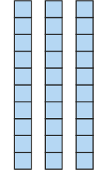
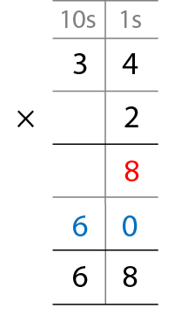
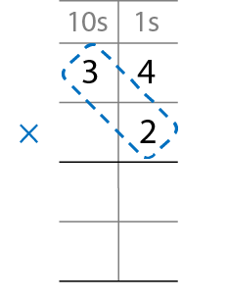
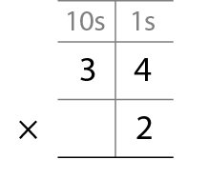
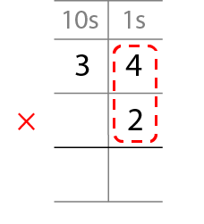
5MD-3 Multiply using a formal written method
The representation shows 2 rows of 34 chairs. How many chairs are there altogether?
Use Dienes to represent the chairs in each row.
For each stage of the calculation, identify what each digit represents using the Dienes to help.
8
2 × 4 ones = 8 ones
6
0
2 × 3 tens = 6 tens
Notes:
Step 1 – write the factors.
Step 2 – multiply the one-digit number by the ones.
Step 3 – multiply the one-digit number by the tens.
Step 4 – add the partial products.

Slide 12
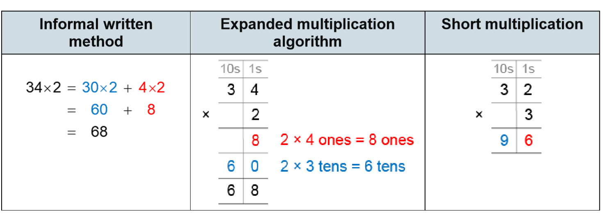
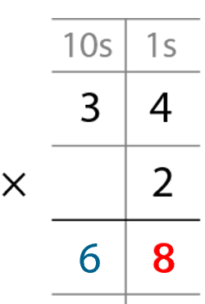
5MD-3 Multiply using a formal written method
The table shows three different ways to solve the same calculation. What’s the same? What’s different?
Use Dienes to model the calculation and explain what each digit within each method represents.

Slide 13
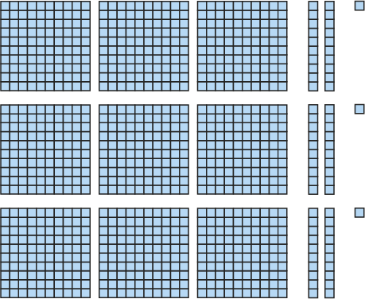
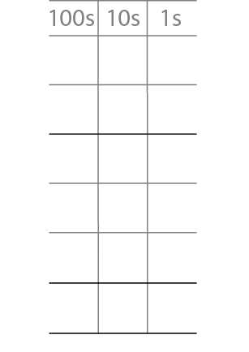
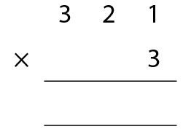
5MD-3 Multiply using a formal written method
321 × 3 =
963
3
2
1
×
3
3
3 × 1 ones = 3 ones
6
0
3 × 2 tens = 6 tens
9
0
0
3 × 3 hundreds = 9 hundreds
9
6
3
9
6
3

Slide 14
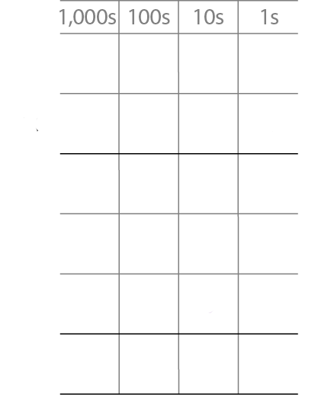
5MD-3 Multiply using a formal written method
367 × 4 =
1,468
3
6
7
×
4
4 × 7 ones = 28 ones
2
8
= 2 tens + 8 ones
4 × 6 tens = 24 tens
2
4
0
= 2 hundreds + 4 tens
4 × 3 hundreds = 12 hundreds
1
2
0
0
= 1 thousand + 2 hundreds
1
4
6
8

Slide 15
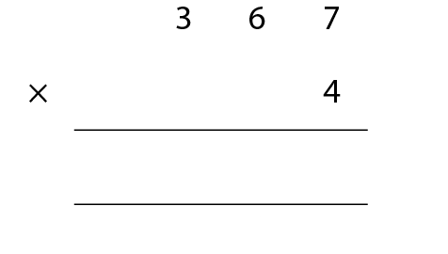
5MD-3 Multiply using a formal written method
Children should refer to the place value counters used in the previous example throughout the step-by-step progressions shown, circling the appropriate sections of counters as they appear.
Identify what each digit represents and why it has been recorded in certain locations.
Now practise calculating a 3-digit number by a single digit number to develop fluency.
367 × 4 =
1,468
4 x 7 = 28
4 times 7 ones = 28 ones.
28 ones = 2 tens and 8 ones.
2 is recorded below the tens column and 8 is recorded in the ones column.
1
4
6
8
2
2
Notes:
First write the largest factor: “367”
Then write the smallest factor below, lining up the digits: “4”
Now multiply, starting with the ones: four times seven ones is equal to twenty-eight ones…
… and regroup: twenty-eight ones is equal to two tens and eight ones;
write “8” in the ones column and “2” below the tens column.
Then move to the tens: four times six tens is equal to twenty-four tens…
… and regroup: twenty-four tens is equal to two hundreds and four tens…
… and add the two tens from regrouping to give two hundreds and six tens:
write “6” in the tens column and “2” below the hundreds column.
Then move to the hundreds: four times three hundreds is equal to twelve hundreds…
… and regroup: twelve hundreds is equal to one thousand and two hundreds…
… and add the two hundreds from regrouping to give one thousand and
four hundreds; write “1” in the thousands column and “4” in the hundreds column.

Slide 16
5MD-3 Multiply using a formal written method
Trebling
https://nrich.maths.org/2004

