Slide 1
5G-2
Compare and calculate areas

Slide 2
5G-2 Compare areas and calculate the area of rectangles (including squares) using standard units.
The materials in this pack have been collated and written to support the teaching of 5G-2. Before planning and teaching the content, read the teaching guidance and example assessment questions in the non-statutory guidance itself, which can be found here.
A video summarising all of the ready-to-progress criteria for Year 5 can be found here.

Slide 3
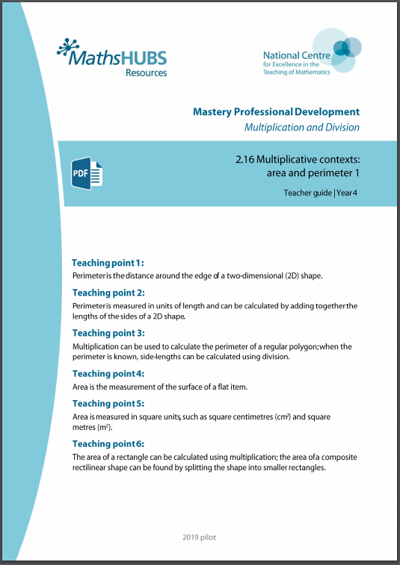
5G-2: Linked mastery PD materials
Additional pedagogical subject knowledge support can be found in the Mastery Professional Development Materials:
2.16 Multiplicative contexts: area and perimeter 1
Several of the activity slides have been taken from these materials.

Slide 4
5G-2
Compare and calculate areas

Slide 5
The following slides contain activities that can be used within the context of pre-teaching, intervention, or as supplementary material integrated into teaching. They do not represent complete lessons and should not be used as such. Also they should not be used all at once, but over the period of a teaching unit. It would be valuable to use many of the activities more than once to build fluency in understanding and application. Also many of them would benefit from the use of manipulatives to support interaction with the ideas. Ensure you engage in rich discussion with the children, asking them to reason and explain the ideas presented. Note that when working with a small group, pupils should also have access to the main teaching delivered by the class teacher and the focus should be directly linked so that the learning is connected and fluency is built.

Slide 6
Guidance for working with a small pre-teaching or intervention group
Take time to build understanding of the key idea. We would recommend no more than four slides in any one session, and probably fewer.
In subsequent sessions, review and practise previous learning before moving on.
Play the animation/observe the image and ask pupils “What do you notice?”.
Encourage pupils to explain what they see, what is happening and why.
Where there is a highlighted sentence, draw out the meaning of this from the image and repeat together and individually.

Slide 7
Guidance for working with a small pre-teaching or intervention group
Engage in the suggested activities, using manipulatives where appropriate, to enhance the interaction and stimulate discussion. However, note that the ultimate aim is to develop fluency in the mathematical ideas such that resources are no longer needed.
Repeat questions, using other numbers/examples where relevant.
Repeat the highlighted language structures wherever relevant to build fluency with the key idea and connect the learning. For example:
10 hundreds are equivalent to 1,000.

Slide 8
5G-2 Compare and calculate areas

Slide 9
5G-2 Compare and calculate areas
Ask children to take three shapes out of a tray of 3D shapes.
Can you see by looking at your shapes which one has the largest area? Can you see which one has the smallest area? How did you make your judgements?
Is it harder comparing the areas of two of the three shapes? Why?
What can you do to help you compare the area of two shapes?
Can you find two shapes which look quite different but which you think have a similar area?
How could placing the shapes on squared paper help inform your decision on their area?

Slide 10
5G-2 Compare and calculate areas
Which of the two shapes shown has a larger area?
How were you able to make this judgement?
The circle has a larger area that the decagon.

Slide 11
5G-2 Compare and calculate areas
The purple, red and yellow shapes above are drawn on centimetre squared paper. The blue square shows each square has an area of 1cm². How does this help to know that the area of each shape is 4cm²?
It is possible to count four squares inside the red and purple shapes.
It is possible to count two whole squares and visualize another two made from the four triangles inside the yellow shape.

Slide 12
5G-2 Compare and calculate areas
Draw the shape shown on squared paper. Count the number of squares found within the shape using your finger tip that covers roughly the area of one squared centimetre (1cm²).
Is it possible to calculate the area in a more efficient way? Can the number of columns and rows of squares help?
The area of the rectangle is equal to 4 rows of 5 square centimetres,
or 5 columns of 4 square centimetres.
4 cm x 5 cm = 5 cm x 4 cm = 20 cm²

Slide 13
5G-2 Compare and calculate areas
Fitted
https://nrich.maths.org/1854

