Slide 1
5F-1
Find non-unit fractions of quantities

Slide 2
5-F1 Find non-unit fractions of quantities
The materials in this pack have been collated and written to support the teaching of 5F-1. Before planning and teaching the content, read the teaching guidance and example assessment questions in the non-statutory guidance itself, which can be found here.
A video summarising all of the ready-to-progress criteria for Year 4 can be found here.

Slide 3
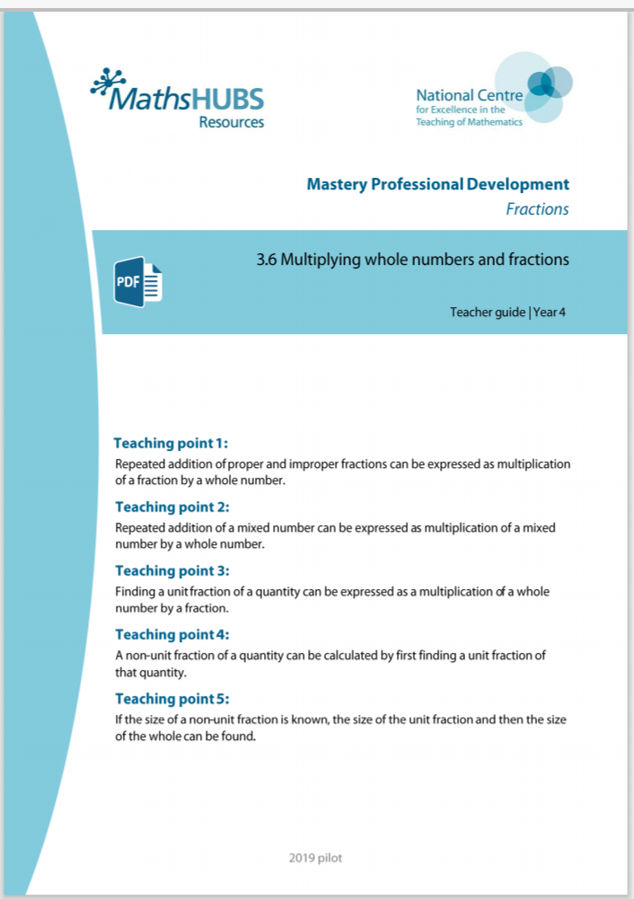
5F-1 Find non-unit fractions of quantities
Additional pedagogical subject knowledge support can be found in the Mastery Professional Development Materials:
3.6 Multiplying whole numbers and fractions
Several of the activity slides have been taken from these materials.

Slide 4
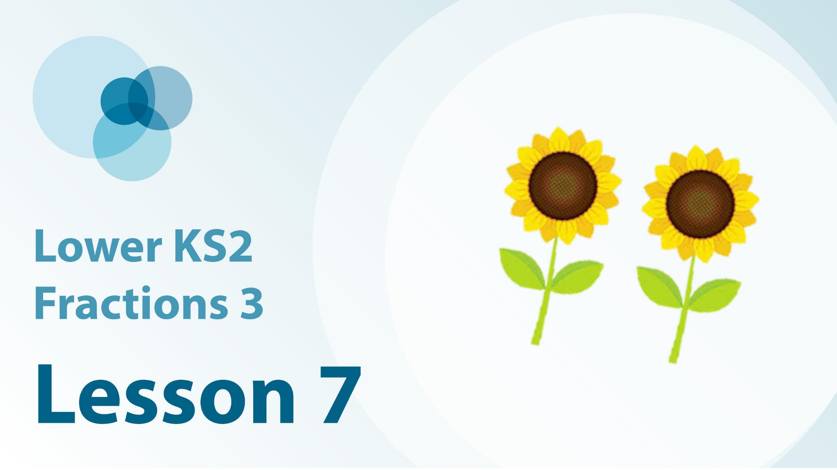
5F-1 Linked video lessons
Lower Key Stage 2 Fractions 3 (note this video has been selected from a lower year group but may be useful for review)
Reason about non-unit fractions in different contexts.

Slide 5
5f-1
Equivalence of 10 hundreds and 1 thousand

Slide 6
The following slides contain activities that can be used within the context of pre-teaching, intervention, or as supplementary material integrated into teaching. They do not represent complete lessons and should not be used as such. Also they should not be used all at once, but over the period of a teaching unit. It would be valuable to use many of the activities more than once to build fluency in understanding and application. Also many of them would benefit from the use of manipulatives to support interaction with the ideas. Ensure you engage in rich discussion with the children, asking them to reason and explain the ideas presented. Note that when working with a small group, pupils should also have access to the main teaching delivered by the class teacher and the focus should be directly linked so that the learning is connected and fluency is built.

Slide 7
Guidance for working with a small pre-teaching or intervention group
Take time to build understanding of the key idea. We would recommend no more than four slides in any one session, and probably fewer.
In subsequent sessions, review and practise previous learning before moving on.
Play the animation/observe the image and ask pupils “What do you notice?”.
Encourage pupils to explain what they see, what is happening and why.
Where there is a highlighted sentence, draw out the meaning of this from the image and repeat together and individually.

Slide 8
Guidance for working with a small pre-teaching or intervention group
Engage in the suggested activities, using manipulatives where appropriate, to enhance the interaction and stimulate discussion. However, note that the ultimate aim is to develop fluency in the mathematical ideas such that resources are no longer needed.
Repeat questions, using other numbers/examples where relevant.
Repeat the highlighted language structures wherever relevant to build fluency with the key idea and connect the learning. For example:
10 hundreds are equivalent to 1,000.

Slide 9
5F-1 Find non-unit fractions of quantities

Slide 10
5F-1 Find non-unit fractions of quantities
Use 15 counters to represent the 15 apples.
Divide the counters into 5 equal groups and identify that each group represents one-fifth of the whole.
Skip count in one-fifths of the whole, using the counters to help, to find non-unit fractions of 15.
of
of
of
2 one-fifths of 15 is equal to 6, 3 one-fifths of 15 is equal to 9…
of
of

Slide 11
5F-1 Find non-unit fractions of quantities
40
What fraction of 40 is 8? How do you know?
Identify how to find $\frac{1}{5}$ of 40 and how this can be used to find non fractional quantities of the same whole.
Repeat with other amounts where the whole is a multiple of the denominator of the fraction.
8
8
8
8
8
1
1
1
1
1
3
5
5
5
5
5
5
To find 3 one-fifths of 40, first find one-fifth of 40 by dividing by 5, and then multiply by 3.
40 ÷ 5 = 8
1
so of 40 = 8
5
3
of 40 = 24
5

Slide 12
5F-1 Find non-unit fractions of quantities
180
How can the information given be used to calculate the unknown value of the whole?
What is $\frac{6}{6}$equal to?
30
30
30
30
30
30
1
1
1
1
1
1
6
6
6
6
6
6
One-sixth of a number is equal to thirty. 6 one-sixths is equal to one whole.
To find the whole, multiply the value of 1 one-sixth by 6.
30 x 6 = 180
1
of a number is 30
6
6 × 30 = 180

Slide 13
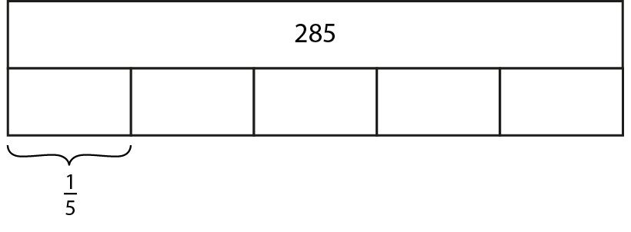
5F-1 Find non-unit fractions of quantities
How many parts has the whole been split into?
How can we use the fact $\frac{1}{5}$ of 285 = 57 to help us calculate $\frac{2}{5}$, $\frac{3}{5}$ and $\frac{4}{5}$ of the same amount?
2 one-fifths is equal to two lots of one-fifth.
57 x 2 = ___

Slide 14
5F-1 Find non-unit fractions of quantities
Why has 90 been recorded as the value of one of the parts and not the whole?
Why are we able to record 90 in each of the parts?
What do you notice about the value of the denominator and the value that 90 has been multiplied by? Why is this the case?
What is $\frac{2}{3}$ f 90?
?
270

Slide 15
5F-1 Find non-unit fractions of quantities
Andy’s Marbles
https://nrich.maths.org/2421

