Slide 1
4NPV-3
Four-digit numbers in the linear number system

Slide 2
4NPV-3 Reason about the location of any four-digit number in the linear number system, including identifying the previous and next multiple of 1,000 and 100, and rounding to the nearest of each.
The materials in this pack have been collated and written to support the teaching of 4NPV-3. Before planning and teaching the content in 4NPV-3, read the teaching guidance and example assessment questions in the non-statutory guidance itself, which can be found here.
A video summarising all of the ready-to-progress criteria for Year 4 can be found here.

Slide 3
4NPV-3: Linked mastery PD materials
Additional pedagogical subject knowledge support can be found in the Mastery Professional Development Materials:
1.22 Composition and calculation: 1,000 and four-digit numbers
Several of the activity slides have been taken from these materials.

Slide 4
4NPV-3
Four-digit numbers in the linear number system

Slide 5
The following slides contain activities that can be used within the context of pre-teaching, intervention, or as supplementary material integrated into teaching. They do not represent complete lessons and should not be used as such. Also they should not be used all at once, but over the period of a teaching unit. It would be valuable to use many of the activities more than once to build fluency in understanding and application. Also many of them would benefit from the use of manipulatives to support interaction with the ideas. Ensure you engage in rich discussion with the children, asking them to reason and explain the ideas presented. Note that when working with a small group, pupils should also have access to the main teaching delivered by the class teacher and the focus should be directly linked so that the learning is connected and fluency is built.

Slide 6
Guidance for working with a small pre-teaching or intervention group
Take time to build understanding of the key idea. We would recommend no more than four slides in any one session, and probably fewer.
In subsequent sessions, review and practise previous learning before moving on.
Play the animation/observe the image and ask pupils “What do you notice?”.
Encourage pupils to explain what they see, what is happening and why.
Where there is a highlighted sentence, draw out the meaning of this from the image and repeat together and individually.

Slide 7
Guidance for working with a small pre-teaching or intervention group
Engage in the suggested activities, using manipulatives where appropriate, to enhance the interaction and stimulate discussion. However, note that the ultimate aim is to develop fluency in the mathematical ideas such that resources are no longer needed.
Repeat questions, using other numbers/examples where relevant.
Repeat the highlighted language structures wherever relevant to build fluency with the key idea and connect the learning. For example:
10 hundreds are equivalent to 1,000.

Slide 8
4NPV-3 Four-digit numbers in the linear number system

Slide 9
4NPV-3 Four-digit numbers in the linear number system
0
1,000
2,000
3,000
4,000
5,000
6,000
7,000
8,000
9,000
10,000
Can you estimate what number the arrow is pointing to? Would 5,900 be a good estimate? Why not? Which two multiples of a thousand is the number between? What is the mid-point between these two multiples? How can this help you? How do you know the number comes before 5,500? How many intervals between each thousand? What does this tell you? Which two multiples of 100 is the number between. What would a suitable estimate be?
Repeat for the other arrows discussing the corresponding multiples either side.
Where do you think 2,458 would be on the line? 7,208? 2,319? Repeat for other numbers.
The previous multiple of 1,000 is ____ .The next multiple of 1,000 is ___.

Slide 10
4NPV-3 Four-digit numbers in the linear number system
0
5,000
10,000
What is different this time? What do you notice?
Can you estimate what number the arrow is pointing to? Would 6,700 be a good estimate? Why not? What could you mark on the line to help you? What would this mid-point be? Reveal the mid-point. How does this help you? Could you add any other landmarks to help you? What would a suitable estimate be?
Repeat for the other arrows discussing adding other landmarks to aid proportional reasoning.
Where do you think 1,349 would be on the line? Repeat for other numbers.

Slide 11
4NPV-3 Four-digit numbers in the linear number system
5,000
5,100
5,200
5,300
5,400
5,500
5,600
5,700
5,800
5,900
6,000
Can you estimate what number the arrow is pointing to? Would 5,758 be a good estimate? Why not? Which two multiples of 100 is the number between? Which of these multiples is the arrow closer to? What would a suitable estimate be?
Repeat for the other arrows discussing the corresponding multiples either side and which the arrow is closer to.
Where do you think 5,620 would be on the line? Repeat for other numbers.
The previous multiple of 100 is ___. The next multiple of 100 is ___.

Slide 12
4NPV-3 Four-digit numbers in the linear number system
0
1,000
2,000
3,000
4,000
5,000
6,000
7,000
8,000
9,000
10,000
Can you estimate what number the arrow is pointing to?
Which two multiples of 1,000 is the number between? Which of these multiples is the arrow closer to? What would a suitable estimate be?
Repeat for the other arrows discussing the corresponding multiples either side and which the arrow is closer to.
Where do you think 7,347 would be on the line? Repeat for other numbers.
The previous multiple of 1,000 is ___. The next multiple of 1,000 is ___.

Slide 13
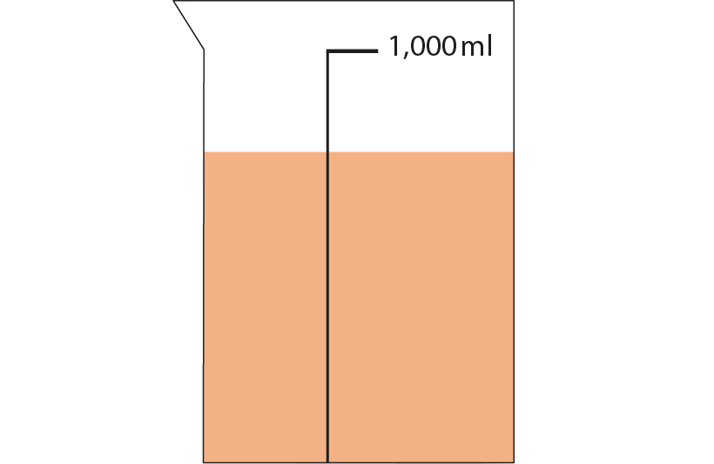
4NPV-3 Four-digit numbers in the linear number system
What do you notice? What could you say about how much liquid is in the jug? Would 300ml be a reasonable estimate? How do you know it is more than 500ml?
Where would 500 be on the scale?
Can you use this to make a reasonable estimate for the amount of liquid?

Slide 14
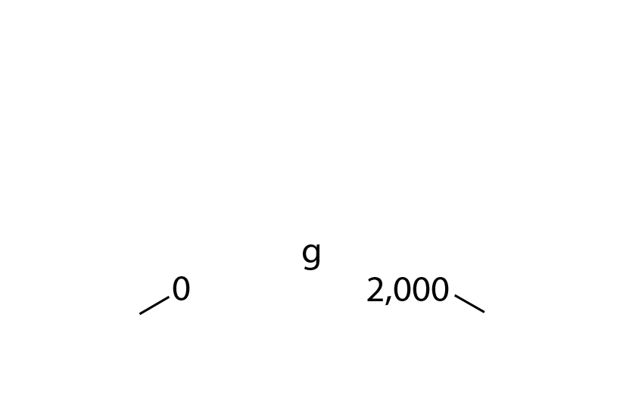
4NPV-3 Four-digit numbers in the linear number system
What is different this time?
Can you estimate where the arrow stops?
What can you do to make your estimation more accurate? Is the arrow pointing to before or after 1,000?
What landmarks can you put on the scale?
Can you now make a reasonable estimate?

Slide 15
4NPV-3 Four-digit numbers in the linear number system
This guidance is for the following nine slides. Additional questions may appear on each slide.
For each of the missing numbers represented by a letter, ask children the following:
What is the previous multiple of 1,000?
What is the next multiple of 1,000?
Which multiple of 1,000 is the number nearest to? (The first three slides are scaffolded with the number line shown – make reference to this useful visual. When the number line is not present, it is necessary to draw attention to the hundreds as being the critical digit when rounding to the nearest 1,000, and similarly the tens digit being the critical digit when rounding to the nearest 100). Discuss the use of the greater than and less signs and use the language structure below, each time populating it with the appropriate letter and values.
The previous multiple of 1,000 is __. The next multiple of 1,000 is __. a is greater than ___ and less than ___. a is nearest to ___ .

Slide 16
4NPV-3 Four-digit numbers in the linear number system

Slide 17
4NPV-3 Four-digit numbers in the linear number system

Slide 18
4NPV-3 Four-digit numbers in the linear number system

Slide 19
4NPV-3 Four-digit numbers in the linear number system
What is different this time? How can we tell which multiple of 1,000 the number is nearest to when we cannot see the number line? Which is the critical digit when rounding to the nearest 1,000?

Slide 20
4NPV-3 Four-digit numbers in the linear number system
1,500
0
1,000
2,000
3,000
What is different this time? When the number is the mid-point between the two multiples either side, what do we need to do?

Slide 21
4NPV-3 Four-digit numbers in the linear number system
The previous multiple of 1,000 is 1,000. The next multiple of 1,000 is 2,000.
1,500 is greater than ___ and less than ___.
1,500 is rounded to 2,000.

Slide 22
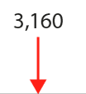
4NPV-3 Four-digit numbers in the linear number system

Slide 23
4NPV-3 Four-digit numbers in the linear number system
What is different this time? How can we tell which multiple of 100 the number is nearest to when we cannot see the number line? Which is the critical digit when rounding to the nearest 100?

Slide 24
4NPV-3 Four-digit numbers in the linear number system
What is different this time? What do you notice about the next multiple of 100?

Slide 25
4NPV-3 Four-digit numbers in the linear number system
5,725
When rounding to the nearest 1,000, what do you notice about the answer? Which digit is critical?
When rounding to the nearest 100, what do you notice about your answer? Which digit is critical?
Repeat this activity for other 4-digit numbers.
1,000s | 100s | 10s | 1s
5
7
2
5
6
0
0
0
nearest 1,000
5
7
0
0
nearest 100

Slide 26
4NPV-3 Four-digit numbers in the linear number system
Reasoned Rounding
https://nrich.maths.org/10945

