Slide 1
4NPV-2
Place value in four-digit numbers

Slide 2
4NPV-2 Recognise the place value of each digit in four-digit numbers, and compose and decompose four-digit numbers using standard and non-standard partitioning.
The materials in this pack have been collated and written to support the teaching of 4NPV-2. Before planning and teaching the content in 4NPV-2, read the teaching guidance and example assessment questions in the non-statutory guidance itself, which can be found here.
A video summarising all of the ready-to-progress criteria for Year 4 can be found here.

Slide 3
4NPV-2: Linked mastery PD materials
Additional pedagogical subject knowledge support can be found in the Mastery Professional Development Materials:
1.22 Composition and calculation: 1,000 and four-digit numbers
Several of the activity slides have been taken from these materials.

Slide 4
4NPV-2
Place value in four-digit numbers

Slide 5
The following slides contain activities that can be used within the context of pre-teaching, intervention, or as supplementary material integrated into teaching. They do not represent complete lessons and should not be used as such. Also they should not be used all at once, but over the period of a teaching unit. It would be valuable to use many of the activities more than once to build fluency in understanding and application. Also many of them would benefit from the use of manipulatives to support interaction with the ideas. Ensure you engage in rich discussion with the children, asking them to reason and explain the ideas presented. Note that when working with a small group, pupils should also have access to the main teaching delivered by the class teacher and the focus should be directly linked so that the learning is connected and fluency is built.

Slide 6
Guidance for working with a small pre-teaching or intervention group
Take time to build understanding of the key idea. We would recommend no more than four slides in any one session, and probably fewer.
In subsequent sessions, review and practise previous learning before moving on.
Play the animation/observe the image and ask pupils “What do you notice?”.
Encourage pupils to explain what they see, what is happening and why.
Where there is a highlighted sentence, draw out the meaning of this from the image and repeat together and individually.

Slide 7
Guidance for working with a small pre-teaching or intervention group
Engage in the suggested activities, using manipulatives where appropriate, to enhance the interaction and stimulate discussion. However, note that the ultimate aim is to develop fluency in the mathematical ideas such that resources are no longer needed.
Repeat questions, using other numbers/examples where relevant.
Repeat the highlighted language structures wherever relevant to build fluency with the key idea and connect the learning. For example:
10 hundreds are equivalent to 1,000.

Slide 8
4NPV-2 Place value in four-digit numbers

Slide 9
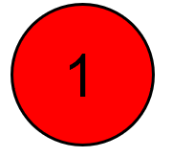
4NPV-2 Place value in four-digit numbers
Represent this number using place value counters and a part-part-whole model.
What digit is in the hundreds place? What is the value of the thousands digit?
What does the 4 represent?
Repeat for different 4-digit numbers
Show children representations of numbers either using part-part-whole or place value counters and ask them to write the value of each number represented.
5,342
5,000
300
40
2
The 4 represents four tens.
Notes:
Animations are not manual

Slide 10
4NPV-2 Place value in four-digit numbers
Say the value of each column of counters.
Click to reveal the value of each set of counters and write the total value as an addition equation.
What is the value of the 3?
Repeat using representations of other 4-digit numbers.
The 3 represents three hundreds.
5,000
+
300
+
40
+
2
= 5,342

Slide 11
4NPV-2 Place value in four-digit numbers
Say and reveal the value of each column of counters. Write the total value as an addition equation.
What do you notice? Does is matter that the counters are in a different order?
What is the value of the 5?
Repeat for other 4-digit numbers, using different arrangements.
The 5 represents five thousands.
40
+
5,000
+
2
+
300
= 5,342

Slide 12
4NPV-2 Place value in four-digit numbers
Click to reveal each digit in turn. Use the language structures below to describe the value of each digit.
Repeat using other 4-digit numbers.
5,342
The digit in the thousands place is 5. It has a value of 5,000.
1,000s | 100s | 10s | 1s
The digit in the hundreds place is 3. It has a value of 300.
5
3
4
2
The digit in the tens place is 4. It has a value of 40.
The digit in the ones place is 2. It has a value of 2.

Slide 13
4NPV-2 Place value in four-digit numbers
5,342
1,000
2,000
3,000
4,000
5,000
6,000
7,000
8,000
9,000
100
200
300
400
500
600
700
800
900
10
20
30
40
50
60
70
80
90
1
2
3
4
5
6
7
8
9
5,000
+
300
+
40
+
2
= 5,342
Click to reveal a 4-digit number and represent the total value as an addition equation.
Use the chart to identify other 4-digit numbers including those containing a zero.

Slide 14
4NPV-2 Place value in four-digit numbers
5,342 = 40 + 2 + _____ + ____
5,000
300
1,000
2,000
3,000
4,000
5,000
6,000
7,000
8,000
9,000
100
200
300
400
500
600
700
800
900
10
20
30
40
50
60
70
80
90
1
2
3
4
5
6
7
8
9
Complete the equation. What do you notice? Does it matter that the parts are in a different order?
Write the equation with the parts in a different order. Does it make a difference to the total value?
Use Gattegno charts and counters to build other 4-digit numbers, including those involving zero.

Slide 15
4NPV-2 Place value in four-digit numbers
What would happen if we took the three hundreds away? Click to reveal this on the representation. Write the number we now have (5,042). What does the zero represent?
Show children other representations of 4-digit numbers using place value counters and ask them to subtract all of one digit. Write the number we are left with.
If I took away six tens and I now have 2,301,what number did I start with?
The zero represents no hundreds.

Slide 16
4NPV-2 Place value in four-digit numbers
Play ‘zap the digit’. Zap the 4 and write the equation.
Repeat with other digits.
Repeat with other numbers.
5,241
5,241 – 40 = 5,201

Slide 17
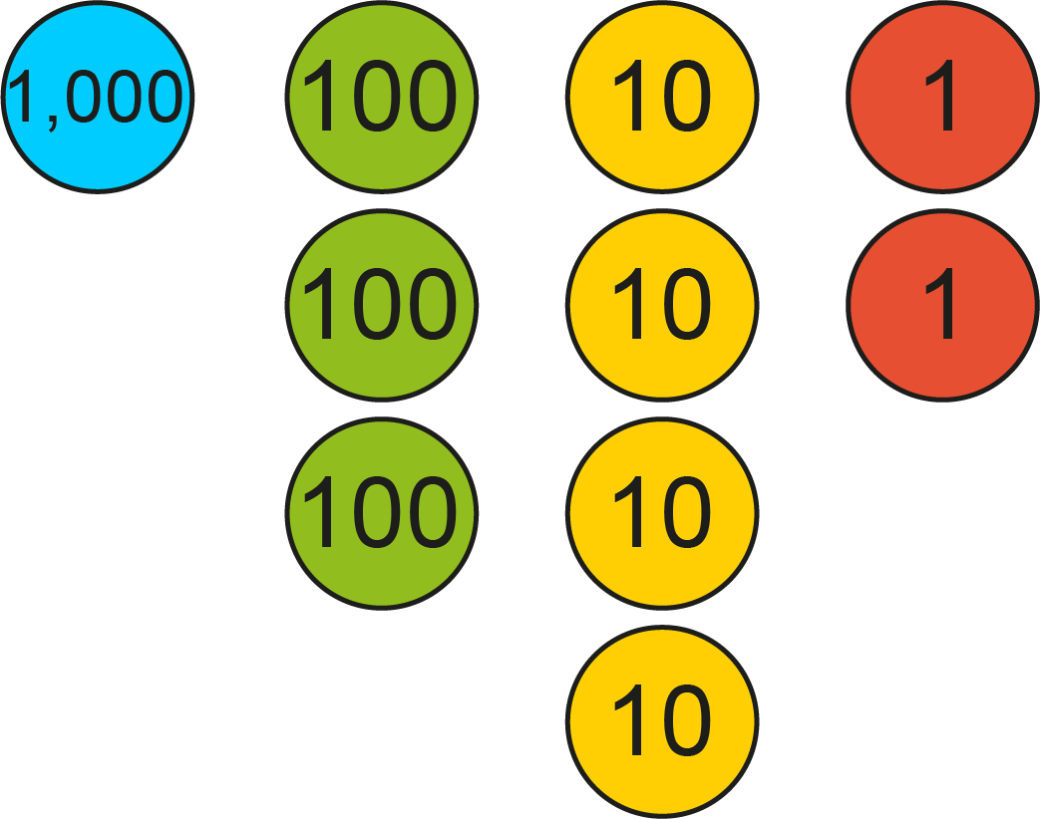
4NPV-2 Place value in four-digit numbers
5,342 – 4,000 = 1,342
Are we taking away all the thousands?
What number is left? Why is there not a zero in this number?
Repeat this activity using other 4-digit numbers.
5,342
4,000
1,342

Slide 18
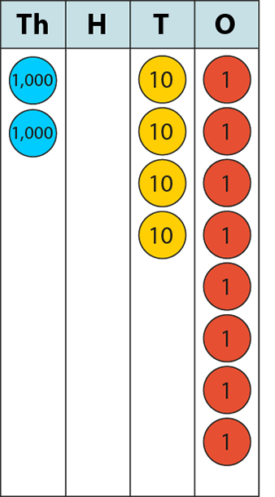
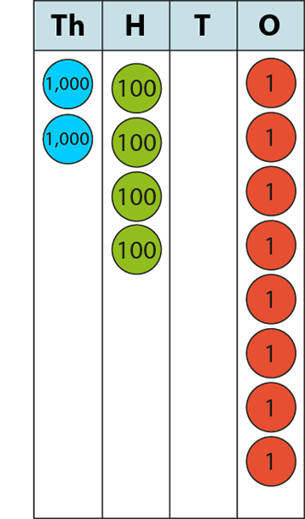
4NPV-2 Place value in four-digit numbers
2,048
<
2,408
What is the same about the two numbers represented? What is different?
Which number is greater? To find out, compare each digit in turn starting with the highest value digit, the thousands. Then move to the hundreds, the first has zero hundreds and the second has 4 hundreds, so the second number has the highest value. Can you explain why?
Repeat with other pairs of 4-digit numbers.

Slide 19
4NPV-2 Place value in four-digit numbers
The Deca Tree
https://nrich.maths.org/2006

