Slide 1
4NF-2
Division problems with remainders

Slide 2
4NF-2 Solve division problems, with two-digit dividends and one-digit divisors, that involve remainders, for example: 74 ÷ 9 = 8 r 2 and interpret remainders appropriately according to the context.
The materials in this pack have been collated and written to support the teaching of 4NF-2. Before planning and teaching the content, read the teaching guidance and example assessment questions in the non-statutory guidance itself, which can be found here.
A video summarising all of the ready-to-progress criteria for Year 4 can be found here.

Slide 3
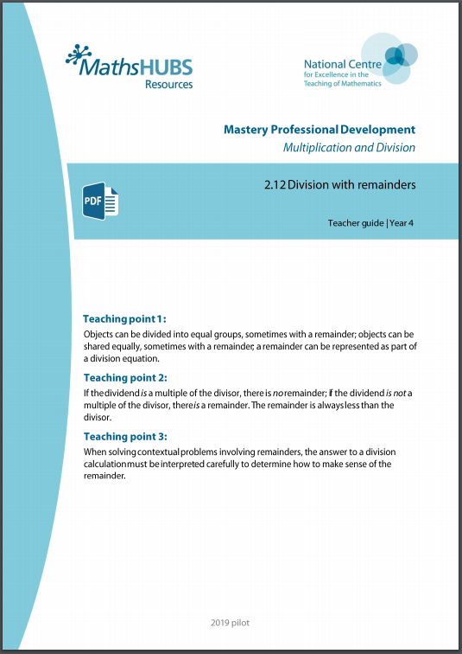
4NF-2: Linked mastery PD materials
Additional pedagogical subject knowledge support can be found in the Mastery Professional Development Materials:
2.12 Division with remainders
Several of the activity slides have been taken from these materials.

Slide 4
4NF-2
Division problems with remainders

Slide 5
The following slides contain activities that can be used within the context of pre-teaching, intervention, or as supplementary material integrated into teaching. They do not represent complete lessons and should not be used as such. Also they should not be used all at once, but over the period of a teaching unit. It would be valuable to use many of the activities more than once to build fluency in understanding and application. Also many of them would benefit from the use of manipulatives to support interaction with the ideas. Ensure you engage in rich discussion with the children, asking them to reason and explain the ideas presented. Note that when working with a small group, pupils should also have access to the main teaching delivered by the class teacher and the focus should be directly linked so that the learning is connected and fluency is built.

Slide 6
Guidance for working with a small pre-teaching or intervention group
Take time to build understanding of the key idea. We would recommend no more than four slides in any one session, and probably fewer.
In subsequent sessions, review and practise previous learning before moving on.
Play the animation/observe the image and ask pupils “What do you notice?”.
Encourage pupils to explain what they see, what is happening and why.
Where there is a highlighted sentence, draw out the meaning of this from the image and repeat together and individually.

Slide 7
Guidance for working with a small pre-teaching or intervention group
Engage in the suggested activities, using manipulatives where appropriate, to enhance the interaction and stimulate discussion. However, note that the ultimate aim is to develop fluency in the mathematical ideas such that resources are no longer needed.
Repeat questions, using other numbers/examples where relevant.
Repeat the highlighted language structures wherever relevant to build fluency with the key idea and connect the learning. For example:
10 hundreds are equivalent to 1,000.

Slide 8
4NF-2 Division problems with remainders

Slide 9
4NF-2 Division problems with remainders
Can you count in fours?
Can we make another group of 4?
What do you notice?
14 = × 4
3
+ 2
14 = 4 ×
3
+ 2
14 ÷ 4 =
3
r 2
One group of 4 is 4.
Two groups of 4 is 8.
Three groups of 4 are 12.
There are 2 left over.
14 is divided into groups of 4. There are 3 groups and a remainder of 2.
0
1
2
3
4
5
6
7
8
9
10
11
12
13
14
Notes:
Three boxes of four are twelve.
There are two cakes left over.

Slide 10
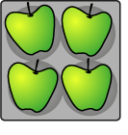
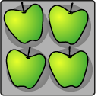
4NF-2 Division problems with remainders
20 ÷ 4 = 5
19 ÷ 4 = 4 r 3
18 ÷ 4 = 4 r 2
17 ÷ 4 = 4 r 1
16 ÷ 4 = 4
15 ÷ 4 = 3 r 3
14 ÷ 4 = 3 r 2
13 ÷ 4 = 3 r 1
12 ÷ 4 = 3
If apples are sold in trays of 4, how many trays can be made if we have __ apples?
Is __ in our 4 times table? Can you count in 4s up to __? Is there a remainder? Can you show this on a number line? Can you write a division equation?
What do you notice about the divisor and the remainder?
The remainder is always less than the divisor.
Notes:
The “23” represents the total number of apples .
The “4” represents the number of apples in each tray.
The “5” represents the number of full trays that can be made.
The “3” represents the number of apples left over.
So, the grocer can make fill full trays of apples; he
will have three apples left over.

Slide 11
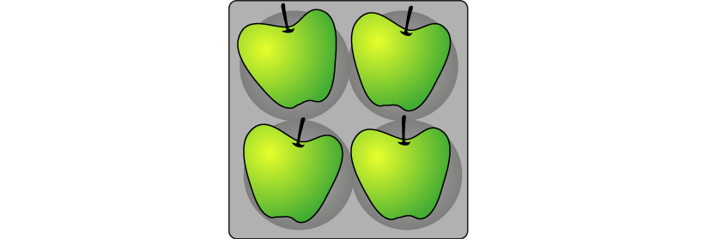
4NF-2 Division problems with remainders
Apples in trays of 4. How many trays?
Total number of apples (dividend) | Number of apples in each tray (divisor) | Number of trays (quotient) | Number of apples left over (remainder) | Equation
12
13
14
15
16
17
18
19
20
4
3
0
12 ÷ 4 = 3
4
3
1
13 ÷ 4 = 3 r 1
4
3
2
14 ÷ 4 = 3 r 2
4
3
3
15 ÷ 4 = 3 r 3
4
4
0
16 ÷ 4 = 4
4
4
1
17 ÷ 4 = 4 r 1
4
4
2
18 ÷ 4 = 4 r 2
4
4
3
19 ÷ 4 = 4 r 3
4
5
0
20 ÷ 4 = 5
Use your counters for each dividend, in order, to represent groups of 4. Which of the total number of apples (dividends) are in the 4 times table? Is there a remainder when we divide these by 4? Which dividends have remainders? Can you see a pattern in the table when you look at the remainders?
When we are dividing by 4 can we have a remainder of 5? Why not?
If the dividend is a multiple of the divisor, there is no remainder.
If the dividend is not a multiple of the divisor, there is a remainder.

Slide 12
4NF-2 Division problems with remainders
How many groups of 8 are there in 21?
Do you think there will be a remainder? Why? Is 21 a multiple of 8?
Can you show with your counters?
Can you count in 8s to 21?
How many groups of 8 are there? And how many more to make 21?
Repeat for other dividends and divisors both with and without remainders.
21 ÷ 8 = 2 remainder 5
2 groups of 8 are16, 5 more make 21.

Slide 13
4NF-2 Division problems with remainders
The following slides deal with contexts where children are required to round up or down appropriately. Here it is useful to provide a variety of real-life contexts in which children should interpret and practise. For example: 4 scouts can fit in each tent. How many tents needed for 30 scouts?
Can you represent the problem with your counters? How many groups of 4 are there? How many remaining? How many full tents are there? What does the remainder 2 mean? Will all the scouts fit into 7 tents? Why not? So how many tents do we need? What can you tell me about the eighth tent? Can you write a calculation to solve this problem? What does each part of your calculation represent? Why do we have to round up?
The 30 represents the total number of scouts.
The 4 represents the number of scouts in each tent.
The 7 represents the number of full tents.
The 2 represents the number of scouts left over.

Slide 14
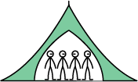
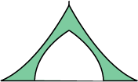
4NF-2 Division problems with remainders
4 scouts can fit in each tent. How many tents needed for 30 scouts?
30 ÷ 4 = 7 r 2
8 tents needed.
We need another tent for the 2 left over scouts.
Notes:
Will all of the scouts fit into seven tents? (No)
Why not? (If there are seven tents, there are two scouts left over.)
So how many tents will we need to fit all of the scouts into tents?
(Eight; we need seven tents of four scouts, and another tent for the two left-over scouts.)
The “30” represents the total number of scouts.
The “4” represents the number of scouts in each tent.
The “7” represents the number of full tents.
The “2” represents the number of scouts left over.

Slide 15
4NF-2 Division problems with remainders
34 biscuits, on plates of 6. How many full plates?
Can you represent the problem with your counters? How many groups of 6 are there? How many remaining? How many full plates of 6 are there? Is the sixth plate full? What does the question ask you this time? Do we need to round up or round down? Can you write a calculation to solve this problem? What does each part of your calculation represent?
Now continue with further contextualised problems where children have to either round up or down. It is important to ask children for their reasoning each time as modelled above.
The 34 represents the total number of biscuits.
The 6 represents the number of biscuits on each plate.
The 5 represents the number of full plates.
The 4 represents the number of biscuits left over.

Slide 16
4NF-2 Division problems with remainders
34 biscuits, on plates of 6. How many full plates?
34 ÷ 6 = 5 r 4
5 full plates.
There are 5 full plates of 6 biscuits. The last plate only has 4 biscuits and it is not full.
Notes:
The “34” represents the total number of biscuits.
The “6” represents the number of biscuits on each plate.
The “5” represents the number of plates of biscuits.
The “4” represents the number of biscuits left over.
So, five full plates of biscuits can be made.

Slide 17
4NF-2 Division problems with remainders
For this last slide, we have the same calculation showing two representations, one rounding down and one rounding up.
What is the same/different about these two representations?
Can you think of a maths story to match each of these?
Repeat this exercise for other representations and calculation showing remainders which can either be rounded up or down in context, encouraging children to use their reasoning each time.

Slide 18
4NF-2 Division problems with remainders
21 ÷ 8
Rounding
down
5
Rounding
up
3

