Slide 1
4MD-3
The distributive property of multiplication

Slide 2
4MD-3 Understand and apply the distributive property of multiplication.
The materials in this pack have been collated and written to support the teaching of 4MD-3. Before planning and teaching the content, read the teaching guidance and example assessment questions in the non-statutory guidance itself, which can be found here.
A video summarising all of the ready-to-progress criteria for Year 4 can be found here.

Slide 3
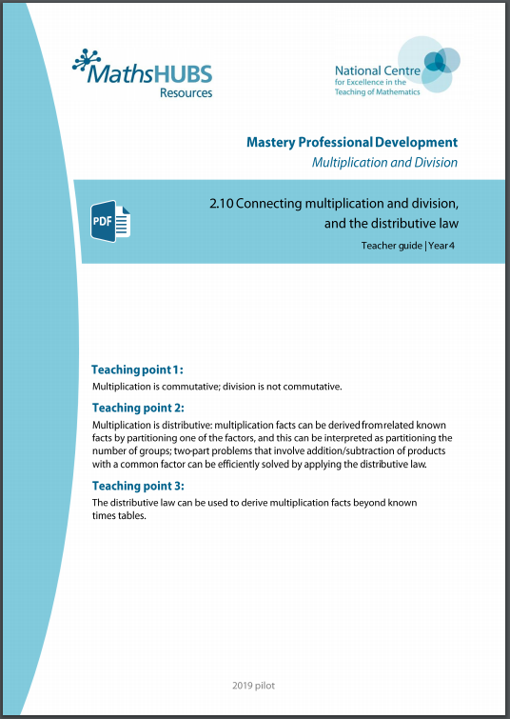
4MD-3: Linked mastery PD materials
Additional pedagogical subject knowledge support can be found in the Mastery Professional Development Materials:
2.10 Connecting multiplication and division, and the distributive law
Several of the activity slides have been taken from these materials.

Slide 4
4MD-3
The distributive property of multiplication

Slide 5
The following slides contain activities that can be used within the context of pre-teaching, intervention, or as supplementary material integrated into teaching. They do not represent complete lessons and should not be used as such. Also they should not be used all at once, but over the period of a teaching unit. It would be valuable to use many of the activities more than once to build fluency in understanding and application. Also many of them would benefit from the use of manipulatives to support interaction with the ideas. Ensure you engage in rich discussion with the children, asking them to reason and explain the ideas presented. Note that when working with a small group, pupils should also have access to the main teaching delivered by the class teacher and the focus should be directly linked so that the learning is connected and fluency is built.

Slide 6
Guidance for working with a small pre-teaching or intervention group
Take time to build understanding of the key idea. We would recommend no more than four slides in any one session, and probably fewer.
In subsequent sessions, review and practise previous learning before moving on.
Play the animation/observe the image and ask pupils “What do you notice?”.
Encourage pupils to explain what they see, what is happening and why.
Where there is a highlighted sentence, draw out the meaning of this from the image and repeat together and individually.

Slide 7
Guidance for working with a small pre-teaching or intervention group
Engage in the suggested activities, using manipulatives where appropriate, to enhance the interaction and stimulate discussion. However, note that the ultimate aim is to develop fluency in the mathematical ideas such that resources are no longer needed.
Repeat questions, using other numbers/examples where relevant.
Repeat the highlighted language structures wherever relevant to build fluency with the key idea and connect the learning. For example:
10 hundreds are equivalent to 1,000.

Slide 8
4MD-3 The distributive property of multiplication

Slide 9
4MD-3 The distributive property of multiplication
0 × 6 = 0
6 × 0 = 0
What do you notice about the next multiple of 6 in the 6 times table?
What is the difference between each multiple of 6?
Is this the same for all adjacent multiples?
Can you show this on a number line?
+ 6
+ 6
1 × 6 = 6
6 × 1 = 6
+ 6
+ 6
2 × 6 = 12
6 × 2 = 12
+ 6
+ 6
3 × 6 = 18
6 × 3 = 18
+ 6
+ 6
4 × 6 = 24
6 × 4 = 24
+ 6
+ 6
5 × 6 = 30
6 × 5 = 30
6 × 6 = 36
6 × 6 = 36
7 × 6 = 42
6 × 7 = 42
8 × 6 = 48
6 × 8 = 48
9 × 6 = 54
6 × 9 = 54
Adjacent multiples of 6 have a difference of 6.
10 × 6 = 60
6 × 10 = 60
11 × 6 = 66
6 × 11 = 66
12 × 6 = 72
6 × 12 = 72

Slide 10
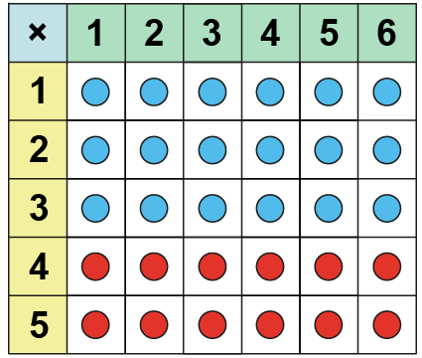
4MD-3 The distributive property of multiplication
If I have four sixes, what would I need to do to find five sixes? Do I need to start from zero and count up in sixes?
Use your counters to make an array to represent 4 x 6. Now change your array to make 5 x 6. Explain what you have done.
Repeat for other multiplications, adding one more multiple. Stop using the array when children are confident.
5 sixes is 4 sixes and one more 6.
5 x 6 = 4 x 6 + 6
4 × 6 + 6 = 5 × 6

Slide 11
4MD-3 The distributive property of multiplication
If I have 3 sixes, what would I need to do to find five sixes?
Use your counters to make an array to represent 3 x 6. Now change your array to make 5 x 6. Explain what you have done.
Can you write a calculation?
Repeat for other multiplications, adding on 2 or more multiples. Stop using the array when children are confident.
3 × 6 + 2 × 6 = 5 × 6

Slide 12
4MD-3 The distributive property of multiplication
Can you see 3 groups of 6 as a part? Can you see 2 groups of 6 as a part? How many groups of 6 do we have in total.
Using part-part-whole representations and counters/jottings, ask children to represent further multiplications, for example:
4 x 3 + 2 x 3 5 x 2 + 3 x 2
5
5 x 6
5 is equal to 3 plus 2, so 5 sixes is equal to 3 sixes plus 2 sixes.
1
1
6
6
1
1
6
6
1
6
3 + 2 = 5
3 x 6 + 2 x 6 = 5 x 6

Slide 13
4MD-3 The distributive property of multiplication
Can you represent this image using a multiplication equation? Point to part of the equation written and ask: What does this part represent?
What if there were 3 more spiders not 2? How will you change your equation?
Can you draw a picture to represent this equation?
4 x 3 + 2 x 3
Repeat.
3 × 5 + 1 × 5 = 4 × 5
4 × 8 + 2 × 8 = 6 x 8

Slide 14
4MD-3 The distributive property of multiplication
Let’s solve 7 fours using our new partitioning method. What has 7 been partitioned into?
Can you write the equation?
Now try 5 x 8.
Repeat using other calculations, including real-life contexts.
7 is equal to 5 plus 2, so 7 fours is equal to 5 fours plus 2 fours.
7 = 5 + 2
7 × 4 =
5 × 4
+ 2 × 4
= 20 + 8
= 28

Slide 15
4MD-3 The distributive property of multiplication
Let’s solve 9 x 4 by finding 10 x 4 first.
Can you write the equation?
Now solve 9 x 6 by finding 10 x 6 first.
Repeat with similar calculations.
Provide real-life contexts in which children can apply this method.
9 is equal to 10 minus 1, so 9 fours is equal to 10 fours minus 1 4.
9 = 10 − 1
9 × 4 = 10 × 4 − 1 × 4
= 40 − 4
= 36

Slide 16
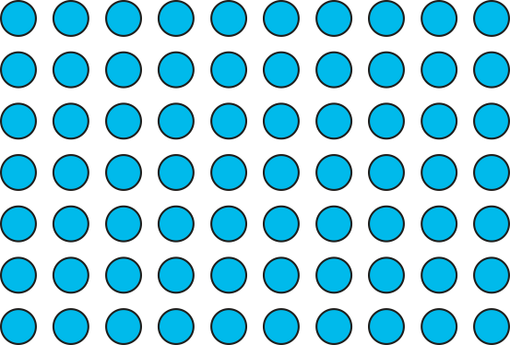
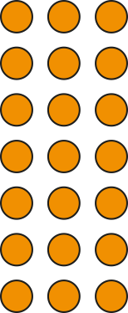
4MD-3 The distributive property of multiplication
13 × 7
= 91
10
3
What is different this time?
Which factor shall we partition?
How should we partition13? Why?
13 sevens is 10 sevens plus 3 sevens.
7
70
21
13 × 7 = 10 × 7 + 3 × 7
= 70
+
21
= 91

Slide 17
4MD-3 The distributive property of multiplication
16 × 5
= 80
Which factor will you partition? Could you represent this using rectangles instead of using your counters?
Can you write the equation?
Repeat using other calculations, multiplying teen numbers by a single digit and varying the order of the factors each time. Ask children to use this rectangular representation, writing the equation beneath.
Can you now solve these without the representation?
10
6
5
50
30
16 × 5 = 10 × 5 + 6 × 5
= 50 + 30
= 80

Slide 18
4MD-3 The distributive property of multiplication
16 × 5
= 80
How else could we partition 16 without thinking of 10 and a bit?
Could we use doubles?
What would this look like as a representation using rectangles.
Can you solve 18 x 3 and 12 x 4 in the same way?
8
8
5
40
40
16 × 5 = 8 × 5 + 8 × 5
= 40 + 40
= 80

