Slide 1
4MD-1
Multiplying and dividing by 10 and 100

Slide 2
4MD-1 Multiply and divide whole numbers by 10 and 100 (keeping to whole number quotients); understand this as equivalent to making a number 10 or 100 times the size.
The materials in this pack have been collated and written to support the teaching of 4MD-1. Before planning and teaching the content, read the teaching guidance and example assessment questions in the non-statutory guidance itself, which can be found here.
A video summarising all of the ready-to-progress criteria for Year 4 can be found here.

Slide 3
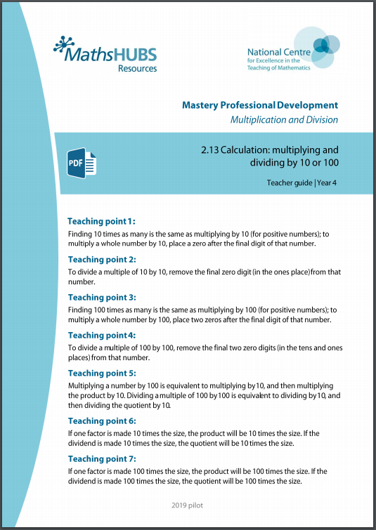
4MD-1: Linked mastery PD materials
Additional pedagogical subject knowledge support can be found in the Mastery Professional Development Materials:
2.13 Calculation: multiplying and dividing by 10 or 100
Several of the activity slides have been taken from these materials.

Slide 4
4MD-1
Multiplying and dividing by 10 and 100

Slide 5
The following slides contain activities that can be used within the context of pre-teaching, intervention, or as supplementary material integrated into teaching. They do not represent complete lessons and should not be used as such. Also they should not be used all at once, but over the period of a teaching unit. It would be valuable to use many of the activities more than once to build fluency in understanding and application. Also many of them would benefit from the use of manipulatives to support interaction with the ideas. Ensure you engage in rich discussion with the children, asking them to reason and explain the ideas presented. Note that when working with a small group, pupils should also have access to the main teaching delivered by the class teacher and the focus should be directly linked so that the learning is connected and fluency is built.

Slide 6
Guidance for working with a small pre-teaching or intervention group
Take time to build understanding of the key idea. We would recommend no more than four slides in any one session, and probably fewer.
In subsequent sessions, review and practise previous learning before moving on.
Play the animation/observe the image and ask pupils “What do you notice?”.
Encourage pupils to explain what they see, what is happening and why.
Where there is a highlighted sentence, draw out the meaning of this from the image and repeat together and individually.

Slide 7
Guidance for working with a small pre-teaching or intervention group
Engage in the suggested activities, using manipulatives where appropriate, to enhance the interaction and stimulate discussion. However, note that the ultimate aim is to develop fluency in the mathematical ideas such that resources are no longer needed.
Repeat questions, using other numbers/examples where relevant.
Repeat the highlighted language structures wherever relevant to build fluency with the key idea and connect the learning. For example:
10 hundreds are equivalent to 1,000.

Slide 8
4MD-1 Multiplying and dividing by 10 and 100

Slide 9
4MD-1 Multiplying and dividing by 10 and 100
8 × 10 = 80
÷ 10
80 ÷ 10 = 8
× 10
one-tenth of the size
ten times the size
What happens when we move up a row? Down a row?
Choose a number from the bottom row and multiply by 10. Start with the same number and make it 10 times the size. What do you notice?
Now choose a number from the tens row and divide by 10. Start with the same number and make it a tenth of the size. What do you notice?
When we multiply by 10 is our answer always a multiple of ten?

Slide 10
4MD-1 Multiplying and dividing by 10 and 100
8 × 100 = 800
÷ 100
800 ÷ 100 = 8
× 100
one-hundredth of the size
one hundred times the size
What happens when we move up two rows? Down two rows?
Choose a number from the bottom row and multiply by 100. Start with the same number and make it 100 times the size. What do you notice?
Now choose a number from the hundreds row and divide by 100. Start with the same number and make it a hundredth of the size. What do you notice?
What is 100 times the size of__? If I start with 900 and divide by 100 what do I have now?

Slide 11
4MD-1 Multiplying and dividing by 10 and 100
8 × 1 = 8
80 ÷ 10 = 8
8 × 10 = 80
If each of my ones become tens, what has happened? If each of my tens become ones, what has happened?
Start with 8 ones, then exchange each for a tens counter. Can you explain what you have done?
Start with 8 tens counters, then exchange each for ones counters. Explain what you have done.
10
10
1
1
1
1
10
10
1
1
10
10
1
1
8 made 10 times the size is 80.
8 multiplied by 10 is 80.
First we had 8 ones, now we have 8 tens.
10
10
ten times the size
one-tenth of the size

Slide 12
4MD-1 Multiplying and dividing by 10 and 100
8 × 100 = 800
800 ÷ 100 = 8
If each of my ones become hundreds what has happened? If each of my hundreds become ones, what has happened?
Start with 8 ones, now exchange each for a tens counter. Can you explain what you have done? Start with a 8 hundreds counters, exchange each for ones counters. Explain what you have done.
100
100
1
1
100
100
1
1
100
100
1
1
100
100
800 made 100 times smaller is 8.
800 divided by 100 is 8.
First we had 8 hundreds, now we have 8 ones.
1
1
one-hundredth of the size
one hundred times the size

Slide 13
4MD-1 Multiplying and dividing by 10 and 100
80 ÷ 10 = 8
8 × 10 = 80
What happens to 8 when we multiply by 10? Why do we need a zero in the ones?
If I start with 80 and divide by 10, what happens? What happens to the zero?
If I start with 6 ones and move this digit one place to the left, what have I done?
Think of 9 and make it ten times the size.
ten times the size
x10
8
8
0
To multiply a whole number by 10, place a zero after the final digit of that number.
÷10
one-tenth of the size

Slide 14
4MD-1 Multiplying and dividing by 10 and 100
800 ÷ 100 = 8
8 × 100 = 800
What happens to 8 when we multiply by 100? Why do we need 2 zeros?
If I start with 800 and divide by 100 what happens to the zeros?
If I start with 3 ones and move this digit two places to the left, what have I done?
Think of 4 and make it a hundred times the size.
x
one hundred times the size
x100
8
8
0
0
To multiply a whole number by 100, place 2 zeros after the final digit of that number.
÷100
one-hundredth of the size

Slide 15
4MD-1 Multiplying and dividing by 10 and 100
36 × 10 = 360
÷ 10
360 ÷ 10 = 36
× 10
one-tenth of the size
ten times the size
What 2-digit number can you see on the chart? If we multiply by ten/make ten times the value, what happens?
Use your own chart. Start with 450 and move each part down a row, what have you done?
When we multiply a 2-digit number by 10, does it always end in a zero? Try with other numbers.

Slide 16
4MD-1 Multiplying and dividing by 10 and 100
18 × 10 = 180
180 ÷ 10 = 18
If each part is ten times the value, show me the counters you will now have. Write a calculation and explain what you have done.
If I then divide by 10, describe what happens.
Provide children with 2-digit numbers to multiply by ten and 3-digit numbers to divide by ten, using counters to show their understanding. Ask them to explain their reasoning.
100
10
10
10
1
1
1
1
10
10
1
1
10
10
1
1
10
10
one-tenth of the size
180 is ten times the size of 18.
18 multiplied by 10 is 180.
ten times the size

Slide 17
4MD-1 Multiplying and dividing by 10 and 100
If we start with 18 and make this ten times the value, what has happened to the ones digit? The tens digit?
What was the value of the 1 before? And now? What was the value of the 8 before? And now?
What happens to the zero when we divide a multiple of 10 by 10? Does this happen for all multiples of 10?
18 × 10 = 180
180 ÷ 10 = 18
ten times the value
x10
x10
1
8
1
8
To multiply by 10, place a zero in the ones place.
To divide a multiple of 10 by 10, remove the zero from the ones place.
1
8
0
÷10
÷10
one-tenth of the value

Slide 18
4MD-1 Multiplying and dividing by 10 and 100
270 × 10 = 2,700
× 10
÷ 10
2,700 ÷ 10 = 270
ten times the size
one-tenth of the size
What happens to 270 when we multiply by 10?
Can you start with 360 on your chart and make it 10 times the value?
Think of 870 and make it one-tenth of the value
What happens to the ones digit when we multiply by 10?

Slide 19
4MD-1 Multiplying and dividing by 10 and 100
4,400 ÷ 10 = 440
440 × 10 = 4,400
Make 440 with your counters. Now make your number 10 times the size. Show me the counters you now have.
Start with 4,400, divide this by 10. Show me the counters you now have. Write a calculation.
Repeat for other similar numbers.
1,000
100
100
10
1,000
100
100
10
1,000
100
10
100
1,000
__ multiplied by 10 is equal to__.
__ is 10 times the size of __.
__ divided by 10 is equal to__.
100
100
10
one-tenth of the size
ten times the size

Slide 20
4MD-1 Multiplying and dividing by 10 and 100
440 × 10 = 4,400
4,400 ÷ 10 = 440
What is the value of the 4 tens after we multiply by 10?
What happens to each digit when we divide by 10?
Why is there a zero in the tens after we make 440 tens times the size?
What happens to the zero in the ones when we divide by 10?
ten times the size
x10
x10
x10
4
4
0
4
4
0
4
4
0
0
We had 44 tens, now we have 44 hundreds.
÷10
÷10
÷10
one-tenth of the size

Slide 21
4MD-1 Multiplying and dividing by 10 and 100
95 × 100 = 9,500
÷ 100
× 100
one-hundredth of the size
9,500 ÷ 100 = 95
one hundred times the size
When we multiply 95 by 100, what is the new value of the 9 digit? The 5 digit?
What happens to the zero in the ones/tens when we divide 9,500 by 100?
Provide further 2-digit numbers to multiply by 100 and multiples of 100 to divide by 100.
To multiply a whole number by 100, place two zeros after the final digit of that number.
To divide a multiple of 100 by 100, remove the zeros from the tens and ones places.

Slide 22
4MD-1 Multiplying and dividing by 10 and 100
62 × 100 = 6,200
6,200 ÷ 100 = 62
If each part is 100 times the value, show me the counters you will now have. Write a calculation and explain what you have done.
Provide children with 2-digit numbers to multiply by 100 and four-digit numbers to divide by 100, using counters to show their understanding. Ask them to explain their reasoning.
1,000
1,000
10
10
1
100
1,000
1,000
10
10
1
100
1,000
1,000
10
10
__ multiplied by 100 is equal to__.
__ is 100 times the size of __.
__ divided by 100 is equal to__.
one-hundredth of the size
one hundred times the size

Slide 23
4MD-1 Multiplying and dividing by 10 and 100
62 × 100 = 6,200
6,200 ÷ 100 = 62
If we start with 62 and make this 100 times the value, what has happened to the ones digit? The tens digit?
What was the value of the 2 before? And now? What was the value of the 6 before? And now?
What happens to the zeros in the tens and ones place when we divide a multiple of 100 by 100? Does this happen for all multiples of 100?
one hundred times the size
x100
x100
6
2
6
2
6
2
0
0
÷100
÷100
one-hundredth of the size

Slide 24
4MD-1 Multiplying and dividing by 10 and 100
Provide children with mixed practice questions involving multiplication of 2- and 3-digit numbers by 10 and 100, without the aid of counters or place value/Gattegno charts.
72 × 10 = 720
482 × 10 = 4,820
91 × 100 = 9,100
To multiply a whole number by 10, place a zero after the final digit of that number.
To multiply a whole number by 100, place two zeros after the final digit of that number.

Slide 25
4MD-1 Multiplying and dividing by 10 and 100
Provide children with mixed practice questions involving division of 3- and 4-digit multiples of 10 and100, by 10 and 100, without the aid of counters or place value/Gattegno charts.
570 ÷ 10 = 57
6,120 ÷ 10 = 612
7,500 ÷ 100 = 75
To divide a multiple of 10 by 10, remove the zero from the ones place. To divide a multiple of 100 by 100, remove the two zeros from the tens and ones place.

Slide 26
4MD-1 Multiplying and dividing by 10 and 100
18 × 100 = 1,800
18 made 100 times the size is 1,800
18 groups of 100 is 1,800
What is the same/different about these two representations?
What is 100 times 13?
Provide children with similar numbers to compare.

Slide 27
4MD-1 Multiplying and dividing by 10 and 100
Multiply Multiples 1
https://nrich.maths.org/10421

