Slide 1
3NPV-1
Equivalence of 10 tens and 1 hundred

Slide 2
3NPV-1 Know that 10 tens are equivalent to 1 hundred, and that 100 is 10 times the size of 10; apply this to identify and work out how many 10s there are in other three-digit multiples of 10.
The materials in this pack have been collated and written to support the teaching of 3NPV-1. Before planning and teaching the content, read the teaching guidance and example assessment questions in the non-statutory guidance itself, which can be found here.
A video summarising all of the ready-to-progress criteria for Year 3 can be found here.

Slide 3
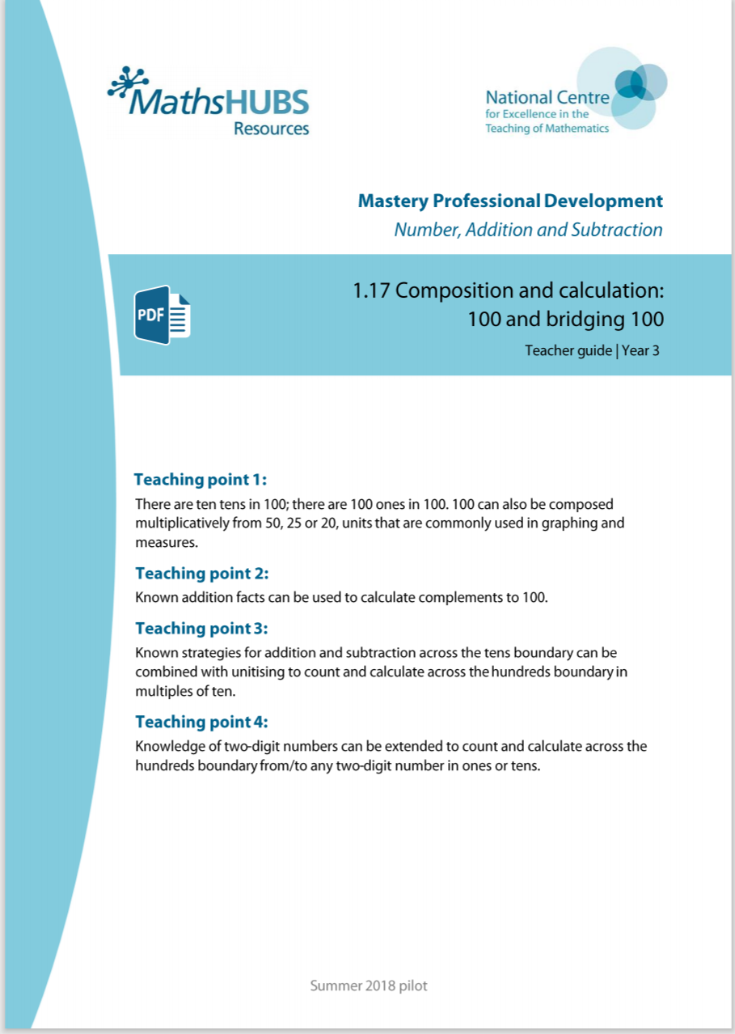
3NPV-1: Linked mastery PD materials
Additional pedagogical subject knowledge support can be found in the Mastery Professional Development Materials:
1.17 Composition and calculation: 100 and bridging 100
Several of the activity slides have been taken from these materials.

Slide 4
3NPV-1
Equivalence of 10 tens and 1 hundred

Slide 5
The following slides contain activities that can be used within the context of pre-teaching, intervention, or as supplementary material integrated into teaching. They do not represent complete lessons and should not be used as such. Also they should not be used all at once, but over the period of a teaching unit. It would be valuable to use many of the activities more than once to build fluency in understanding and application. Also many of them would benefit from the use of manipulatives to support interaction with the ideas. Ensure you engage in rich discussion with the children, asking them to reason and explain the ideas presented. Note that when working with a small group, pupils should also have access to the main teaching delivered by the class teacher and the focus should be directly linked so that the learning is connected and fluency is built.

Slide 6
Guidance for working with a small pre-teaching or intervention group
Take time to build understanding of the key idea. We would recommend no more than four slides in any one session, and probably fewer.
In subsequent sessions, review and practise previous learning before moving on.
Play the animation/observe the image and ask pupils “What do you notice?”.
Encourage pupils to explain what they see, what is happening and why.
Where there is a highlighted sentence, draw out the meaning of this from the image and repeat together and individually.

Slide 7
Guidance for working with a small pre-teaching or intervention group
Engage in the suggested activities, using manipulatives where appropriate, to enhance the interaction and stimulate discussion. However, note that the ultimate aim is to develop fluency in the mathematical ideas such that resources are no longer needed.
Repeat questions, using other numbers/examples where relevant.
Repeat the highlighted language structures wherever relevant to build fluency with the key idea and connect the learning. For example:
10 hundreds are equivalent to 1,000.

Slide 8
3NPV-1 Equivalence of 10 tens and 1 hundred

Slide 9
3NPV-1 Equivalence of 10 tens and 1 hundred
10 tens are equivalent to 100.
10
10
10
10
10
Count in steps of 10 to 100.
How many steps did you count?
100
10
10
10
10
10

Slide 10
3NPV-1 Equivalence of 10 tens and 1 hundred
Use Dienes blocks to show that 10 tens are equivalent to 100.
Count to 100 using Dienes tens. How many did you count?

Slide 11
3NPV-1 Equivalence of 10 tens and 1 hundred
Point to 10cm on the measuring stick.
How many 10cm lengths are there in 100cm?
Point to where 1m is on the measuring stick.
How many 10cm lengths are there in 1m?

Slide 12
3NPV-1 Equivalence of 10 tens and 1 hundred
10
10
10
10
10 tens are equivalent to 100.
18 tens are equivalent to 180.
10
10
10
10
Take a handful of 10 counters and write the number you have. Say it two ways: the number of tens you have, and the way the number is normally read.
Repeat the activity several times.
180
10
10
10
10
10
10
10
10
10
10

Slide 13
3NPV-1 Equivalence of 10 tens and 1 hundred
10
10
10
10
10
10
10
10
10
10
10
10
10
10
10
10
10
10
10
10
10
10
10
10
10
10
10
10
10
10
10
10
10
10
10
10
10
10
10
10
10
10
10
10
10
10
10
10
10
10
Count up in 10s. Stop at a number. How many tens do you have in total?
Repeat several times, stopping at different numbers.

Slide 14
3NPV-1 Equivalence of 10 tens and 1 hundred
10
20
30
40
50
60
70
80
90
100
Count in multiples of 10. What do you notice when you get to the end of each row?
Choose a number and say how many tens it is made from.
Repeat several times.
110
120
130
140
150
160
170
180
190
200
210
220
230
240
250
260
270
280
290
300
310
320
330
340
350
360
370
380
390
400
410
420
430
440
450
460
470
480
490
500
510
520
530
540
550
560
570
580
590
600
610
620
630
640
650
660
670
680
690
700
710
720
730
740
750
760
770
780
790
800
810
820
830
840
850
860
870
880
890
900
910
920
930
940
950
960
970
980
990
1,000

Slide 15
3NPV-1 Equivalence of 10 tens and 1 hundred
10
10
10
10
10
10
10
10
10
10
What do you notice about the value of the each row? And of the whole grid?
Click in the grid to reveal a number of tens.
How many tens are there? What is the total value of those tens?
Highlight some of the tens in a grid yourself. How many tens are there? What is the number you have made?
Repeat several times.
10
10
10
10
10
10
10
10
10
10
10
10
10
10
10
10
10
10
10
10
10
10
10
10
10
10
10
10
10
10
10
10
10
10
10
10
10
10
10
10
10
10
10
10
10
10
10
10
10
10
10
10
10
10
10
10
10
10
10
10
10
10
10
10
10
10
10
10
10
10
10
10
10
10
10
10
10
10
10
10
10
10
10
10
10
10
10
10
10
10

Slide 16
3NPV-1 Equivalence of 10 tens and 1 hundred
1,000 | 2,000 | 3,000 | 4,000 | 5,000 | 6,000 | 7,000 | 8,000 | 9,000
100 | 200 | 300 | 400 | 500 | 600 | 700 | 800 | 900
10 | 20 | 30 | 40 | 50 | 60 | 70 | 80 | 90
1 | 2 | 3 | 4 | 5 | 6 | 7 | 8 | 9
Click to reveal a number.
Use this slide to practise saying other numbers made of hundreds and tens, or place counters onto Gattegno charts to identify and say other numbers.
How many tens are there in each number you say?

Slide 17
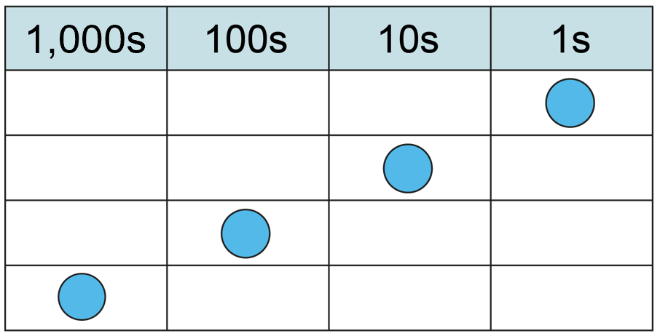
3NPV-1 Equivalence of 10 tens and 1 hundred
one-tenth of the size
one-tenth of the size
If the blue counter has a value of 1, what happens to its value when it moves from the ones column to the tens column? And from the tens column to the hundreds column?
What happens to the counter’s value when you move it the other way?
ten times the size
ten times the size

Slide 18
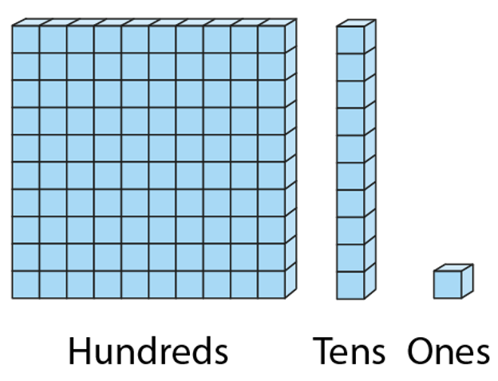
3NPV-1 Equivalence of 10 tens and 1 hundred
Compare the value of the units. What do you notice?

Slide 19
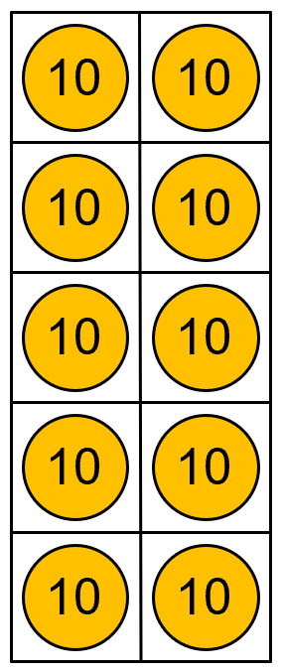
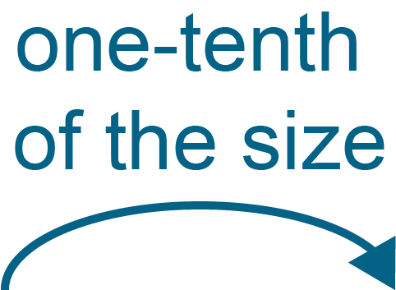
3NPV-1 Equivalence of 10 tens and 1 hundred
Grouping and exchange model
Scaling model
10 tens are equivalent to
1 hundred.
100 is ten times the size of 10.
10 is one-tenth the size of 100.
Practise describing the relationship between 10 and 100 in these two different ways.

