Slide 1
3NF-2
Recall of multiplication tables

Slide 2
3NF-2
Recall multiplication facts, and corresponding division facts, in the 10, 5, 2, 4 and 8 multiplication tables, and recognise products in these multiplication tables as multiples of the corresponding number.
The materials in this pack have been collated and written to support the teaching of 3NF-2. Before planning and teaching the content, read the teaching guidance and example assessment questions in the non-statutory guidance itself, which can be found here.
A video summarising all of the ready-to-progress criteria for Year 3 can be found here.

Slide 3
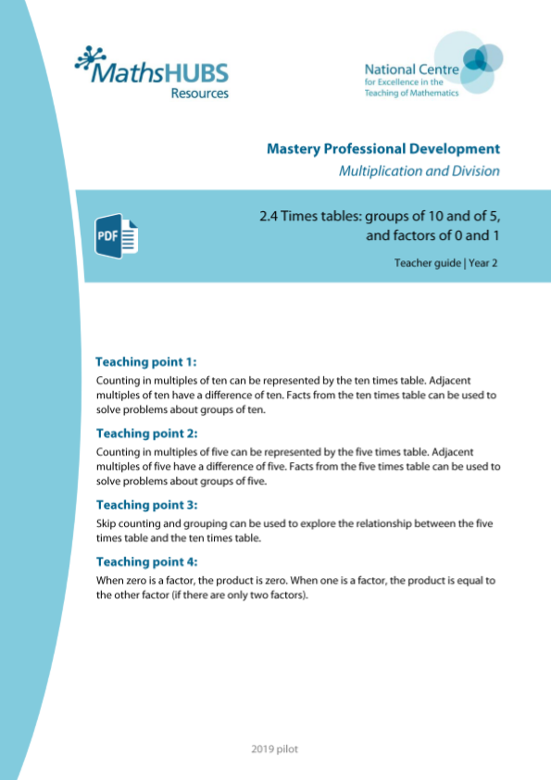
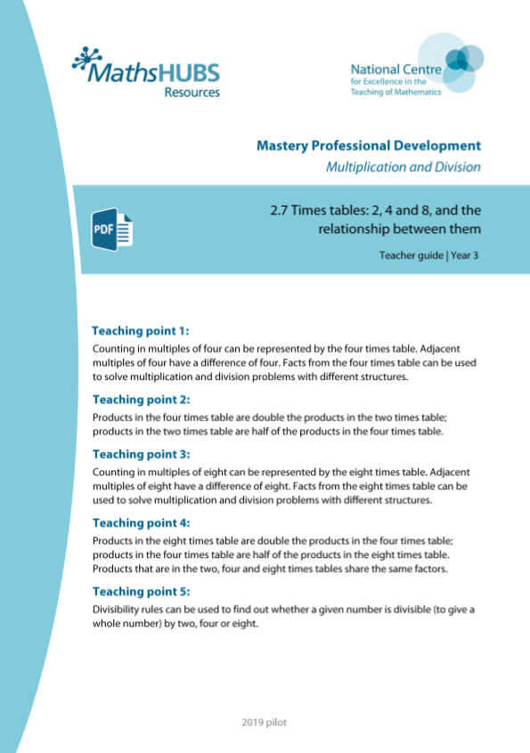
3NF-2: Linked mastery PD materials
Additional pedagogical subject knowledge support can be found in the following Mastery Professional Development materials:
  2.4 Times tables: groups of 10 and of 5, and factors of 0 and 1
  2.7 Times tables: 2, 4 and 8, and the relationship between them
Several of the activity slides have been taken from these materials.

Slide 4
3NF-2
Recall of multiplication tables

Slide 5
The following slides contain activities that can be used within the context of pre-teaching, intervention, or as supplementary material integrated into teaching. They do not represent complete lessons and should not be used as such. Also they should not be used all at once, but over the period of a teaching unit. It would be valuable to use many of the activities more than once to build fluency in understanding and application. Also many of them would benefit from the use of manipulatives to support interaction with the ideas. Ensure you engage in rich discussion with the children, asking them to reason and explain the ideas presented. Note that when working with a small group, pupils should also have access to the main teaching delivered by the class teacher and the focus should be directly linked so that the learning is connected and fluency is built.

Slide 6
Guidance for working with a small pre-teaching or intervention group
These slides are designed to build fluency in key facts. Use the ideas at the start to ensure understanding is secure.
Use the retrieval slides once children have built some recall, to provide regular practice to build fluency.

Slide 7
3NF-2 Recall of multiplication tables

Slide 8
3NF-2 Recall of multiplication tables
1 × 1 | 1 × 2 | 1 × 3 | 1 × 4 | 1 × 5 | 1 × 6 | 1 × 7 | 1 × 8 | 1 × 9 | 1 × 10 | 1 × 11 | 1 × 12
2 × 1 | 2 × 2 | 2 × 3 | 2 × 4 | 2 × 5 | 2 × 6 | 2 × 7 | 2 × 8 | 2 × 9 | 2 × 10 | 2 × 11 | 2 × 12
3 × 1 | 3 × 2 | 3 × 3 | 3 × 4 | 3 × 5 | 3 × 6 | 3 × 7 | 3 × 8 | 3 × 9 | 3 × 10 | 3 × 11 | 3 × 12
4 × 1 | 4 × 2 | 4 × 3 | 4 × 4 | 4 × 5 | 4 × 6 | 4 × 7 | 4 × 8 | 4 × 9 | 4 × 10 | 4 × 11 | 4 × 12
5 × 1 | 5 × 2 | 5 × 3 | 5 × 4 | 5 × 5 | 5 × 6 | 5 × 7 | 5 × 8 | 5 × 9 | 5 × 10 | 5 × 11 | 5 × 12
6 × 1 | 6 × 2 | 6 × 3 | 6 × 4 | 6 × 5 | 6 × 6 | 6 × 7 | 6 × 8 | 6 × 9 | 6 × 10 | 6 × 11 | 6 × 12
7 × 1 | 7 × 2 | 7 × 3 | 7 × 4 | 7 × 5 | 7 × 6 | 7 × 7 | 7 × 8 | 7 × 9 | 7 × 10 | 7 × 11 | 7 × 12
8 × 1 | 8 × 2 | 8 × 3 | 8 × 4 | 8 × 5 | 8 × 6 | 8 × 7 | 8 × 8 | 8 × 9 | 8 × 10 | 8 × 11 | 8 × 12
9 × 1 | 9 × 2 | 9 × 3 | 9 × 4 | 9 × 5 | 9 × 6 | 9 × 7 | 9 × 8 | 9 × 9 | 9 × 10 | 9 × 11 | 9 × 12
10 × 1 | 10 × 2 | 10 × 3 | 10 × 4 | 10 × 5 | 10 × 6 | 10 × 7 | 10 × 8 | 10 × 9 | 10 × 10 | 10 × 11 | 10 × 12
11 × 1 | 11 × 2 | 11 × 3 | 11 × 4 | 11 × 5 | 11 × 6 | 11 × 7 | 11 × 8 | 11 × 9 | 11 × 10 | 11 × 11 | 11 × 12
12 × 1 | 12 × 2 | 12 × 3 | 12 × 4 | 12 × 5 | 12 × 6 | 12 × 7 | 12 × 8 | 12 × 9 | 12 × 10 | 12 × 11 | 12 × 12
This grid shows the 144 multiplication facts which occur in the Year 4 multiplication check.
What do you notice about each row? Each column?
What happens to the product when we go down a row? Across a column?
Can you spot any rows/columns the same?
Which row/column do you find easiest?

Slide 9
3NF-2 Recall of multiplication tables
1 × 1 | 1 × 2 | 1 × 3 | 1 × 4 | 1 × 5 | 1 × 6 | 1 × 7 | 1 × 8 | 1 × 9 | 1 × 10 | 1 × 11 | 1 × 12
2 × 1 | 2 × 2 | 2 × 3 | 2 × 4 | 2 × 5 | 2 × 6 | 2 × 7 | 2 × 8 | 2 × 9 | 2 × 10 | 2 × 11 | 2 × 12
3 × 1 | 3 × 2 | 3 × 3 | 3 × 4 | 3 × 5 | 3 × 6 | 3 × 7 | 3 × 8 | 3 × 9 | 3 × 10 | 3 × 11 | 3 × 12
4 × 1 | 4 × 2 | 4 × 3 | 4 × 4 | 4 × 5 | 4 × 6 | 4 × 7 | 4 × 8 | 4 × 9 | 4 × 10 | 4 × 11 | 4 × 12
5 × 1 | 5 × 2 | 5 × 3 | 5 × 4 | 5 × 5 | 5 × 6 | 5 × 7 | 5 × 8 | 5 × 9 | 5 × 10 | 5 × 11 | 5 × 12
6 × 1 | 6 × 2 | 6 × 3 | 6 × 4 | 6 × 5 | 6 × 6 | 6 × 7 | 6 × 8 | 6 × 9 | 6 × 10 | 6 × 11 | 6 × 12
7 × 1 | 7 × 2 | 7 × 3 | 7 × 4 | 7 × 5 | 7 × 6 | 7 × 7 | 7 × 8 | 7 × 9 | 7 × 10 | 7 × 11 | 7 × 12
8 × 1 | 8 × 2 | 8 × 3 | 8 × 4 | 8 × 5 | 8 × 6 | 8 × 7 | 8 × 8 | 8 × 9 | 8 × 10 | 8 × 11 | 8 × 12
9 × 1 | 9 × 2 | 9 × 3 | 9 × 4 | 9 × 5 | 9 × 6 | 9 × 7 | 9 × 8 | 9 × 9 | 9 × 10 | 9 × 11 | 9 × 12
10 × 1 | 10 × 2 | 10 × 3 | 10 × 4 | 10 × 5 | 10 × 6 | 10 × 7 | 10 × 8 | 10 × 9 | 10 × 10 | 10 × 11 | 10 × 12
11 × 1 | 11 × 2 | 11 × 3 | 11 × 4 | 11 × 5 | 11 × 6 | 11 × 7 | 11 × 8 | 11 × 9 | 11 × 10 | 11 × 11 | 11 × 12
12 × 1 | 12 × 2 | 12 × 3 | 12 × 4 | 12 × 5 | 12 × 6 | 12 × 7 | 12 × 8 | 12 × 9 | 12 × 10 | 12 × 11 | 12 × 12
1 × 1 | 1 × 2 | 1 × 3 | 1 × 4 | 1 × 5 | 1 × 6 | 1 × 7 | 1 × 8 | 1 × 9 | 1 × 10 | 1 × 11 | 1 × 12
2 × 1 | 2 × 2 | 2 × 3 | 2 × 4 | 2 × 5 | 2 × 6 | 2 × 7 | 2 × 8 | 2 × 9 | 2 × 10 | 2 × 11 | 2 × 12
3 × 1 | 3 × 2 | 3 × 3 | 3 × 4 | 3 × 5 | 3 × 6 | 3 × 7 | 3 × 8 | 3 × 9 | 3 × 10 | 3 × 11 | 3 × 12
4 × 1 | 4 × 2 | 4 × 3 | 4 × 4 | 4 × 5 | 4 × 6 | 4 × 7 | 4 × 8 | 4 × 9 | 4 × 10 | 4 × 11 | 4 × 12
5 × 1 | 5 × 2 | 5 × 3 | 5 × 4 | 5 × 5 | 5 × 6 | 5 × 7 | 5 × 8 | 5 × 9 | 5 × 10 | 5 × 11 | 5 × 12
6 × 1 | 6 × 2 | 6 × 3 | 6 × 4 | 6 × 5 | 6 × 6 | 6 × 7 | 6 × 8 | 6 × 9 | 6 × 10 | 6 × 11 | 6 × 12
7 × 1 | 7 × 2 | 7 × 3 | 7 × 4 | 7 × 5 | 7 × 6 | 7 × 7 | 7 × 8 | 7 × 9 | 7 × 10 | 7 × 11 | 7 × 12
8 × 1 | 8 × 2 | 8 × 3 | 8 × 4 | 8 × 5 | 8 × 6 | 8 × 7 | 8 × 8 | 8 × 9 | 8 × 10 | 8 × 11 | 8 × 12
9 × 1 | 9 × 2 | 9 × 3 | 9 × 4 | 9 × 5 | 9 × 6 | 9 × 7 | 9 × 8 | 9 × 9 | 9 × 10 | 9 × 11 | 9 × 12
10 × 1 | 10 × 2 | 10 × 3 | 10 × 4 | 10 × 5 | 10 × 6 | 10 × 7 | 10 × 8 | 10 × 9 | 10 × 10 | 10 × 11 | 10 × 12
11 × 1 | 11 × 2 | 11 × 3 | 11 × 4 | 11 × 5 | 11 × 6 | 11 × 7 | 11 × 8 | 11 × 9 | 11 × 10 | 11 × 11 | 11 × 12
12 × 1 | 12 × 2 | 12 × 3 | 12 × 4 | 12 × 5 | 12 × 6 | 12 × 7 | 12 × 8 | 12 × 9 | 12 × 10 | 12 × 11 | 12 × 12
Discuss the highlighted columns.
Each product is repeated due to the commutative law and so if, for example, we know 3 x 4 = 12, we also know 4 x 3 = 12.
By learning our 5, 10, 2, 4 and 8 times table, these are all the facts we can recall.

Slide 10
3NF-2 Recall of multiplication tables
20
20
5
5
5
5
4
4
4
4
4
What do you see? We have a row of 5, another row of 5, another row of 5 and another row of 5. We have four rows of 5. We have four 5s which makes 20.
Now let’s look at it a different way. We have a column of 4, another column of 4… we have five columns of 4. We have five 4s which makes 20.
4 x 5 = 5 x 4 = 20

Slide 11
3NF-2 Recall of multiplication tables
20
20
5
5
5
5
4
4
4
4
4
5 × 4 = 20
20 ÷ 5 = 4
of 20 = 4
5
4 × 5 = 20
20 ÷ 4 = 5
of 20 = 5
4
What other related facts can you write using division?
Can you write any facts using fractions of amounts?

Slide 12
3NF-2 Recall of multiplication tables
The following slides provide recall practice of the multiplication facts in the 5, 10, 2, 4 and 8 times tables.
It also includes corresponding division facts.
Pupils should verbalise the facts regularly and be provided with retrieval practice.
Pupils can also have their own set of cards, broken down into smaller sets for practice. When practising recall, stop every so often and check that children can:
  draw a bar model and array images to show that they can link a fact to associated structures (as per slide 10);
  write other facts that they know from the fact they have recalled, including division and fractional amounts (as per slide 10).

Slide 13
3NF-2 Recall of multiplication tables
7 × 5 =
35

Slide 14
3NF-2 Recall of multiplication tables
10 × 11 =
110

Slide 15
3NF-2 Recall of multiplication tables
5 × 2 =
10

Slide 16
3NF-2 Recall of multiplication tables
12 × 4 =
48

Slide 17
3NF-2 Recall of multiplication tables
8 × 1 =
8

Slide 18
3NF-2 Recall of multiplication tables
11 × 4 =
44

Slide 19
3NF-2 Recall of multiplication tables
8 × 12 =
96

Slide 20
3NF-2 Recall of multiplication tables
5 × 10 =
50

Slide 21
3NF-2 Recall of multiplication tables
9 × 2 =
18

Slide 22
3NF-2 Recall of multiplication tables
6 × 8 =
48

Slide 23
3NF-2 Recall of multiplication tables
4 × 7 =
28

Slide 24
3NF-2 Recall of multiplication tables
5 × 3 =
15

Slide 25
3NF-2 Recall of multiplication tables
6 × 4 =
24

Slide 26
3NF-2 Recall of multiplication tables
5 × 11 =
55

Slide 27
3NF-2 Recall of multiplication tables
3 × 4 =
12

Slide 28
3NF-2 Recall of multiplication tables
12 × 2 =
24

Slide 29
3NF-2 Recall of multiplication tables
4 × 5 =
20

Slide 30
3NF-2 Recall of multiplication tables
2 × 7 =
14

Slide 31
3NF-2 Recall of multiplication tables
11 × 8 =
88

Slide 32
3NF-2 Recall of multiplication tables
10 × 1 =
10

Slide 33
3NF-2 Recall of multiplication tables
12 × 5 =
60

Slide 34
3NF-2 Recall of multiplication tables
5 × 5 =
25

Slide 35
3NF-2 Recall of multiplication tables
7 × 8 =
56

Slide 36
3NF-2 Recall of multiplication tables
4 × 2 =
8

Slide 37
3NF-2 Recall of multiplication tables
9 × 5 =
45

Slide 38
3NF-2 Recall of multiplication tables
4 × 4 =
16

Slide 39
3NF-2 Recall of multiplication tables
8 × 9 =
72

Slide 40
3NF-2 Recall of multiplication tables
5 × 6 =
30

Slide 41
3NF-2 Recall of multiplication tables
8 × 10 =
80

Slide 42
3NF-2 Recall of multiplication tables
9 × 4 =
36

Slide 43
3NF-2 Recall of multiplication tables
10 × 3 =
30

Slide 44
3NF-2 Recall of multiplication tables
2 × 6 =
12

Slide 45
3NF-2 Recall of multiplication tables
7 × 10 =
70

Slide 46
3NF-2 Recall of multiplication tables
1 × 2 =
2

Slide 47
3NF-2 Recall of multiplication tables
12 × 10 =
120

Slide 48
3NF-2 Recall of multiplication tables
2 × 2 =
4

Slide 49
3NF-2 Recall of multiplication tables
8 × 2 =
16

Slide 50
3NF-2 Recall of multiplication tables
2 × 11 =
22

Slide 51
3NF-2 Recall of multiplication tables
4 × 8 =
32

Slide 52
3NF-2 Recall of multiplication tables
10 × 2 =
20

Slide 53
3NF-2 Recall of multiplication tables
4 × 1 =
4

Slide 54
3NF-2 Recall of multiplication tables
4 × 10 =
40

Slide 55
3NF-2 Recall of multiplication tables
40 ÷ 8 =
5

Slide 56
3NF-2 Recall of multiplication tables
1 × 5 =
5

Slide 57
3NF-2 Recall of multiplication tables
5 × 8 =
40

Slide 58
3NF-2 Recall of multiplication tables
8 × 3 =
24

Slide 59
3NF-2 Recall of multiplication tables
8 × 8 =
64

Slide 60
3NF-2 Recall of multiplication tables
6 × 10 =
60

Slide 61
3NF-2 Recall of multiplication tables
10 × 9 =
90

Slide 62
3NF-2 Recall of multiplication tables
2 × 3 =
6

Slide 63
3NF-2 Recall of multiplication tables
10 × 10 =
100

Slide 64
3NF-2 Recall of multiplication tables
48 ÷ 4 =
12

Slide 65
3NF-2 Recall of multiplication tables
50 ÷ 5 =
10

Slide 66
3NF-2 Recall of multiplication tables
80 ÷ 10 =
8

Slide 67
3NF-2 Recall of multiplication tables
60 ÷ 5 =
12

Slide 68
3NF-2 Recall of multiplication tables
120 ÷ 10 =
12

Slide 69
3NF-2 Recall of multiplication tables
30 ÷ 5 =
6

Slide 70
3NF-2 Recall of multiplication tables
36 ÷ 4 =
9

Slide 71
3NF-2 Recall of multiplication tables
40 ÷ 4 =
10

Slide 72
3NF-2 Recall of multiplication tables
12 ÷ 2 =
6

Slide 73
3NF-2 Recall of multiplication tables
60 ÷ 10 =
6

Slide 74
3NF-2 Recall of multiplication tables
20 ÷ 4 =
5

Slide 75
3NF-2 Recall of multiplication tables
8 ÷ 2 =
4

Slide 76
3NF-2 Recall of multiplication tables
8 ÷ 8 =
1

Slide 77
3NF-2 Recall of multiplication tables
30 ÷ 10 =
3

Slide 78
3NF-2 Recall of multiplication tables
20 ÷ 5 =
4

Slide 79
3NF-2 Recall of multiplication tables
90 ÷ 10 =
9

Slide 80
3NF-2 Recall of multiplication tables
16 ÷ 8 =
2

Slide 81
3NF-2 Recall of multiplication tables
5 ÷ 5 =
1

Slide 82
3NF-2 Recall of multiplication tables
24 ÷ 4 =
6

Slide 83
3NF-2 Recall of multiplication tables
2 ÷ 2 =
1

Slide 84
3NF-2 Recall of multiplication tables
15 ÷ 5 =
3

Slide 85
3NF-2 Recall of multiplication tables
110 ÷ 10 =
11

Slide 86
3NF-2 Recall of multiplication tables
16 ÷ 4 =
4

Slide 87
3NF-2 Recall of multiplication tables
4 ÷ 2 =
2

Slide 88
3NF-2 Recall of multiplication tables
32 ÷ 8 =
4

Slide 89
3NF-2 Recall of multiplication tables
6 ÷ 2 =
3

Slide 90
3NF-2 Recall of multiplication tables
96 ÷ 8 =
12

Slide 91
3NF-2 Recall of multiplication tables
40 ÷ 5 =
8

Slide 92
3NF-2 Recall of multiplication tables
20 ÷ 2 =
10

Slide 93
3NF-2 Recall of multiplication tables
44 ÷ 4 =
11

Slide 94
3NF-2 Recall of multiplication tables
70 ÷ 10 =
7

Slide 95
3NF-2 Recall of multiplication tables
28 ÷ 4 =
7

Slide 96
3NF-2 Recall of multiplication tables
10 ÷ 2 =
5

Slide 97
3NF-2 Recall of multiplication tables
48 ÷ 8 =
6

Slide 98
3NF-2 Recall of multiplication tables
18 ÷ 2 =
9

Slide 99
3NF-2 Recall of multiplication tables
24 ÷ 8 =
3

Slide 100
3NF-2 Recall of multiplication tables
22 ÷ 2 =
11

Slide 101
3NF-2 Recall of multiplication tables
16 ÷ 2 =
8

Slide 102
3NF-2 Recall of multiplication tables
24 ÷ 2 =
12

Slide 103
3NF-2 Recall of multiplication tables
4 ÷ 4 =
1

Slide 104
3NF-2 Recall of multiplication tables
50 ÷ 10 =
5

Slide 105
3NF-2 Recall of multiplication tables
20 ÷ 10 =
2

Slide 106
3NF-2 Recall of multiplication tables
64 ÷ 8 =
8

Slide 107
3NF-2 Recall of multiplication tables
8 ÷ 4 =
2

Slide 108
3NF-2 Recall of multiplication tables
32 ÷ 4 =
8

Slide 109
3NF-2 Recall of multiplication tables
10 ÷ 5 =
2

Slide 110
3NF-2 Recall of multiplication tables
25 ÷ 5 =
5

Slide 111
3NF-2 Recall of multiplication tables
100 ÷ 10 =
10

Slide 112
3NF-2 Recall of multiplication tables
56 ÷ 8 =
7

Slide 113
3NF-2 Recall of multiplication tables
35 ÷ 5 =
7

Slide 114
3NF-2 Recall of multiplication tables
14 ÷ 2 =
7

Slide 115
3NF-2 Recall of multiplication tables
12 ÷ 4 =
3

Slide 116
3NF-2 Recall of multiplication tables
45 ÷ 5 =
9

Slide 117
3NF-2 Recall of multiplication tables
80 ÷ 8 =
10

Slide 118
3NF-2 Recall of multiplication tables
55 ÷ 5 =
11

Slide 119
3NF-2 Recall of multiplication tables
88 ÷ 8 =
11

Slide 120
3NF-2 Recall of multiplication tables
10 ÷ 10 =
1

Slide 121
3NF-2 Recall of multiplication tables
40 ÷ 10 =
4

Slide 122
3NF-2 Recall of multiplication tables
72 ÷ 8 =
9

