Slide 1
3NF-1
Fluently add and subtract within and across 10

Slide 2
3NF-1 Secure fluency in addition and subtraction facts that bridge 10, through continued practice.
The materials in this pack have been collated and written to support the teaching of 3NF-1. Before planning and teaching the content, read the teaching guidance and example assessment questions in the non-statutory guidance itself, which can be found here.
A video summarising all of the ready-to-progress criteria for Year 3 can be found here.

Slide 3
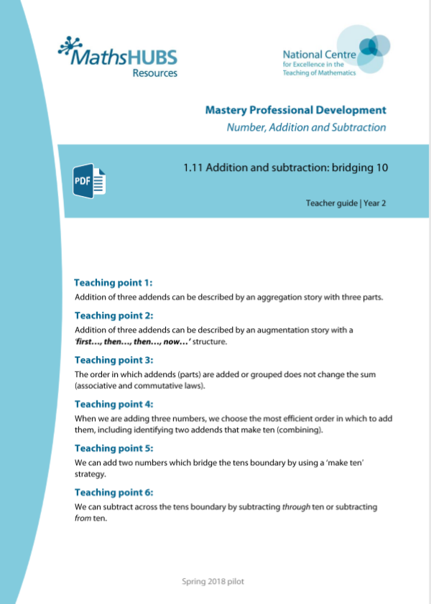
3NF-1: Linked mastery PD materials
Additional pedagogical subject knowledge support can be found in the Mastery Professional Development Materials:
1.11 Addition and subtraction: bridging 10
Several of the activity slides have been taken from these materials.

Slide 4
3NF-1
Fluently add and subtract within and across 10

Slide 5
The following slides contain activities that can be used within the context of pre-teaching, intervention, or as supplementary material integrated into teaching. They do not represent complete lessons and should not be used as such. Also they should not be used all at once, but over the period of a teaching unit. It would be valuable to use many of the activities more than once to build fluency in understanding and application. Also many of them would benefit from the use of manipulatives to support interaction with the ideas. Ensure you engage in rich discussion with the children, asking them to reason and explain the ideas presented. Note that when working with a small group, pupils should also have access to the main teaching delivered by the class teacher and the focus should be directly linked so that the learning is connected and fluency is built.

Slide 6
Guidance for working with a small pre-teaching or intervention group
These slides are designed to build fluency in key facts. If children are not fluent in addition and subtraction facts within 10, the PowerPoint for 1NF-1 should be used to help children learn these.
Where children do not already have strategies for these addition and subtraction facts across 10 use the PowerPoint for 2AS-1 to help children learn addition and subtraction facts across 10.
Use the retrieval slides once children have built some recall, to provide regular practice to build fluency.

Slide 7
Guidance for working with a small pre-teaching or intervention group
Engage in the suggested activities, using manipulatives where appropriate, to enhance the interaction and stimulate discussion. However, note that the ultimate aim is to develop fluency in the mathematical ideas such that resources are no longer needed.
Repeat questions, using other numbers/examples where relevant.
Repeat the highlighted language structures wherever relevant to build fluency with the key idea and connect the learning. For example:
10 hundreds are equivalent to 1,000.

Slide 8
3NF-1 Fluently add and subtract within and across 10

Slide 9
3NF-1 Fluently add and subtract within and across 10
The Year 2 ready-to-progress criterion 2AS-1 is Add and subtract across 10.
The Year 3 ready-to-progress criterion 3NF-1 is Secure fluency in addition and subtraction facts that bridge 10, through continued practice. It assumes that children will start Year 3 able to add and subtract across 10, but will need ongoing practice to maintain and improve fluency.
The slides in this PowerPoint show just the addition and subtraction facts within and across 10 that children need to be fluent in. Where children do not already have strategies for these addition and subtraction facts, the PowerPoint for 2AS-1 should be used to help children learn addition and subtraction facts across 10.
If children are not fluent in addition and subtraction facts within 10, the PowerPoint for 1NF-1 should be used to help children learn these.

Slide 10
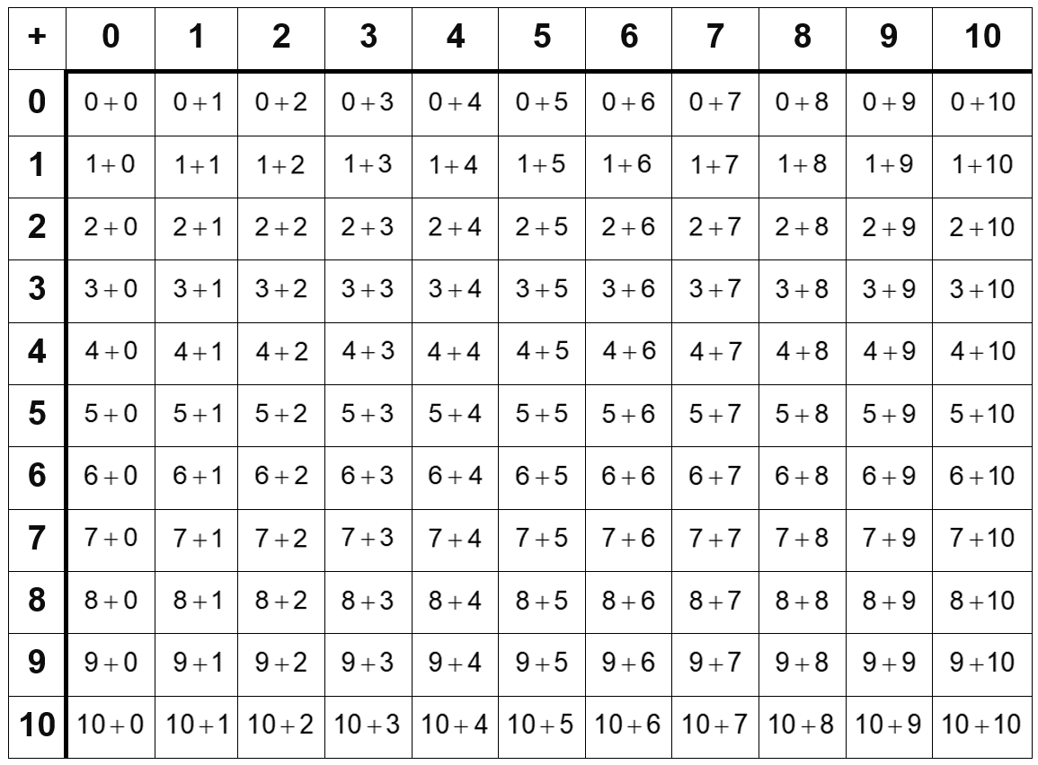
3NF-1 Fluently add and subtract within and across 10
This grid shows the addition facts within 10 and across 10 that children need to be fluent in.
Children should also practise the corresponding subtractions to fluency.

Slide 11
3NF-1 Fluently add and subtract within and across 10
12 – 3 =
9

Slide 12
3NF-1 Fluently add and subtract within and across 10
9 + 4 =
13

Slide 13
3NF-1 Fluently add and subtract within and across 10
14 – 5 =
9

Slide 14
3NF-1 Fluently add and subtract within and across 10
6 + 9 =
15

Slide 15
3NF-1 Fluently add and subtract within and across 10
8 + 3 =
11

Slide 16
3NF-1 Fluently add and subtract within and across 10
8 + 8 =
16

Slide 17
3NF-1 Fluently add and subtract within and across 10
14 – 8 =
6

Slide 18
3NF-1 Fluently add and subtract within and across 10
5 + 8 =
13

Slide 19
3NF-1 Fluently add and subtract within and across 10
13 – 9 =
4

Slide 20
3NF-1 Fluently add and subtract within and across 10
12 – 5 =
7

Slide 21
3NF-1 Fluently add and subtract within and across 10
6 + 8 =
14

Slide 22
3NF-1 Fluently add and subtract within and across 10
4 + 7 =
11

Slide 23
3NF-1 Fluently add and subtract within and across 10
14 – 6 =
8

Slide 24
3NF-1 Fluently add and subtract within and across 10
7 + 5 =
12

Slide 25
3NF-1 Fluently add and subtract within and across 10
15 – 7 =
8

Slide 26
3NF-1 Fluently add and subtract within and across 10
5 + 6 =
11

Slide 27
3NF-1 Fluently add and subtract within and across 10
12 – 6 =
6

Slide 28
3NF-1 Fluently add and subtract within and across 10
9 + 8 =
17

Slide 29
3NF-1 Fluently add and subtract within and across 10
17 – 8 =
9

Slide 30
3NF-1 Fluently add and subtract within and across 10
11 – 5 =
6

Slide 31
3NF-1 Fluently add and subtract within and across 10
18 – 9 =
9

Slide 32
3NF-1 Fluently add and subtract within and across 10
14 – 7 =
7

Slide 33
3NF-1 Fluently add and subtract within and across 10
6 + 6 =
12

Slide 34
3NF-1 Fluently add and subtract within and across 10
13 – 7 =
6

Slide 35
3NF-1 Fluently add and subtract within and across 10
16 – 7 =
9

Slide 36
3NF-1 Fluently add and subtract within and across 10
7 + 7 =
14

Slide 37
3NF-1 Fluently add and subtract within and across 10
15 – 9 =
6

Slide 38
3NF-1 Fluently add and subtract within and across 10
3 + 9 =
12

Slide 39
3NF-1 Fluently add and subtract within and across 10
16 – 8 =
8

Slide 40
3NF-1 Fluently add and subtract within and across 10
13 – 5 =
8

Slide 41
3NF-1 Fluently add and subtract within and across 10
7 + 8 =
15

Slide 42
3NF-1 Fluently add and subtract within and across 10
13 – 4 =
9

Slide 43
3NF-1 Fluently add and subtract within and across 10
7 + 9 =
16

Slide 44
3NF-1 Fluently add and subtract within and across 10
12 – 4 =
8

Slide 45
3NF-1 Fluently add and subtract within and across 10
11 – 9 =
2

Slide 46
3NF-1 Fluently add and subtract within and across 10
12 – 8 =
4

Slide 47
3NF-1 Fluently add and subtract within and across 10
7 + 6 =
13

Slide 48
3NF-1 Fluently add and subtract within and across 10
11 – 7 =
4

Slide 49
3NF-1 Fluently add and subtract within and across 10
9 + 9 =
18

Slide 50
3NF-1 Fluently add and subtract within and across 10
11 – 4 =
7

Slide 51
3NF-1 Fluently add and subtract within and across 10
11 – 3 =
8

Slide 52
3NF-1 Fluently add and subtract within and across 10
The Deca Tree
https://nrich.maths.org/2006

