Slide 1
3F-1
Use and understand fraction notation

Slide 2
3F-1 Interpret and write proper fractions to represent 1 or several parts of a whole that is divided into equal parts.
The materials in this pack have been collated and written to support the teaching of 3F-1. Before planning and teaching the content, read the teaching guidance and example assessment questions in the non-statutory guidance itself, which can be found here.
A video summarising all of the ready-to-progress criteria for can be found here.

Slide 3
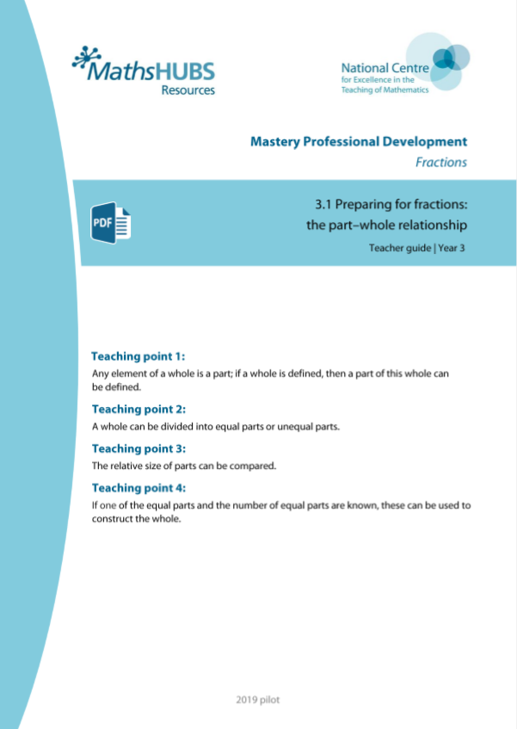
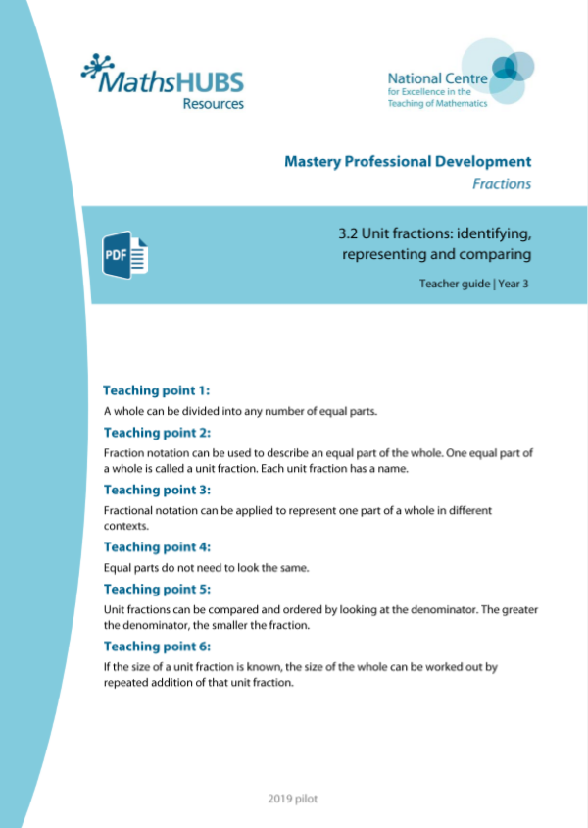
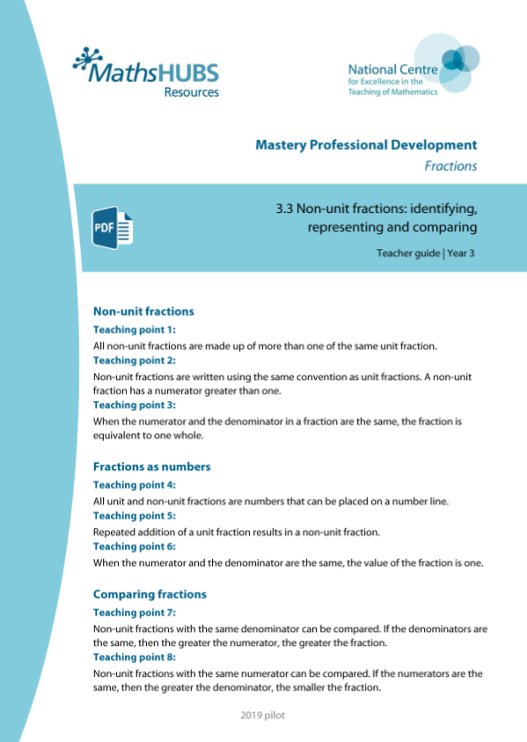
3F-1: Linked mastery PD materials
Additional pedagogical subject knowledge support can be found in the following Mastery Professional Development materials:
3.1 Preparing for fractions: the part–whole relationship
3.2 Unit fractions: identifying, representing and comparing
3.3 Non-unit fractions: identifying, representing and comparing
Several of the activity slides have been taken from these materials.

Slide 4
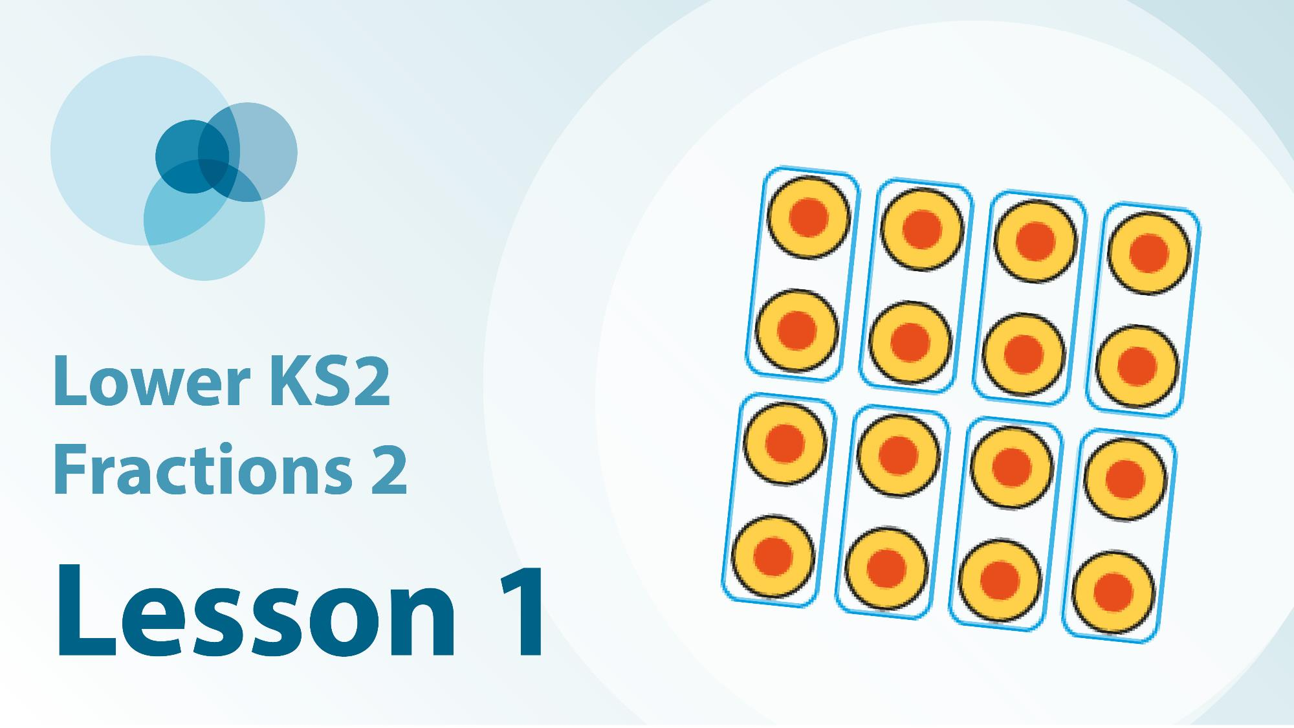
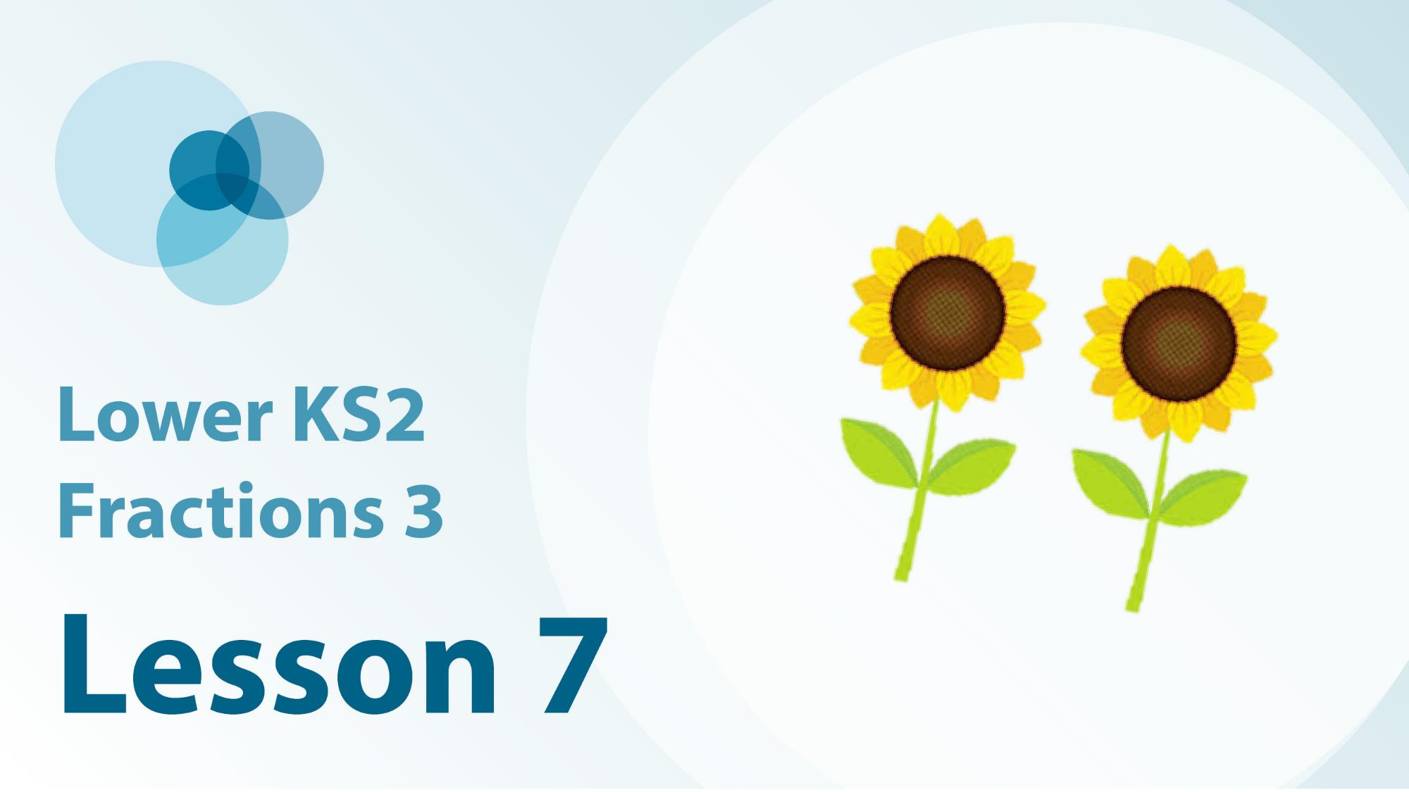
3F-1 Linked video lessons
Lower Key Stage 2 Fractions 2
Divide and describe the same whole when divided into differing numbers of equal parts
Understand fraction notation to represent a relationship between part and whole
Begin to use and understand the terms ‘numerator’ and ‘denominator’
Name unit fractions and match them with the fraction notation and a representation
Embed previous fraction work using a linear model
Assign unit fraction names and notation to 3D representations
Assign unit fraction names and notation to equal parts of quantities
Lower Key Stage 2 fractions 3
Reason about non-unit fractions in different contexts

Slide 5
3F-1
Use and understand fraction notation

Slide 6
The following slides contain activities that can be used within the context of pre-teaching, intervention, or as supplementary material integrated into teaching. They do not represent complete lessons and should not be used as such. Also they should not be used all at once, but over the period of a teaching unit. It would be valuable to use many of the activities more than once to build fluency in understanding and application. Also many of them would benefit from the use of manipulatives to support interaction with the ideas. Ensure you engage in rich discussion with the children, asking them to reason and explain the ideas presented. Note that when working with a small group, pupils should also have access to the main teaching delivered by the class teacher and the focus should be directly linked so that the learning is connected and fluency is built.

Slide 7
Guidance for working with a small pre-teaching or intervention group
Take time to build understanding of the key idea. We would recommend no more than four slides in any one session, and probably fewer.
In subsequent sessions, review and practise previous learning before moving on.
Play the animation/observe the image and ask pupils “What do you notice?”.
Encourage pupils to explain what they see, what is happening and why.
Where there is a highlighted sentence, draw out the meaning of this from the image and repeat together and individually.

Slide 8
Guidance for working with a small pre-teaching or intervention group
Engage in the suggested activities, using manipulatives where appropriate, to enhance the interaction and stimulate discussion. However, note that the ultimate aim is to develop fluency in the mathematical ideas such that resources are no longer needed.
Repeat questions, using other numbers/examples where relevant.
Repeat the highlighted language structures wherever relevant to build fluency with the key idea and connect the learning. For example:
10 hundreds are equivalent to 1,000.

Slide 9
3F-1 Use and understand fraction notation

Slide 10
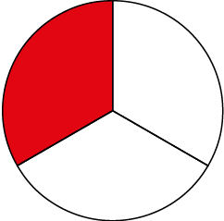
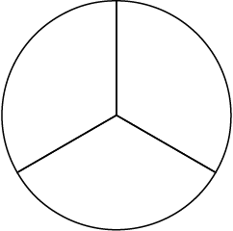
3F-1 Use and understand fraction notation
What does the 3 represent?
What does the 1 represent?
Now write the fraction as you say:
The whole has been divided… (Draw the division bar.)
into 3 equal parts. (Write the 3, this represents the whole.)
1 of the parts has been shaded. (Write the 1, this represents the part.)
Practise writing and saying fractions in this way.
The whole has been divided...
into 3 equal parts.
1 of the parts has been shaded.

Slide 11
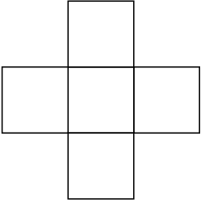
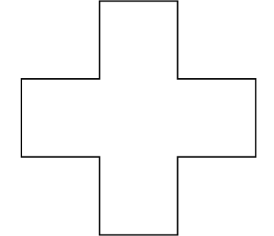
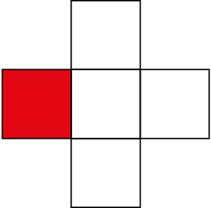
3F-1 Use and understand fraction notation
What does the 5 represent?
What does the 1 represent?
Practise writing and saying the fraction. Don’t forget to the division bar, the whole and the part in the correct order!
into 5 equal parts.
The whole has been divided ...
1 of the parts has been shaded.

Slide 12
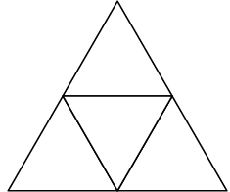
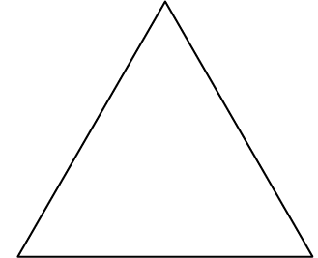
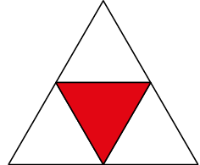
3F-1 Use and understand fraction notation
What does the 4 represent?
What does the 1 represent?
Practise writing and saying the fraction. Don’t forget to write the division bar, the whole and the part in the correct order!
into 4 equal parts.
The whole has been divided ...
1 of the parts has been shaded.

Slide 13
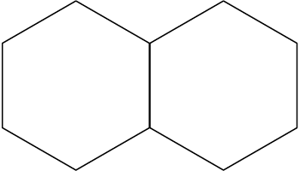
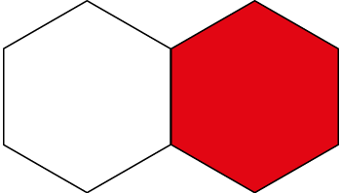
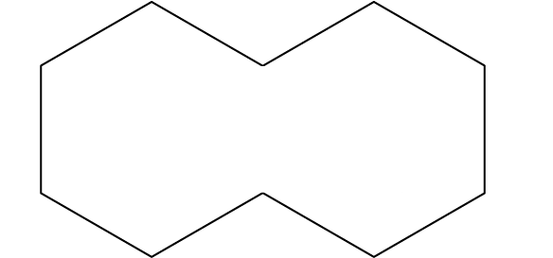
3F-1 Use and understand fraction notation
What does the 2 represent?
What does the 1 represent?
Practise writing and saying the fraction. Don’t forget to write the division bar, the whole and the part in the correct order!
The whole has been divided ...
into 2 equal parts.
1 of the parts has been shaded.

Slide 14
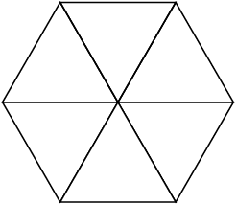
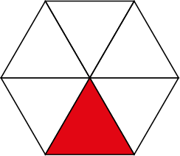
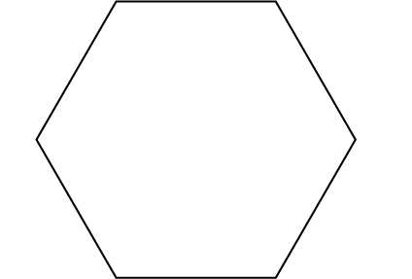
3F-1 Use and understand fraction notation
What does the 6 represent?
6 is the denominator. It tells us the whole and the number of equal parts it has been divided into.
What does the 1 represent?
1 is the numerator. It tells us the number of parts that are shaded.
The whole has been divided ...
into 6 equal parts.
1 of the parts has been shaded.
The denominator is six because the whole is divided into six equal parts.
The numerator is one because one part is shaded.

Slide 15
3F-1 Use and understand fraction notation
What is the denominator in each fraction? The denominator is… because the whole is divided into…
What is the numerator in each fraction? The numerator is… because…

Slide 16
3F-1 Use and understand fraction notation
Which name matches which shape?
Are there any clues?
Can you explain your thinking to someone else?
one-third
one-sixth
one-quarter
one-half
one-fifth

Slide 17
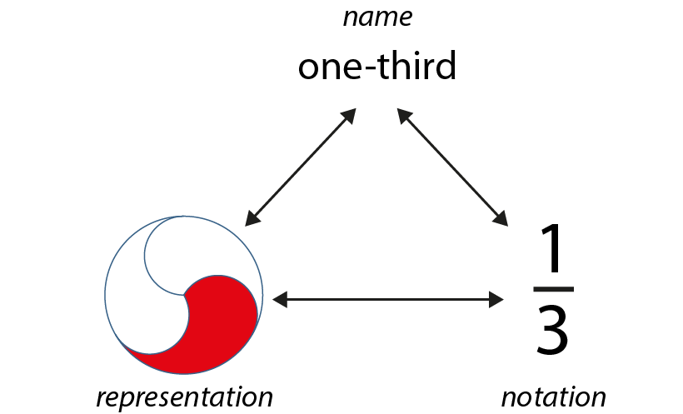
3F-1 Use and understand fraction notation
Practise moving between the name, written notation and visual representation for a fraction.
How do we say $\frac{1}{7}$ in words?
How do we write one-twelfth. As you write, use the sentences again: The whole has been divided...
Make some cards like these of different unit fractions and play a matching game by turning the cards over.
Who is the first to collect a whole set of three matching cards?
Notes:
How do we say $\frac{1}{7}$ in words?
How do we write “one twelfth”?

Slide 18
3F-1 Use and understand fraction notation
How many equal parts has the whole ribbon been divided into?
What fraction of the whole ribbon is each equal part?
How much of the ribbon has been cut off?
You could try folding some paper strips into equal parts and cutting one part off.
The whole has been divided into ____ equal parts.
Each equal part is one- ____ of the whole.
One- ____ of the whole ribbon has been cut off.
Notes:
The whole has been divided into six equal parts.
Each equal part is one-sixth of the whole.
One-sixth of the whole ribbon has been cut off.

Slide 19
3F-1 Use and understand fraction notation
✓
Does each shape show the given fraction?
Can you explain your thinking for each answer?
The denominator is the number of equal parts in the whole.

Slide 20
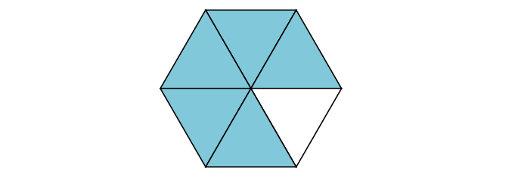
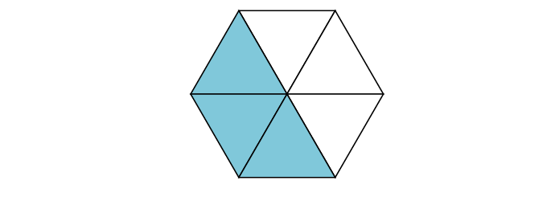
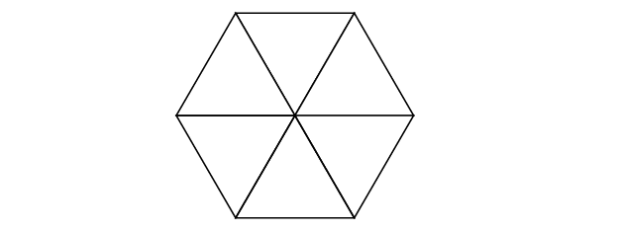
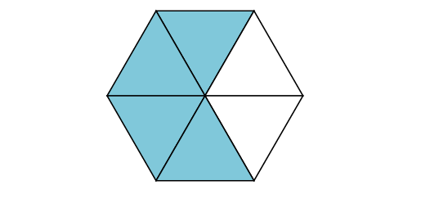
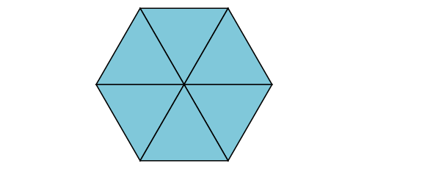
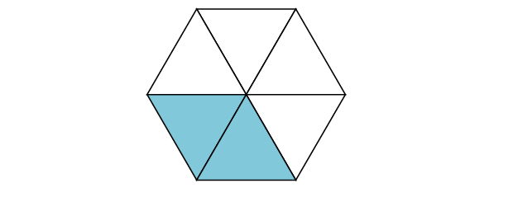
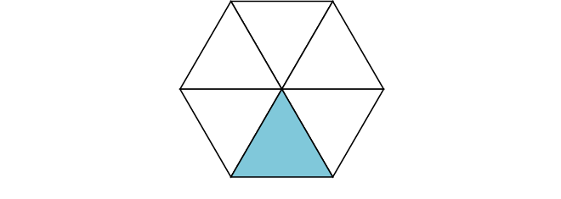
3F-1 Use and understand fraction notation
Describe the fraction that you can see in two ways as shown.
What is 5 one-sixths the same as?
What is two-sixths the same as?
5 one-sixths = five-sixths
4 one-sixths = four-sixths
6 one-sixths = six-sixths
3 one-sixths = three-sixths
1 one-sixth = one-sixth
2 one-sixths = two-sixths
Notes:
For each example, use the stem sentence: I have ____ one-sixths; I have ____-sixths.

Slide 21
3F-1 Use and understand fraction notation
5 one-tenths = five-tenths
4 one-tenths = four-tenths
6 one-tenths = six-tenths
7 one-tenths = seven-tenths
2 one-tenths = two-tenths
3 one-tenths = three-tenths
1 one-tenth = one-tenth
8 one-tenths = eight-tenths
9 one-tenths = nine-tenths
10 one-tenths = ten-tenths
Describe the fraction that you can see in two ways as shown.
What is 7 one-tenths the same as?
What is nine-tenths the same as?
Try practising this with fractions with other denominators.

Slide 22
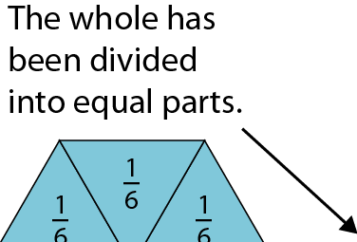
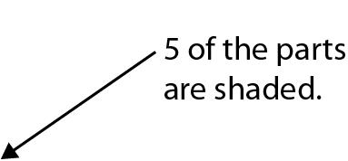
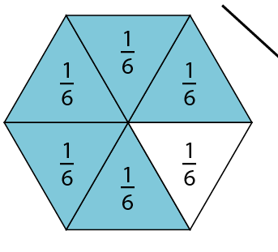
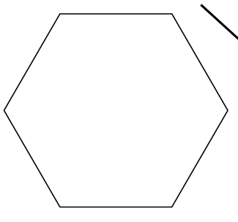
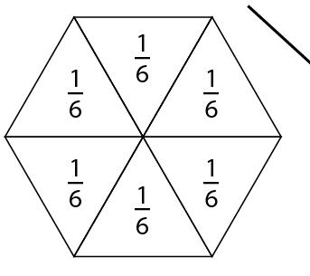
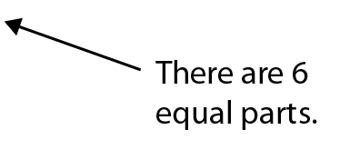
3F-1 Use and understand fraction notation
What does the 6 represent?
What does the 5 represent?
What number is the denominator? How do you know?
What number is the numerator? How do you know?
Can you explain why the numerator is not 1?
Notes:
What does the ‘6’ represent?
What does the ‘5’ represent?
The whole has been divided into six equal parts.
Five of the parts are shaded.
This is five-sixths of the whole.

Slide 23
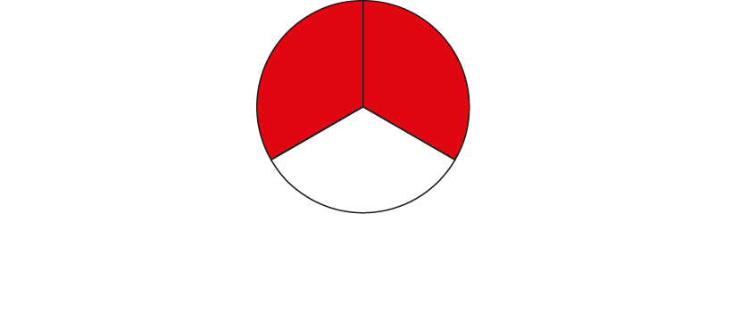
3F-1 Use and understand fraction notation
How many equal parts has the whole been divided into?
How many equal parts are shaded?
Can you write the fraction to match this representation? Don’t forget to write it in the correct order, using the sentence.
What does each number in the fraction represent?
The whole has been divided into 3 equal parts.
2 parts have been shaded.
Notes:
What does the ‘3’ represent?
What does the ‘2’ represent?

Slide 24
3F-1 Use and understand fraction notation
How many equal parts has the whole been divided into?
How many equal parts are shaded?
Can you write the fraction to match this representation?
What does each number in the fraction represent?
The whole has been divided into 5 equal parts.
3 parts have been shaded.
Notes:
The whole has been divided into five equal parts.
Three of the equal parts have been shaded.
What does the ‘5’ represent?
What does the ‘3’ represent?

Slide 25
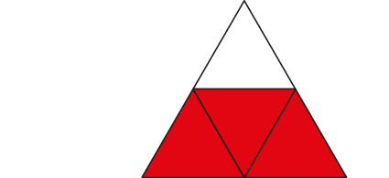
3F-1 Use and understand fraction notation
How many equal parts has the whole been divided into?
How many equal parts are shaded?
Can you write the fraction to match this representation?
What does each number in the fraction represent?
The whole has been divided into 4 equal parts.
3 parts have been shaded.
Notes:
The whole has been divided into four equal parts.
Three of the equal parts have been shaded.
What does the ‘4’ represent?
What does the ‘3’ represent?

Slide 26
3F-1 Use and understand fraction notation
How many equal parts has the whole been divided into?
How many equal parts are shaded?
Can you write the fraction to match this representation?
What does each number in the fraction represent?
What do you notice when the numerator and denominator are the same number?
The whole has been divided into 2 equal parts.
2 parts have been shaded.
Notes:
The whole has been divided into two equal parts.
Two of the equal parts have been shaded.

Slide 27
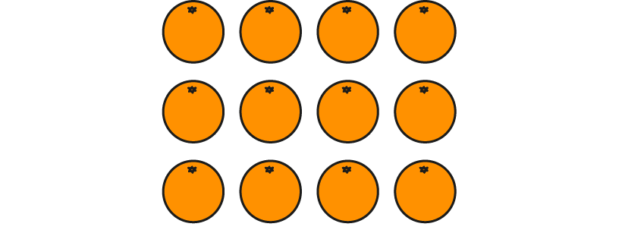
3F-1 Use and understand fraction notation
The whole has been divided into 4 equal parts, 3 of them are selected
The whole has been divided into 3 equal parts, 2 of them are selected.
The whole has been divided into 12 equal parts, 5 of them are selected.
The whole has been divided into 2 equal parts, 1 of them is one half.
The whole has been divided into 6 equal parts, 2 of them are selected
To work out the fraction of oranges selected, think about the denominator and then the numerator.
How many equal parts has the whole group has been divided into? This is the denominator.
How many equal parts have been selected? This is the numerator.
You could use 12 counters and set some questions like these for a partner to answer.
The denominator tells us the number of equal parts the whole is divided into.
The numerator tells us the number of equal parts selected.

Slide 28
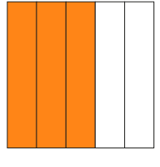
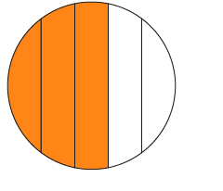
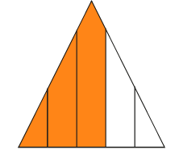
3F-1 Use and understand fraction notation
Look carefully at each of these representations.
Does the representation show $\frac{3}{5}$?
Can you explain your thinking for each answer?
✓

