Slide 1
3AS-2
Columnar addition and subtraction

Slide 2
3AS-2 Add and subtract up to three-digit numbers using columnar methods.
The materials in this pack have been collated and written to support the teaching of 3AS-2. Before planning and teaching the content, read the teaching guidance and example assessment questions in the non-statutory guidance itself, which can be found here.
A video summarising all of the ready-to-progress criteria for Year 3 can be found here.

Slide 3
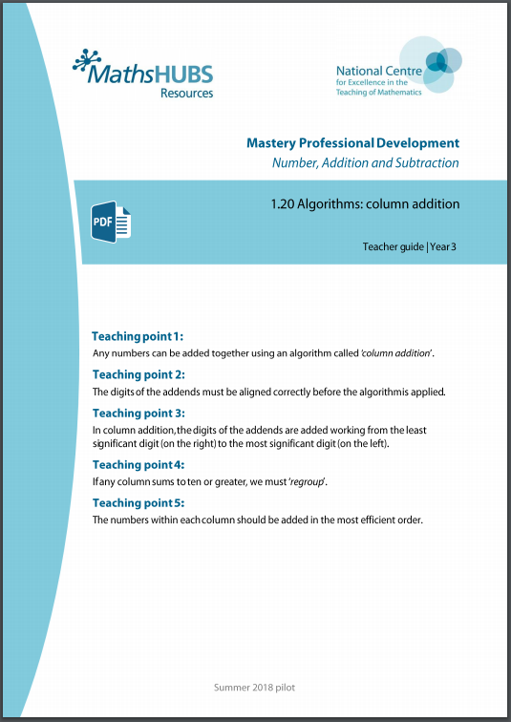
3AS-2: Linked mastery PD materials
Additional pedagogical subject knowledge support can be found in the following Mastery Professional Development materials:
1.20 Algorithms: column addition
1.21 Algorithms: column subtraction
Several of the activity slides have been taken from these materials.

Slide 4
3AS-2
Columnar addition and subtraction

Slide 5
The following slides contain activities that can be used within the context of pre-teaching, intervention, or as supplementary material integrated into teaching. They do not represent complete lessons and should not be used as such. Also they should not be used all at once, but over the period of a teaching unit. It would be valuable to use many of the activities more than once to build fluency in understanding and application. Also many of them would benefit from the use of manipulatives to support interaction with the ideas. Ensure you engage in rich discussion with the children, asking them to reason and explain the ideas presented. Note that when working with a small group, pupils should also have access to the main teaching delivered by the class teacher and the focus should be directly linked so that the learning is connected and fluency is built.

Slide 6
Guidance for working with a small pre-teaching or intervention group
Take time to build understanding of the key idea. We would recommend no more than four slides in any one session, and probably fewer.
In subsequent sessions, review and practise previous learning before moving on.
Play the animation/observe the image and ask pupils “What do you notice?”.
Encourage pupils to explain what they see, what is happening and why.
Where there is a highlighted sentence, draw out the meaning of this from the image and repeat together and individually.

Slide 7
Guidance for working with a small pre-teaching or intervention group
Engage in the suggested activities, using manipulatives where appropriate, to enhance the interaction and stimulate discussion. However, note that the ultimate aim is to develop fluency in the mathematical ideas such that resources are no longer needed.
Repeat questions, using other numbers/examples where relevant.
Repeat the highlighted language structures wherever relevant to build fluency with the key idea and connect the learning. For example:
10 hundreds are equivalent to 1,000.

Slide 8
3AS-2 Columnar addition and subtraction

Slide 9
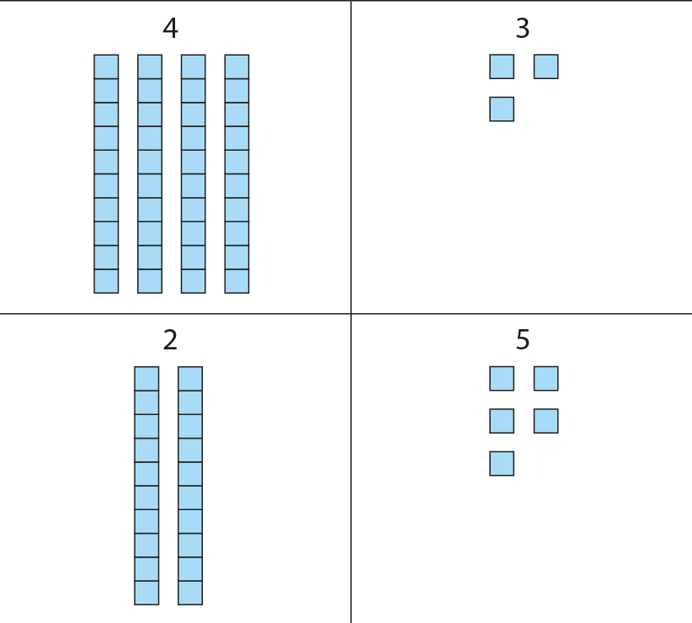
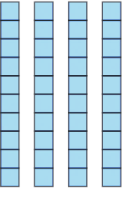
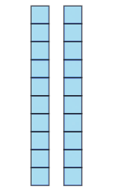
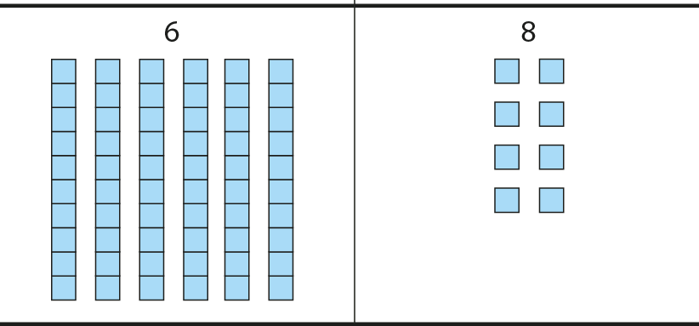
3AS-2 Columnar addition and subtraction
Write the two numbers as shown ready for column addition. Is it important that the 5 ones is written underneath the 3 ones?
We add like values together, so tens with tens and ones with ones.
Use Dienes to model the calculation.
What does the digit 3 represent?
What does the digit 2 represent?
In column addition, we start at the right-hand side.
 |  | 4 | 3
 |  | 6 | 8
 |  | 2 | 5
 |  | 6 | 8
 |  | 4 | 3
 | + | 2 | 5
 |  | 6 | 8
We add the ones.3 ones plus 5 ones is equal to 8 ones.
We add the tens. 4 tens plus 2 tens is equal to 6 tens.

Slide 10
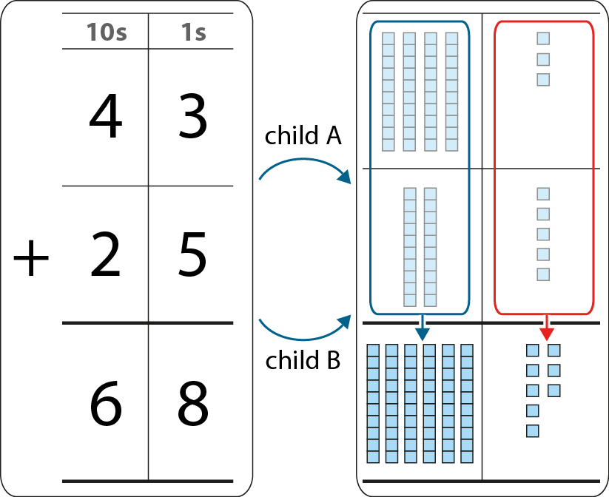
3AS-2 Columnar addition and subtraction
Work in pairs. Child A writes the calculation to solve as column addition. Child B uses Dienes to model the calculation. See if you get the same answer.
Use the language focus box to help you explain what is happening.
Solve the following calculations: 51 + 24; 62 + 27; 72 + 15. Swap over roles each time.
We add the ones. 3 ones plus 5 ones is equal to 8 ones.
We add the tens. 4 tens plus 2 tens is equal to 6 tens.

Slide 11
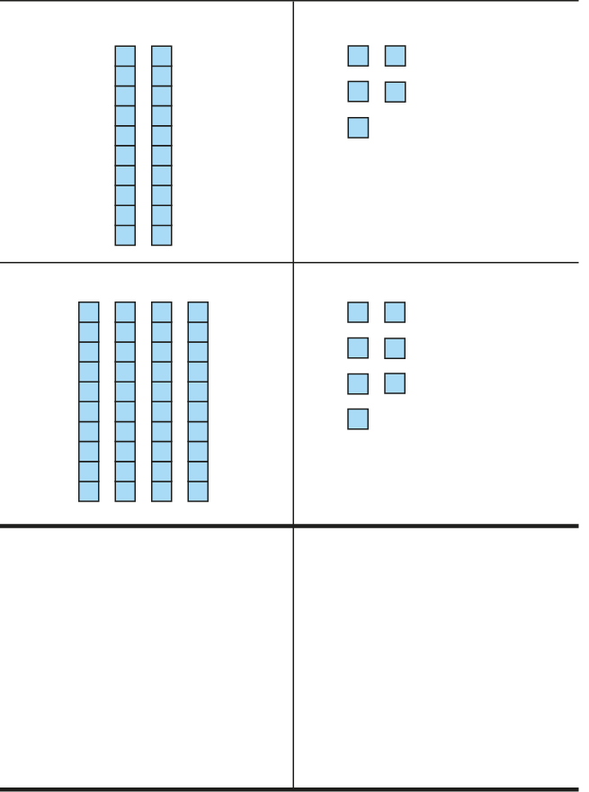
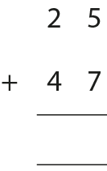
3AS-2 Columnar addition and subtraction
Run this slide a few times to secure the idea.
What numbers are represented by the Dienes?
First we need to add the ones.
Can you see where this total of twelve is on each of the representations shown?
Then we add the tens.
5 ones plus 7 ones is equal to 12 ones. I can regroup 12 ones. 12 ones is equal to 1 ten and 2 ones.
7
1
2
2
1
2 tens plus 4 tens is 6 tens. We also need to add 1 ten from the regrouping. There are 7 tens altogether.
If a column group is equal to ten or more we must regroup.
10 ones is equivalent to 1 ten. 10 tens is equivalent to 1 hundred.

Slide 12
3AS-2 Columnar addition and subtraction
SET A
Practise adding the two 2-digit numbers together from Set A. You could work in pairs again. Child A could write the calculation as a column addition and child B could model the calculation using Dienes.
See if you can explain to your partner how you got your answer.
Why do all these calculations involve regrouping the ones?
When you are more confident you won’t need to use the Dienes to see why column addition works.
Now try working out the answers to the expressions in Set B. What do you notice?
45 + 28
37 + 56
79km + 14km
£46 + £35
SET B
345 + 171
537 + 284
472kg + 469kg
£637 + £182

Slide 13
3AS-2 Columnar addition and subtraction
Which calculations require regrouping?
Which require regrouping only once?
Which require regrouping twice?
Can you answer these questions without having to solve the calculations?
 | 1 | 2 | 4
+ | 2 | 3 | 3
 | 6 | 4 | 4
+ | 1 | 7 | 2
 | 3 | 6 | 6
+ | 2 | 7 | 7
 | 5 | 7 | 9
+ | 2 | 2 | 1
 | 7 | 9 | 1
+ | 1 | 6 | 3
 | 5 | 6 | 7
+ | 2 | 3 | 3
If the column sum is equal to ten or more, we must regroup.

Slide 14
3AS-2 Columnar addition and subtraction
475 + 25
237 + 156
Look at these expressions carefully.
Can you solve any of them without using column addition? Sort them into a table like the one shown.
Explain your thinking.
349 + 84
120 + 130
Use column addition | Use mental strategies

Slide 15
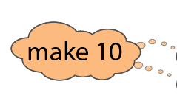
3AS-2 Columnar addition and subtraction
We can also use column addition to find the sum of three numbers.
Look carefully at numbers in each column. Look for numbers which are easy to add together.
416
+
223
+
184
=
823

Slide 16
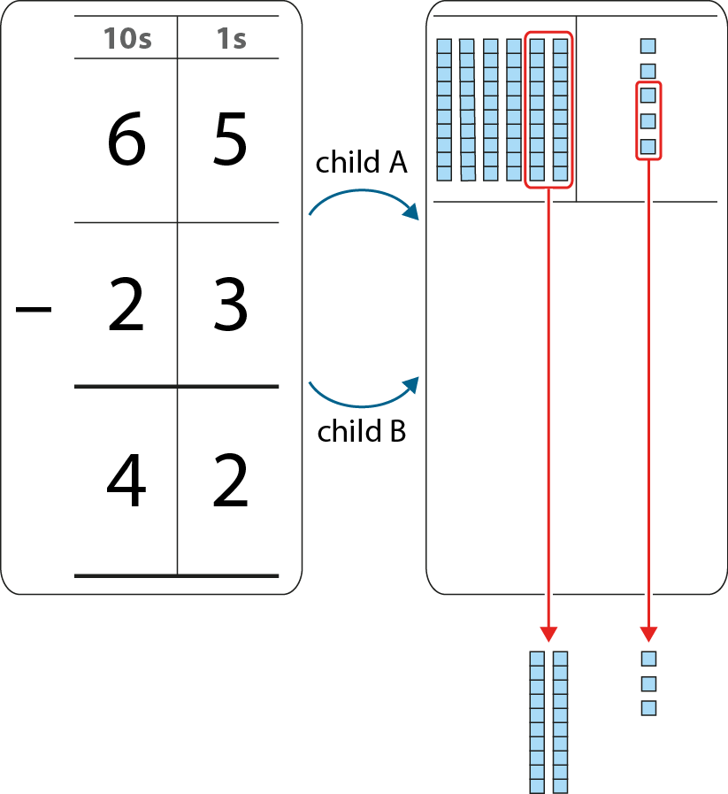
3AS-2 Columnar addition and subtraction
Work in pairs. Child A writes the calculation to solve as column subtraction. Child B uses Dienes to model the calculation. See if you get the same answer.
Use the language focus box to help you explain what is happening.
Swap over roles each time. Solve the following calculations 58 – 34; 69 – 27; 95 – 33.
We subtract the ones. 5 ones minus 3 ones is equal to 2 ones.
We subtract the tens. 6 tens minus 2 tens is equal to 4 tens.

Slide 17
3AS-2 Columnar addition and subtraction
Give children opportunity to practise columnar subtraction without exchange involving 3 digit numbers, e.g. 376 – 254.
Give children opportunity to practise columnar subtraction calculations that involve exchange. Initially with 2-digit numbers, then progressing to 3-digit numbers (shown on the next two slides). Ensure you play the animated slides a few times and engage the children in explanation of what is happening.
Exchange builds on pupils’ understanding that 10 ones is equivalent to 1 ten, and that 10 tens is equivalent to 1 hundred.
Use Dienes to model the calculations, and to draw attention to the exchange in subtraction. Move away from using Dienes when children are more confident.
10 ones is equivalent to 1 ten. 10 tens is equivalent to 1 hundred.

Slide 18
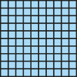
3AS-2 Columnar addition and subtraction
223 − 142
= 81

Slide 19
3AS-2 Columnar addition and subtraction
2 | 2 | 3
1 | 4 | 2
1
1
−
0
8
1

Slide 20
3AS-2 Columnar addition and subtraction
Which calculations require exchange?
Which require exchange only once?
Which require exchange twice?
Which require exchange through a zero?
Can you answer these questions without having to solve the calculations?
 | 5 | 6 | 3
− | 2 | 1 | 3
 | 4 | 8 | 2
− | 1 | 9 | 7
 | 8 | 2 | 4
− | 3 | 1 | 9
 | 4 | 0 | 5
− | 1 | 2 | 3
 | 3 | 1 | 6
− | 1 | 0 | 3
 | 9 | 0 | 3
− | 1 | 2 | 4

Slide 21
3AS-2 Columnar addition and subtraction
475 − 358
170 − 140
Look at these expressions carefully.
Can you solve any of them without using column subtraction? Sort them into a table like the one shown.
Explain your thinking.
349 − 101
201 − 198
Use column subtraction | Use mental strategies

Slide 22
3AS-2 Columnar addition and subtraction
Dicey Addition
https://nrich.maths.org/11863

