Slide 1
3AS-1
Calculate complements to 100

Slide 2
3AS-1 Calculate complements to 100, for example: 46 + ? = 100
The materials in this pack have been collated and written to support the teaching of 3AS-1. Before planning and teaching the content, read the teaching guidance and example assessment questions in the non-statutory guidance itself, which can be found here.
A video summarising all of the ready-to-progress criteria Year 3 can be found here.

Slide 3
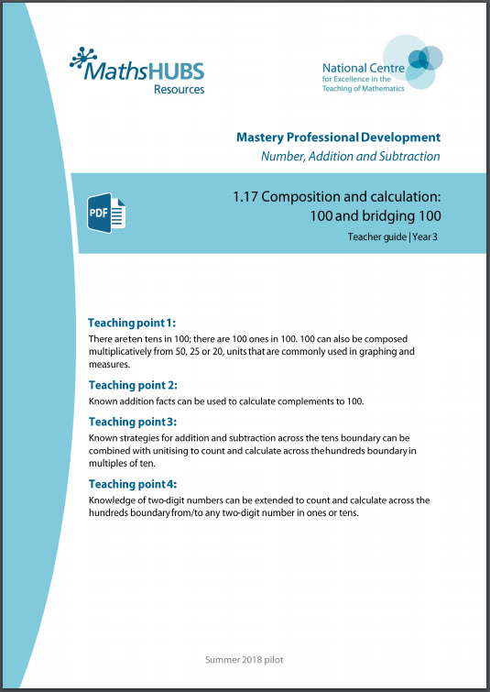
3AS-1: Linked mastery PD materials
Additional pedagogical subject knowledge support can be found in the Mastery Professional Development Materials:
1.17 Composition and calculation: 100 and bridging 100
Several of the activity slides have been taken from these materials.

Slide 4
3AS-1
Calculate complements to 100

Slide 5
The following slides contain activities that can be used within the context of pre-teaching, intervention, or as supplementary material integrated into teaching. They do not represent complete lessons and should not be used as such. Also they should not be used all at once, but over the period of a teaching unit. It would be valuable to use many of the activities more than once to build fluency in understanding and application. Also many of them would benefit from the use of manipulatives to support interaction with the ideas. Ensure you engage in rich discussion with the children, asking them to reason and explain the ideas presented. Note that when working with a small group, pupils should also have access to the main teaching delivered by the class teacher and the focus should be directly linked so that the learning is connected and fluency is built.

Slide 6
Guidance for working with a small pre-teaching or intervention group
Take time to build understanding of the key idea. We would recommend no more than four slides in any one session, and probably fewer.
In subsequent sessions, review and practise previous learning before moving on.
Play the animation/observe the image and ask pupils “What do you notice?”.
Encourage pupils to explain what they see, what is happening and why.
Where there is a highlighted sentence, draw out the meaning of this from the image and repeat together and individually.

Slide 7
Guidance for working with a small pre-teaching or intervention group
Engage in the suggested activities, using manipulatives where appropriate, to enhance the interaction and stimulate discussion. However, note that the ultimate aim is to develop fluency in the mathematical ideas such that resources are no longer needed.
Repeat questions, using other numbers/examples where relevant.
Repeat the highlighted language structures wherever relevant to build fluency with the key idea and connect the learning. For example:
10 hundreds are equivalent to 1,000.

Slide 8
3AS-1 Calculate complements to 100

Slide 9
3AS-1 Calculate complements to 100
24
+
76
=
100
24
+
76
=
100
20
20
4
6
70
10
10
Let’s think about 24 + 76 in the hundred square representation.
How many full rows of yellow squares are there?
How many full rows of blue squares are there?
The total of these rows is 9 tens or 90.
What two numbers do you add together to make the tenth ten?
Use a printed hundred square to explore which two 2-digit numbers have a total of 100. What is the same about all of them?
70
First we make ten ones. The ones digits add up to 1 ten, so we need 9 more tens to make a total of 100 .

Slide 10
3AS-1 Calculate complements to 100
100
100
Which of these two part-part-whole models is correct?
Can you explain your thinking?
Why does the first calculation make a total of 110?
62
48
62
38
62
+
48
=
110
62
+
38
=
100
60
2
8
40
60
2
8
30
10
10

Slide 11
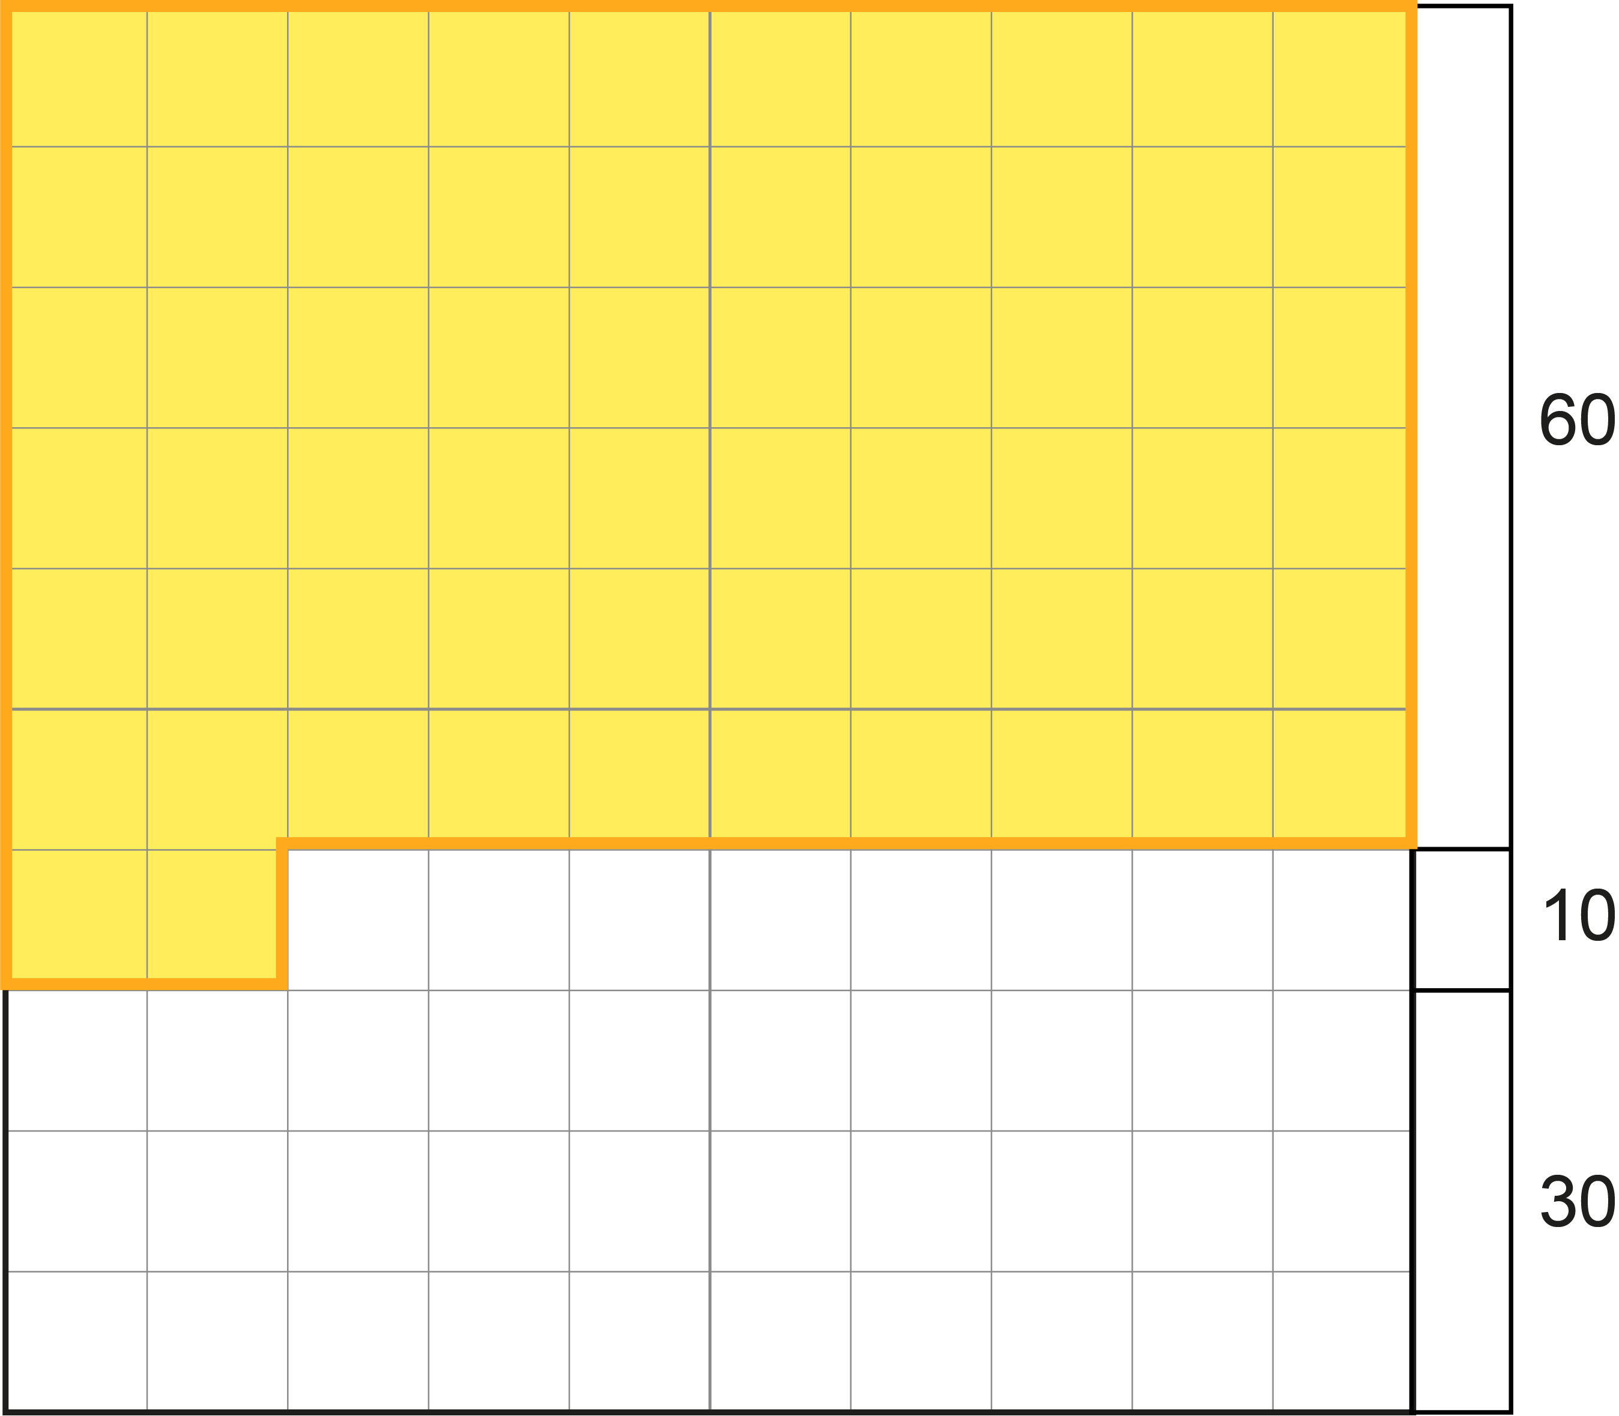
3AS-1 Calculate complements to 100
What is the missing addend in this calculation?
Use the hundred square representation to support your thinking. You could also show this on a hundred abacus.
Think about what you need to add to make ten ones first.
Then think about how many more tens are needed to total 100.
Why is the missing addend 38 and not 48?
Set some more calculations like this where you have to calculate the missing addend to total 100.
First we make ten ones. The ones digits add up to 1 ten, so we need 9 more tens to make a total of 100 .
3
8
8
62 + = 100

Slide 12
3AS-1 Calculate complements to 100
Which of these expressions are correct bonds to 100 and which are incorrect bonds to 100?
Draw a table like the one shown and sort the expressions using the headings.
Click to see if you were right.
Can you write two more expressions which are correct bonds to 100?
Can you write two more expressions which are incorrect bonds to 100?
What is the same about all the expressions which are correct bonds to 100?
Correct bond to 100 | Incorrect bond to 100
62 + 48
43 + 67
39 + 71
28 + 72
55 + 45
84 + 16

