Slide 1
2NF-1
Fluently add and subtract within 10

Slide 2
2NF-1 Secure fluency in addition and subtraction facts within 10, through continued practice.
The materials in this pack have been collated and written to support the teaching of 2NF-1. Before planning and teaching the content, read the teaching guidance and example assessment questions in the non-statutory guidance itself, which can be found here.
A video summarising all of the ready-to-progress criteria for Year 2 can be found here.

Slide 3
2NF-1: Linked mastery PD materials
Additional pedagogical subject knowledge support can be found in the Mastery Professional Development Materials:
1.7 Addition and subtraction: strategies within 10
Several of the activity slides have been taken from these materials.

Slide 4
2NF-1
Fluently add and subtract within 10

Slide 5
The following slides contain activities that can be used within the context of pre-teaching, intervention, or as supplementary material integrated into teaching. They do not represent complete lessons and should not be used as such. Also they should not be used all at once, but over the period of a teaching unit. It would be valuable to use many of the activities more than once to build fluency in understanding and application. Also many of them would benefit from the use of manipulatives to support interaction with the ideas. Ensure you engage in rich discussion with the children, asking them to reason and explain the ideas presented. Note that when working with a small group, pupils should also have access to the main teaching delivered by the class teacher and the focus should be directly linked so that the learning is connected and fluency is built.

Slide 6
Guidance for working with a small pre-teaching or intervention group
The slides in this PowerPoint show just the addition and subtraction facts within 10. They don’t, however, show supporting models, or group the facts in families, to help children learn them. Where children do not already have strategies for these addition and subtraction facts, the PowerPoint for 1NF-1 should be used to help children learn the facts.
Use the retrieval slides once children have built some recall, to provide regular practice to build fluency.

Slide 7
2NF-1 Fluently add and subtract within 10

Slide 8
2NF-1 Fluently add and subtract within 10
The Year 1 ready-to-progress criterion 1NF-1 is Develop fluency in addition and subtraction facts within 10.
The Year 2 ready to progress criterion 2NF-1 is Secure fluency in addition and subtraction facts within 10, through continued practice. It assumes that children will start Year 2 able to add and subtract within 10, but will need ongoing practice to maintain and improve fluency.
The slides in this PowerPoint show just the addition and subtraction facts within 10. They don’t, however, show supporting models, or group the facts in families, to help children learn them. Where children do not already have strategies for these addition and subtraction facts, the PowerPoint for 1NF-1 should be used to help children learn the facts.

Slide 9
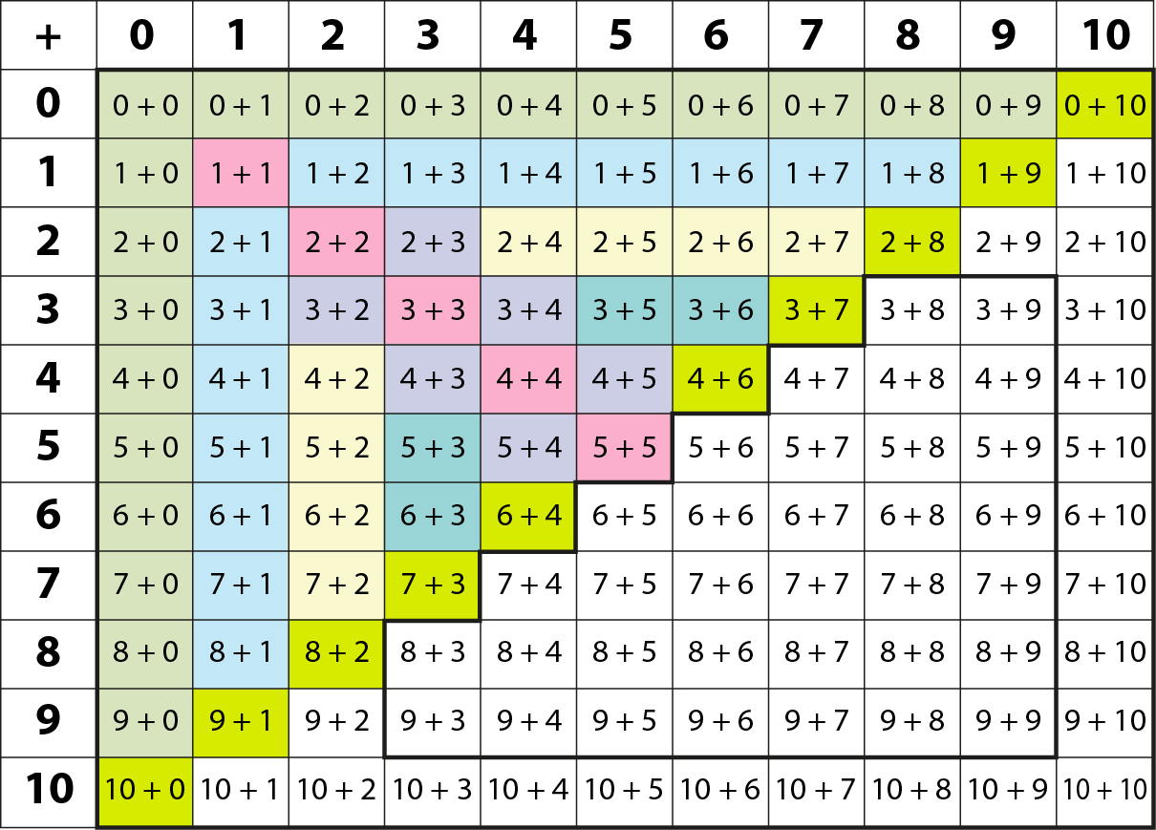
2NF-1 Fluently add and subtract within 10
Y1 facts
Y2
facts
This grid shows the addition facts within 10 and strategies to recall or derive them that children learn in Year 1.
Children should also practise the corresponding subtractions.
Adding 1
Adding 2
Bonds to 10
Adding 0
Doubles
Near doubles

Slide 10
2NF-1 Fluently add and subtract within 10
9 – 2 =
7

Slide 11
2NF-1 Fluently add and subtract within 10
1 + 9 =
10

Slide 12
2NF-1 Fluently add and subtract within 10
7 – 2 =
5

Slide 13
2NF-1 Fluently add and subtract within 10
5 + 5 =
10

Slide 14
2NF-1 Fluently add and subtract within 10
7 – 6 =
1

Slide 15
2NF-1 Fluently add and subtract within 10
0 + 3 =
3

Slide 16
2NF-1 Fluently add and subtract within 10
2 – 0 =
2

Slide 17
2NF-1 Fluently add and subtract within 10
3 + 2 =
5

Slide 18
2NF-1 Fluently add and subtract within 10
5 – 1 =
4

Slide 19
2NF-1 Fluently add and subtract within 10
3 + 7 =
10

Slide 20
2NF-1 Fluently add and subtract within 10
8 – 4 =
4

Slide 21
2NF-1 Fluently add and subtract within 10
3 + 5 =
8

Slide 22
2NF-1 Fluently add and subtract within 10
10 – 4 =
6

Slide 23
2NF-1 Fluently add and subtract within 10
6 + 3 =
9

Slide 24
2NF-1 Fluently add and subtract within 10
7 – 0 =
7

Slide 25
2NF-1 Fluently add and subtract within 10
9 – 9 =
0

Slide 26
2NF-1 Fluently add and subtract within 10
4 + 3 =
7

Slide 27
2NF-1 Fluently add and subtract within 10
6 – 4 =
2

Slide 28
2NF-1 Fluently add and subtract within 10
9 – 5 =
4

Slide 29
2NF-1 Fluently add and subtract within 10
2 + 7 =
9

Slide 30
2NF-1 Fluently add and subtract within 10
10 – 8 =
2

Slide 31
2NF-1 Fluently add and subtract within 10
8 – 3 =
5

Slide 32
2NF-1 Fluently add and subtract within 10
3 + 6 =
9

Slide 33
2NF-1 Fluently add and subtract within 10
9 + 1 =
10

Slide 34
2NF-1 Fluently add and subtract within 10
7 + 0 =
7

Slide 35
2NF-1 Fluently add and subtract within 10
10 – 1 =
9

Slide 36
2NF-1 Fluently add and subtract within 10
2 + 8 =
10

Slide 37
2NF-1 Fluently add and subtract within 10
10 – 6 =
4

Slide 38
2NF-1 Fluently add and subtract within 10
4 + 1 =
5

Slide 39
2NF-1 Fluently add and subtract within 10
6 + 4 =
10

Slide 40
2NF-1 Fluently add and subtract within 10
1 + 6 =
7

Slide 41
2NF-1 Fluently add and subtract within 10
3 + 4 =
7

Slide 42
2NF-1 Fluently add and subtract within 10
2 + 0 =
2

Slide 43
2NF-1 Fluently add and subtract within 10
8 – 1 =
7

Slide 44
2NF-1 Fluently add and subtract within 10
2 + 1 =
3

Slide 45
2NF-1 Fluently add and subtract within 10
8 + 2 =
10

Slide 46
2NF-1 Fluently add and subtract within 10
3 – 3 =
0

Slide 47
2NF-1 Fluently add and subtract within 10
10 – 3 =
7

Slide 48
2NF-1 Fluently add and subtract within 10
7 + 1 =
8

Slide 49
2NF-1 Fluently add and subtract within 10
1 + 3 =
4

Slide 50
2NF-1 Fluently add and subtract within 10
0 + 4 =
4

Slide 51
2NF-1 Fluently add and subtract within 10
4 + 6 =
10

Slide 52
2NF-1 Fluently add and subtract within 10
4 – 3 =
1

Slide 53
2NF-1 Fluently add and subtract within 10
7 – 4 =
3

Slide 54
2NF-1 Fluently add and subtract within 10
5 + 2 =
7

Slide 55
2NF-1 Fluently add and subtract within 10
10 – 7 =
3

Slide 56
2NF-1 Fluently add and subtract within 10
5 – 2 =
3

Slide 57
2NF-1 Fluently add and subtract within 10
2 + 6 =
8

Slide 58
2NF-1 Fluently add and subtract within 10
9 – 3 =
6

Slide 59
2NF-1 Fluently add and subtract within 10
3 + 2 =
5

Slide 60
2NF-1 Fluently add and subtract within 10
9 – 6 =
3

Slide 61
2NF-1 Fluently add and subtract within 10
7 – 1 =
6

Slide 62
2NF-1 Fluently add and subtract within 10
5 + 5 =
10

Slide 63
2NF-1 Fluently add and subtract within 10
2 + 4 =
6

Slide 64
2NF-1 Fluently add and subtract within 10
6 – 2 =
4

Slide 65
2NF-1 Fluently add and subtract within 10
8 + 2 =
10

Slide 66
2NF-1 Fluently add and subtract within 10
9 – 8 =
1

Slide 67
2NF-1 Fluently add and subtract within 10
4 + 4 =
8

Slide 68
2NF-1 Fluently add and subtract within 10
4 – 2 =
2

Slide 69
2NF-1 Fluently add and subtract within 10
9 – 7 =
2

Slide 70
2NF-1 Fluently add and subtract within 10
10 – 9 =
1

Slide 71
2NF-1 Fluently add and subtract within 10
8 – 6 =
2

Slide 72
2NF-1 Fluently add and subtract within 10
1 + 9 =
10

Slide 73
2NF-1 Fluently add and subtract within 10
5 + 0 =
5

Slide 74
2NF-1 Fluently add and subtract within 10
0 + 8 =
8

Slide 75
2NF-1 Fluently add and subtract within 10
5 – 5 =
0

Slide 76
2NF-1 Fluently add and subtract within 10
10 – 5 =
5

Slide 77
2NF-1 Fluently add and subtract within 10
2 – 1 =
1

Slide 78
2NF-1 Fluently add and subtract within 10
2 + 2 =
4

Slide 79
2NF-1 Fluently add and subtract within 10
6 – 3 =
3

Slide 80
2NF-1 Fluently add and subtract within 10
4 + 5 =
9

Slide 81
2NF-1 Fluently add and subtract within 10
1 + 1 =
2

Slide 82
2NF-1 Fluently add and subtract within 10
2 + 3 =
5

Slide 83
2NF-1 Fluently add and subtract within 10
5 + 4 =
9

Slide 84
2NF-1 Fluently add and subtract within 10
10 – 2 =
8

Slide 85
2NF-1 Fluently add and subtract within 10
7 + 3 =
10

Slide 86
2NF-1 Fluently add and subtract within 10
9 – 4 =
5

Slide 87
2NF-1 Fluently add and subtract within 10
3 + 3 =
6

Slide 88
2NF-1 Fluently add and subtract within 10
10 – 5 =
5

Slide 89
2NF-1 Fluently add and subtract within 10
5 + 3 =
8

Slide 90
2NF-1 Fluently add and subtract within 10
7 – 3 =
4

Slide 91
2NF-1 Fluently add and subtract within 10
5 – 3 =
2

Slide 92
2NF-1 Fluently add and subtract within 10
8 – 5 =
3

Slide 93
2NF-1 Fluently add and subtract within 10
Number Round Up
https://nrich.maths.org/188

